Slide 1
Solving simultaneous equations graphically
LO: To solve simultaneous equations graphically.

Slide 2
Simultaneous equations
If we are given two linear equations involving x and y, the solution to each equation will form a straight line.
If we graph both equations on the same set of axes, any point of intersection correspond to a simultaneous solution of the equations
If the lines are parallel but not identical, the lines will never meet. The simultaneous equations have no solution.
If the lines are identical, there will be infinitely many points of intersection. The simultaneous equations have infinitely many solutions.
If the lines are not parallel, the lines will meet at exactly one point. The simultaneous equations have exactly one solution.

Slide 3
Simultaneous equations
To solve simultaneous equations graphically:
Draw the graphs for both equations on one set of axes
The solution is where the graphs intersect.
If the graphs do not intersect, there is no solution
If the graphs are the same, there is an infinite number of solutions

Slide 4

Graphical Solution of Simultaneous Equations
2x – y = 8
Example 1
Solve
x – y = 1
Graph the straight line with equation
2x - y = 8.
y
10
9
8
7
The easiest way to graph lines given in general form is to use the axes intercepts:
6
5
4
3
2
The x-intercept is found by letting y = 0
1
x
-10
-9
-8
-7
-6
-5
-4
-3
-2
-1
0
1
2
3
4
5
6
7
8
9
10
-1
Cover up method
-2
-3
2x - y = 8
-4
x = 4
-5
-6
The x-intercept is (4, 0).
-7
-8
-9
-10

Slide 5
Graphical Solution of Simultaneous Equations
2x – y = 8
Example 1
Solve
x – y = 1
Graph the straight line with equation
2x - y = 8.
y
10
9
8
7
The easiest way to graph lines given in general form is to use the axes intercepts:
6
5
4
3
2
The y-intercept is found by letting x = 0
1
x
-10
-9
-8
-7
-6
-5
-4
-3
-2
-1
0
1
2
3
4
5
6
7
8
9
10
-1
Cover up method
-2
-3
2x - y = 8
-4
y = -8
-5
-6
The y-intercept is (0, -8).
-7
-8
-9
-10

Slide 6
Graphical Solution of Simultaneous Equations
2x – y = 8
Example 1
Solve
x – y = 1
Graph the straight line with equation
x - y = 1.
y
10
9
8
7
The easiest way to graph lines given in general form is to use the axes intercepts:
6
5
4
3
2
The x-intercept is found by letting y = 0
1
x
-10
-9
-8
-7
-6
-5
-4
-3
-2
-1
0
1
2
3
4
5
6
7
8
9
10
-1
Cover up method
-2
-3
x - y = 1
-4
x = 1
-5
-6
The x-intercept is (1, 0).
-7
-8
-9
-10

Slide 7
Graphical Solution of Simultaneous Equations
2x – y = 8
Example 1
Solve
x – y = 1
Graph the straight line with equation
x - y = 1.
y
Solutions
x = 7, y = 6
10
9
8
7
The easiest way to graph lines given in general form is to use the axes intercepts:
6
(7,6)
5
4
3
2
The y-intercept is found by letting x = 0
1
x
-10
-9
-8
-7
-6
-5
-4
-3
-2
-1
0
1
2
3
4
5
6
7
8
9
10
-1
Cover up method
-2
-3
x - y = 1
-4
y = -1
-5
-6
The x-intercept is (0, -1).
-7
-8
-9
-10

Slide 8
Graphical Solution of Simultaneous Equations
y = 2x - 4
Example 2
Solve
2x + 3y = 12
Graph the straight line with equation
y = 2x - 4.
y
10
9
8
7
The easiest way to graph lines given in gradient-intercept form is to use the y-intercept and the gradient
6
5
4
3
2
1
x
-10
-9
-8
-7
-6
-5
-4
-3
-2
-1
0
1
2
3
4
5
6
7
8
9
10
-1
The y-intercept is (0, -4).
-2
-3
-4
-5
-6
-7
-8
-9
-10

Slide 9
Graphical Solution of Simultaneous Equations
y = 2x - 4
Example 1
Solve
2x + 3y = 12
Graph the straight line with equation
y = 2x - 4.
y
10
9
8
7
The easiest way to graph lines given in gradient-intercept form is to use the y-intercept and the gradient
6
5
4
3
2
1
x
The gradient is 2
-10
-9
-8
-7
-6
-5
-4
-3
-2
-1
0
1
2
3
4
5
6
7
8
9
10
-1
It means:
-2
rise = 2
-3
run = 1
-4
-5
-6
Another point is (1, -2).
-7
-8
-9
-10

Slide 10
Graphical Solution of Simultaneous Equations
y = 2x - 4
Example 1
Solve
2x + 3y = 12
Graph the straight line with equation
2x + 3y = 12.
y
10
9
8
7
The easiest way to graph lines given in general form is to use the axes intercepts:
6
5
4
3
2
The x-intercept is found by letting y = 0
1
x
-10
-9
-8
-7
-6
-5
-4
-3
-2
-1
0
1
2
3
4
5
6
7
8
9
10
-1
Cover up method
-2
-3
2x + 3y = 12
-4
x = 6
-5
-6
The x-intercept is (6, 0).
-7
-8
-9
-10

Slide 11
Graphical Solution of Simultaneous Equations
y = 2x - 4
Example 1
Solve
2x + 3y = 12
Graph the straight line with equation
2x + 3y = 12.
y
10
9
8
Solutions
x = 3, y = 2
7
The easiest way to graph lines given in general form is to use the axes intercepts:
6
5
4
3
(3,2)
2
The y-intercept is found by letting x = 0
1
x
-10
-9
-8
-7
-6
-5
-4
-3
-2
-1
0
1
2
3
4
5
6
7
8
9
10
-1
Cover up method
-2
-3
2x + 3y = 12.
-4
y = 4
-5
-6
The x-intercept is (0, 4).
-7
-8
-9
-10

Slide 12
Use the graphs to solve the following simultaneous equations.
y
10
x - y = 2
2x + y = - 8
x + 2y = 14
9
8
x = -2, y = - 4
7
2x + y = -8
6
2. x + 2y = 14
y = x + 7
5
x – y = 2
4
x = 0, y = 7
3
2
3. y = 3x - 10
x – y = 2
1
x
-10
-9
-8
-7
-6
-5
-4
-3
-2
-1
0
1
2
3
4
5
6
7
8
9
10
x = 4, y = 2
y = x + 7
-1
-2
4. 2x + y = - 8
y = x + 7
-3
-4
y = 3x - 10
-5
x = -5, y = 2
-6
5. x - y = 2
x + 2y = 14
-7
-8
-9
x = 6, y = 4
-10

Slide 13
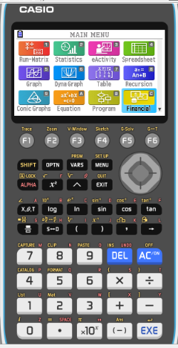
Solving simultaneous equations using the GDC
We can also solve linear simultaneous equations by graphing each of the equations.
The coordinates of the intersection point give us the solution to the equations
Use graphical method to solve
y = 3x - 2
2x + y = 13
When using graphics calculator, you must first rearrange the equations so that y is the subject
y = 3x - 2
y = -2x + 13
We are going to use Graphing display calculator to solve the Simultaneous equations using Graph
CASIO

Slide 14
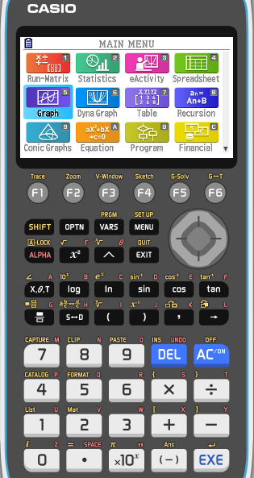
Solving simultaneous equations using the GDC
y = 3x - 2
y = -2x + 13
Select GRAPH from the main MENU

Slide 15
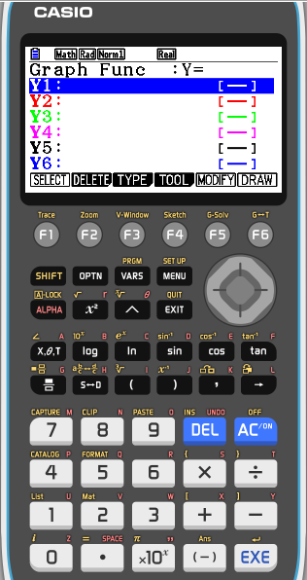
Solving simultaneous equations using the GDC
y = 3x - 2
y = -2x + 13
Select GRAPH from the main MENU
Type 3x - 2 into Y1 and
-2x + 13 into Y2.

Slide 16
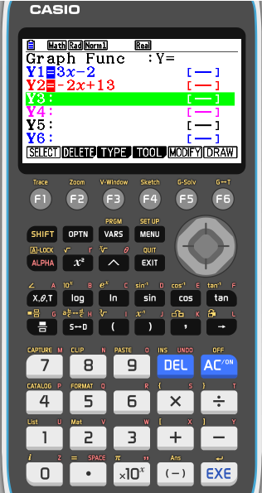
Solving simultaneous equations using the GDC
y = 3x - 2
y = -2x + 13
Select GRAPH from the main MENU
Type 3x - 2 into Y1 and
-2x + 13 into Y2.
Press F6 (DRAW) to draw a graph of the functions

Slide 17
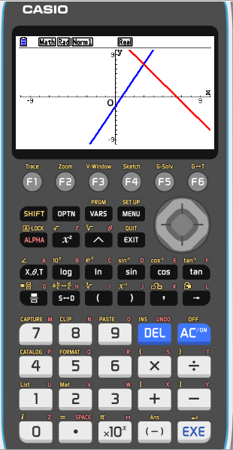
Solving simultaneous equations using the GDC
y = 3x - 2
y = -2x + 13
Select GRAPH from the main MENU
Type 3x - 2 into Y1 and
-2x + 13 into Y2.
Press F6 (DRAW) to draw a graph of the functions
To find their point of intersection, press F5 (G-Solv)
F5 (ISCT).

Slide 18
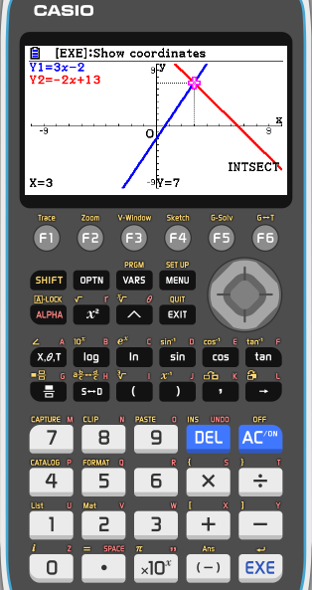
Solving simultaneous equations using the GDC
y = 3x - 2
y = -2x + 13
Select GRAPH from the main MENU
Store 3x - 2 into Y1 and
-2x + 13 into Y2.
Press F6 (DRAW) to draw a graph of the functions
To find their point of intersection, press F5 (G-Solv)
F5 (ISCT).
So, the solution is x = 3, y = 7.

Slide 19

Thank you for using resources from
For more resources visit our website
https://www.mathssupport.org
If you have a special request, drop us an email
info@mathssupport.org
Get 20% off in your next purchase from our website, just use this code when checkout: MSUPPORT_20

