Slide 1
Annuities and Amortization
LO: Use the Graphic Display Calculator to calculate the amortization of a loan.
Use the Graphic Display Calculator to calculate annuities.

Slide 2
Amortization
Amortization is a repayment of a loan in equal periodic payments.
The payments are made at fixed time intervals.
The periodic payments are of equal size.
The payments are made at the end of the compounding period.
The payment is large enough to cover periodic interest and reduce some of the balance.
The future value FV of the payments must equal the future value of investing the principal PV in an account with the same interest rate and compounding.

Slide 3
Amortization
The future value FV of the payments (annuities) must equal the future value of investing the principal in a compound interest account with the same interest rate and compounding.
$$A=\frac{p\left({\left(1+\frac{r}{n}\right)}^{nt}−1\right)}{\left(\frac{r}{n}\right)}$$
$$FV={P\left(1+\frac{r}{n}\right)}^{nt}$$
$${P\left(1+\frac{r}{n}\right)}^{nt}=\frac{p\left({\left(1+\frac{r}{n}\right)}^{nt}−1\right)}{\left(\frac{r}{n}\right)}$$
Here, big P is the Present value of the loan, little p is the payment that amortized big P.

Slide 4
Amortization
Example 1:
Kevin take out a $1000 loan. The terms of the 1-year loan are 5% annual interest compounded monthly on the unpaid balance.
How much are the monthly payments?
Using the formula
$${P\left(1+\frac{r}{n}\right)}^{nt}=\frac{p\left({\left(1+\frac{r}{n}\right)}^{nt}−1\right)}{\left(\frac{r}{n}\right)}$$
P =
1000
r =
5% = 0.05
n =
12
Substituting
12 × 1
t =
(
$$\frac{0.05}{12}$$
)
)
1
(
p
1 +
− 1
12×1
$$\frac{0.05}{12}$$
)
p =
(
=
?
100
1 +
$$\frac{0.05}{12}$$
Solving for p
p = 85.60748179
The monthly payments are $85.61

Slide 5
Amortization
Each payment is broken down into two parts:
the interest owed is paid first
and then the rest of the payment goes towards paying off the amount owed (principal).
The amount of interest paid is the largest in your first payment, while nearly all of the last payment goes towards the principal. Even though the payment is the same each month, the distribution of interest and principal changes with every payment

Slide 6
Amortization
Complete the amortization table for the example 1
Kevin take out a $1000 loan. The terms of the 1-year loan are 5% annual interest compounded monthly on the unpaid balance.
Month
Payment
Interest paid
Σ Interest
Principal paid
Σ Principal
Remaining Balance
0
1000.00
1
85.61
4.17
4.17
81.44
81.44
918.56
2
85.61
3.83
7.99
81.78
163.22
836.78
3
85.61
3.49
11.48
82.12
245.34
754.66
4
85.61
3.14
14.62
82.46
327.80
672.20
5
85.61
2.80
17.43
82.81
410.61
589.39
6
85.61
2.46
19.88
83.15
493.76
506.24
7
85.61
2.11
21.99
83.50
577.26
422.74
8
85.61
1.76
23.75
83.85
661.11
338.89
9
85.61
1.41
25.16
84.20
745.30
254.70
10
85.61
1.06
26.23
84.55
829.85
170.15
11
85.61
0.71
26.93
84.90
914.75
85.25
12
85.61
0.36
27.29
85.25
1000.00
0

Slide 7
Amortization
Example 2:
The Federal Perkins Loan is a low-interest loan for both undergraduate and graduate students. The interest rate for a Perkins loan is 5% compounded monthly with monthly payments and the borrower has up to 10 years to repay.
Suppose a student has a $19,000 Perkins Loan and will take 10 years to repay it.
(a) What is the total amount of payments over the life of the loan?
(b) What are the monthly payments?
(c) What is the balance after 4 years?
(d) How much interest is paid over the life of the loan?

Slide 8
Amortization
Example 2:
The Federal Perkins Loan is a low-interest loan for both undergraduate and graduate students. The interest rate for a Perkins loan is 5% compounded monthly with monthly payments and the borrower has up to 10 years to repay.
Suppose a student has a $19,000 Perkins Loan and will take 10 years to repay it.
(a) What is the total amount of payments over the life of the loan?
120 payments
In 10 years with monthly payments
10 × 12 = 120

Slide 9
Amortization
Example 2:
The Federal Perkins Loan is a low-interest loan for both undergraduate and graduate students. The interest rate for a Perkins loan is 5% compounded monthly with monthly payments and the borrower has up to 10 years to repay.
Suppose a student has a $19,000 Perkins Loan and will take 10 years to repay it.
(b) What are the monthly payments?
We will use a GDC to solve this question
CASIO

Slide 10
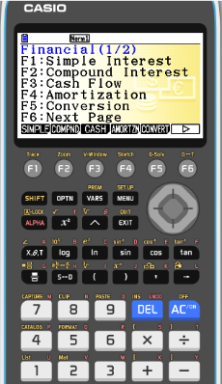
Amortization
Example 2:
The Federal Perkins Loan is a low-interest loan for both undergraduate and graduate students. The interest rate for a Perkins loan is 5% compounded monthly with monthly payments and the borrower has up to 10 years to repay.
Suppose a student has a $19,000 Perkins Loan and will take 10 years to repay it.
(b) What are the monthly payments?
Using the GDC
F2
Compound interest

Slide 11
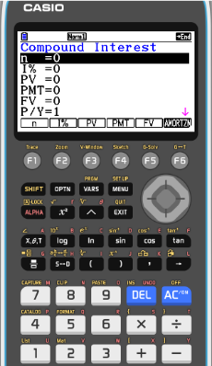
Amortization
Example 2:
The Federal Perkins Loan is a low-interest loan for both undergraduate and graduate students. The interest rate for a Perkins loan is 5% compounded monthly with monthly payments and the borrower has up to 10 years to repay.
Suppose a student has a $19,000 Perkins Loan and will take 10 years to repay it.
(b) What are the monthly payments?
Using the GDC
F2
Compound interest
n =
10 × 12 = 120
I% =
5
PV =
-19 000
PMT =
We want to know
FV =
0
C/Y =
P/Y =
12
12

Slide 12
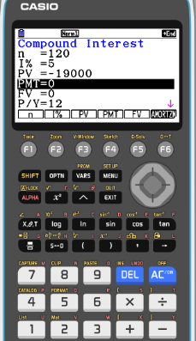
Amortization
Example 2:
The Federal Perkins Loan is a low-interest loan for both undergraduate and graduate students. The interest rate for a Perkins loan is 5% compounded monthly with monthly payments and the borrower has up to 10 years to repay.
Suppose a student has a $19,000 Perkins Loan and will take 10 years to repay it.
(b) What are the monthly payments?
Using the GDC
F2
Compound interest
n =
10 × 12 = 120
I% =
5
PV =
-19 000
PMT =
We want to know
FV =
0
P/Y =
12
C/Y =
12
F4
PMT

Slide 13
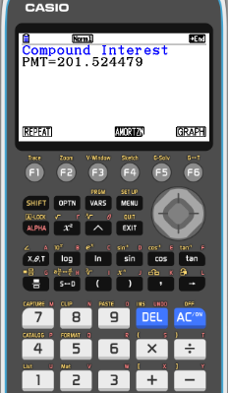
Amortization
Example 2:
The Federal Perkins Loan is a low-interest loan for both undergraduate and graduate students. The interest rate for a Perkins loan is 5% compounded monthly with monthly payments and the borrower has up to 10 years to repay.
Suppose a student has a $19,000 Perkins Loan and will take 10 years to repay it.
(b) What are the monthly payments?
Using the GDC
F2
Compound interest
n =
10 × 12 = 120
I% =
5
PV =
-19 000
PMT =
201.52
FV =
0
C/Y =
P/Y =
12
F4
PMT
12

Slide 14
Amortization
Example 2:
The Federal Perkins Loan is a low-interest loan for both undergraduate and graduate students. The interest rate for a Perkins loan is 5% compounded monthly with monthly payments and the borrower has up to 10 years to repay.
Suppose a student has a $19,000 Perkins Loan and will take 10 years to repay it.
(a) What is the total amount of payments over the life of the loan?
120 payments
(b) What are the monthly payments?
$201.52
(c) What is the balance after 4 years?
(d) How much interest is paid over the life of the loan?

Slide 15
Amortization
Example 2:
The Federal Perkins Loan is a low-interest loan for both undergraduate and graduate students. The interest rate for a Perkins loan is 5% compounded monthly with monthly payments and the borrower has up to 10 years to repay.
Suppose a student has a $19,000 Perkins Loan and will take 10 years to repay it.
(c) What is the balance after 4 years?
Using the GDC
EXIT
F6
AMORTZN

Slide 16
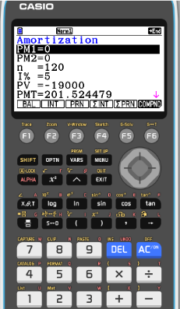
Amortization
Example 2:
The Federal Perkins Loan is a low-interest loan for both undergraduate and graduate students. The interest rate for a Perkins loan is 5% compounded monthly with monthly payments and the borrower has up to 10 years to repay.
Suppose a student has a $19,000 Perkins Loan and will take 10 years to repay it.
(c) What is the balance after 4 years?
Using the GDC
EXIT
F6
AMORTZN
PM1 =
1
PM2 =
4 × 12 = 48
n =
10 × 12 = 120
I% =
5
PV =
19 000
PMT =
-201.524479
F1
BAL
C/Y =
P/Y =
12
12

Slide 17
Amortization
Example 2:
The Federal Perkins Loan is a low-interest loan for both undergraduate and graduate students. The interest rate for a Perkins loan is 5% compounded monthly with monthly payments and the borrower has up to 10 years to repay.
Suppose a student has a $19,000 Perkins Loan and will take 10 years to repay it.
(c) What is the balance after 4 years?
Using the GDC
EXIT
F6
AMORTZN
PM1 =
1
PM2 =
4 × 12 = 48
n =
10 × 12 = 120
I% =
5
PV =
19 000
PMT =
-201.524479
P/Y =
F1
BAL
12
C/Y =
12

Slide 18
Amortization
Example 2:
The Federal Perkins Loan is a low-interest loan for both undergraduate and graduate students. The interest rate for a Perkins loan is 5% compounded monthly with monthly payments and the borrower has up to 10 years to repay.
Suppose a student has a $19,000 Perkins Loan and will take 10 years to repay it.
(a) What is the total amount of payments over the life of the loan?
120 payments
(b) What are the monthly payments?
$201.52
(c) What is the balance after 4 years?
$12 513.21
(d) How much interest is paid over the life of the loan?

Slide 19
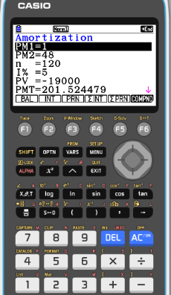
Amortization
Example 2:
The Federal Perkins Loan is a low-interest loan for both undergraduate and graduate students. The interest rate for a Perkins loan is 5% compounded monthly with monthly payments and the borrower has up to 10 years to repay.
Suppose a student has a $19,000 Perkins Loan and will take 10 years to repay it.
(d) How much interest is paid over the life of the loan?
Using the GDC
EXIT
PM2 =
120
F4
Σ INT

Slide 20
Amortization
Example 2:
The Federal Perkins Loan is a low-interest loan for both undergraduate and graduate students. The interest rate for a Perkins loan is 5% compounded monthly with monthly payments and the borrower has up to 10 years to repay.
Suppose a student has a $19,000 Perkins Loan and will take 10 years to repay it.
(d) How much interest is paid over the life of the loan?
Using the GDC
EXIT
PM2 =
120
F4
Σ INT
5 182.94

Slide 21
Amortization
Example 2:
The Federal Perkins Loan is a low-interest loan for both undergraduate and graduate students. The interest rate for a Perkins loan is 5% compounded monthly with monthly payments and the borrower has up to 10 years to repay.
Suppose a student has a $19,000 Perkins Loan and will take 10 years to repay it.
(a) What is the total amount of payments over the life of the loan?
120 payments
(b) What are the monthly payments?
$201.52
(c) What is the balance after 4 years?
$12 513.21
(d) How much interest is paid over the life of the loan?
$5 182.94

Slide 22
Annuities using technology
LO: Use the Graphic Display Calculator to calculate annuities.

Slide 23
Annuities
An annuity is a savings account in which money is deposited at regular intervals, rather than one large lump-sum
The payments are made at fixed time intervals.
The periodic payments are of equal size.
The payments are made at the end of the interval.
The interest is paid at the end of the interval.

Slide 24
Annuities
The formula for annuities is .
$$A=\frac{p\left({\left(1+\frac{r}{n}\right)}^{nt}−1\right)}{\left(\frac{r}{n}\right)}$$
Where:
p = regular deposit amount,
r = rate
n = compounding frequency
t = years
A = future value
The most common compounding frequencies are:
Compounding | Annually | Semi-annualy | Quarterly | Monthly | Weekly | Daily
Times per year | 1 | 2 | 4 | 12 | 52 | 365

Slide 25
Annuities
Example 1:
Ryan deposits $100 every month into an annuity at 5% compounded monthly, for 9 years. Find the future value and the interest his account earned.
$$A=\frac{p\left({\left(1+\frac{r}{n}\right)}^{nt}−1\right)}{\left(\frac{r}{n}\right)}$$
Using the formula
p =
100
r =
5% = 0.05
(
12 × 9
)
n =
12
(
$$\frac{0.05}{12}$$
)
100
1 +
− 1
t =
9
Substituting
A =
A =
$$\frac{0.05}{12}$$
?
Using the calculator the Future value is
A =
13 604.32

Slide 26
Annuities
Example 1:
Ryan deposits $100 every month into an annuity at 5% compounded monthly, for 9 years. Find the future value and the interest his account earned.
What is the interest earned?
p =
100
She made $100 deposits every month for 9 years.
r =
5% = 0.05
n =
12
That is 108 deposits of $100 each, so she personally deposited $10,800.
t =
9
Interest =
Future value
- Total deposited
A =
13 604.32
I =
13 604.32
- 10 800
I =
2 804.32

Slide 27
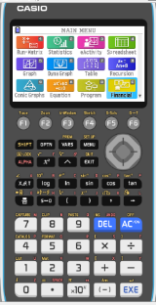
Using a GDC
Example 1:
Ryan deposits $100 every month into an annuity at 5% compounded monthly, for 9 years. Find the future value and the interest his account earned.
Now we are going to use Graphing display calculator to solve the problem
CASIO

Slide 28
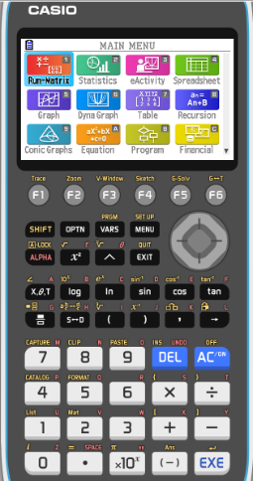
Annuities
Example 1:
Ryan deposits $100 every month into an annuity at 5% compounded monthly, for 9 years. Find the future value and the interest his account earned.
Turn on the GDC
TVM
MENU
or Financial

Slide 29
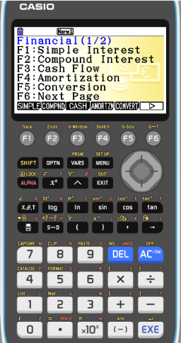
Annuities
Example 1:
Ryan deposits $100 every month into an annuity at 5% compounded monthly, for 9 years. Find the future value and the interest his account earned.
Turn on the GDC
MENU
TVM
or Financial
F2
Compound interest

Slide 30
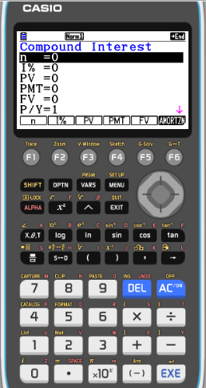
Annuities
Example 1:
Ryan deposits $100 every month into an annuity at 5% compounded monthly, for 9 years. Find the future value and the interest his account earned.
Turn on the GDC
MENU
TVM
or Financial
F2
Compound interest
Number of payment periods
n =
12 × 9 = 108
I% =
5
The percentage rate, given as a percent.
PV =
The present value of the account. If money is being paid into the account, PV is entered as a negative number;
0
PMT =
The amount of each payment.
-100
FV =
Future value of the account.
We want to know
P/Y =
Number of payments per year.
12
C/Y =
12
Number of compoundings per year.

Slide 31
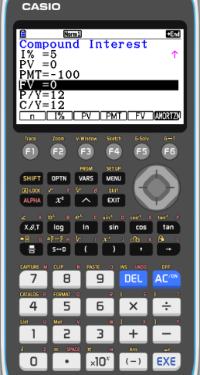
Annuities
Example 1:
Ryan deposits $100 every month into an annuity at 5% compounded monthly, for 9 years. Find the future value and the interest his account earned.
Turn on the GDC
MENU
TVM
or Financial
F2
Compound interest
n =
12 × 9 = 108
I% =
5
PV =
0
PMT =
-100
FV =
We want to know
P/Y =
12
F5
FV
C/Y =
12

Slide 32
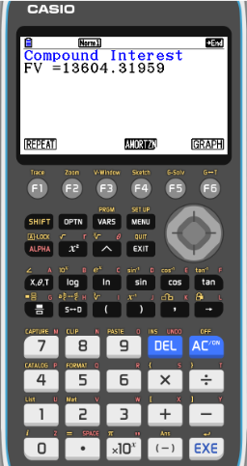
Annuities
Example 1:
Ryan deposits $100 every month into an annuity at 5% compounded monthly, for 9 years. Find the future value and the interest his account earned.
Turn on the GDC
MENU
TVM
or Financial
F2
Compound interest
n =
12 × 9 = 108
I% =
5
PV =
0
PMT =
-100
FV =
We want to know
= 13604.32
P/Y =
12
F5
FV
C/Y =
12
I =
13 604.32
- 10 800
= 2 804.32

Slide 33
Annuities
Example 2:
Dave wants to save $20,000 for a down payment on a really cool speedboat. He opens an annuity at 4.25% compounded quarterly for 3 years. What is his quarterly payment?
Using the GDC to solve the problem.
n =
Number of payment periods
4 × 3 = 12
I% =
4.25
The percentage rate, given as a percent.
PV =
The present value of the account.
0
PMT =
The amount of each payment.
We want to know
FV =
Future value of the account.
20 000
P/Y =
Number of payments per year.
4
C/Y =
4
Number of compoundings per year.

Slide 34
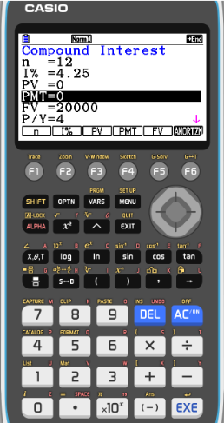
Annuities
Example 2:
Dave wants to save $20,000 for a down payment on a really cool speedboat. He opens an annuity at 4.25% compounded quarterly for 3 years. What is his quarterly payment?
Using the GDC to solve the problem.
n =
4 × 3 = 12
I% =
4.25
PV =
0
PMT =
We want to know
FV =
20 000
P/Y =
4
C/Y =
4
F4
PMT

Slide 35
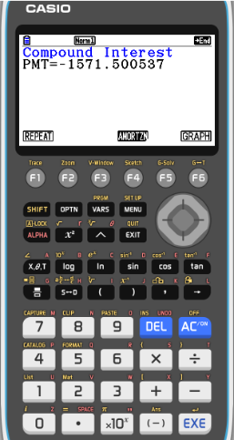
Annuities
Example 2:
Dave wants to save $20,000 for a down payment on a really cool speedboat. He opens an annuity at 4.25% compounded quarterly for 3 years. What is his quarterly payment?
Using the GDC to solve the problem.
n =
4 × 3 = 12
I% =
4.25
PV =
0
PMT =
-1571.50
FV =
20 000
P/Y =
4
C/Y =
4
F4
PMT

Slide 36
Annuities
Example 2:
Dave wants to save $20,000 for a down payment on a really cool speedboat. He opens an annuity at 4.25% compounded quarterly for 3 years. What is his quarterly payment?
Using the GDC to solve the problem.
n =
4 × 3 = 12
I% =
4.25
PV =
0
PMT =
-1571.50
FV =
20 000
P/Y =
4
C/Y =
4
F4
PMT
He should deposit $1571.50 every three months that combined with the interest, will grow to $20,000 in 3 years.

Slide 37
Thank you for using resources from
For more resources visit our website
https://www.mathssupport.org
If you have a special request, drop us an email
info@mathssupport.org
Get 20% off in your next purchase from our website, just use this code when checkout: MSUPPORT_20

