Slide 1
Exponents
LO: Know and use the Laws of exponents.

Slide 2
Exponents
We use exponents as a shorthand way of representing the repeated multiplication of a number by itself.
For example,
we can use index notation to write 2 × 2 × 2 × 2 × 2 as
Exponent, index or power
2⁵
base
This number is read as ‘two to the power of five’.
2⁵ =
2 × 2 × 2 × 2 × 2 =
32
Notes:
Talk about the use of index notation as a mathematical shorthand.

Slide 3
Index notation
Evaluate the following:
When we raise a negative number to an odd power the answer is negative.
6² =
6 × 6 =
36
3⁴ =
3 × 3 × 3 × 3 =
81
(–5)³ =
–5 × –5 × –5 =
–125
2⁷ =
2 × 2 × 2 × 2 × 2 × 2 × 2 =
128
When we raise a negative number to an even power the answer is positive.
(–1)⁵ =
–1 × –1 × –1 × –1 × –1 =
–1
(–4)⁴ =
–4 × –4 × –4 × –4 =
64
Notes:
Talk through each example.
Recall that two negative numbers multiply together to give a positive number. So if we calculate –1 × –1 × –1 × –1 × –1, for example, there are five negatives multiplied together. That makes two positive numbers with one negative number left over. The answer is therefore negative.
Remind pupils that 6² can be said as ‘six squared’ or ‘six to the power of two’ and that (–5)³ can be said as ‘negative five cubed’ or ‘negative five to the power of three’.

Slide 4
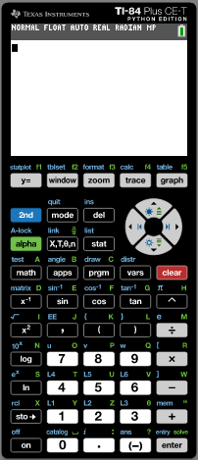
Calculating powers
We can use the GDC to find powers.
We are going to use a Graphing display calculator to calculate the value of 7⁴
Texas Instruments
Notes:
Reveal the steps on the board. Ensure that pupils are able to locate the power key, x^{y}, on their calculators.
We could also key in 7 × 7 × 7 × 7, but using the x^{y} key is more efficient and we are less likely to make a mistake.
State that 2401 must be a square number and ask pupils how we can show that this is true.

Slide 5
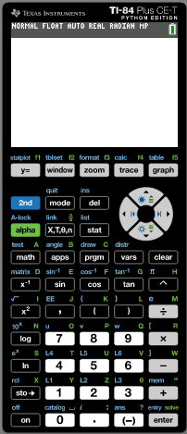
Calculating powers
We can use the GDC to find powers.
For example,
to calculate the value of 7⁴ we key in:
Notes:
Reveal the steps on the board. Ensure that pupils are able to locate the power key, x^{y}, on their calculators.
We could also key in 7 × 7 × 7 × 7, but using the x^{y} key is more efficient and we are less likely to make a mistake.
State that 2401 must be a square number and ask pupils how we can show that this is true.

Slide 6
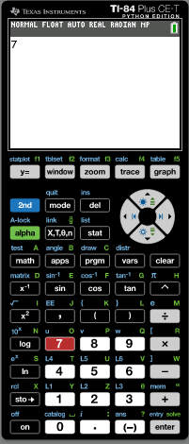
Calculating powers
We can use the GDC to find powers.
For example,
to calculate the value of 7⁴ we key in:
Notes:
Reveal the steps on the board. Ensure that pupils are able to locate the power key, x^{y}, on their calculators.
We could also key in 7 × 7 × 7 × 7, but using the x^{y} key is more efficient and we are less likely to make a mistake.
State that 2401 must be a square number and ask pupils how we can show that this is true.

Slide 7
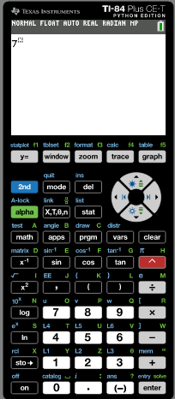
Calculating powers
We can use the GDC to find powers.
For example,
to calculate the value of 7⁴ we key in:
Notes:
Reveal the steps on the board. Ensure that pupils are able to locate the power key, x^{y}, on their calculators.
We could also key in 7 × 7 × 7 × 7, but using the x^{y} key is more efficient and we are less likely to make a mistake.
State that 2401 must be a square number and ask pupils how we can show that this is true.

Slide 8
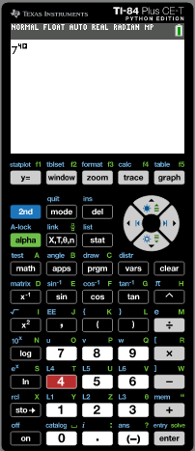
Calculating powers
We can use the GDC to find powers.
For example,
to calculate the value of 7⁴ we key in:
Notes:
Reveal the steps on the board. Ensure that pupils are able to locate the power key, x^{y}, on their calculators.
We could also key in 7 × 7 × 7 × 7, but using the x^{y} key is more efficient and we are less likely to make a mistake.
State that 2401 must be a square number and ask pupils how we can show that this is true.

Slide 9
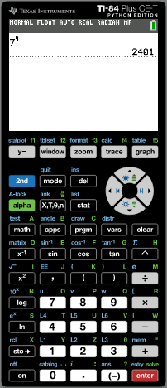
Calculating powers
We can use the GDC to find powers.
For example,
to calculate the value of 7⁴ we key in:
The calculator shows this as 2401.
7⁴ = 7 × 7 × 7 × 7 = 2401
Notes:
Reveal the steps on the board. Ensure that pupils are able to locate the power key, x^{y}, on their calculators.
We could also key in 7 × 7 × 7 × 7, but using the x^{y} key is more efficient and we are less likely to make a mistake.
State that 2401 must be a square number and ask pupils how we can show that this is true.

Slide 10
Laws of exponents -
multiplication
When we multiply two numbers written in index form and with the same base we can see an interesting result.
For example,
3⁴ × 3² =
(3 × 3 × 3 × 3) × (3 × 3)
= 3 × 3 × 3 × 3 × 3 × 3
= 3⁶
= 3⁽⁴ ⁺ ²⁾
a³ × a⁵ =
(a × a × a) × (a × a × a × a × a)
= a × a × a × a × a × a × a × a
= a⁸
= a⁽³ ⁺ ⁵⁾
What do you notice?
When we multiply two numbers with the same base the indices are added.
a^{m} × a^{n} =
a^{(m + n)}
Notes:
Stress that the indices can only be added when the base is the same.

Slide 11
Laws of exponents -
multiplication
When we multiply two powers with different bases but the same exponent we can see an interesting result.
For example,
a⁴ × b⁴ =
(a × a × a × a) × (b × b × b × b)
= ab × ab × ab × ab
= (ab)⁴
What do you notice?
When we multiply two powers with different bases but the indices are the same is equal to the product of the bases with the same exponent
a^{n} × b^{n} =
(ab) ^{n}
Notes:
Stress that the indices can only be added when the base is the same.

Slide 12
division
Laws of exponents -
When we divide two numbers written in index form and with the same base we can see another interesting result.
For example,
4⁵ ÷ 4² =
4 × 4 × 4 × 4 × 4
4 × 4 × 4 =
4³
= 4^{(5 – 2)}
=
4 × 4
a⁶ ÷ a⁴ =
a × a × a × a × a × a
a × a =
a²
= a^{(6 – 4)}
=
a × a × a × a
What do you notice?
When we divide two numbers with the same base the indices are subtracted.
a^{m} ÷a^{n} =
a^{(m - n)}
Notes:
Stress that the indices can only be subtracted when the base is the same.

Slide 13
division
Laws of exponents -
When we divide two powers with different bases but the same exponent, we can see another interesting result.
For example,
a⁵ ÷ b⁵ =
a × a × a × a × a
b × b × b × b × b
a
a
a
a
a
a
a
( )
⁵
=
×
×
×
×
=
⁵
b
b
b
b
b
b
b
⁵
What do you notice?
When we divide two powers with different bases but the indices are the same, is equal to the quotient of the bases with the same exponent.
a
a
^{n}
( )
=
^{n}
b
b
^{n}
Notes:
Stress that the indices can only be subtracted when the base is the same.

Slide 14
Laws of exponents -
Raising to a power
When we raise a power to another power we can see another interesting result.
For example,
(3⁴)² =
(3 × 3 × 3 × 3)
× (3 × 3 × 3 × 3)
= 3 × 3 × 3 × 3 × 3 × 3 × 3 × 3
= 3⁸
= 3^{(4 ˟ 2)}
(a²)⁵ =
(a × a)
× (a × a)
× (a × a)
× (a × a)
× (a × a)
= a × a × a × a × a × a × a × a × a × a
= a¹⁰
= a^{(2 ˟ 5)}
What do you notice?
When we raise a power to another power the indices are multiplied.
(a^{m})^{n} =
a^{m n}
Notes:
Stress that the indices can only be added when the base is the same.

Slide 15
The power zero
Look at the following division:
6⁴ ÷ 6⁴ =
1
Using the second index law,
6⁴ ÷ 6⁴ = 6^{(4 – 4)} =
6⁰
That means that,
6⁰ = 1
Any number raised to the power of zero is equal to one.
For example,
10⁰ = 1
3.452⁰ = 1
723 538 592⁰ = 1
a⁰ = 1
a⁰ =
1

Slide 16
Negative exponents
Look at the following division:
3⁴ ÷ 3⁶
Using the second index law,
3⁴ ÷ 3⁶ = 3^{(4 – 6)} =
3⁻²
Solving the division,
3 × 3 × 3 × 3
1
=
1
3⁴ ÷ 3⁶ =
=
= 3^{–2}
3 × 3 × 3 × 3 × 3 × 3
3 × 3
3²
a × a
1
1
a² ÷ a⁵ =
=
=
= a^{–3}
a × a × a × a × a
a × a × a
a³
What do you notice?
When we raise a number to a negative power, is the same as one over the number with positive power.
1
a^{-n} =
a^{n}
Notes:
Stress that the indices can only be subtracted when the base is the same.

Slide 17
Thank you for using resources from
For more resources visit our website
https://www.mathssupport.org
If you have a special request, drop us an email
info@mathssupport.org

