Slide 1
Geometric sequences
Lesson objective: Find the terms of a geometric sequence.
Find the nth term of a geometric sequence

Slide 2
Geometric sequences
In a geometric sequence (or geometric progression) each term is produced by multiplying the previous term by a non-zero constant value.
For example, the sequence
3, 6, 12, 24, 48, 96, …
is a geometric sequence that starts with 3 and each term can be obtained by multiplying the previous term by 2.
6
12
24
48
96
Notice that:
=
=
=
=
=
2
=
r
3
6
12
24
48
r is a constant called the common ratio
We could write this sequence as
3,
3 × 2,
3 × 2 × 2,
3 × 2 × 2 × 2,
3 × 2 × 2 × 2 × 2, …
or
3,
3 × 2,
3 × 2²,
3 × 2³,
3 × 2⁴,
3 × 2⁵, …

Slide 3
Geometric sequences
It is called geometric sequence because if we take any three consecutive terms, the middle term is the geometric mean of the terms on either side.
If the terms are:
a,
b,
c,
d,
we take any three consecutive terms
b
c
The common ratio is
=
a
b
b²
=
a
c
$$±\sqrt{}$$
b
=
a
c
Where
a
c
is the geometric mean.

Slide 4
Geometric sequences
If we call the first term of a geometric sequence u₁ and the common ratio r we can write a general geometric sequence as:
Term number
1
2
3
4
5
6
…
n
u₁,
u₁ r,
u₁ r²,
u₁ r³,
u₁ r⁴,
u₁ r⁵, …
u₁ r ^{n -1}
The n^{th} term of a geometric sequence with first term u₁ and common ratio r is:
u_{n} = u₁ r^{n–1}

Slide 5
Geometric sequences
Consider the geometric sequence 8, 12, 18, 27, …
a) Show that the sequence is geometric
12
3
18
3
27
3
=
=
=
8
2
12
2
18
2
Assuming the pattern continues, consecutive terms have a common ratio of ∴ the sequence is geometric with u₁ = 8 and r =
3
3
2
2
b) Find the general term u_{n} .
u_{n} = u₁ r^{n–1}
3
( )
^{n–1}
u_{n} = 8
2
u₈ = 8( )
c) Find the 8th term.
3
^{8–1}
2
u₈ = 136.6875

Slide 6
Geometric sequences
The 3rd term in a geometric sequence is 36 and the 6th term is 972. What is the value of the 1st term and the common ratio?
u₃ =
Using the 3rd term:
u₁r² = 36
Using the 6th term:
u₆ =
u₁r⁵ = 972
u₁r⁵
972
Dividing these gives:
=
u₁r²
36
So:
r³ = 27
r = 3
Substituting this into u₁r² = 36 gives:
u₁ × 3² = 36
9u₁ = 36
u₁ = 4
So the first term of the sequence is 4 and the common ratio is 3.
The general term of this sequence is u_{n} = 4 × (3)^{n–1}.

Slide 7
Geometric sequences
The 4th term in a geometric sequence is 24 and the 7th term is 192. What is the value of the 1st term and the common ratio?
u₄ =
Using the 4th term:
u₁r³ = 24
Using the 7th term:
u₇ =
u₁r⁶ = 192
u₁r⁶
192
Dividing these gives:
=
u₁r³
24
So:
r³ = 8
r = 2
Substituting this into u₁r³ = 24 gives:
u₁ × 2³ = 24
8u₁ = 24
u₁ = 3
So the first term of the sequence is 3 and the common ratio is 2.
The general term of this sequence is u_{n} = 3 × (2)^{n–1}.

Slide 8
Geometric sequences
k – 1, 2k, and 21 – k are consecutive terms of a geometric sequence. Find k
2k
21 - k
Since the terms are geometric,
=
common ratio
k - 1
2k
∴ 4k² = (21 – k)(k – 1)
∴ 4k² = 21k – 21 – k² + k
∴ 5k² – 22k + 21 = 0
Using the GDC:
k =
7
or
k = 3
5

Slide 9
Geometric sequences
Find the first term of the sequence 6, $6\sqrt{2}$, 12, $12\sqrt{2}$, …. which exceeds 1400.
u₁ =
Using the 1st term:
6
Is this a geometric sequence?
r should be the same
Dividing any term by its previous must be equal.
$$6\sqrt{2}$$
$$12$$
r
=
=
=$\sqrt{2}$
6
$$6\sqrt{2}$$
The general term of this sequence is u_{n} = 6 × ($\sqrt{2}$)^{n–1}.
We need to find n such that u_{n} > 1400

Slide 10
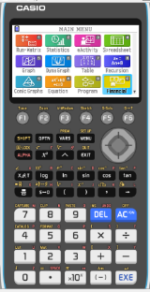
Using a GDC
Find the first term of the sequence 6, $6\sqrt{2}$, 12, $12\sqrt{2}$, …. which exceeds 1400.
We are going to use Graphing display calculator to solve the problem
CASIO

Slide 11
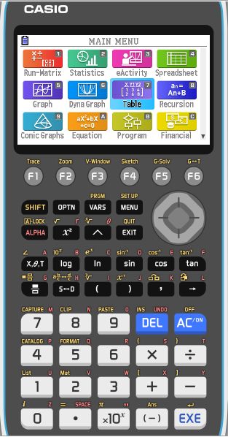
Using the GDC: Casio
We need to find n such that u_{n} > 1400
Select TABLE from the main MENU

Slide 12
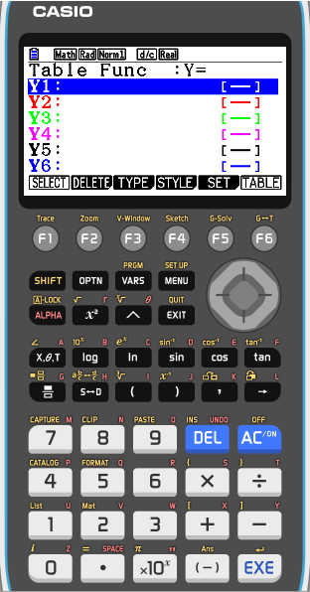
Using the GDC: Casio
We need to find n such that u_{n} > 1400
Select TABLE from the main MENU
Type in Y1 : 6 × ($\sqrt{2}$) ^ X – 1
EXE

Slide 13
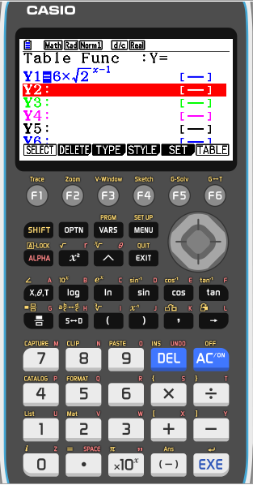
Using the GDC: Casio
We need to find n such that u_{n} > 1400
Select TABLE from the main MENU
Type in Y1 : 6 × ($\sqrt{2}$) ^ X – 1
EXE
SET
Press F5

Slide 14
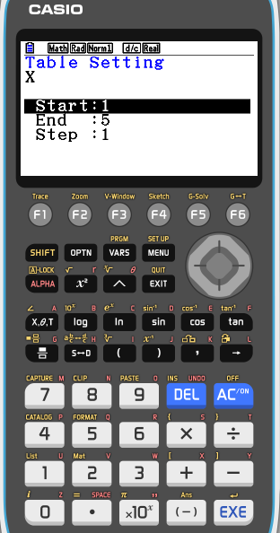
Using the GDC: Casio
We need to find n such that u_{n} > 1400
Select TABLE from the main MENU
Type in Y1 : 6 × ($\sqrt{2}$) ^ X – 1
EXE
Press F5
SET
State the starting number
1
EXE
State the ending number
20
EXE
State the step between numbers
1
EXE
Press F6

Slide 15
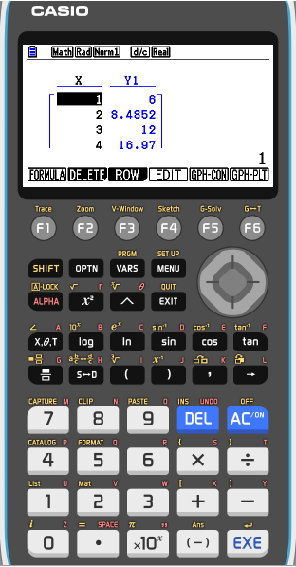
Using the GDC: Casio
We need to find n such that u_{n} > 1400
Select TABLE from the main MENU
Type in Y1 : 6 × ($\sqrt{2}$) ^ X – 1
Press F5
SET
State the starting number
1
EXE
State the ending number
20
EXE
State the step between numbers
1
EXE
Press F6
Scroll down until you find the first term greater than 1400

Slide 16
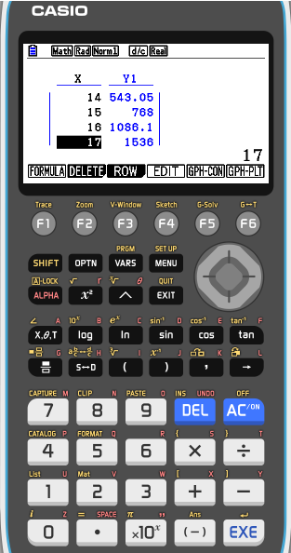
Using the GDC: Casio
We need to find n such that u_{n} > 1400
Select TABLE from the main MENU
Type in Y1 : 6 × ($\sqrt{2}$) ^ X – 1
Press F5
SET
State the starting number
1
EXE
State the ending number
20
EXE
State the step between numbers
1
EXE
Press F6
Scroll down until you find the first term greater than 1400
The first term to exceed 1400 is
u₁₇ =
1536

Slide 17
Thank you for using resources from
For more resources visit our website
https://www.mathssupport.org
If you have a special request, drop us an email
info@mathssupport.org

