Slide 1
Arithmetic series
Friday, 11 August 2023
Lesson objective: Find the sum of the first n terms of an arithmetic series

Slide 2
Series
The sum of all the terms of a sequence is called a series.
For example:
1, 3, 5, 7, 9, … is a sequence
while:
1 + 3 + 5 + 7 + 9 + … is a series.
When the difference between each term in a series is constant, as in this example, the series is called an arithmetic series.
The sum of a series containing n terms is often denoted by S_{n}, so for the series given above we could write:
S₅ = 1 + 3 + 5 + 7 + 9
= 25
When n is large, a more systematic approach for calculating the sum of a given number of terms is required.

Slide 3
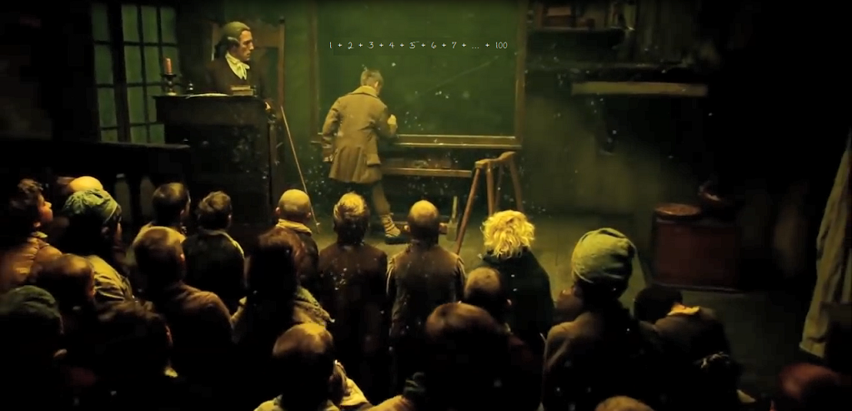
Gauss’ method
It is said that when the famous mathematician Karl Friedrich Gauss was a seven-year-old boy at school, his teacher asked the class to add together every whole number from one to a hundred.
The teacher expected this activity to keep the class occupied for some time and so he was amazed when Gauss put up his hand and gave the answer, 5050, almost immediately!

Slide 4
Gauss’ method
Gauss worked the answer out by noticing that you can quickly add together consecutive numbers by writing the numbers once in order and once in reverse order and adding them together.
So to add the numbers from 1 to 100:
S =
1
+
2
+
3
+
4
+
5
+
…
+
98
+
99
+
100
S =
100
+
99
+
98
+
97
+
96
+
…
+
3
+
2
+
1
2S =
101
+
101
+
101
+
101
+
101
+
…
+
101
+
101
+
101
So:
2S = 100 × 101
= 10 100
S = 5050

Slide 5


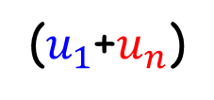

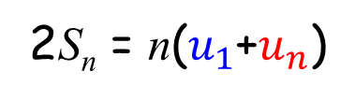


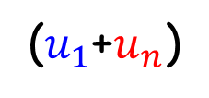











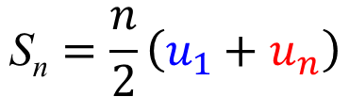
The sum of the first n terms in an arithmetic series
To find the sum of the first n terms in an arithmetic series we can generalize Gauss’ method as follows.
Write the sum of the first n terms as:
S_{n} =
$$u_{1}$$
$u_{1}$ $+ d$
+
$u_{1}$ $+2d$
+
…
+
$$u_{n}−2d$$
+
$$u_{n}−d$$
+
$$u_{n}$$
+
$$u_{n}−2d$$
+
$u_{1}$ $+2d$
$u_{1}$ $+ d$
+
$$u_{1}$$
$$u_{n}$$
$$u_{n}−d$$
+
…
+
S_{n} =
+
+
2S_{n} =
($u_{1}$+$u_{n}$)
+
($u_{1}$+$u_{n}$)
+
($u_{1}$+$u_{n}$)
+
…
+
($u_{1}$+$u_{n}$)
+
($u_{1}$+$u_{n}$)
+
($u_{1}$+$u_{n}$)
This gives us:
2S_{n} = n($u_{1}$+$u_{n}$)
So:
The sum of the first n terms is given by
$$\text{S}\text{n}=\frac{n}{2}\left(u_{1}+u_{n}\right)$$

Slide 6


The sum of an arithmetic series
So:
The sum of the first n terms in an arithmetic series is
S_{n} =
$$\frac{n}{2}\left(u_{1}+u_{n}\right)$$
where $u_{1}$ is the first term and $u_{n}$ is the last.
But in the arithmetic sequences
u_{n} = (u₁ + (n – 1)d)
We can substitute u_{n} in this formula to have an alternate formula for the sum of an arithmetic series.
S_{n} =
$$\frac{n}{2}\left(2u_{1}+\left(n−1\right)d\right)$$
We can use this alternate formula for the sum of an arithmetic series if we don’t know the last term but we know the common difference

Slide 7



The sum of an arithmetic series
S_{n} =
$$\frac{n}{2}\left(u_{1}+u_{n}\right)$$
S_{n} =
$$\frac{n}{2}\left(2u_{1}+\left(n−1\right)d\right)$$
Find the sum of the first 20 terms of the arithmetic series
5 + 11 + 17 + 23 + …
We don’t know the last term so we can use:
S_{n} =
$$\frac{n}{2}\left(2u_{1}+\left(n−1\right)d\right)$$
with u₁ = 5, d = 6 and n = 20.
S₂₀ = 10(10 + 114)
= 1240

Slide 8


The sum of an arithmetic series
S_{n} =
$$\frac{n}{2}\left(u_{1}+u_{n}\right)$$
S_{n} =
$$\frac{n}{2}\left(2u_{1}+\left(n−1\right)d\right)$$
Find the sum of -2 + 7 + 16 + …… + 178
The series is arithmetic with u₁ = -2, d = 9 and u_{n} = 178.
First we need to find n
Now using
u_{n} = 178
S_{n} =
$$\frac{n}{2}\left(u_{1}+u_{n}\right)$$
u_{n} = u₁ + (n – 1)d
S₂₁ =
$$\frac{21}{2}\left(−2+178\right)$$
178 = -2 + 9(n – 1)
180 = 9(n – 1)
S₂₁ = 10.5 (176)
20 = n – 1
= 1848
n = 21

Slide 9





The sum of an arithmetic series
S_{n} =
$$\frac{n}{2}\left(u_{1}+u_{n}\right)$$
S_{n} =
$$\frac{n}{2}\left(2u_{1}+\left(n−1\right)d\right)$$
An arithmetic sequence has first term 7 and common difference 8. The sum of the terms of the sequence is 351. Find the number of terms in the sequence
The sequence is arithmetic with u₁ = 7, d = 8 and S_{n} = 351
S_{n} =
$$\frac{n}{2}\left(2u_{1}+\left(n−1\right)d\right)$$
351 =
$$\frac{n}{2}\left(2 ×7+8\left(n−1\right)\right)$$
351 =
$$\frac{n}{2}\left(14+8n −8\right)$$
351 =
$$\frac{n}{2}\left(8n+6\right)$$
351 =
$$\left(4n^{2}+3n\right)$$
4n² + 3n – 351 = 0
Using GDC
n = 9
n = -9.75
But n > 0, so n = 9 ∴ there are 9 terms in the sequence

Slide 10

Thank you for using resources from
For more resources visit our website
https://www.mathssupport.org
If you have a special request, drop us an email
info@mathssupport.org

