Slide 1
Local maximum and minimum points
LO: Identify if a point is a local maximum or minimum.

Slide 2

Maxima/minima
A function has a relative maximum point (or local maximum) when the function changes from increasing to decreasing.
An absolute maximum (or global maximum) occurs at either the relative extrema or endpoints of a function.
local maximum
E
B
C
increasing
decreasing
D
A
$$\frac{dy}{dx}$$
is positive
B is a local maximum
is 0
is negative
E is a global maximum

Slide 3

Maxima/minima
A function has a relative minimum point (or local minimum) when the function changes from decreasing to increasing.
An absolute minimum (or global minimum) occurs at either the relative extrema or endpoints of a function.
E
B
decreasing
increasing
C
D
local minimum
A
$$\frac{dy}{dx}$$
is negative
is 0
is positive
D is a local minimum
A is a global minimum

Slide 4
Maxima/minima
Relative minimum and maximum points are called the relative extrema of a function.
The first derivative test is used to locate relative extrema of f.
If f is defined at a critical number c then:
1 - If f ’(x) changes from positive to negative at x = c, then f has a relative maximum point at (c, f(c)).
2 - If f ’ (x) changes from negative to positive at x = c, then f has a relative minimum point at (c, f(c)).
3 - If f ’ (x) does not change the sign at x = c, then, the point (c, f(c)) is a horizontal inflection.

Slide 5
Maxima/minima
Example 1
Use the first derivative test to find the relative extrema for the function f(x) = 2x³ – 3x² – 12x.
Find the derivative of f
f’(x) = 6x² – 6x - 12
Find the critical numbers of f by making f’(x) = 0
6x² – 6x – 12 = 0
6(x – 2)(x + 1) = 0
x = 2 or x = –1
Use the sign diagram for f’
+
-
+
Evaluate f’(x) to determine the signs
-1
2
Since f ’(x) changes from positive to negative at x = -1 there is a relative maximum at x = –1
f’(0) = -12
f’(-2) = 6(-2)² – 6(-3) - 12
f’(-2) = 24
f’(0) = 6(0)² – 6(0) - 12
f’(3) = 6(3)² – 6(3) - 12
f’(3) = 24
Since f ’(x) changes from negative to positive at x = 2 there is a relative minimum at x = 2
f(-1) = 2(-1)³ –3(-1)² - 12(-1)
f(-1) = 7
Evaluate f(x) for the critical numbers
Relative maximum point is (-1, 7)
f(2) = 2(2)³ –3(2)² - 12(2)
f(2) = -20
Relative minimum point is (2, -20)

Slide 6
Maxima/minima
Example 2
Use the first derivative test to find the relative extrema for the function f(x) = x³.
Find the derivative of f
f’(x) = 3x²
Find the critical numbers of f by making f’(x) = 0
3x² = 0
x = 0
Use the sign diagram for f’
+
+
0
Note that f ’(x) = 0 but there is not change in the sign of the gradient
Evaluate f ’(x) to determine the signs
f’(-1) = 3(-1)²
f’(1) = 3(1)²
f’(1) = 3
f’(-1) = 3
f (x) has no relative extrema since the derivative does not change sign at x = 0
f(0) = (0)³
f(0) = 0
Evaluate f(x) for the critical number
The point (0, 0) is a point of inflection

Slide 7
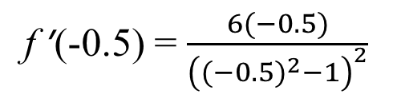
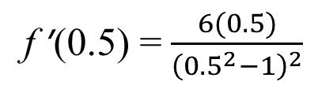
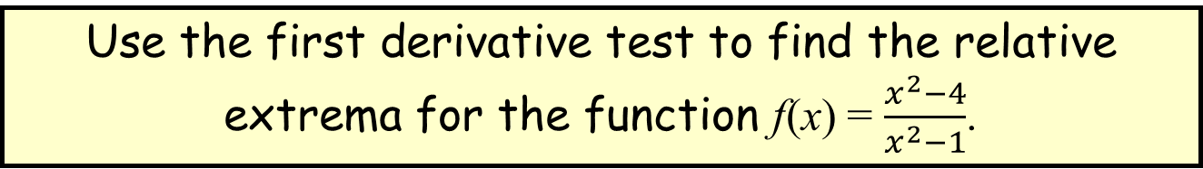


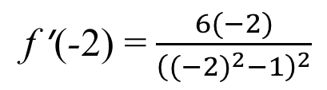

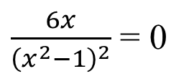
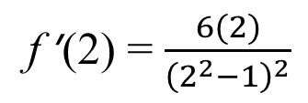
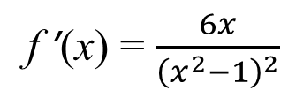

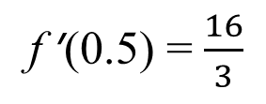
Maxima/minima
Example 3
Use the first derivative test to find the relative extrema for the function f(x) = $\frac{x^{2}−4}{x^{2}−1}$.
Find the first derivative of f
f ’(x) = $\frac{6x}{{\left(x^{2}−1\right)}^{2}}$
Find the critical numbers of f by making f ’(x) = 0
$\frac{6x}{{\left(x^{2}−1\right)}^{2}}$ = 0
x = 0
x = 1 or x = –1 are undefined
-
-
+
+
Use the sign diagram for f ’
-1
0
1
Since f ’(x) changes from negative to positive at x = 0 there is a relative minimum at x = 0
f ’(0) = $−\frac{16}{3}$
f ’(0.5) = $\frac{16}{3}$
f ’(-2) = $−\frac{4}{3}$
f ’(-2) = $\frac{6(−2)}{{\left(({−2)}^{2}−1\right)}^{2}}$
f ’(2) = $\frac{4}{3}$
f ’(2) = $\frac{6(2)}{{\left(2^{2}−1\right)}^{2}}$
f ’(-0.5) = $\frac{6(−0.5)}{{\left({(−0.5)}^{2}−1\right)}^{2}}$
Evaluate f ’(x) to determine the signs
f ’(0.5) = $\frac{6(0.5)}{{\left({0.5}^{2}−1\right)}^{2}}$
There would not be relative extrema at x = –1 and x = 1 even if the sign of f ’(x) had changed, since f is undefined at x = –1 and x = 1
f(0) = $\frac{0^{2}−4}{0^{2}−1}$
f(0) = 4
Evaluate f(x) for the critical number 0
Relative minimum point is (0, 4)

Slide 8
Maxima/minima
Example 4
Identify each labelled point as an absolute maximum or minimum, a relative maximum or minimum or neither
A is an absolute minimum
Since the value of the function of A is the least value of the function over its entire domain.
C
D
B is a relative minimum
Cannot be an absolute minimum since there are values of the function less than the value of the function at B
C is an absolute maximum and relative maximum
A
B
Since the value of the function of C is the greatest value of the function over its entire domain.
D is a neither
The points on the graph above the blue line have values greater than the value of the function at D and those below the blue line have values less than the value of the function at D

Slide 9
Maxima/minima
Example 5
Find the absolute maximum and minimum for f(x) = x² - 2x on -1 ≤ x ≤ 2
Find the derivative of f
f ’(x) = 2x – 2
Find the critical numbers where f ’(x) = 0
2x – 2 = 0
2x = 2
x = 1
Endpoints
Evaluate f(x) at each endpoint and critical number in the interval
f(-1) = (-1)² – 2(-1)
f(-1) = 3
f(2) = (2)² – 2(2)
f(2) = 0
Critical number
f(1) = (1)² – 2(1)
f(2) = -1
Absolute maximum is 3
Absolute minimum is -1

Slide 10

Thank you for using resources from
For more resources visit our website
https://www.mathssupport.org
If you have a special request, drop us an email
info@mathssupport.org

