Slide 1
Area of a region enclosed by a curve and the x-axis
LO: To calculate the area enclosed by a curve and the x-axis.

Slide 2
Areas of irregular shapes
Look at the area under the curve y = x² from x = 1 to x = 3
We can get an approximation of the area using rectangles
Let us use rectangles base 1 and height x²
y
= 1
16
Area of R₁ = 1 × 1
14
Area of R₂ = 1 × 4
= 4
12
10
Total Area = 5
8
Notice that the error in the approximation is the total area of the blue space between the curve and the rectangles
6
4
2
R₂
R₁
0
0.5
1
1.5
2
2.5
3
3.5
4
x
We can fill the space with rectangles of smaller width

Slide 3
Areas of irregular shapes
Look at the area under the curve y = x² from x = 1 to x = 3
We can get an approximation of the area using rectangles
Let us use 4 rectangles base 0.5 and height x²
y
Area of R₁ = 0.5 × 1
= 0.5
16
Area of R₂ = 0.5 × 2.25
= 1.125
14
Area of R₃ = 0.5 × 4
= 2
12
Area of R₄ = 0.5 × 6.25
= 3.125
10
8
Total Area = 6.75
6
Notice that the error in the approximation is less
4
2
R1
R2
R3
R4
We can increase the number of rectangles reducing the width
0
0.5
1
1.5
2
2.5
3
3.5
4
x

Slide 4
Areas of irregular shapes
Look at the area under the curve y = x² from x = 1 to x = 3
We can get an approximation of the area using rectangles
Let us use 8 rectangles base 0.25 and height x²
Area of R₁ = 0.25 × 1
= 0.25
y
= 0.391
Area of R₂ = 0.25 × 1.5625
16
Area of R₃ = 0.25 × 2.25
= 0.5625
14
Area of R₄ = 0.25 × 3.0625
= 0.766
12
Area of R₅ = 0.25 × 4
= 1
10
= 1.266
Area of R₆ = 0.25 × 5.0625
8
Area of R₇ = 0.25 × 6.25
= 1.5625
6
Area of R₈ = 0.25 × 7.5625
= 1.891
4
Total Area = 7.6875
2
R2
R5
R7
We get a better approximation
R3
R6
R1
R4
R8
0
0.5
1
1.5
2
2.5
3
3.5
4
x
We have seen that by summing the areas of eight rectangles we have an approximation.

Slide 5
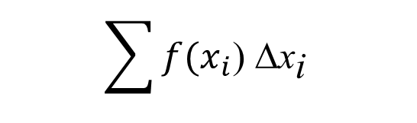
Areas of irregular shapes
Look at the area under the curve y = x² from x = 1 to x = 3
We can get an approximation of the area using rectangles
the approximate area approaches the actual area
As the number of rectangles increases,
If we are trying to find the area under the curve of f(x) from x = a to x = b
y
16
14
you can divide [a,b] into n sub-intervals of equal length and call this length Δx.
12
10
8
f(x₁₆)
f(x₁₅)
The width of a rectangle is Δx
f(x₁₄)
6
f(x₁₃)
f(x₁₂)
f(x₁₁)
The height of a rectangle is f(x)
f(x₁₀)
4
f(x₉)
f(x₈)
f(x₇)
f(x₆)
f(x₅)
2
f(x₄)
f(x₃)
The Area of a rectangle is = f(x) Δx
f(x₂)
f(x₁)
0
a
x
The total area is
1
2.5
3
3.5
0.5
1.5
2
b
4
Δx
$$\sum{{f(x}_{i}\text{)} \text{D}{\text{x}}_{\text{i}} }$$

Slide 6
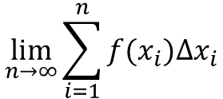
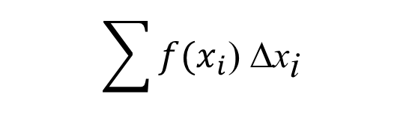
Areas of irregular shapes
Look at the area under the curve y = x² from x = 1 to x = 3
We can get an approximation of the area using rectangles
As the number of rectangles increases,
the approximate area approaches the actual area
The total area is
y
16
$$\sum{{f(x}_{i}\text{)} \text{D}{\text{x}}_{\text{i}} }$$
14
12
f(x_{i}) represents the height of each rectangle
10
8
f(x₁₆)
Δx_{i} represents the width of each rectangle
f(x₁₅)
f(x₁₄)
6
f(x₁₃)
f(x₁₂)
f(x₁₁)
f(x₁₀)
4
f(x₉)
f(x₈)
Using an infinite number of rectangles
f(x₇)
f(x₆)
f(x₅)
2
f(x₄)
f(x₃)
f(x₂)
f(x₁)
$$\lim_{n→∞}{\sum_{i=1}^{n}{f(x_{i})∆x_{i}}}$$
0
a
b
x
Δx
Leads to the exact area

Slide 7
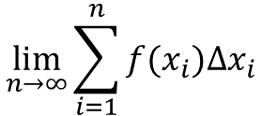
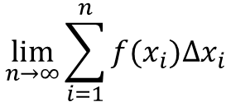
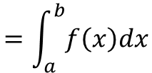
Areas of irregular shapes
Look at the area under the curve y = x² from x = 1 to x = 3
We can get an approximation of the area using rectangles
As the number of rectangles increases, the approximate area approaches the actual area
If a function f is defined for a ≤ x ≤ b
y
16
$$\lim_{n→∞}{\sum_{i=1}^{n}{f(x_{i})∆x_{i}}}$$
and
exist, we say that
14
12
f is integrable on a ≤ x ≤ b
10
We call this limit the definite integral and denote it as:
8
6
$$\lim_{n→∞}{\sum_{i=1}^{n}{f(x_{i})∆x_{i}}}$$
$$=\int_{a}^{b}{f\left(x\right)dx}$$
4
2
a is the lower limit of integration
0
a
b
x
b is the upper limit of integration
The symbol ∫ is an elongated S and is also used to indicate a sum

Slide 8
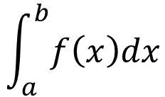
Areas of irregular shapes
When f is a non-negative function for a ≤ x ≤ b
$$\int_{a}^{b}{f\left(x\right)dx}$$
Gives the area under the curve from x = a to x = b
y
0
a
b
x

Slide 9
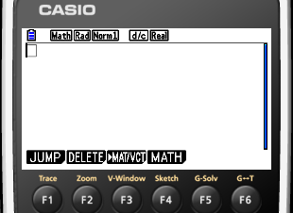


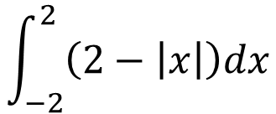
Using GDC to evaluate the definite integral
Write down a definite integral that gives the area of the shaded region and evaluate it using a GDC
$$\int_{a}^{b}{f\left(x\right)dx}$$
The area under the curve is given by from x = a to x = b
y
a is the lower limit
= −2
4
b is the upper limit
= 2
$$\int_{−2}^{2}{\left(2−\left|x\right|\right)dx}$$
3
2
MENU
1
1
MATH
F4
x
-2
-1
0
1
2
$$f\left(x\right)=2−\left|x\right|$$

Slide 10
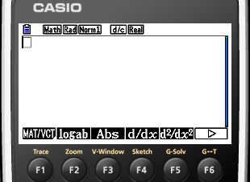
Using GDC to evaluate the definite integral
Write down a definite integral that gives the area of the shaded region and evaluate it using a GDC
$$\int_{a}^{b}{f\left(x\right)dx}$$
The area under the curve is given by from x = a to x = b
y
a is the lower limit
= −2
4
b is the upper limit
= 2
$$\int_{−2}^{2}{\left(2−\left|x\right|\right)dx}$$
3
2
MENU
1
1
MATH
F4
⬥
F6
x
-2
-1
0
1
2
$$f\left(x\right)=2−\left|x\right|$$

Slide 11
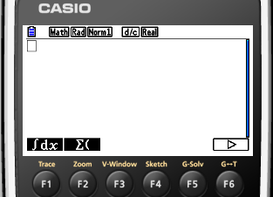
Using GDC to evaluate the definite integral
Write down a definite integral that gives the area of the shaded region and evaluate it using a GDC
$$\int_{a}^{b}{f\left(x\right)dx}$$
The area under the curve is given by from x = a to x = b
y
a is the lower limit
= −2
4
b is the upper limit
= 2
$$\int_{−2}^{2}{\left(2−\left|x\right|\right)dx}$$
3
2
MENU
1
1
MATH
F4
⬥
F6
x
^{ʃdx}
F1
-2
-1
0
1
2
$$f\left(x\right)=2−\left|x\right|$$

Slide 12
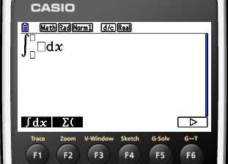

Using GDC to evaluate the definite integral
Write down a definite integral that gives the area of the shaded region and evaluate it using a GDC
$$\int_{a}^{b}{f\left(x\right)dx}$$
The area under the curve is given by from x = a to x = b
y
a is the lower limit
= −2
4
b is the upper limit
= 2
$$\int_{−2}^{2}{\left(2−\left|x\right|\right)dx}$$
3
2
MENU
1
1
MATH
F4
⬥
F6
x
^{ʃdx}
F1
-2
-1
0
1
2
TYPE
$$f\left(x\right)=2−\left|x\right|$$
$$\left(2−\left|x\right|\right)$$

Slide 13
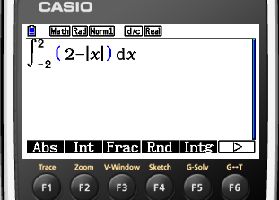
Using GDC to evaluate the definite integral
Write down a definite integral that gives the area of the shaded region and evaluate it using a GDC
$$\int_{a}^{b}{f\left(x\right)dx}$$
The area under the curve is given by from x = a to x = b
y
a is the lower limit
= −2
4
b is the upper limit
= 2
$$\int_{−2}^{2}{\left(2−\left|x\right|\right)dx}$$
3
2
MENU
1
1
MATH
F4
⬥
F6
x
^{ʃdx}
F1
-2
-1
0
1
2
TYPE
$$f\left(x\right)=2−\left|x\right|$$
$$\left(2−\left|x\right|\right)$$
EXE

Slide 14
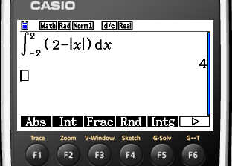
Using GDC to evaluate the definite integral
Write down a definite integral that gives the area of the shaded region and evaluate it using a GDC
$$\int_{a}^{b}{f\left(x\right)dx}$$
The area under the curve is given by from x = a to x = b
y
a is the lower limit
= −2
4
b is the upper limit
= 2
$$\int_{−2}^{2}{\left(2−\left|x\right|\right)dx}$$
3
= 4
2
MENU
1
1
MATH
F4
⬥
F6
x
^{ʃdx}
F1
-2
-1
0
1
2
TYPE
$$f\left(x\right)=2−\left|x\right|$$
$$\left(2−\left|x\right|\right)$$
EXE

Slide 15


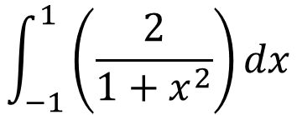
Using GDC to evaluate the definite integral
Write down a definite integral that gives the area of the shaded region and evaluate it using a GDC
$$\int_{a}^{b}{f\left(x\right)dx}$$
The area under the curve is given by from x = a to x = b
y
a is the lower limit
= −1
4
b is the upper limit
= 1
$$\int_{−1}^{1}{\left(\frac{2}{1+x^{2}}\right)dx}$$
3
2
1
MATH
F4
x
-2
-1
0
1
2
$$f\left(x\right)=\frac{2}{1+x^{2}}$$

Slide 16
Using GDC to evaluate the definite integral
Write down a definite integral that gives the area of the shaded region and evaluate it using a GDC
$$\int_{a}^{b}{f\left(x\right)dx}$$
The area under the curve is given by from x = a to x = b
y
a is the lower limit
= −1
4
b is the upper limit
= 1
$$\int_{−1}^{1}{\left(\frac{2}{1+x^{2}}\right)dx}$$
3
2
1
MATH
F4
⬥
F6
x
-2
-1
0
1
2
$$f\left(x\right)=\frac{2}{1+x^{2}}$$

Slide 17
Using GDC to evaluate the definite integral
Write down a definite integral that gives the area of the shaded region and evaluate it using a GDC
$$\int_{a}^{b}{f\left(x\right)dx}$$
The area under the curve is given by from x = a to x = b
y
a is the lower limit
= −1
4
b is the upper limit
= 1
$$\int_{−1}^{1}{\left(\frac{2}{1+x^{2}}\right)dx}$$
3
2
1
MATH
F4
⬥
F6
x
^{ʃdx}
F1
-2
-1
0
1
2
$$f\left(x\right)=\frac{2}{1+x^{2}}$$

Slide 18
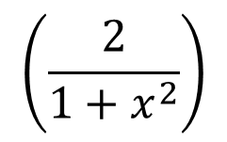
Using GDC to evaluate the definite integral
Write down a definite integral that gives the area of the shaded region and evaluate it using a GDC
$$\int_{a}^{b}{f\left(x\right)dx}$$
The area under the curve is given by from x = a to x = b
y
a is the lower limit
= −1
4
b is the upper limit
= 1
$$\int_{−1}^{1}{\left(\frac{2}{1+x^{2}}\right)dx}$$
3
2
1
MATH
F4
⬥
F6
x
^{ʃdx}
F1
-2
-1
0
1
2
TYPE
$$f\left(x\right)=\frac{2}{1+x^{2}}$$
$$\left(\frac{2}{1+x^{2}}\right)$$

Slide 19
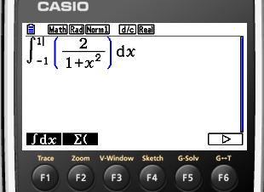
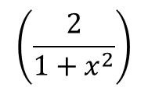
Using GDC to evaluate the definite integral
Write down a definite integral that gives the area of the shaded region and evaluate it using a GDC
$$\int_{a}^{b}{f\left(x\right)dx}$$
The area under the curve is given by from x = a to x = b
y
a is the lower limit
= −1
4
b is the upper limit
= 1
$$\int_{−1}^{1}{\left(\frac{2}{1+x^{2}}\right)dx}$$
3
2
1
MATH
F4
⬥
F6
x
^{ʃdx}
F1
-2
-1
0
1
2
TYPE
$$f\left(x\right)=\frac{2}{1+x^{2}}$$
$$\left(\frac{2}{1+x^{2}}\right)$$
EXE

Slide 20
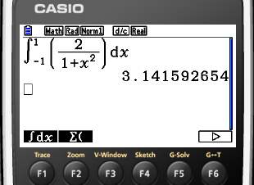
Using GDC to evaluate the definite integral
Write down a definite integral that gives the area of the shaded region and evaluate it using a GDC
$$\int_{a}^{b}{f\left(x\right)dx}$$
The area under the curve is given by from x = a to x = b
y
a is the lower limit
= −1
4
b is the upper limit
= 1
$$\int_{−1}^{1}{\left(\frac{2}{1+x^{2}}\right)dx}$$
3
≈ 3.14
2
1
MATH
F4
⬥
F6
x
^{ʃdx}
F1
-2
-1
0
1
2
TYPE
$$f\left(x\right)=\frac{2}{1+x^{2}}$$
$$\left(\frac{2}{1+x^{2}}\right)$$
EXE

Slide 21
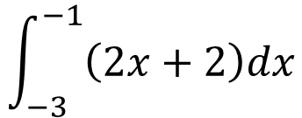
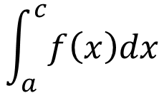
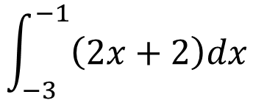
When f is a not non-negative function for a ≤ x ≤ c
$$\int_{a}^{c}{f\left(x\right)dx}$$
Gives the area under the curve from x = a to x = c
y
10
Consider what happened when f is not non-negative.
9
8
7
6
5
$$\int_{−3}^{−1}{\left(2x+2\right)dx}$$
4
3
2
1
x
The area of the shaded triangle is 4, but
-10
-9
-8
-7
-6
-5
-4
-3
-2
-1
0
1
2
3
4
5
6
7
8
9
10
-1
-2
$$\int_{−3}^{−1}{\left(2x+2\right)dx}$$
-3
= - 4
-4
-5
-6
Since f(x) < 0 when -3 < x < -1
-7
-8
-9
-10

Slide 22
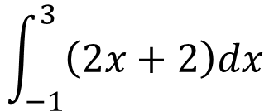
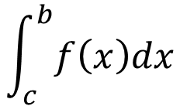
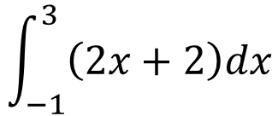
When f is a non-negative function for c ≤ x ≤ b
$$\int_{c}^{b}{f\left(x\right)dx}$$
Gives the area under the curve from x = c to x = b
y
10
Consider what happened when f is non-negative.
9
8
7
6
5
$$\int_{−1}^{3}{\left(2x+2\right)dx}$$
4
3
2
1
x
The area of the shaded triangle is 16,
-10
-9
-8
-7
-6
-5
-4
-3
-2
-1
0
1
2
3
4
5
6
7
8
9
10
-1
-2
$$\int_{−1}^{3}{\left(2x+2\right)dx}$$
-3
= 16
-4
-5
-6
Since f(x) > 0 when -1 < x < 3
-7
-8
-9
-10

Slide 23
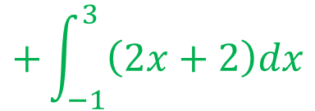
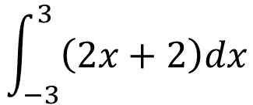
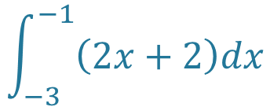
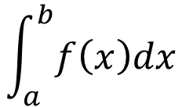
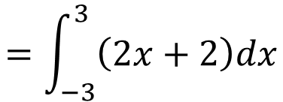
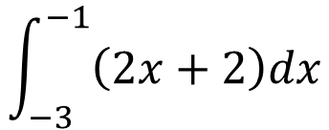
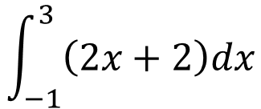
When f is a non-negative function for a ≤ x ≤ b
$$\int_{a}^{b}{f\left(x\right)dx}$$
Gives the area under the curve from x = a to x = b
y
$$\int_{−3}^{3}{\left(2x+2\right)dx}$$
10
= 12
9
8
$$\int_{−3}^{−1}{\left(2x+2\right)dx}$$
7
= - 4
6
5
4
$$\int_{−1}^{3}{\left(2x+2\right)dx}$$
3
A₂
= 16
2
1
The area of the shaded region is equals to the area of the region A₁ plus the area of the region A₂
x
-10
-9
-8
-7
-6
-5
-4
-3
-2
-1
0
1
2
3
4
5
6
7
8
9
10
A₁
-1
-2
-3
-4
-5
$$\int_{−3}^{−1}{\left(2x+2\right)dx}$$
$$+\int_{−1}^{3}{\left(2x+2\right)dx}$$
$$=\int_{−3}^{3}{\left(2x+2\right)dx}$$
- 4
+ 16
= 12

Slide 24
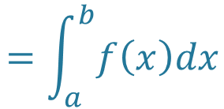
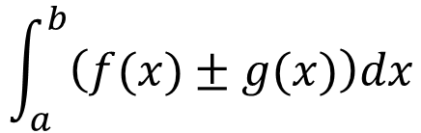
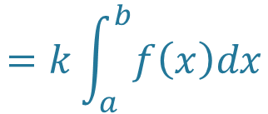
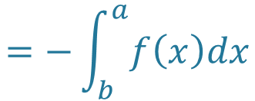
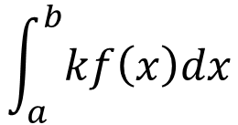
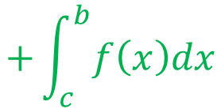
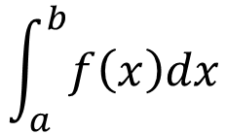
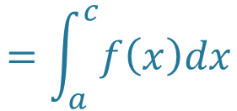
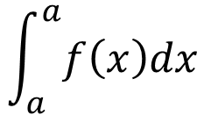
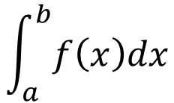
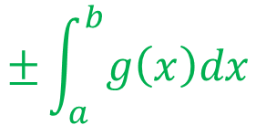
When f is a non-negative function for a ≤ x ≤ b
The example perfectly illustrates one of the properties of definite integrals
$$\int_{a}^{b}{f\left(x\right)dx}$$
$$=\int_{a}^{c}{f\left(x\right)dx}$$
$$+\int_{c}^{b}{f\left(x\right)dx}$$
Some other properties of definite integrals
$$\int_{a}^{b}{kf\left(x\right)dx}$$
$$=k\int_{a}^{b}{f\left(x\right)dx}$$
$$\int_{a}^{b}{\left(f(x)±g(x)\right)dx}$$
$$=\int_{a}^{b}{f\left(x\right)dx}$$
$$±\int_{a}^{b}{g\left(x\right)dx}$$
$$\int_{a}^{a}{f\left(x\right)dx}$$
= 0
$$\int_{a}^{b}{f\left(x\right)dx}$$
$$=−\int_{b}^{a}{f\left(x\right)dx}$$

Slide 25
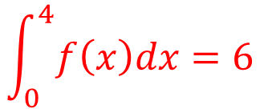
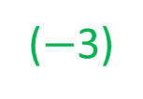
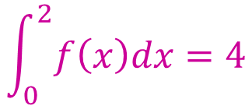
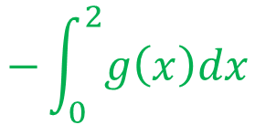








When f is a non-negative function for a ≤ x ≤ b
Given that
$$\int_{0}^{2}{f\left(x\right)dx=4}$$
$$\int_{2}^{5}{f\left(x\right)dx=12}$$
$$\int_{0}^{2}{g\left(x\right)dx=−3}$$
$$\int_{0}^{4}{f\left(x\right)dx=6}$$
Evaluate these definite integrals without using your GDC
$$\int_{0}^{2}{(3f\left(x\right)−g\left(x\right))dx}$$
$$=\int_{0}^{2}{3f\left(x\right)dx}$$
$$−\int_{0}^{2}{g\left(x\right)dx}$$
Apply property
.$\int_{a}^{b}{\left(f(x)±g(x)\right)dx=\int_{a}^{b}{f\left(x\right)dx±\int_{a}^{b}{g\left(x\right)dx}}}$
$$=3\int_{0}^{2}{f\left(x\right)dx}$$
$$−\int_{0}^{2}{g\left(x\right)dx}$$
Apply property
.$\int_{a}^{b}{kf\left(x\right)dx}$=k$\int_{a}^{b}{f\left(x\right)dx}$
(4)
= 3
−
($−$3)
Substitute and evaluate
= 15

Slide 26




When f is a non-negative function for a ≤ x ≤ b
Given that
$$\int_{0}^{2}{f\left(x\right)dx=4}$$
$$\int_{2}^{5}{f\left(x\right)dx=12}$$
$$\int_{0}^{2}{g\left(x\right)dx=−3}$$
$$\int_{0}^{4}{f\left(x\right)dx=6}$$
Evaluate these definite integrals without using your GDC
$$\int_{2}^{2}{g\left(x\right)dx+\int_{5}^{2}{f\left(x\right)dx}}$$
Apply property .$\int_{a}^{a}{f\left(x\right)dx}$=0 to the first term and property $\int_{a}^{b}{f\left(x\right)dx}=−\int_{b}^{a}{f\left(x\right)dx}$ to the second term
$$−\int_{2}^{5}{f\left(x\right)dx}$$
$$=0$$
−
= 0
12
Substitute and evaluate
= 12

Slide 27




When f is a non-negative function for a ≤ x ≤ b
Given that
$$\int_{0}^{2}{f\left(x\right)dx=4}$$
$$\int_{2}^{5}{f\left(x\right)dx=12}$$
$$\int_{0}^{2}{g\left(x\right)dx=−3}$$
$$\int_{0}^{4}{f\left(x\right)dx=6}$$
Evaluate these definite integrals without using your GDC
$$\int_{0}^{5}{f\left(x\right)dx}$$
$$=\int_{0}^{2}{f\left(x\right)dx}$$
$$+\int_{2}^{5}{f\left(x\right)dx}$$
Apply property
. $\int_{a}^{b}{f\left(x\right)dx}=\int_{a}^{c}{f\left(x\right)dx+\int_{c}^{b}{f\left(x\right)dx}}$
= 4
+
12
Substitute and evaluate
= 16

Slide 28











When f is a non-negative function for a ≤ x ≤ b
Given that
$$\int_{0}^{2}{f\left(x\right)dx=4}$$
$$\int_{2}^{5}{f\left(x\right)dx=12}$$
$$\int_{0}^{2}{g\left(x\right)dx=−3}$$
$$\int_{0}^{4}{g\left(x\right)dx=6}$$
Evaluate these definite integrals without using your GDC
$$\int_{2}^{4}{g\left(x\right)dx}$$
$$\int_{0}^{2}{g\left(x\right)dx}$$
$$+\int_{2}^{4}{g\left(x\right)dx}$$
$$=\int_{0}^{4}{g\left(x\right)dx}$$
Apply property
. $\int_{a}^{b}{f\left(x\right)dx}=\int_{a}^{c}{f\left(x\right)dx+\int_{c}^{b}{f\left(x\right)dx}}$
$$\int_{2}^{4}{g\left(x\right)dx}$$
$$=\int_{0}^{4}{g\left(x\right)dx}$$
$$−\int_{0}^{2}{g\left(x\right)dx}$$
Rearranging terms
= 6
$$−$$
$−$3
Substitute and evaluate
= 9

Slide 29

Thank you for using resources from
For more resources visit our website
https://www.mathssupport.org
If you have a special request, drop us an email
info@mathssupport.org

