Slide 1
Definite integral using technology
LO: Use the GDC to find the definite integral.

Slide 2
Definite integrals using GDC
Using GDC to evaluate a definite integral
$$\int_{1}^{5}{\frac{1}{4x}dx}$$
Evaluate the definite integral
We are going to use Graphing display calculator to solve this question

Slide 3
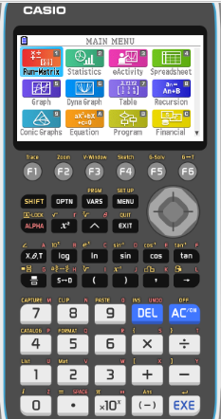
Definite integrals using GDC
$$\int_{1}^{5}{\frac{1}{4x}dx}$$
Evaluate the definite integral
Turn on the GDC
1
Run-Matrix

Slide 4
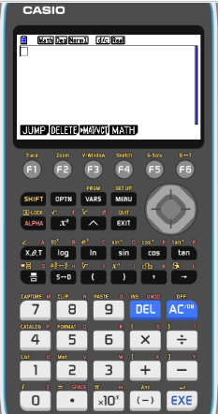
Definite integrals using GDC
$$\int_{1}^{5}{\frac{1}{4x}dx}$$
Evaluate the definite integral
Turn on the GDC
1
Run-Matrix
F4
MATH

Slide 5
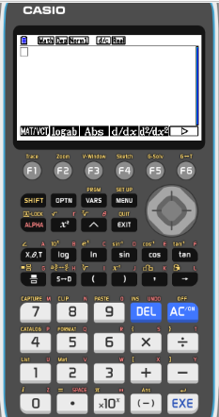
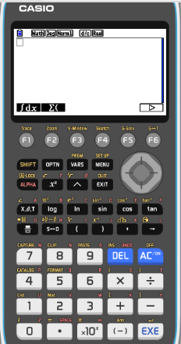
Definite integrals using GDC
$$\int_{1}^{5}{\frac{1}{4x}dx}$$
Evaluate the definite integral
Turn on the GDC
1
Run-Matrix
F4
MATH
F6


F1
∫dx

Slide 6
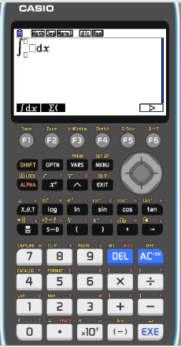
Definite integrals using GDC
$$\int_{1}^{5}{\frac{1}{4x}dx}$$
Evaluate the definite integral
Turn on the GDC
1
Run-Matrix
F4
MATH
F6


F1
∫dx
Type in
1

4
x

Slide 7
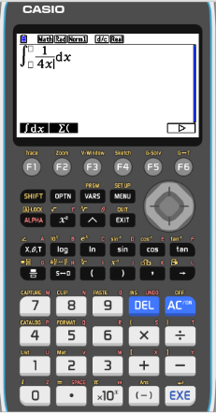
Definite integrals using GDC
$$\int_{1}^{5}{\frac{1}{4x}dx}$$
Evaluate the definite integral
Turn on the GDC
1
Run-Matrix
F4
MATH
F6


F1
∫dx
Type in
1

4
x


1

5

Slide 8
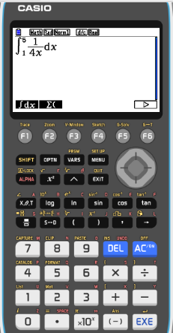
Definite integrals using GDC
$$\int_{1}^{5}{\frac{1}{4x}dx}$$
Evaluate the definite integral
Turn on the GDC
1
Run-Matrix
F4
MATH
F6

F1
∫dx
Type in
1

4
x


1

5
EXE

Slide 9
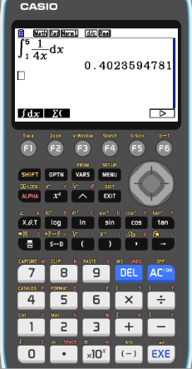
Definite integrals using GDC
$$\int_{1}^{5}{\frac{1}{4x}dx}$$
Evaluate the definite integral
Turn on the GDC
1
Run-Matrix
F4
MATH
F6

F1
∫dx
Type in
1

4
x


1

5
EXE
$$\int_{1}^{5}{\frac{1}{4x}dx}$$
$$=0.402$$
3sf

Slide 10
Definite integrals using GDC
$$\int_{0}^{\frac{π}{6}}{\sin^{2}x cos xdx}$$
Evaluate the definite integral
Turn on the GDC
1
Run-Matrix

Slide 11
Definite integrals using GDC
$$\int_{0}^{\frac{π}{6}}{\sin^{2}x cos xdx}$$
Evaluate the definite integral
Turn on the GDC
1
Run-Matrix
F4
MATH

Slide 12
Definite integrals using GDC
$$\int_{0}^{\frac{π}{6}}{\sin^{2}x cos xdx}$$
Evaluate the definite integral
Turn on the GDC
1
Run-Matrix
F4
MATH
F6


F1
∫dx

Slide 13
Definite integrals using GDC
$$\int_{0}^{\frac{π}{6}}{\sin^{2}x cos xdx}$$
Evaluate the definite integral
Turn on the GDC
1
Run-Matrix
F4
MATH
F6

F1
∫dx
Type in
(
sin
x
)
²

Slide 14
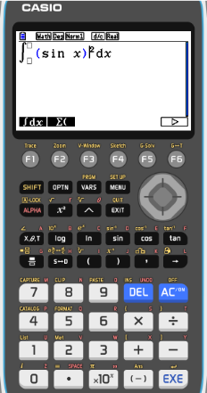
Definite integrals using GDC
$$\int_{0}^{\frac{π}{6}}{\sin^{2}x cos xdx}$$
Evaluate the definite integral
Turn on the GDC
1
Run-Matrix
F4
MATH
F6

F1
∫dx
Type in
(
sin
x
²
)
cos
x

Slide 15
Definite integrals using GDC
$$\int_{0}^{\frac{π}{6}}{\sin^{2}x cos xdx}$$
Evaluate the definite integral
Turn on the GDC
1
Run-Matrix
F4
MATH
F6



F1
∫dx
Type in
(
sin
x
cos
x
)
²

π

6
EXE
0

SHIFT

Slide 16
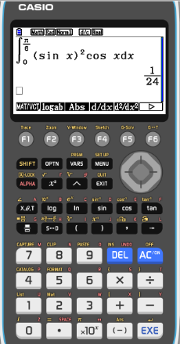
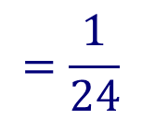
Definite integrals using GDC
$$\int_{0}^{\frac{π}{6}}{\sin^{2}x cos xdx}$$
Evaluate the definite integral
Turn on the GDC
1
Run-Matrix
F4
MATH
F6

F1
∫dx
Type in
(
sin
²
x
)
cos
x

π

6
EXE
0

SHIFT
$$\int_{0}^{\frac{π}{6}}{{\left(\sin{x}\right)}^{2}\cos{x}dx}$$
$$=\frac{1}{24}$$
Make sure your GDC setting is in RAD for angles

Slide 17
Thank you for using resources from
For more resources visit our website
https://www.mathssupport.org
If you have a special request, drop us an email
info@mathssupport.org

