Slide 1
The derivative of functions of the form f(x) = axⁿ + bxⁿ–¹
LO: To find the derivative of functions using the sum or difference rule.

Slide 2
The derivative of other functions
Constant rule
If f(x) = k, where k is any real number, then f ’(x) = 0
The derivative of any constant is zero.
Constant multiple rule
If y = kf(x), where k is any real number, then y ’(x) = kf ’(x)
The derivative of a constant times a function is the constant times the derivative of the function.
Sum or difference rule
If f(x) = u(x) ± v(x), then f ’(x) = u’(x) ± v’(x)
The derivative of a function that is the sum or difference of two or more terms is the sum or difference of the derivatives of the terms

Slide 3
The derivative of other functions
Differentiate f(x) = 4x³ + 2x² – 3 with respect to x.
f(x) = 4x³ + 2x² – 3
Find the derivative of each term
f ’ (x) =
4(3x³⁻¹)
+ 2(2x²⁻¹)
– 0
Note the derivative of the constant term is 0
f ’ (x) =
12x²
+ 4x

Slide 4
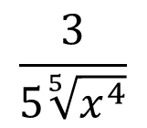
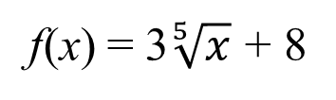
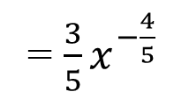
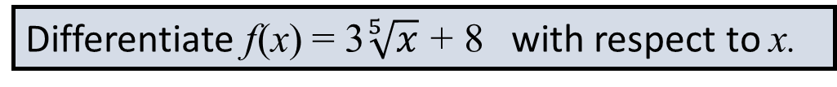
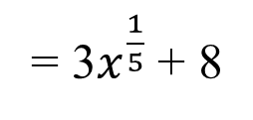
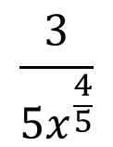
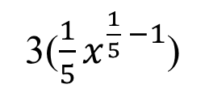
The derivative of other functions
Differentiate f(x) = 3$\sqrt[5]{x}$ + 8 with respect to x.
f(x) = 3$\sqrt[5]{x}$ + 8
= 3$x^{\frac{1}{5}}$ + 8
Rewrite using rational exponents
f ’ (x) =
3(${\frac{1}{5}x}^{\frac{1}{5} −1}$)
+ 0
Find the derivative of each term
Note the derivative of the constant term is 0
= ${\frac{3}{5}x}^{−\frac{4}{5} }$
$$\frac{3}{5x^{\frac{4}{5}}}$$
$$\frac{3}{5\sqrt[5]{x^{4}}}$$
Simplify
f ’ (x) =
or

Slide 5
The derivative of other functions
Differentiate f(x) = (x – 2) (x + 4) with respect to x.
Expand the brackets
f(x) = x² + 2x – 8
Find the derivative of each term
f ’ (x) =
(2x²⁻¹)
+ 2(x¹⁻¹)
– 0
Note the derivative of the constant term is 0
f ’ (x) =
2x
+ 2

Slide 6
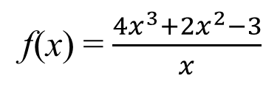
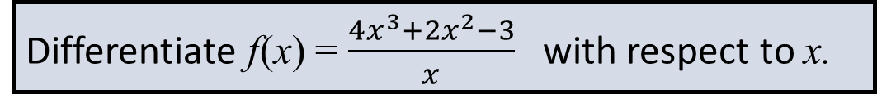
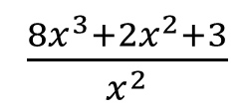
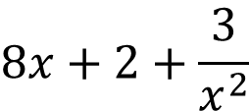
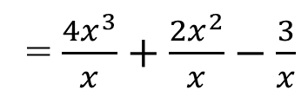
The derivative of other functions
Differentiate f(x) = $\frac{4x^{3}+2x^{2}−3}{x}$ with respect to x.
Rewrite so that the function is the sum or difference of terms in the form ax^{n}
f(x) = $\frac{4x^{3}+2x^{2}−3}{x}$
= $\frac{4x^{3}}{x}+\frac{2x^{2}}{x}−\frac{3}{x}$
f(x) = 4x² + 2x – 3x⁻¹
Find the derivative of each term
f ’ (x) =
4(2x²⁻¹)
+ 2(x¹⁻¹)
– 3(–1x⁻¹⁻¹)
Simplify
f ’ (x) =
8x
+ 2
+ 3x⁻²
f ’ (x) =
$$8x+2+\frac{3}{x^{2}}$$
or
$\frac{8x^{3}+2x^{2}+3}{x^{2}}$

Slide 7

Thank you for using resources from
For more resources visit our website
https://www.mathssupport.org
If you have a special request, drop us an email
info@mathssupport.org

