Slide 1
Inverse Normal calculations
LO: Given the percentage area under the curve, find the value corresponding to it
To find the mean and standard deviation.

Slide 2
Inverse normal calculations
Sometimes you are given the percentage area under the curve, i.e. the probability or the proportion, and you are asked to find the value corresponding to it. This is called an inverse normal calculation.
Always make a sketch to illustrate the information given.
You must always remember to use the area to the left when using your GDC. If you are given the area to the right of the value, you must subtract this from 1 (or 100%) before using your GDC.
95%
5%
For example, an area of 5% above a certain value means there is an area of 95% below it.
You can use the GDC to find this value. The calculator has a function called inverse Normal which will do this.

Slide 3
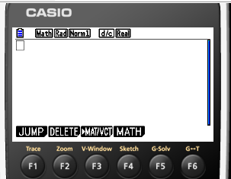
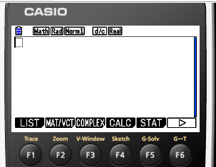
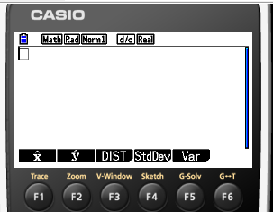
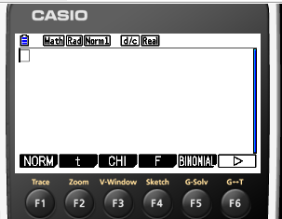
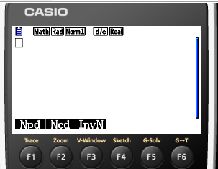
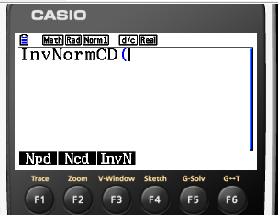
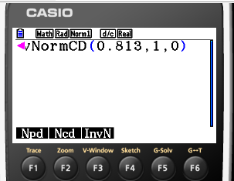
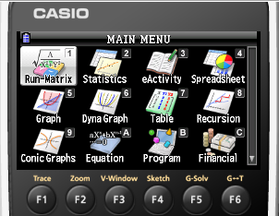
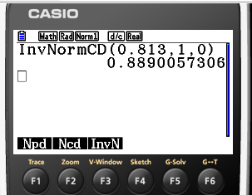
Inverse normal calculations
In these examples we will return to the standard normal distribution Z ~ N(0, 1).
Given that Z ~ N(0, 1) use your GDC to find a.
P (Z < a) = 0.813.
Step 1:
Draw a sketch
Step 2:
Use your GDC
f(z)
Turn on the GDC
Type 1
Run-Matrix
0.813
Press OPTN
F5: STAT
a
z
F3: DIST
0
F1: NORM
F3: InvN
Type in this order: 0.813, 1, 0)
EXE
The value of a is 0.889

Slide 4
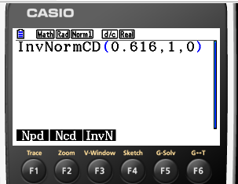
Inverse normal calculations
In these examples we will return to the standard normal distribution Z ~ N(0, 1).
Given that Z ~ N(0, 1) use your GDC to find a.
P (Z > a) = 0.384.
Step 1:
Draw a sketch
Step 2:
Use your GDC
f(z)
Turn on the GDC
Type 1
Run-Matrix
0.616
Press OPTN
0.384
a
z
F5: STAT
0
F3: DIST
Notice that the vale of a for P(Z > a) = 0.384 is the same as the value of a for P(Z < a) = 1 - 0.384, let’s find a for P(Z < a) = 0.616
F1: NORM
F3: InvN
Type in this order: 0.616, 1, 0)
EXE
The value of a is 0.295

Slide 5
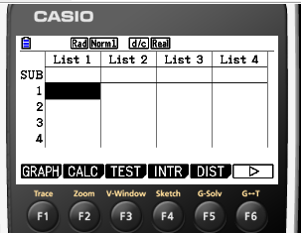
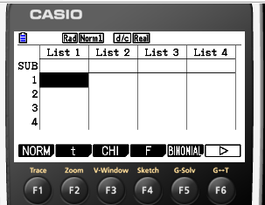
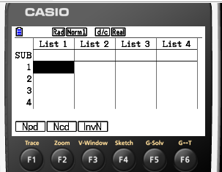
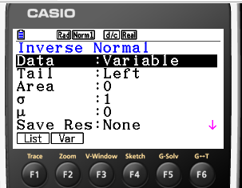
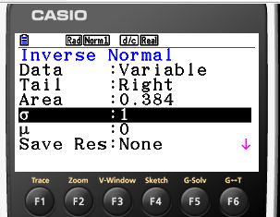
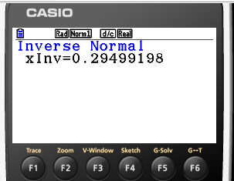
Inverse normal calculations
In these examples we will return to the standard normal distribution Z ~ N(0, 1).
Given that Z ~ N(0, 1) use your GDC to find a.
P (Z > a) = 0.384.
Using an alternative method
Step 1:
Draw a sketch
Step 2:
Use your GDC
f(z)
Turn on the GDC
Type 2
Statistics
F5: DIST
F1: NORM
0.384
F3: InvN
a
z
0
Type in this order:
Notice that the area for P(Z > a) = 0.384 is in the right side of the curve
Data:
F2 Variable
Tail:
F2 Right
Area:
EXE
0.384
σ:
EXE
1
μ:
0
The value of a is 0.295
EXE

Slide 6
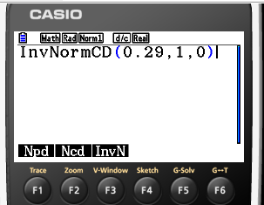
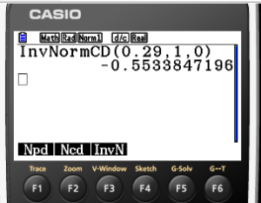
Inverse normal calculations
In these examples we will return to the standard normal distribution Z ~ N(0, 1).
Given that Z ~ N(0, 1) use your GDC to find a.
P (–a < Z < a) = 0.42.
Step 1:
Draw a sketch
Step 2:
Use your GDC
f(z)
Turn on the GDC
Type 1
Run-Matrix
Press OPTN
0.42
F5: STAT
0.29
a
z
F3: DIST
–a
0
Notice that the vale of a can be found if we know the area in the left side
F1: NORM
F3: InvN
Type in this order: 0.29, 1, 0)
EXE
$$\frac{1}{2}\left(1−0.42\right)=0.29$$
The value of –a is –0.553
The value of a is 0.553

Slide 7
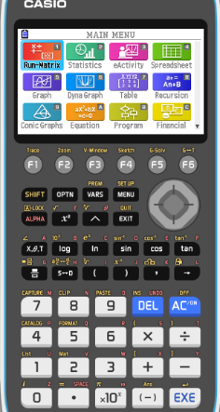
Inverse normal calculations
The volume of cartons of milk is normally distributed with a mean of 995ml and a standard deviation of 5ml.
10% of cartons are rejected for containing to little milk. Find the minimum volume, to the nearest ml, that a carton must contain if it is to be accepted.
Sketching the normal distribution diagram gives a clear idea of what is happening.
The shaded area represents 10% of the cartons.
995
Turn on the GDC
Click on MENU and type 2 to go to Statistics

Slide 8
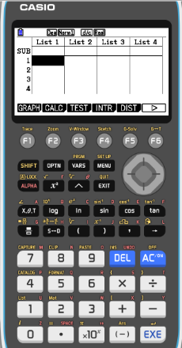
Inverse normal calculations
The volume of cartons of milk is normally distributed with a mean of 995ml and a standard deviation of 5ml.
10% of cartons are rejected for containing to little milk. Find the minimum volume, to the nearest ml, that a carton must contain if it is to be accepted.
Sketching the normal distribution diagram gives a clear idea of what is happening.
The shaded area represents 10% of the cartons.
995
Click on F5 DIST

Slide 9
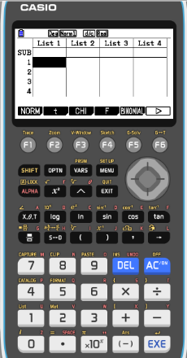
Inverse normal calculations
The volume of cartons of milk is normally distributed with a mean of 995ml and a standard deviation of 5ml.
10% of cartons are rejected for containing to little milk. Find the minimum volume, to the nearest ml, that a carton must contain if it is to be accepted.
Sketching the normal distribution diagram gives a clear idea of what is happening.
The shaded area represents 10% of the cartons.
995
Click on F1 NORM

Slide 10
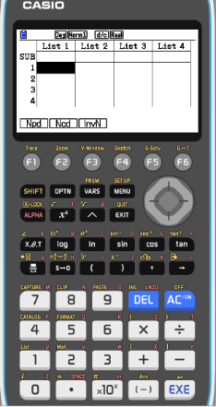
Inverse normal calculations
The volume of cartons of milk is normally distributed with a mean of 995ml and a standard deviation of 5ml.
10% of cartons are rejected for containing to little milk. Find the minimum volume, to the nearest ml, that a carton must contain if it is to be accepted.
Sketching the normal distribution diagram gives a clear idea of what is happening.
The shaded area represents 10% of the cartons.
995
Click on F3 InvN

Slide 11
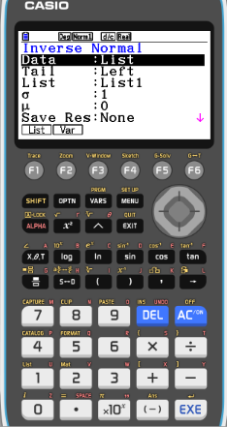
Inverse normal calculations
The volume of cartons of milk is normally distributed with a mean of 995ml and a standard deviation of 5ml.
10% of cartons are rejected for containing to little milk. Find the minimum volume, to the nearest ml, that a carton must contain if it is to be accepted.
Sketching the normal distribution diagram gives a clear idea of what is happening.
The shaded area represents 10% of the cartons.
995
Click on F2 Var

Slide 12
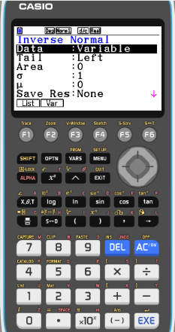
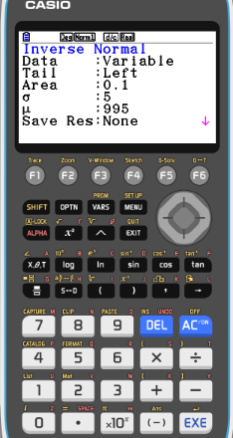
Inverse normal calculations
The volume of cartons of milk is normally distributed with a mean of 995ml and a standard deviation of 5ml.
10% of cartons are rejected for containing to little milk. Find the minimum volume, to the nearest ml, that a carton must contain if it is to be accepted.
Sketching the normal distribution diagram gives a clear idea of what is happening.
The shaded area represents 10% of the cartons.
Tail: Left:
995
Now type the information from the problem:
Area: 0.1
EXE
σ: 5
EXE
μ: 995
EXE
EXE

Slide 13
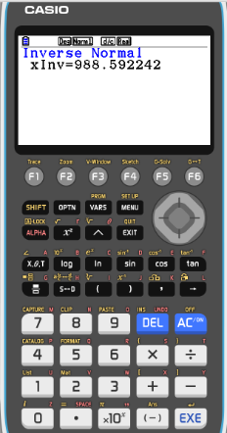
Inverse normal calculations
The volume of cartons of milk is normally distributed with a mean of 995ml and a standard deviation of 5ml.
10% of cartons are rejected for containing to little milk. Find the minimum volume, to the nearest ml, that a carton must contain if it is to be accepted.
Sketching the normal distribution diagram gives a clear idea of what is happening.
The shaded area represents 10% of the cartons.
995
The solution on the calculator is 988.592242
So the minimum volume is 989ml to the nearest ml.

Slide 14
Example 2
The weights of pears are normally distributed with a mean of 110g and a standard deviation of 8g.
Find the percentage of pears that weigh between 100g and 130g.
It is known that 8% of the pears weigh more than m g. Find the value of m.
250 pears are weighed. Calculate the expected number of pears that weigh less than 105g.
μ
110
Sketch a diagram. μ = 110g σ = 8g
μ – σ
102
μ + σ
118
μ - 2σ
94
μ + 2σ
126
μ - 3σ
86
μ + 3σ
134

Slide 15
Example 2
The weights of pears are normally distributed with a mean of 110g and a standard deviation of 8g.
Find the percentage of pears that weigh between 100g and 130g.
Sketch a diagram. μ = 110g σ = 8g
μ
110
μ – σ
102
μ + σ
118
μ - 2σ
94
μ + 2σ
126
μ - 3σ
86
μ + 3σ
134
Click on MENU and go to Statistics [2]

Slide 16
Example 2
The weights of pears are normally distributed with a mean of 110g and a standard deviation of 8g.
Find the percentage of pears that weigh between 100g and 130g.
Sketch a diagram. μ = 110g σ = 8g
μ
110
μ – σ
102
μ + σ
118
μ - 2σ
94
μ + 2σ
126
μ - 3σ
86
μ + 3σ
134
Click on F5 DIST

Slide 17
Example 2
The weights of pears are normally distributed with a mean of 110g and a standard deviation of 8g.
Find the percentage of pears that weigh between 100g and 130g.
Sketch a diagram. μ = 110g σ = 8g
μ
110
μ – σ
102
μ + σ
118
μ - 2σ
94
μ + 2σ
126
μ - 3σ
86
μ + 3σ
134
Click on F1 NORM

Slide 18
Example 2
The weights of pears are normally distributed with a mean of 110g and a standard deviation of 8g.
Find the percentage of pears that weigh between 100g and 130g.
Sketch a diagram. μ = 110g σ = 8g
μ
110
μ – σ
102
μ + σ
118
μ - 2σ
94
μ + 2σ
126
μ - 3σ
86
μ + 3σ
134
Click on F2 Ncd

Slide 19
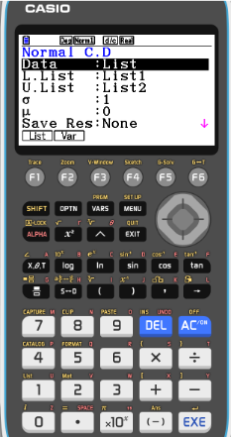
Example 2
The weights of pears are normally distributed with a mean of 110g and a standard deviation of 8g.
Find the percentage of pears that weigh between 100g and 130g.
Sketch a diagram. μ = 110g σ = 8g
μ
110
μ – σ
102
μ + σ
118
μ - 2σ
94
μ + 2σ
126
μ - 3σ
86
μ + 3σ
134
Click on F2 Var

Slide 20
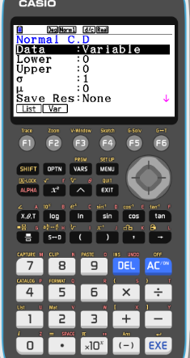
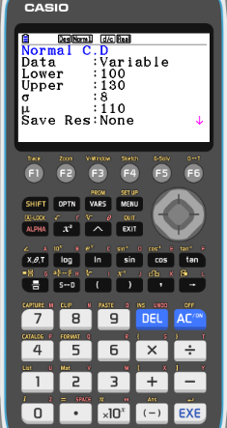
Example 2
The weights of pears are normally distributed with a mean of 110g and a standard deviation of 8g.
Find the percentage of pears that weigh between 100g and 130g.
Sketch a diagram. μ = 110g σ = 8g
μ
110
μ – σ
102
μ + σ
118
μ - 2σ
94
μ + 2σ
126
μ - 3σ
86
μ + 3σ
134
Type the information from the problem:
Lower: 100
EXE
Upper: 130
EXE
σ: 8
EXE
μ: 110
EXE
EXE

Slide 21
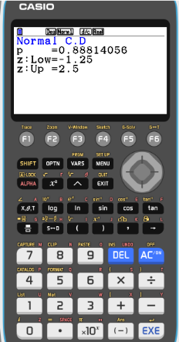
Example 2
The weights of pears are normally distributed with a mean of 110g and a standard deviation of 8g.
Find the percentage of pears that weigh between 100g and 130g.
88.8%
Sketch a diagram. μ = 110g σ = 8g
μ
110
μ – σ
102
μ + σ
118
μ - 2σ
94
μ + 2σ
126
μ - 3σ
86
μ + 3σ
134
The solution on the calculator is 0.88814056
So the percentage of pears that weigh between 100g and 130g is 88.8%

Slide 22
Example 2
The weights of pears are normally distributed with a mean of 110g and a standard deviation of 8g.
Find the percentage of pears that weigh between 100g and 130g.
It is known that 8% of the pears weigh more than m g. Find the value of m.
88.8%
Sketch a diagram. μ = 110g σ = 8g
μ
110
μ – σ
102
μ + σ
118
μ - 2σ
94
μ + 2σ
126
μ - 3σ
86
μ + 3σ
134
EXIT, EXIT
8%
Click on F5 DIST

Slide 23
Example 2
The weights of pears are normally distributed with a mean of 110g and a standard deviation of 8g.
Find the percentage of pears that weigh between 100g and 130g.
It is known that 8% of the pears weigh more than m g. Find the value of m.
88.8%
μ
110
Sketch a diagram. μ = 110g σ = 8g
μ – σ
102
μ + σ
118
μ - 2σ
94
μ + 2σ
126
μ - 3σ
86
μ + 3σ
134
8%
Click on F1 NORM

Slide 24
Example 2
The weights of pears are normally distributed with a mean of 110g and a standard deviation of 8g.
Find the percentage of pears that weigh between 100g and 130g.
It is known that 8% of the pears weigh more than m g. Find the value of m.
88.8%
Sketch a diagram. μ = 110g σ = 8g
μ
110
μ – σ
102
μ + σ
118
μ - 2σ
94
μ + 2σ
126
μ - 3σ
86
μ + 3σ
134
8%
Click on F3 InvN

Slide 25
Example 2
The weights of pears are normally distributed with a mean of 110g and a standard deviation of 8g.
Find the percentage of pears that weigh between 100g and 130g.
It is known that 8% of the pears weigh more than m g. Find the value of m.
88.8%
Sketch a diagram. μ = 110g σ = 8g
μ
110
μ – σ
102
μ + σ
118
μ - 2σ
94
μ + 2σ
126
μ - 3σ
86
μ + 3σ
134
8%
In this case the 8% of the pears are to the right of m, so 92% are to the left of m.
Type the information from the problem:
Area: 0.92
EXE
σ: 8
EXE
μ: 110
EXE
EXE

Slide 26
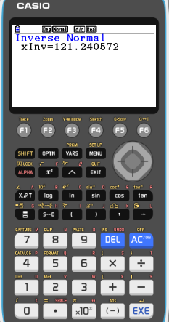
Example 2
The weights of pears are normally distributed with a mean of 110g and a standard deviation of 8g.
Find the percentage of pears that weigh between 100g and 130g.
It is known that 8% of the pears weigh more than m g. Find the value of m.
88.8%
121g
Sketch a diagram. μ = 110g σ = 8g
μ
110
μ – σ
102
μ + σ
118
μ - 2σ
94
μ + 2σ
126
μ - 3σ
86
μ + 3σ
134
8%
The solution on the calculator is 121.2405725
So m = 121g (to 3 sig. fig.)

Slide 27
Example 2
The weights of pears are normally distributed with a mean of 110g and a standard deviation of 8g.
Find the percentage of pears that weigh between 100g and 130g.
It is known that 8% of the pears weigh more than m g. Find the value of m.
88.8%
c) 250 pears are weighed. Calculate the expected number of pears that weigh less than 105g.
121g
Sketch a diagram. μ = 110g σ = 8g
μ
110
μ – σ
102
μ + σ
118
μ - 2σ
94
μ + 2σ
126
μ - 3σ
86
μ + 3σ
134
EXIT, EXIT
Click on F5 DIST

Slide 28
Example 2
The weights of pears are normally distributed with a mean of 110g and a standard deviation of 8g.
Find the percentage of pears that weigh between 100g and 130g.
It is known that 8% of the pears weigh more than m g. Find the value of m.
88.8%
c) 250 pears are weighed. Calculate the expected number of pears that weigh less than 105g.
121g
Sketch a diagram. μ = 110g σ = 8g
μ
110
μ – σ
102
μ + σ
118
μ - 2σ
94
μ + 2σ
126
μ - 3σ
86
μ + 3σ
134
Click on F1 NORM

Slide 29
Example 2
The weights of pears are normally distributed with a mean of 110g and a standard deviation of 8g.
Find the percentage of pears that weigh between 100g and 130g.
It is known that 8% of the pears weigh more than m g. Find the value of m.
88.8%
c) 250 pears are weighed. Calculate the expected number of pears that weigh less than 105g.
121g
Sketch a diagram. μ = 110g σ = 8g
μ
110
μ – σ
102
μ + σ
118
μ - 2σ
94
μ + 2σ
126
μ - 3σ
86
μ + 3σ
134
Click on F2 Ncd

Slide 30
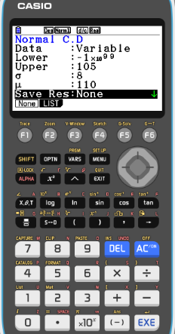
Example 2
The weights of pears are normally distributed with a mean of 110g and a standard deviation of 8g.
Find the percentage of pears that weigh between 100g and 130g.
It is known that 8% of the pears weigh more than m g. Find the value of m.
88.8%
c) 250 pears are weighed. Calculate the expected number of pears that weigh less than 105g.
121g
Sketch a diagram. μ = 110g σ = 8g
μ
110
μ – σ
102
μ + σ
118
μ - 2σ
94
μ + 2σ
126
μ - 3σ
86
μ + 3σ
134
Type the information from the problem:
Lower: -1E99
EXE
Upper: 105
EXE
σ: 8
EXE
μ: 110
EXE
EXE

Slide 31
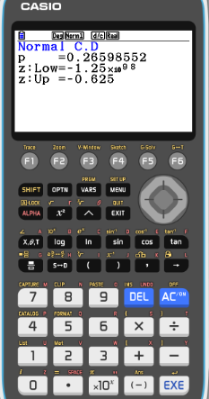
Example 2
The weights of pears are normally distributed with a mean of 110g and a standard deviation of 8g.
Find the percentage of pears that weigh between 100g and 130g.
It is known that 8% of the pears weigh more than m g. Find the value of m.
88.8%
c) 250 pears are weighed. Calculate the expected number of pears that weigh less than 105g.
121g
Sketch a diagram. μ = 110g σ = 8g
μ
110
μ – σ
102
μ + σ
118
μ - 2σ
94
μ + 2σ
126
μ - 3σ
86
μ + 3σ
134
The solution on the calculator is 0.26598552
So the percentage of pears that weigh between 100g and 130g is 26.6%.
250 x 0.266 = 66.5, so the expected number of pears that weigh less than 105g is 66 or 67.

Slide 32
Thank you for using resources from
For more resources visit our website
https://www.mathssupport.org
If you have a special request, drop us an email
info@mathssupport.org

