Slide 1
Mean and variance of the binomial distribution
LO: Calculate the mean and variance of the binomial distribution.

Slide 2
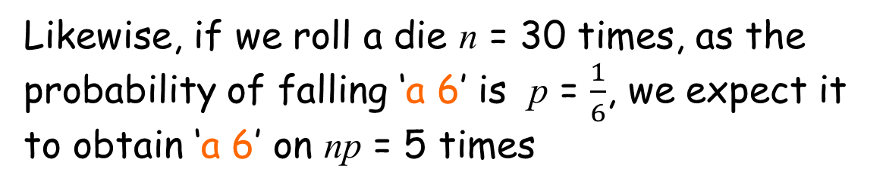
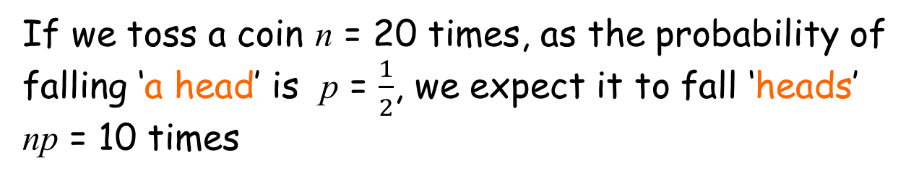
Expectation
If we toss a coin n = 20 times, as the probability of falling ‘a head’ is p = $\frac{1}{2}$, we expect it to fall ‘heads’ np = 10 times
Likewise, if we roll a die n = 30 times, as the probability of falling ‘a 6’ is p = $\frac{1}{6}$, we expect it to obtain ‘a 6’ on np = 5 times

Slide 3
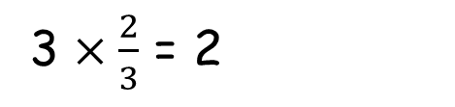

Expectation
If you have a biased coin where P(H) = $\frac{2}{3}$and you toss the coin three times, How many times you expect to get a head?
We calculate it
3 $×\frac{2}{3}$ = 2
Number of trials multiplied by the probability that happens
For the binomial distribution where X ~ B(n, p), the expectation of X, written E(X) = np = μ.

Slide 4
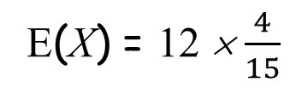
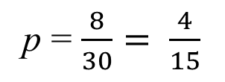
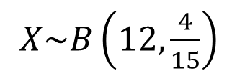
Expectation
A biased dice is thrown 30 times and the number of sixes seen is 8. The dice is thrown a further 12 times. Find the expected number of sixes for these 12 throws
X ~ B(n, p),
X ~ B(30, p),
p = $\frac{8}{30}= \frac{4}{15}$
$X\sim B\left(12,\frac{4}{15}\right)$
E(X) = np
E(X) = 12 × $\frac{4}{15}$
E(X) = 3.2

Slide 5
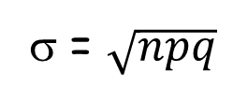
Variance and standard deviation
To find the standard deviation we can calculate the variance:
For the binomial distribution where X ~ B(n, p),
the variance of X, written Var(X) = npq where q = 1 - p
To calculate the standard deviation we only have to square root the variance
σ = $\sqrt{npq}$

Slide 6
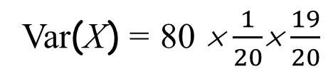
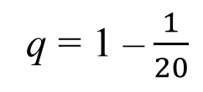
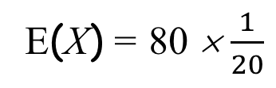
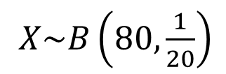
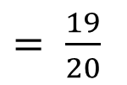
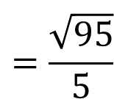
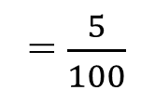
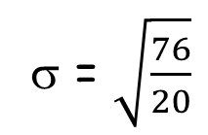
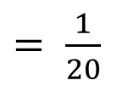
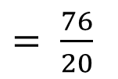
Variance and standard deviation
5% of a batch of batteries are defective. A random sample of 80 batteries is taken with replacement. Find the mean and standard deviation of the number of defectives in the sample.
X ~ B(n, p),
n = 80
$X\sim B\left(80,\frac{1}{20}\right)$
p = 5%
= $\frac{5}{100}$
$= \frac{1}{20}$
μ = E(X) = np
q = 1 –$\frac{1}{20}$
$= \frac{19}{20}$
E(X) = 80 × $\frac{1}{20}$
μ = 4
Var(X) = npq
Var(X) = 80 × $\frac{1}{20}$× $\frac{19}{20}$
$= \frac{76}{20}$
We expect a defective battery 4 times, with standard deviation 1.949
σ = $\sqrt{\frac{76}{20}}$
$$=\frac{\sqrt{95}}{5}$$
≈ 1.949

Slide 7

Thank you for using resources from
For more resources visit our website
https://www.mathssupport.org
If you have a special request, drop us an email
info@mathssupport.org

