Slide 1
The multiplication law of probability and independent events
LO: To use the multiplication law of probability.

Slide 2
The multiplication law of probability
Now we look more closely at compound events involving two events.
Two events are independent if the occurrence of each event does not affect the occurrence of the other.
For example:
Tossing a coin and rolling a die simultaneously.
1
=
P(A)
Event A: “Getting a head”.
P(a head)
=
2
1
=
P(B)
=
Event B: “Rolling a 3”.
P(a 3)
6
The two events are independent since the outcome of the coin toss has no effect on the outcome from the dice roll.
P(a head and a 3)
=
×
P(a 3)
P(a head)
1
1
1
P(A ∩ B)
=
×
=
2
6
12
If two events A and B are independent then
P(A)
P(A ∩ B)
=
×
P(B)
Remember A ∩ B means A and B

Slide 3
The multiplication law of probability
A coin is tossed and a square spinner labelled A, B, C, and D is spun simultaneously. Determine the probability of getting a tail and a C..
The two events are independent since the outcome of the coin toss does not affect the outcome from the spinner and vice versa.
1
=
P(A)
Event A: “Getting a head”.
P(a head)
=
2
1
=
P(B)
=
Event B: “Getting a C”.
P(a 3)
4
P(a head and a C)
=
×
P(a C)
P(a head)
1
1
1
P(A ∩ B)
=
×
=
2
4
8

Slide 4
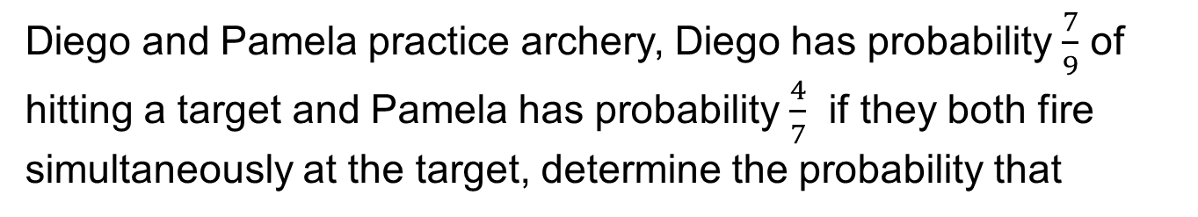
The multiplication law of probability
Diego and Pamela practice archery, Diego has probability $\frac{7}{9}$ of hitting a target and Pamela has probability $\frac{4}{7}$ if they both fire simultaneously at the target, determine the probability that
(a) They both hit.
(b) They both miss.
P(A)
7
2
Event A: “Diego hits”.
=
P(A’)
=
9
9
4
3
P(B)
Event B: “Pamela hits”.
=
P(B’)
=
7
7
×
P(B)
P(both hit)
P(A ∩ B)
=
P(A)
=
7
×
4
4
=
=
9
7
9
×
P(B’)
P(both miss)
=
P(A’)
=
P(A’ ∩ B’)
2
×
3
2
=
=
9
7
21

Slide 5
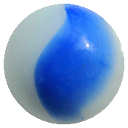
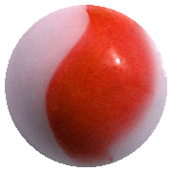
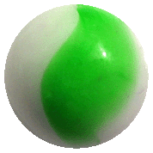








The multiplication law of probability
A marble is selected at random from each of these bags
(a) Draw a tree diagram to display the possible outcomes.
(b) Find the probability of obtaining a blue marble and a red marble.
Bag A
Bag B
Let
B represent a Blue marble
The events B and R are independent then
R represent a Red marble
G represent a Green marble
P(B)
P(B ∩ R)
=
×
P(R)
Bag A
Bag B
P(blue and a red marble)
$$\frac{4}{7}$$
B
3
×
2
6
$$\frac{2}{7}$$
✓
=
B
R
5
7
35
If two or more branches satisfy the event, the probabilities are added
$$\frac{3}{5}$$
$$\frac{1}{7}$$
G
2
4
8
✓
×
=
$$\frac{4}{7}$$
B
5
7
35
$$\frac{2}{5}$$
R
$$\frac{2}{7}$$
R
8
14
6
+
=
$$\frac{1}{7}$$
35
35
35
G

Slide 6

Thank you for using resources from
For more resources visit our website
https://www.mathssupport.org
If you have a special request, drop us an email
info@mathssupport.org
Get 20% off in your next purchase from our website, just use this code when checkout: MSUPPORT_20

