Slide 1
Variance and
Standard deviation
30 July 2023
LO: To understand and calculate Variance and standard deviation.

Slide 2


Variance.
The range and interquartile range are good measures of spread, but they are calculated from only two data values.
We need to consider alternative measures of spread or dispersion which take into account all data values of a data set.
The variance combines all the values in a data set to produce a measure of spread
The variance is the arithmetic mean of the squared differences between each value and the mean value.
The population variance of a data set {x₁, x₂, x₃, … x_{n}} is
$$\sum_{i=1}^{k}{{\left(x_{i}−μ\right)}^{2}}$$
, where
μ is the population mean.
$$σ^{2}=\frac{ }{n}$$
n is the number of data values.

Slide 3
Variance.
Squaring the difference between each value and the mean value has at least three advantages:
squaring makes each term positive so that values above the mean do not cancel values below the mean
squaring adds more weighting to the larger differences.
The mathematics is relatively manageable when using this measure in subsequent statistical calculations.

Slide 4

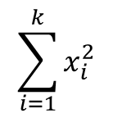

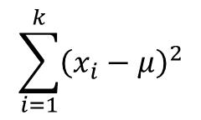
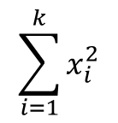
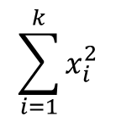

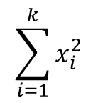
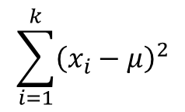



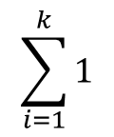

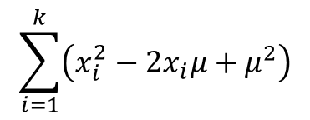




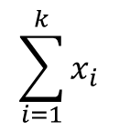


Variance.
We can do some algebraic manipulation to deduce a simplified form of this formula
$$\sum_{i=1}^{k}{{\left(x_{i}−μ\right)}^{2}}$$
$$\sum_{i=1}^{k}{\left(x_{i}^{2}−2x_{i}μ+μ^{2}\right)}$$
Expanding the square of the difference
$$σ^{2}=\frac{ }{n}$$
$=\frac{ }{n}$
$$\sum_{i=1}^{k}{x_{i}^{2}}$$
$$\sum_{i=1}^{k}{x_{i}}$$
$$\sum_{i=1}^{k}{1}$$
Using distributive properties.
$=\frac{ }{n}$
$−2μ\frac{ }{n}$
$+μ^{2}\frac{ }{n}$
$$\sum_{i=1}^{k}{x_{i}^{2}}$$
Using the definition of mean and simplifying the third sum
$=\frac{ }{n}$
$$−2μ\left(μ\right)$$
$+μ^{2}\frac{ n }{n}$
$$\sum_{i=1}^{k}{x_{i}^{2}}$$
$$−2μ^{2}$$
$$+μ^{2}$$
$=\frac{ }{n}$
$$\sum_{i=1}^{k}{x_{i}^{2}}$$
$$\sum_{i=1}^{k}{{\left(x_{i}−μ\right)}^{2}}$$
or
$$−μ^{2}$$
$$σ^{2}=\frac{ }{n}$$
$σ^{2}=\frac{ }{n}$

Slide 5









Variance.
The formula of the variance of a simple data set is
$$\sum_{i=1}^{k}{x_{i}^{2}}$$
$$\sum_{i=1}^{k}{{\left(x_{i}−μ\right)}^{2}}$$
or
$σ^{2}=\frac{ }{n}$
$$−μ^{2}$$
$$σ^{2}=\frac{ }{n}$$
The standard deviation is the square root of the variance
The formula of the standard deviation of a simple data set is
$$\sqrt{\begin{aligned}\sum_{i=1}^{k}{x_{i}^{2}} \\ \frac{ }{n}−μ^{2}\end{aligned}}$$
$$\sqrt{\begin{aligned}\sum_{i=1}^{k}{{\left(x_{i}−μ\right)}^{2}} \\ \frac{ }{n}\end{aligned}}$$
$$σ=$$
or
$$σ=$$

Slide 6









Standard Deviation.
The formula of the variance of a grouped frequency data set is
$$\sum_{i=1}^{k}{{f_{i}x}_{i}^{2}}$$
$$\sum_{i=1}^{k}{{f_{i}\left(x_{i}−μ\right)}^{2}}$$
or
$σ^{2}=\frac{ }{n}$
$$−μ^{2}$$
$$σ^{2}=\frac{ }{n}$$
The Standard deviation (σ) is the square root of the variance
$$\sqrt{\begin{aligned}\sum_{i=1}^{k}{f_{i}x_{i}^{2}} \\ \frac{ }{n} −μ^{2}\end{aligned}}$$
$$\sqrt{\begin{aligned}\sum_{i=1}^{k}{f_{i}{\left(x_{i}−μ\right)}^{2}} \\ \frac{ }{n}\end{aligned}}$$
$$σ=$$
$$\text{or}$$
$$σ=$$
where
f_{i} is every individual frequency
x_{i} is every individual datum
μ is the mean.
n is the number of data values.

Slide 7
Standard Deviation.
The Standard deviation of a distribution is
a measure of spread
affected by the size of each data value
a commonly calculated and used statistic
The Standard deviation shows how much variation there is from the mean.
Although you will usually calculate the Standard deviation on the GDC we will see some examples to shows how to calculate the standard deviation step by step using the formula.

Slide 8
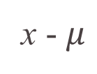


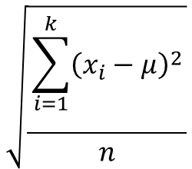
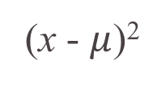
All of the exam marks from a group of students:
x 1 3 4 5 8 9
Calculate the variance and standard deviation
Using this formula
$$\sqrt{\begin{aligned}\sum_{i=1}^{k}{{\left(x_{i}−μ\right)}^{2}} \\ \frac{ }{n}\end{aligned}}$$
x - $μ$
(x - $μ$)²
$$σ=$$
Score (x)
1
3
4
5
8
9
1 – 5 =
–4
16
Step 1:
Calculate the mean
3 – 5 =
–2
4
$$μ$$
1 + 3 + 4 + 5 + 8 + 9
=
30
=
5
4 – 5 =
–1
1
=
6
6
5 – 5 =
0
0
Step 2: Find the difference from the mean
8 – 5 =
3
9
Step 3: Square these differences.
4
9 – 5 =
16
Step 4: add up the square of the differences.
46
Step 5: substitute into the formula for standard deviation.
$$\text{Standard} \text{deviation} = \sqrt{\text{7.67}}=2.77$$

Slide 9
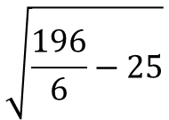

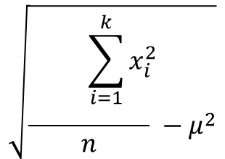



All of the exam marks from a group of students:
x 1 3 4 5 8 9
Calculate the variance and standard deviation
Using this formula
$$\sqrt{\begin{aligned}\sum_{i=1}^{k}{x_{i}^{2}} \\ \frac{ }{n} −μ^{2}\end{aligned}}$$
x²
Score (x)
1
3
4
5
8
9
$$σ=$$
1
Step 1:
Calculate the mean
9
$$μ$$
1 + 3 + 4 + 5 + 8 + 9
=
30
16
=
=
5
6
6
25
Step 2: Find the square of each x value
64
Step 3: add up this column.
$${μ }^{2}$$
25
81
=
Step 4: Square the mean.
Step 5: substitute into the formula for standard deviation.
196
$$\sqrt{\frac{196}{6}−25}$$
$$σ=$$

Slide 10
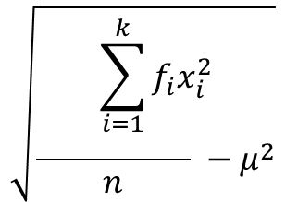



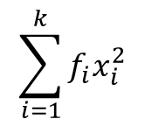











Example. Consider the following grouped frequency distribution
x | f
0 ≤ x < 100 | 8
100 ≤ x < 200 | 11
200 ≤ x < 400 | 24
400 ≤ x < 600 | 15
600 ≤ x < 1000 | 14
TOTAL
To calculate the mean, we need fx_{i}
MP (x_{i})
f x_{i}
x_{i} ²
f x_{i}²
50
400
2500
20 000
150
1650
22 500
247 500
300
7200
90 000
2 160 000
$$μ$$
=
27 950
500
7500
250 000
3 750 000
72
$$μ$$
=
388.2
800
11 200
640 000
8 960 000
72
27 950
15 137 500
$$μ2$$
=
150 694.9
If we have a population summarised in a grouped frequency distribution, then work out the mid points.
Using the formula for
Variance
Standard deviation
$$\sqrt{\begin{aligned}\sum_{i=1}^{k}{f_{i}x_{i}^{2}} \\ \frac{ }{n} −μ^{2}\end{aligned}}$$
$$\sum_{i=1}^{k}{{f_{i}x}_{i}^{2}}$$
$$σ^{2}=$$
$\frac{ }{n}$
$$−μ^{2}$$
$$σ=$$
$$σ^{2}=$$
$$\frac{15 137 500}{72}$$
$$−150 694.9$$
$$σ=$$
$$\sqrt{σ^{2}}$$
$$σ^{2}=$$
59 548.16
$$σ=$$
244.02

Slide 11
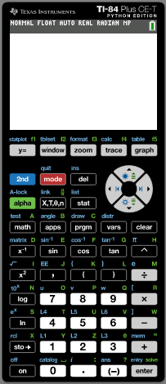
Example. Consider the following grouped frequency distribution
x | f
0 ≤ x < 100 | 8
100 ≤ x < 200 | 11
200 ≤ x < 400 | 24
400 ≤ x < 600 | 15
600 ≤ x < 1000 | 14
TOTAL
MP (x_{i})
Turn on the GDC
50
150
Click STAT
300
500
800
72
If we are going to use the GDC, then we have to work out the mid points.

Slide 12
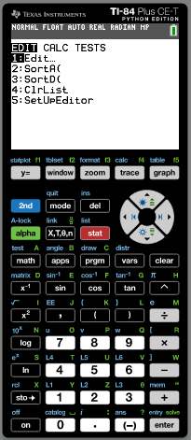
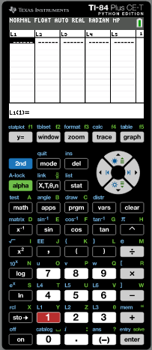
Example. Consider the following grouped frequency distribution
x | f
0 ≤ x < 100 | 8
100 ≤ x < 200 | 11
200 ≤ x < 400 | 24
400 ≤ x < 600 | 15
600 ≤ x < 1000 | 14
TOTAL
MP (x_{i})
Turn on the GDC
50
150
Click STAT
300
Click 1:
Edit
500
Type in the values of MP in list 1 and the values of frequency in list 2
800
72
If we are going to use the GDC, then we have to work out the mid points.

Slide 13
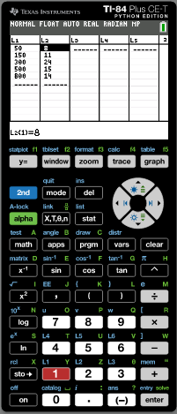
Example. Consider the following grouped frequency distribution
x | f
0 ≤ x < 100 | 8
100 ≤ x < 200 | 11
200 ≤ x < 400 | 24
400 ≤ x < 600 | 15
600 ≤ x < 1000 | 14
TOTAL
MP (x_{i})
Turn on the GDC
50
150
Click STAT
300
Click 1:
Edit
500
Type in the values of MP in list 1 and the values of frequency in list 2
800
72
If we are going to use the GDC, then we have to work out the mid points.
Click
STAT

Slide 14
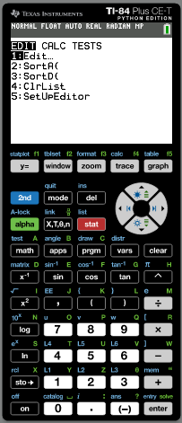
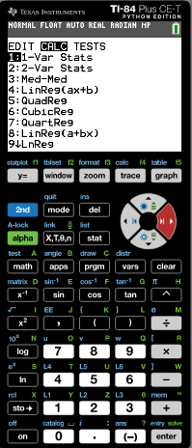
Example. Consider the following grouped frequency distribution
x | f
0 ≤ x < 100 | 8
100 ≤ x < 200 | 11
200 ≤ x < 400 | 24
400 ≤ x < 600 | 15
600 ≤ x < 1000 | 14
TOTAL
MP (x_{i})
Turn on the GDC
50
150
Click STAT
300
Click 1:
Edit
500
Type in the values of MP in list 1 and the values of frequency in list 2
800
72
If we are going to use the GDC, then we have to work out the mid points.
Click
STAT
Move right
CALC
Click 1
1:1Var-Stats

Slide 15
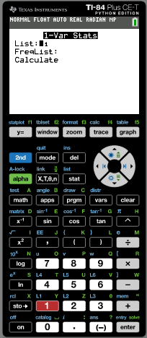
Example. Consider the following grouped frequency distribution
x | f
0 ≤ x < 100 | 8
100 ≤ x < 200 | 11
200 ≤ x < 400 | 24
400 ≤ x < 600 | 15
600 ≤ x < 1000 | 14
TOTAL
MP (x_{i})
Turn on the GDC
50
150
Click STAT
300
Click 1:
Edit
500
Type in the values of MP in list 1 and the values of frequency in list 2
800
72
If we are going to use the GDC, then we have to work out the mid points.
Click
STAT
Move right
CALC
Click 1
1:1Var-Stats
List:
L1
FreqList:
2nd
L2

Slide 16
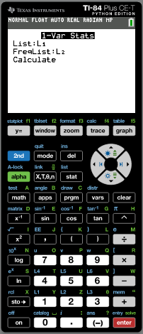
Example. Consider the following grouped frequency distribution
x | f
0 ≤ x < 100 | 8
100 ≤ x < 200 | 11
200 ≤ x < 400 | 24
400 ≤ x < 600 | 15
600 ≤ x < 1000 | 14
TOTAL
MP (x_{i})
Turn on the GDC
50
150
Click STAT
300
Click 1:
Edit
500
Type in the values of MP in list 1 and the values of frequency in list 2
800
72
If we are going to use the GDC, then we have to work out the mid points.
Click
STAT
Move right
CALC
Click 1
1:1Var-Stats
List:
L1
FreqList:
2nd
L2
Scroll down to calculate
enter

Slide 17
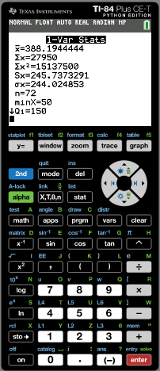

Example. Consider the following grouped frequency distribution
x | f
0 ≤ x < 100 | 8
100 ≤ x < 200 | 11
200 ≤ x < 400 | 24
400 ≤ x < 600 | 15
600 ≤ x < 1000 | 14
TOTAL
MP (x_{i})
Turn on the GDC
50
150
Click STAT
300
Click 1:
Edit
500
Type in the values of MP in list 1 and the values of frequency in list 2
800
72
If we are going to use the GDC, then we have to work out the mid points.
Click
STAT
Move right
CALC
Click 1
1:1Var-Stats
List:
L1
FreqList:
2nd
L2
Scroll down to calculate
enter
$$σx=$$
244.02

Slide 18

Thank you for using resources from
For more resources visit our website
https://www.mathssupport.org
If you have a special request, drop us an email
info@mathssupport.org

