Slide 1
Box and whisker plots
LO: To draw and interpret box and whisker diagrams

Slide 2
Box and whisker plots
A box and whisker diagram or simply box plot is a visual display of some of the descriptive statistics of a data set
It shows:
The minimum value
The lower quartile (Q₁)
These five numbers form the five-number summary of a data set
The median (Q₂)
The upper quartile (Q₃)
The maximum value
It is possible to get a sense of a data set’s distribution by examining a five-number summary.

Slide 3
A box-and-whisker diagram
A box-and-whisker diagram, or boxplot, can be used to illustrate the spread of the data in a given distribution.
Knowing the five-number summary we draw the boxplot
Median Q₂
Maximum value
Minimum value
Lower quartile Q₁
Upper quartile Q₃
Whisker
Whisker
A short line at the left hand side is the minimum value
A short line at the right hand side is the maximum value
The left end of the box is the lower quartile
The right side of the box is the upper quartile.
A vertical line in the interior of the box is the median
Lines from the minimum and maximum points to the box are the whiskers

Slide 4
A box-and-whisker diagram
A box-and-whisker diagram, or boxplot, can be used to illustrate the spread of the data in a given distribution.
Knowing the five-number summary we draw the boxplot
Range
Interquartile range
Q₁
Q₃
x_{Min}
x_{Max}
From the diagram we are able to find the range
We are also able to find the interquartile range

Slide 5
Box-and-whisker diagram
Example 1:
Draw a Box plot for the data below
Q₁
Q₂
Q₃
3, 4, 4, 6, 8, 8, 8, 9, 10, 10, 15
Lower Quartile = 4
Upper Quartile = 10
Maximum
Minimum
Median = 8
3
4
5
6
7
8
9
10
11
12
13
14
15

Slide 6
A box-and-whisker diagram
Example 2:
Draw a Box plot for the data below
Q₁
Q₂
Q₃
4, 4, 5, 6, 8, 8, 8, 9, 9, 9, 10, 12
Lower Quartile = 5½
Upper Quartile = 9
Median = 8
Maximum
Minimum
4
5
6
7
8
9
10
11
12

Slide 7
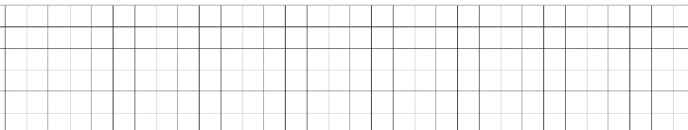
Box-and-whisker diagram
Example 3:
Draw a box and whisker for this sample:
First list the sample in order, to determine the median and the quartiles
1
5
7
9
11
15
22
Minimum
Upper quartile
Maximum
Lower quartile
Median
0
2
4
6
8
10
12
14
16
18
20
22
24

Slide 8

Box-and-whisker diagram
Example 4:
Given the information below, draw a box and whisker plot.
Minimum: 82
Lower Quartile: 94
Median: 95
Upper Quartiles: 102
Maximum: 110
80
90
100
110

Slide 9
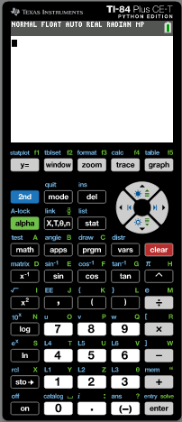
A box-and-whisker diagram
Example 5:
(a) Using the GDC, find the median and upper and lower quartiles for this data set.
37, 43, 43, 44, 44, 46, 46, 47, 47, 47, 47, 48, 51, 52, 53, 53, 54
Turn on the calculator
Click
stat

Slide 10
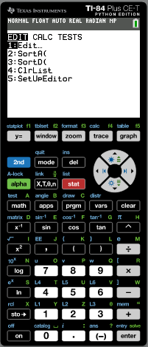
A box-and-whisker diagram
Example 5:
(a) Using the GDC, find the median and upper and lower quartiles for this data set.
37, 43, 43, 44, 44, 46, 46, 47, 47, 47, 47, 48, 51, 52, 53, 53, 54
Turn on the calculator
Click
stat
Click 1 Edit

Slide 11
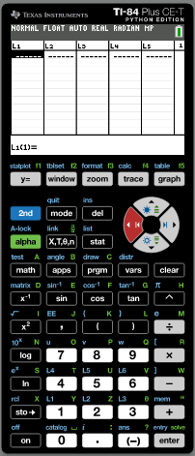
A box-and-whisker diagram
Example 5:
(a) Using the GDC, find the median and upper and lower quartiles for this data set.
37, 43, 43, 44, 44, 46, 46, 47, 47, 47, 47, 48, 51, 52, 53, 53, 54
Turn on the calculator
Click
stat
Click 1 Edit
In List 1 Type in the data

Slide 12
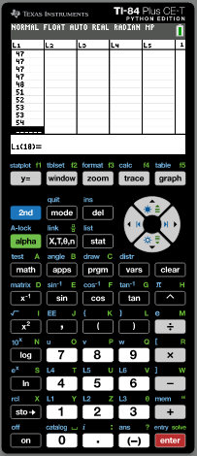
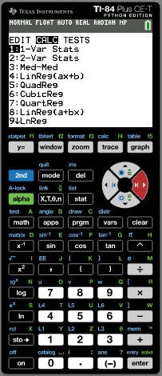
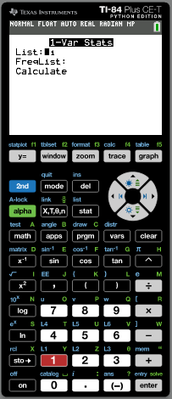
A box-and-whisker diagram
Example 5:
(a) Using the GDC, find the median and upper and lower quartiles for this data set.
37, 43, 43, 44, 44, 46, 46, 47, 47, 47, 47, 48, 51, 52, 53, 53, 54
Turn on the calculator
Click
stat
Click 1 Edit
In List 1 Type in the data
Click stat
Move the cursor right: Calc
Click 1: 1-Var stat
List: L1
Scroll down to Calculate
enter

Slide 13
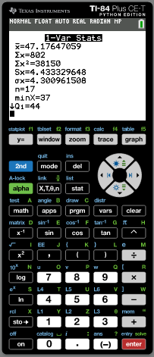
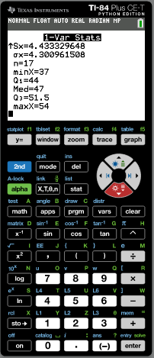
A box-and-whisker diagram
Example 5:
(a) Using the GDC, find the median and upper and lower quartiles for this data set.
37, 43, 43, 44, 44, 46, 46, 47, 47, 47, 47, 48, 51, 52, 53, 53, 54
Turn on the calculator
Click
stat
Click 1 Edit
In List 1 Type in the data
Click stat
Move the cursor right: Calc
Click 1: 1-Var stat
List: L1
Scroll down to Calculate
enter
Scroll down
We got them
Median
47
Q1
44
Q3
51.5

Slide 14
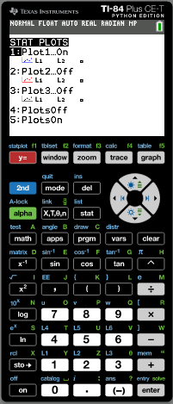
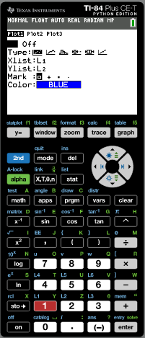
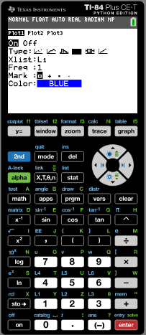
A box-and-whisker diagram
Example 5:
(a) Using the GDC, find the median and upper and lower quartiles for this data set.
(b) Show this data on a box plot.
37, 43, 43, 44, 44, 46, 46, 47, 47, 47, 47, 48, 51, 52, 53, 53, 54
37, 43, 43, 44, 44, 46, 46, 47, 47, 47, 47, 48, 51, 52, 53, 53, 54
2nd
StatPlot
Median
47
Press 1
Q1
44
Scroll down to Type
Q3
51.5
select
enter
Min x
37
Press zoom
Max x
54

Slide 15
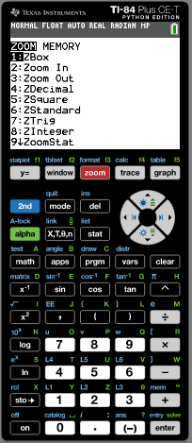
A box-and-whisker diagram
Example 5:
(a) Using the GDC, find the median and upper and lower quartiles for this data set.
(b) Show this data on a box plot.
37, 43, 43, 44, 44, 46, 46, 47, 47, 47, 47, 48, 51, 52, 53, 53, 54
37, 43, 43, 44, 44, 46, 46, 47, 47, 47, 47, 48, 51, 52, 53, 53, 54
2nd
StatPlot
Median
47
Press 1
Q1
44
Scroll down to Type
Q3
51.5
select
enter
Min x
37
Press zoom
Max x
54
Press 9↓ZoomStat

Slide 16
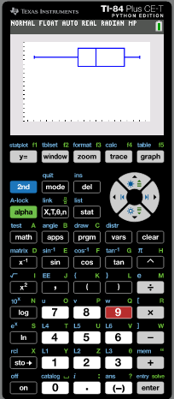
A box-and-whisker diagram
Example 5:
(a) Using the GDC, find the median and upper and lower quartiles for this data set.
(b) Show this data on a box plot.
37, 43, 43, 44, 44, 46, 46, 47, 47, 47, 47, 48, 51, 52, 53, 53, 54
37, 43, 43, 44, 44, 46, 46, 47, 47, 47, 47, 48, 51, 52, 53, 53, 54
2nd
StatPlot
Median
47
Press 1
Q1
44
Scroll down to Type
Q3
51.5
select
enter
Min x
37
Press zoom
Max x
54
Press 9↓ZoomStat
Sketch the diagram on your book

Slide 17
A box-and-whisker diagram
Example 5:
(a) Using the GDC, find the median and upper and lower quartiles for this data set.
(b) Show this data on a box plot.
37, 43, 43, 44, 44, 46, 46, 47, 47, 47, 47, 48, 51, 52, 53, 53, 54
37, 43, 43, 44, 44, 46, 46, 47, 47, 47, 47, 48, 51, 52, 53, 53, 54
Median
47
Q1
44
Q3
51.5
Min x
37
Max x
54
36
38
40
42
44
46
48
50
52
54
56

Slide 18
Parallel Box and whisker diagrams
A parallel box and whisker diagram or parallel box plot enables us to make a visual comparison of the distributions of two data sets
We can easily compare descriptive statistic such as
Their median
The range
The interquartile range

Slide 19
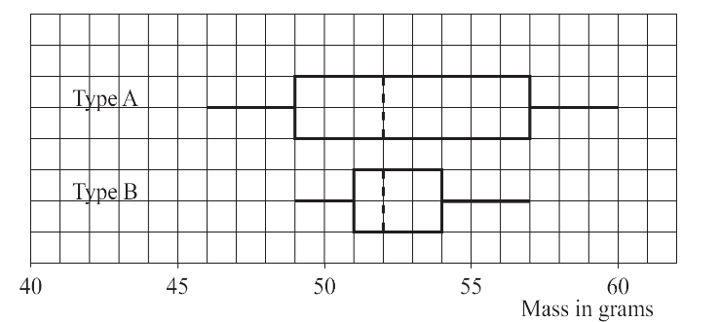
Parallel Box and whisker diagrams
Example 6:
A gardener collected data on two types of tomato. The parallel box and whisker plot below shows data for the masses in grams of the tomatoes in the two samples.
Compare and contrast the two types and advise the gardener which type of tomato he should grow in future.

Slide 20
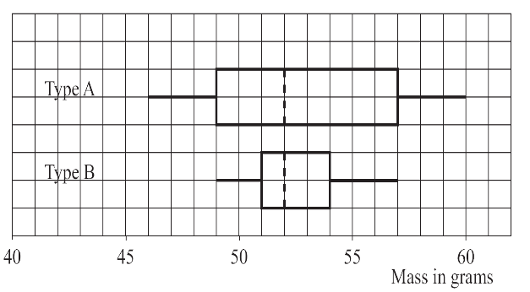
Parallel Box and whisker diagrams
Example 6:
 | Type A | Type B
Median
Lower Quartile
Upper Quartile
Interquartile range
Range
52 grams
52 grams
49 grams
51 grams
57 grams
54 grams
8 grams
3 grams
14 grams
8 grams

Slide 21
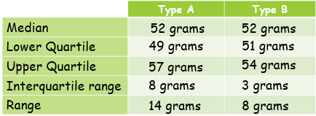
Parallel Box and whisker diagrams
Example 6:
From this table we can see that both types of tomato have the same average mass because their medians are the same.
Comparing the medians and interquartile ranges shows that there is far more variation in the masses of the type A tomatoes, which means that the masses of type B are more consistent than those of type A.
However, comparing the upper quartiles, shows that type A tomatoes will generally have a larger mass than those of type B.
Nevertheless, there will be some type A tomatoes that are lighter than any of type B.
Taking all this together, the gardener would be best advised to plant type A tomatoes in future as he is likely to get a better yield from them than from type B.

Slide 22
Outliers
Outliers are extraordinary data that are separated from the main body of the data.
However, we have so far identified outliers rather informally by looking at the data directly, or at a column graph of the data
A commonly used test to identify outliers involves the calculation of upper and lower boundaries:
Upper boundary = upper quartile + 1.5 × IQR
Any data larger than the upper boundary is an outlier.
Lower boundary = lower quartile – 1.5 × IQR
Any data smaller than the lower boundary is an outlier.
Outliers are marked with an asterisk on a box plot.
It is possible to have more than one outlier at either end

Slide 23
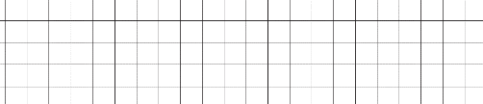
Outliers
Example 7:
Test the following data for outliers. Construct a box and whisker for this data
1
3
3
5
7
7
8
8
8
8
9
9
10
10
12
13
14
18
Min = 1
Q1 = 7
Median = 8
Q3 = 10
Max = 18
IQR =
Q₃
–
Q₁
=
10
–
= 3
7
Test for outliers:
Upper boundary
Lower boundary
= upper quartile + 1.5 × IQR
= lower quartile – 1.5 × IQR
=
+ 1.5 ×
3
=
14.5
– 1.5 ×
=
10
=
7
3
2.5
18 is above the upper boundary, so it is an outlier.
1 is below the lower boundary, so it is an outlier.
Each whisker is drawn to the last value that is not an outlier
*
*
0
2
4
6
8
10
12
14
16
18
20

Slide 24

Thank you for using resources from
For more resources visit our website
https://www.mathssupport.org
If you have a special request, drop us an email
info@mathssupport.org

