Slide 1
Sampling techniques
LO: To understand different methods of sampling and error that could occur.

Slide 2
Reliability of data
Data is reliable if you can repeat the data collection process and obtain similar results.
Data is sufficient if there is enough data available to support your conclusions.
When doing practical work students often ask: How many data items should I have?
There is not a fixed value, but you need to ensure that you collect enough data so that your results are reliable and are representative: they represent the whole population well.

Slide 3
Methods of collecting data
Taking a census
If every member of a population is observed or measured this is called taking a census.
For example, if you want to find the mean height of students of IB in your school, you could measure each student. You would be then taking a census.
A census is used if:
The size of the population is small
Extreme accuracy is required.

Slide 4
Methods of collecting data
The advantage of using a census
It should give a completely accurate resuly.
The disadvantages of using a census
It is very time-consuming and expensive
It cannot be used when the testing process is to destruction (for example testing a strawberry for sweetness).
The information is difficult to process because there is so much of it.

Slide 5
Methods of collecting data
Sampling
If the population is very large it will be impractical to collect data from every single element of it. It will be practical to take a sample.
For example, if you want to find the mean height of students of secondary in your school, you could select a sample.
The size of the sample does not depend on the size of the population
It depends on the accuracy you require and the resources you are willing to allocate to data collection.
A large sample will usually be more accurate than a small one.
The number of items sampled may also be affected by the nature of the population: if the population is very variable you will require a larger sample size than you would if the population were more uniform.

Slide 6
Sampling techniques:
There are a number of ways in which you can draw a sample from the population.
You should always try to choose a method which results in the sample giving the best approximation for the population as a whole.
A sampling BIAS occurs when you take a sample from a population and some members of the population are not as likely to be chosen as others.
When a sampling BIAS occurs, the sample might not give an accurate representation of the population, and there can be inappropriate conclusions drawn about the population.

Slide 7
Sampling techniques:
Convenience sampling.
This is the easiest method by which you can generate a sample. You select those members of the population who are the most easily accessible or readily available
Example.
You want to find the mean length of time spent doing homework, How to conduct a convenience sample?
You might survey those students who are in the same class as you.
The advantage of using Convenience sampling
Is easy to generate a sample.
The disadvantages of using Convenience sampling
Is not always reliable.

Slide 8
Sampling techniques:
Simple random sampling.
Each member of the population has an equal chance of being selected. A sample is chosen by drawing names from a hat or assigning numbers to the population and using a random number generator.
Example.
You want to find the mean length of time spent doing homework. How to conduct a simple random sample?
Suppose 5 students are to be sampled from a class of 50 students.
You might put the names of every student into a hat and draw out the names of 5 students to form a sample.
Each student has the same chance $\left(\frac{1}{10}\right)$ of being selected.
Each set of 5 students is just as likely to be selected as any other.

Slide 9
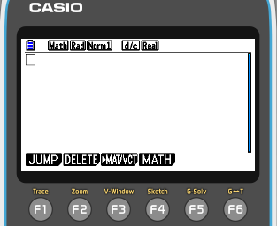
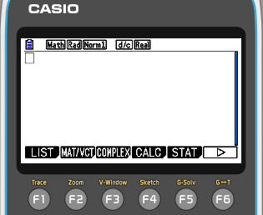
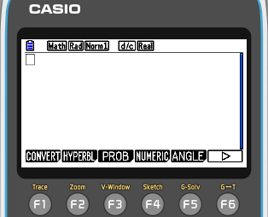
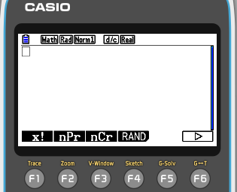
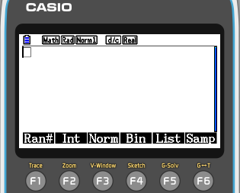
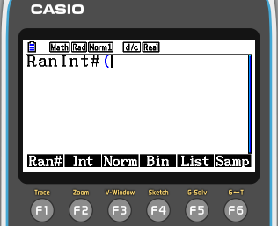
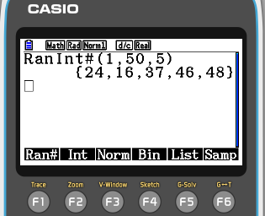
Sampling techniques:
Simple random sampling.
Instead of drawing names from the hat, it is more practical to number the member of the population and use a random number generator to select the sample.
You can use your calculator to generate random numbers.
We are going to select 5 random numbers from 1 through 50.
Turn on the GDC
MENU
1
Press
OPTN
F6
⬥
F3
PROB
F4
RAND
F2
Int
Now press 1, 50, 5)
EXE
In this case, the 24th, 16th, 37th, 46th and 48th student would be selected.

Slide 10
Sampling techniques:
Simple random sampling.
The advantage of using Simple random sampling
The numbers are truly random and free from bias
It is easy to use
The numbers are truly random and free from bias
The disadvantage of using Simple random sampling
Is not suitable where the sample size is large.

Slide 11
Sampling techniques:
Systematic sampling.
Here, you list the members of the population and select a sample according to a random starting point and a fixed interval.
Example.
You want to find the mean length of time spent doing homework, How to conduct a systematic sample?
You want to create a systematic sample of 10 Year 12 students at a school with 100 in Year 12, you would choose every tenth person from a list of all students. Then you choose a starting number from 1 to 10 (for example 4). So you would select the student with number 4, 14, 24, 34 and so on.
You can use your calculator to generate the random starting number.

Slide 12
Sampling techniques:
Systematic sampling.
Systematic sampling is used when:
When the population is too large for simple random sampling.
The advantage of using Systematic sampling.
It is simple to use
It is suitable for large samples
The disadvantage of using Systematic sampling.
It is only random if the ordered list is truly random.

Slide 13
Sampling techniques:
Stratified sampling.
This involves dividing the population into smaller groups known as strata.
The strata are formed based on members' shared characteristic.
You then choose a random sample from each stratum and put them together to form your sample.
Example.
In the secondary school of 700 students, you want to find the mean length of time spent doing homework, How to conduct a stratified sample?
You could choose 35 students from all 7 year-groups to form a sample where each subgroup is represented fairly in the sample.

Slide 14
Sampling techniques:
Stratified sampling.
This is the distribution of the 700 students in the secondary school: 135 students in Year 7, 125 students in Year 8, 105 students in Year 9, 100 students in Year 10, 90 students in Year 11, 85 students in Year 12, 60 students in Year 13,
How many should be randomly selected from each Year group for the sample we want?
Year 7 = $\frac{135}{700}×35≈7$
Year 12 = $\frac{85}{700}×35≈4$
Year 8 = $\frac{125}{700}×35≈6$
Year 13 = $\frac{60}{700}×35=3$
Year 9 = $\frac{105}{700}×35≈5$
Year 10 = $\frac{100}{700}×35≈5$
Year 11 = $\frac{90}{700}×35≈5$

Slide 15
Sampling techniques:
Stratified sampling.
Stratified sampling is used when:
The sample is large
The population divides naturally into mutually exclusive groups
The advantage of using Stratified sampling.
It can give more accurate estimates than simple random sampling where there are clear strata present
It gives separate estimates for the strata.
The disadvantage of using Stratified sampling.
Within the strata, the problems are the same as for any simple random sample
If the strata are not clearly defined, they may overlap.

Slide 16
Sampling techniques:
Quota sampling.
This is like stratified sampling, but involves taking a sample size from each stratum, which is in proportion to the size of the stratum.
Example.
You want to find the mean length of time spent doing homework, How to conduct a quota sample?
In the high school of 1000 students where 60% of the students are female and 40% are male, your sample should also be 60% female and 40% male.

Slide 17
Errors in sampling
There are four main categories of error:
Sampling error.
Measurement error.
Coverage error.
Non-response error.

Slide 18
Errors in sampling
Sampling error.
This error occurs when a characteristic of a sample differs from that of the whole population. This error is random, and will occur even for samples which are well chosen to avoid bias
Measurement error.
Refer to inaccuracies in measurements at the data collection stage.
For example: when we record a person’s height to the nearest centimetre, the recorded height is slightly different from the person’s exact height.

Slide 19
Errors in sampling
Coverage error.
This error occurs when a sample does not truly reflect the population we are trying to find information about.
To avoid coverage errors, samples should be sufficiently large and unbiased.
Non-response error.
This errors occur when a large number of people selected for a survey choose not to respond to it

Slide 20
Thank you for using resources from
For more resources visit our website
https://www.mathssupport.org
If you have a special request, drop us an email
info@mathssupport.org

