Slide 1
Geometric sequences
Lesson objective: Find the terms of a geometric sequence.
Find the nth term of a geometric sequence

Slide 2
Geometric sequences
In a geometric sequence (or geometric progression) each term is produced by multiplying the previous term by a non-zero constant value.
For example, the sequence
3, 6, 12, 24, 48, 96, …
is a geometric sequence that starts with 3 and each term can be obtained by multiplying the previous term by 2.
6
12
24
48
96
Notice that:
=
=
=
=
=
2
=
r
3
6
12
24
48
r is a constant called the common ratio
We could write this sequence as
3,
3 × 2,
3 × 2 × 2,
3 × 2 × 2 × 2,
3 × 2 × 2 × 2 × 2, …
or
3,
3 × 2,
3 × 2²,
3 × 2³,
3 × 2⁴,
3 × 2⁵, …

Slide 3


Geometric sequences
It is called geometric sequence because if we take any three consecutive terms, the middle term is the geometric mean of the terms on either side.
If the terms are:
a,
b,
c,
d,
we take any three consecutive terms
b
c
The common ratio is
=
a
b
b²
=
a
c
$$±\sqrt{}$$
b
=
a
c
Where
a
c
is the geometric mean.

Slide 4
Geometric sequences
If we call the first term of a geometric sequence u₁ and the common ratio r we can write a general geometric sequence as:
Term number
1
2
3
4
5
6
…
n
u₁,
u₁ r,
u₁ r²,
u₁ r³,
u₁ r⁴,
u₁ r⁵, …
u₁ r ^{n -1}
The n^{th} term of a geometric sequence with first term u₁ and common ratio r is:
u_{n} = u₁ r^{n–1}

Slide 5
Geometric sequences
Consider the geometric sequence 8, 12, 18, 27, …
a) Show that the sequence is geometric
12
3
18
3
27
3
=
=
=
8
2
12
2
18
2
Assuming the pattern continues, consecutive terms have a common ratio of ∴ the sequence is geometric with u₁ = 8 and r =
3
3
2
2
b) Find the general term u_{n} .
u_{n} = u₁ r^{n–1}
3
( )
^{n–1}
u_{n} = 8
2
u₈ = 8( )
c) Find the 8th term.
3
^{8–1}
2
u₈ = 136.6875

Slide 6
Geometric sequences
The 3rd term in a geometric sequence is 36 and the 6th term is 972. What is the value of the 1st term and the common ratio?
u₃ =
Using the 3rd term:
u₁r² = 36
Using the 6th term:
u₆ =
u₁r⁵ = 972
u₁r⁵
972
Dividing these gives:
=
u₁r²
36
So:
r³ = 27
r = 3
Substituting this into u₁r² = 36 gives:
u₁ × 3² = 36
9u₁ = 36
u₁ = 4
So the first term of the sequence is 4 and the common ratio is 3.
The general term of this sequence is u_{n} = 4 × (3)^{n–1}.

Slide 7
Geometric sequences
The 4th term in a geometric sequence is 24 and the 7th term is 192. What is the value of the 1st term and the common ratio?
u₄ =
Using the 4th term:
u₁r³ = 24
Using the 7th term:
u₇ =
u₁r⁶ = 192
u₁r⁶
192
Dividing these gives:
=
u₁r³
24
So:
r³ = 8
r = 2
Substituting this into u₁r³ = 24 gives:
u₁ × 2³ = 24
8u₁ = 24
u₁ = 3
So the first term of the sequence is 3 and the common ratio is 2.
The general term of this sequence is u_{n} = 3 × (2)^{n–1}.

Slide 8
Geometric sequences
k – 1, 2k, and 21 – k are consecutive terms of a geometric sequence. Find k
2k
21 - k
Since the terms are geometric,
=
common ratio
k - 1
2k
∴ 4k² = (21 – k)(k – 1)
∴ 4k² = 21k – 21 – k² + k
∴ 5k² – 22k + 21 = 0
Using the GDC:
k =
7
or
k = 3
5

Slide 9
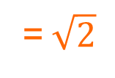




Geometric sequences
Find the first term of the sequence 6, $6\sqrt{2}$, 12, $12\sqrt{2}$, …. which exceeds 1400.
u₁ =
Using the 1st term:
6
Is this a geometric sequence?
r should be the same
Dividing any term by its previous must be equal.
$$6\sqrt{2}$$
$$12$$
r
=
=
=$\sqrt{2}$
6
$$6\sqrt{2}$$
The general term of this sequence is u_{n} = 6 × ($\sqrt{2}$)^{n–1}.
We need to find n such that u_{n} > 1400

Slide 10
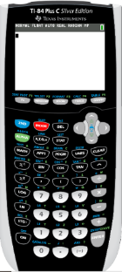
Using a GDC
Find the first term of the sequence 6, $6\sqrt{2}$, 12, $12\sqrt{2}$, …. which exceeds 1400.
We are going to use Graphing display calculator to solve the problem
Click on the calculator you are using
Texas Instruments

Slide 11
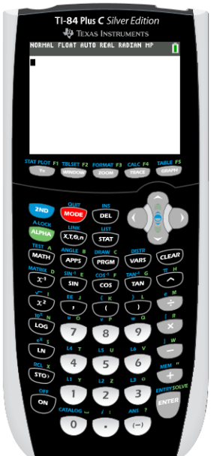
Using the GDC: TI-84 Plus
We need to find n such that u_{n} > 1400
Turn on the calculator
Press Y =

Slide 12
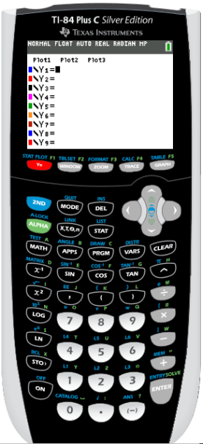

Using the GDC: TI-84 Plus
We need to find n such that u_{n} > 1400
Turn on the calculator
Press Y =
Type in Y1 = 6 × ($\sqrt{2}$) ^ X – 1
ENTER

Slide 13
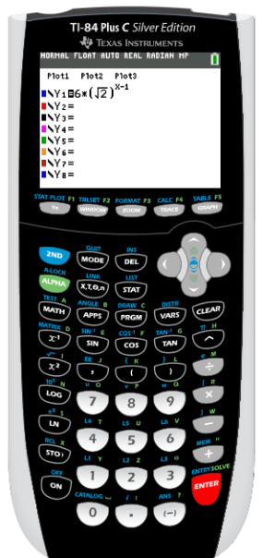
Using the GDC: TI-84 Plus
We need to find n such that u_{n} > 1400
Turn on the calculator
Press Y =
Type in Y1 = 6 × ($\sqrt{2}$) ^ X – 1
ENTER
Press 2nd
WINDOW

Slide 14
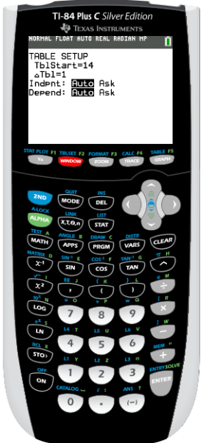
Using the GDC: TI-84 Plus
We need to find n such that u_{n} > 1400
Turn on the calculator
Press Y =
Type in Y1 = 6 × ($\sqrt{2}$) ^ X – 1
ENTER
Press 2nd
WINDOW
State the number you want to start with
I want to start in 1. EXE
The ΔTbl is the change in the table,
I set 1
We have two options for the independent and dependent variable: Auto and Ask
I leave both in Auto
Press 2nd
GRAPH

Slide 15
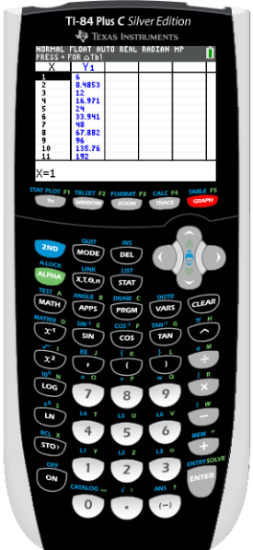
Using the GDC: TI-84 Plus
We need to find n such that u_{n} > 1400
Turn on the calculator
Press Y =
Type in Y1 = 6 × ($\sqrt{2}$) ^ X – 1
ENTER
Press 2nd
WINDOW
State the number you want to start with
I want to start in 1. EXE
The ΔTbl is the change in the table,
I set 1
We have two options for the independent and dependent variable: Auto and Ask
I leave both in Auto
Press 2nd
GRAPH
Scroll down until you find the first term greater than 1400

Slide 16
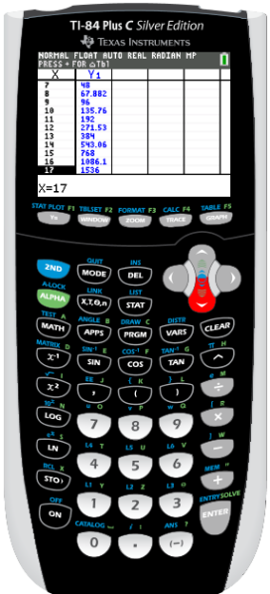
Using the GDC: TI-84 Plus
We need to find n such that u_{n} > 1400
Turn on the calculator
Press Y =
Type in Y1 = 6 × ($\sqrt{2}$) ^ X – 1
ENTER
Press 2nd
WINDOW
State the number you want to start with
I want to start in 1. EXE
The ΔTbl is the change in the table,
I set 1
We have two options for the independent and dependent variable: Auto and Ask
I leave both in Auto
Press 2nd
GRAPH
Scroll down until you find the first term greater than 1400
The first term to exceed 1400 is
u₁₇ =
1536

Slide 17

Thank you for using resources from
For more resources visit our website
https://www.mathssupport.org
If you have a special request, drop us an email
info@mathssupport.org

