Slide 1
Real-life context
LO: Use sine and cosine modelling in real-life context.

Slide 2
Modelling with sine and cosine functions
Many real-life situations can be modelled using sine and cosine functions.
To create a cosine function model for data you need to know:
a
The amplitude of function.
b
The period
c
The horizontal translation
d
The vertical translation
a
( ( – c))
+ d
f (x) =
cos b x
The sine function has the same amplitude, period, and vertical translation but its horizontal translation is one-fourth of the period of the cosine curve.

Slide 3
Modelling with sine and cosine functions
Example 1:
Create a model for this data, which shows the mean monthly maximum temperature (°C) for a city in Italy.
Month | Jan | Feb | Mar | Apr | May | Jun | Jul | Aug | Sep | Oct | Nov | Dec
Temp | 15 | 14 | 15 | 18 | 21 | 25 | 27 | 26 | 24 | 20 | 18 | 16
1
2
3
4
5
6
7
8
9
10
11
12
We will attempt to model this data to
y = a sin (b(x – c)) + d
Where y is temperature (T) and x is the month number (n)
T = a sin (b(n – c)) + d
To calculate a
We need a maximum
And a minimum
$$a=\frac{\max{−\text{min}}}{2}$$
a = 6.5
$$a=\frac{27{−14}}{2}$$

Slide 4
Modelling with sine and cosine functions
Example 1:
Create a model for this data, which shows the mean monthly maximum temperature (°C) for a city in Italy.
Month | Jan | Feb | Mar | Apr | May | Jun | Jul | Aug | Sep | Oct | Nov | Dec
Temp | 15 | 14 | 15 | 18 | 21 | 25 | 27 | 26 | 24 | 20 | 18 | 16
1
2
3
4
5
6
7
8
9
10
11
12
We will attempt to model this data to
y = a sin (b(x – c) + d
Where y is temperature (T) and x is the month number (n)
T = a sin (b(n – c)) + d
a = 6.5
To calculate b
$$T=\frac{2π}{\left|b\right|}$$
We know that the period
b = $\frac{π}{6}$
The period is 12 months
$$b=\frac{2π}{12}$$

Slide 5
Modelling with sine and cosine functions
Example 1:
Create a model for this data, which shows the mean monthly maximum temperature (°C) for a city in Italy.
Month | Jan | Feb | Mar | Apr | May | Jun | Jul | Aug | Sep | Oct | Nov | Dec
Temp | 15 | 14 | 15 | 18 | 21 | 25 | 27 | 26 | 24 | 20 | 18 | 16
1
2
3
4
5
6
7
8
9
10
11
12
We will attempt to model this data to
y = a sin (b(x – c) + d
Where y is temperature (T) and x is the month number (n)
T = a sin (b(n – c)) + d
a = 6.5
To calculate c we need
b = $\frac{π}{6}$
The x value that is halfway between a minimum and the following maximum.
$$c=\frac{2{+7}}{2}$$
The first minimum is in February (x = 2)
The following maximum is in July (x = 7)
$$c=4.5$$

Slide 6
Modelling with sine and cosine functions
Example 1:
Create a model for this data, which shows the mean monthly maximum temperature (°C) for a city in Italy.
Month | Jan | Feb | Mar | Apr | May | Jun | Jul | Aug | Sep | Oct | Nov | Dec
Temp | 15 | 14 | 15 | 18 | 21 | 25 | 27 | 26 | 24 | 20 | 18 | 16
1
2
3
4
5
6
7
8
9
10
11
12
We will attempt to model this data to
y = a sin (b(x – c) + d
Where y is temperature (T) and x is the month number (n)
T = a sin (b(n – c)) + d
a = 6.5
To calculate d
b = $\frac{π}{6}$
The principal axis is the value of y that is halfway between a minimum and a maximum
$$c=4.5$$
$$d=\frac{27{+14}}{2}$$
$$d=20.5$$

Slide 7
Modelling with sine and cosine functions
Example 1:
Create a model for this data, which shows the mean monthly maximum temperature (°C) for a city in Italy.
Month | Jan | Feb | Mar | Apr | May | Jun | Jul | Aug | Sep | Oct | Nov | Dec
Temp | 15 | 14 | 15 | 18 | 21 | 25 | 27 | 26 | 24 | 20 | 18 | 16
1
2
3
4
5
6
7
8
9
10
11
12
We will attempt to model this data to
y = a sin (b(x – c) + d
Where y is temperature (T) and x is the month number (n)
T = a sin (b(n – c)) + d
a = 6.5
Substituting the values of a, b, c, and d
b = $\frac{π}{6}$
T = 6.5sin ($\frac{π}{6}$(n – 4.5)) + 20.5
$$c=4.5$$
or
$$d=20.5$$
T = 6.5sin (0.524n – 2.356) + 20.5

Slide 8
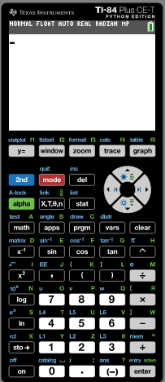
Modelling with sine and cosine functions
Example 1:
Create a model for this data, which shows the mean monthly maximum temperature (°C) for a city in Italy.
Month | Jan | Feb | Mar | Apr | May | Jun | Jul | Aug | Sep | Oct | Nov | Dec
Temp | 15 | 14 | 15 | 18 | 21 | 25 | 27 | 26 | 24 | 20 | 18 | 16
1
2
3
4
5
6
7
8
9
10
11
12
T = 6.5sin (0.524n – 2.356) + 20.5
We will use technology to check the answer
Turn on the calculator
Click Stat

Slide 9
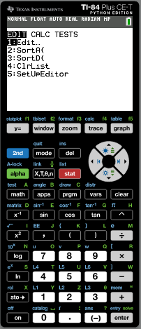
Modelling with sine and cosine functions
Example 1:
Create a model for this data, which shows the mean monthly maximum temperature (°C) for a city in Italy.
Month | Jan | Feb | Mar | Apr | May | Jun | Jul | Aug | Sep | Oct | Nov | Dec
Temp | 15 | 14 | 15 | 18 | 21 | 25 | 27 | 26 | 24 | 20 | 18 | 16
1
2
3
4
5
6
7
8
9
10
11
12
T = 6.5sin (0.524n – 2.356) + 20.5
We will use technology to check the answer
Click 1: Edit

Slide 10
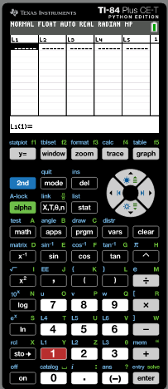
Modelling with sine and cosine functions
Example 1:
Create a model for this data, which shows the mean monthly maximum temperature (°C) for a city in Italy.
Month | Jan | Feb | Mar | Apr | May | Jun | Jul | Aug | Sep | Oct | Nov | Dec
Temp | 15 | 14 | 15 | 18 | 21 | 25 | 27 | 26 | 24 | 20 | 18 | 16
1
2
3
4
5
6
7
8
9
10
11
12
T = 6.5sin (0.524n – 2.356) + 20.5
We will use technology to check the answer
Type in the month values in the List 1
Type in the Temp values in the List 2

Slide 11
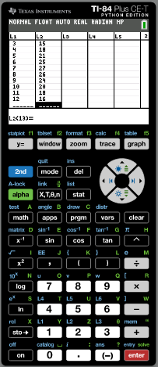
Modelling with sine and cosine functions
Example 1:
Create a model for this data, which shows the mean monthly maximum temperature (°C) for a city in Italy.
Month | Jan | Feb | Mar | Apr | May | Jun | Jul | Aug | Sep | Oct | Nov | Dec
Temp | 15 | 14 | 15 | 18 | 21 | 25 | 27 | 26 | 24 | 20 | 18 | 16
1
2
3
4
5
6
7
8
9
10
11
12
T = 6.5sin (0.524n – 2.356) + 20.5
We will use technology to check the answer
Click Stat

Slide 12
Modelling with sine and cosine functions
Example 1:
Create a model for this data, which shows the mean monthly maximum temperature (°C) for a city in Italy.
Month | Jan | Feb | Mar | Apr | May | Jun | Jul | Aug | Sep | Oct | Nov | Dec
Temp | 15 | 14 | 15 | 18 | 21 | 25 | 27 | 26 | 24 | 20 | 18 | 16
1
2
3
4
5
6
7
8
9
10
11
12
T = 6.5sin (0.524n – 2.356) + 20.5
We will use technology to check the answer
Use the arrow to move the cursor to the right to CALC

Slide 13
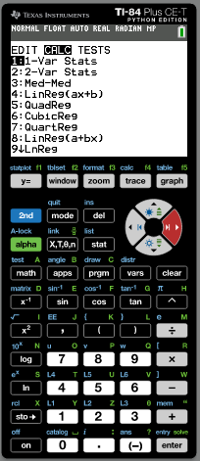
Modelling with sine and cosine functions
Example 1:
Create a model for this data, which shows the mean monthly maximum temperature (°C) for a city in Italy.
Month | Jan | Feb | Mar | Apr | May | Jun | Jul | Aug | Sep | Oct | Nov | Dec
Temp | 15 | 14 | 15 | 18 | 21 | 25 | 27 | 26 | 24 | 20 | 18 | 16
1
2
3
4
5
6
7
8
9
10
11
12
T = 6.5sin (0.524n – 2.356) + 20.5
We will use technology to check the answer
Scroll down to C↓SinReg
enter

Slide 14
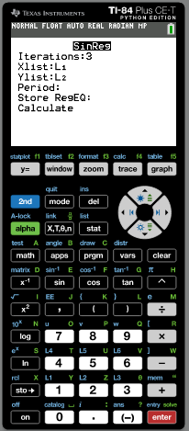
Modelling with sine and cosine functions
Example 1:
Create a model for this data, which shows the mean monthly maximum temperature (°C) for a city in Italy.
Month | Jan | Feb | Mar | Apr | May | Jun | Jul | Aug | Sep | Oct | Nov | Dec
Temp | 15 | 14 | 15 | 18 | 21 | 25 | 27 | 26 | 24 | 20 | 18 | 16
1
2
3
4
5
6
7
8
9
10
11
12
T = 6.5sin (0.524n – 2.356) + 20.5
We will use technology to check the answer
Iterations:
16
The largest the better
Xlist:
L1
Ylist:
L2
Period:
Store RegEq
Click vars
Move right to Y-vars
Click 1: Function
Click 1: Y1
Scroll down to Calculate

Slide 15
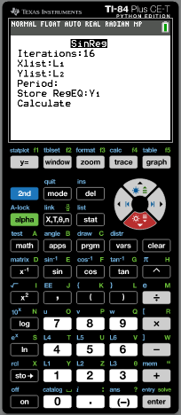
Modelling with sine and cosine functions
Example 1:
Create a model for this data, which shows the mean monthly maximum temperature (°C) for a city in Italy.
Month | Jan | Feb | Mar | Apr | May | Jun | Jul | Aug | Sep | Oct | Nov | Dec
Temp | 15 | 14 | 15 | 18 | 21 | 25 | 27 | 26 | 24 | 20 | 18 | 16
1
2
3
4
5
6
7
8
9
10
11
12
T = 6.5sin (0.524n – 2.356) + 20.5
We will use technology to check the answer
Iterations:
16
The largest the better
Xlist:
L1
Ylist:
L2
Period:
Store RegEq
Click vars
Move right to Y-vars
Click 1: Function
Click 1: Y1
Scroll down to Calculate
enter

Slide 16
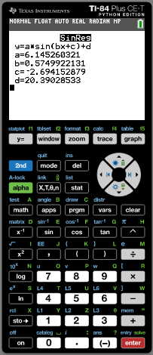
Modelling with sine and cosine functions
Example 1:
Create a model for this data, which shows the mean monthly maximum temperature (°C) for a city in Italy.
Month | Jan | Feb | Mar | Apr | May | Jun | Jul | Aug | Sep | Oct | Nov | Dec
Temp | 15 | 14 | 15 | 18 | 21 | 25 | 27 | 26 | 24 | 20 | 18 | 16
1
2
3
4
5
6
7
8
9
10
11
12
T = 6.5sin (0.524n – 2.356) + 20.5
We will use technology to check the answer
T = 6.15sin (0.575n – 2.69) + 20.4
a = 6.15
How well does the model fit?
b = $0.575$
2nd
Statplot
$$c=−2.69$$
$$d=20.4$$

Slide 17
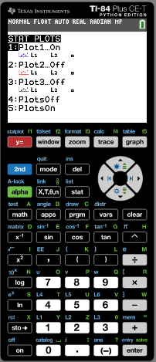
Modelling with sine and cosine functions
Example 1:
Create a model for this data, which shows the mean monthly maximum temperature (°C) for a city in Italy.
Month | Jan | Feb | Mar | Apr | May | Jun | Jul | Aug | Sep | Oct | Nov | Dec
Temp | 15 | 14 | 15 | 18 | 21 | 25 | 27 | 26 | 24 | 20 | 18 | 16
1
2
3
4
5
6
7
8
9
10
11
12
T = 6.5sin (0.524n – 2.356) + 20.5
We will use technology to check the answer
T = 6.15sin (0.575n – 2.69) + 20.4
a = 6.15
How well does the model fit?
b = $0.575$
2nd
Statplot
$$c=−2.69$$
Make sure that Plot1 is on
$$d=20.4$$
Click graph

Slide 18
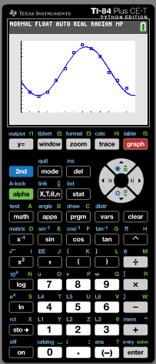
Modelling with sine and cosine functions
Example 1:
Create a model for this data, which shows the mean monthly maximum temperature (°C) for a city in Italy.
Month | Jan | Feb | Mar | Apr | May | Jun | Jul | Aug | Sep | Oct | Nov | Dec
Temp | 15 | 14 | 15 | 18 | 21 | 25 | 27 | 26 | 24 | 20 | 18 | 16
1
2
3
4
5
6
7
8
9
10
11
12
T = 6.5sin (0.524n – 2.356) + 20.5
We will use technology to check the answer
T = 6.15sin (0.575n – 2.69) + 20.4
a = 6.15
b = $0.575$
What do you say about the model?
$$c=−2.69$$
$$d=20.4$$

Slide 19
Thank you for using resources from
For more resources visit our website
https://www.mathssupport.org
If you have a special request, drop us an email
info@mathssupport.org

