Slide 1
Graphing circular functions: tan
LO: To draw the graph of circular functions.
To solve trigonometric equations using graphs.

Slide 2
Graphing tangent function
List the tangent values in the tables
Angle measure
0º
30º
45º
60º
90º
120º
135º
150º
180º
$$\frac{\sqrt{3}}{3}$$
Und.
$$−\frac{\sqrt{3}}{3}$$
tangent value
0
1
$$\sqrt{3}$$
-$\sqrt{3}$
-1
0
Angle measure
210º
225º
240º
270º
300º
315º
330º
360º
390º
$$\frac{\sqrt{3}}{3}$$
$$−\frac{\sqrt{3}}{3}$$
$$\frac{\sqrt{3}}{3}$$
tangent value
1
$$\sqrt{3}$$
und
$$−\sqrt{3}$$
$$−1$$
0
If we let y = tan x we can plot these values on a graph
What if we continue finding points?
y
8
6
4
2
0
90º
180º
270º
360º
450º
540º
x
-2
-4
-6
-8

Slide 3
Tangent function
Like the sine and cosine functions, the tangent function is periodic.
There are vertical asymptotes at values of x where the function does not exist.
The same cycle of values repeats between each pair of vertical asymptotes.
The period of the tangent function is 180º (or π radians).
Unlike the sine and cosine functions, the tangent function does not have an amplitude. It has no maximum or minimum values.
8
y
6
4
2
0
90º
180º
270º
360º
450º
540º
x
-2
-4
-6
-8

Slide 4
Graphing tangent function
If we measure the angles in radians
Angle measure
0º
$$\frac{π}{6}$$
$$\frac{π}{4}$$
$$\frac{π}{3}$$
$$\frac{π}{2}$$
$$\frac{2π}{3}$$
$$\frac{3π}{4}$$
$$\frac{π}{6}$$
π
$$\frac{\sqrt{3}}{3}$$
Und.
$$−\frac{\sqrt{3}}{3}$$
tangent value
0
1
$$\sqrt{3}$$
-$\sqrt{3}$
-1
0
Angle measure
$$\frac{7π}{6}$$
$$\frac{5π}{4}$$
$$\frac{4π}{3}$$
$$\frac{3π}{2}$$
$$\frac{5π}{3}$$
$$\frac{7π}{4}$$
$$\frac{11π}{6}$$
2π
$$\frac{13π}{6}$$
$$\frac{\sqrt{3}}{3}$$
$$−\frac{\sqrt{3}}{3}$$
$$\frac{\sqrt{3}}{3}$$
tangent value
1
$$\sqrt{3}$$
und
$$−\sqrt{3}$$
$$−1$$
0
If we let y = tan x we can plot these values on a graph
8
y
The graph has the same shape
6
4
2
0
$$\frac{π}{2}$$
π
$$\frac{3π}{2}$$
2π
$$\frac{5π}{2}$$
3π
x
-2
-4
-6
-8

Slide 5
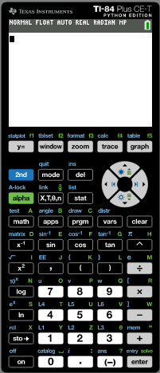
Solving equations using the graphs
Solve the equation tan x = 1 - x, -2π ≤ x ≤ 2π
Give your answers to 3 sf.
We will use the GDC to solve
Turn on the GDC
Press mode

Slide 6
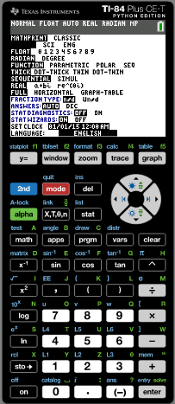
Solving equations using the graphs
Solve the equation tan x = 1 - x, -2π ≤ x ≤ 2π
Give your answers to 3 sf.
We will use the GDC to solve
Turn on the GDC
Press mode
Now check that the GDC is in radians mode
If not use the arrows to put the cursor in radians and press enter

Slide 7
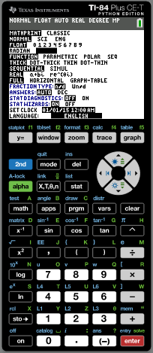
Solving equations using the graphs
Solve the equation tan x = 1 - x, -2π ≤ x ≤ 2π
Give your answers to 3 sf.
We will use the GDC to solve
Turn on the GDC
Press mode
Now check that the GDC is in radians mode
If not use the arrows to put the cursor in radians and press enter
Press y =

Slide 8
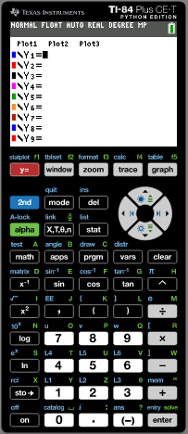
Solving equations using the graphs
Solve the equation tan x = 1 - x, -2π ≤ x ≤ 2π
Give your answers to 3 sf.
We will use the GDC to solve
Turn on the GDC
Press mode
Now check that the GDC is in radians mode
If not use the arrows to put the cursor in radians and press enter
Press y =
Enter for Y1
tan x
enter

Slide 9
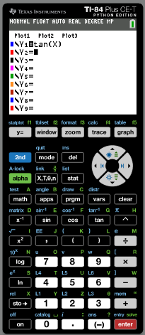
Solving equations using the graphs
Solve the equation tan x = 1 - x, -2π ≤ x ≤ 2π
Give your answers to 3 sf.
We will use the GDC to solve
Turn on the GDC
Press mode
Now check that the GDC is in radians mode
If not use the arrows to put the cursor in radians and press enter
Press y =
Enter for Y1
tan x
enter
Enter for Y2
1 - x
enter

Slide 10
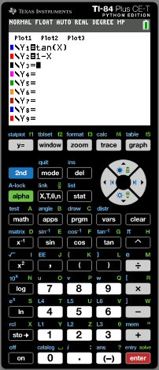
Solving equations using the graphs
Solve the equation tan x = 1 - x, -2π ≤ x ≤ 2π
Give your answers to 3 sf.
We will use the GDC to solve
Turn on the GDC
Press mode
Now check that the GDC is in radians mode
If not use the arrows to put the cursor in radians and press enter
Press y =
Enter for Y1
tan x
enter
Enter for Y2
1 - x
enter
Press window

Slide 11
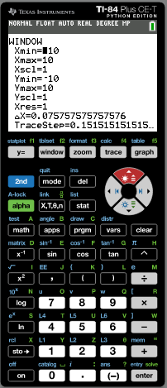
Solving equations using the graphs
Solve the equation tan x = 1 - x, -2π ≤ x ≤ 2π
Give your answers to 3 sf.
We will use the GDC to solve
Turn on the GDC
Press mode
Now check that the GDC is in radians mode
If not use the arrows to put the cursor in radians and press enter
Press y =
Enter for Y1
tan x
enter
Enter for Y2
1 - x
enter
Press window
enter
Xmin
- 2π
enter
Xmax
2π
enter
Ymin
-8
Ymax
8
enter

Slide 12
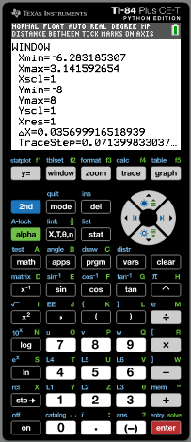
Solving equations using the graphs
Solve the equation tan x = 1 - x, -2π ≤ x ≤ 2π
Give your answers to 3 sf.
We will use the GDC to solve
Turn on the GDC
Press mode
Now check that the GDC is in radians mode
If not use the arrows to put the cursor in radians and press enter
Press y =
Enter for Y1
tan x
enter
Enter for Y2
1 - x
enter
Press window
Xmin
- 2π
enter
Xmax
2π
enter
Ymin
enter
-8
enter
Press graph
Ymax
8

Slide 13
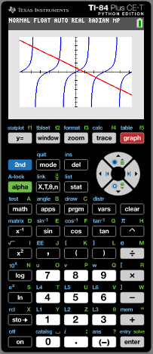
Solving equations using the graphs
Solve the equation tan x = 1 - x, -2π ≤ x ≤ 2π
Give your answers to 3 sf.
Press 2nd
calc

Slide 14
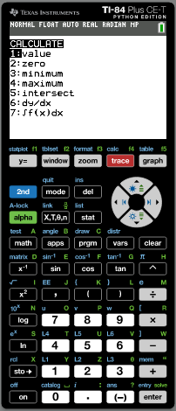
Solving equations using the graphs
Solve the equation tan x = 1 - x, -2π ≤ x ≤ 2π
Give your answers to 3 sf.
calc
intersect
Press 2nd
Press 5

Slide 15
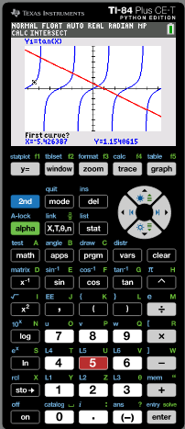
Solving equations using the graphs
Solve the equation tan x = 1 - x, -2π ≤ x ≤ 2π
Give your answers to 3 sf.
calc
intersect
Press 2nd
Press 5
Use the arrows to put the cursor on the curve at the left of the first intersection. Enter. Then move the cursor to the line close to the intersecting point. Press enter
enter

Slide 16
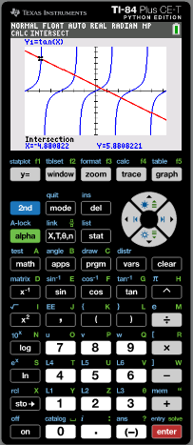
Solving equations using the graphs
Solve the equation tan x = 1 - x, -2π ≤ x ≤ 2π
Give your answers to 3 sf.
calc
intersect
Press 2nd
Press 5
Use the arrows to put the cursor on the curve at the left of the first intersection. Enter. Then move the cursor to the line close to the intersecting point. Press enter
enter
x = -4.88
calc
intersect
Press 2nd
Press 5
Use the arrows to put the cursor on the curve at the left of the second intersection. Enter. Then move the cursor to the line close to the intersecting point. Press enter
enter

Slide 17
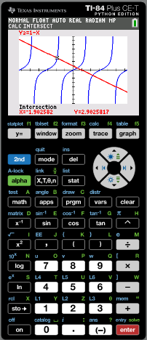
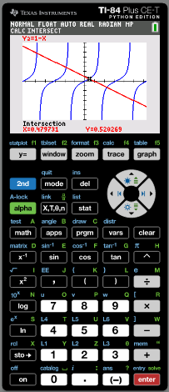
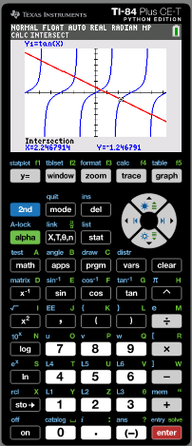
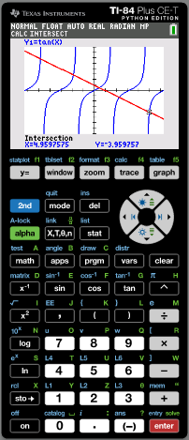
Solving equations using the graphs
Solve the equation tan x = 1 - x, -2π ≤ x ≤ 2π
Give your answers to 3 sf.
x = -1.90
calc
intersect
Press 2nd
Press 5
Use the arrows to put the cursor on the line at the left of the third intersection. Enter. Then move the cursor to the curve close to the intersecting point. Press enter
enter
x = 0.480
Repeat the same steps for the other points of intersection.
x = 2.25
x = 4.96

Slide 18
Thank you for using resources from
For more resources visit our website
https://www.mathssupport.org
If you have a special request, drop us an email
info@mathssupport.org

