Slide 1
Graphing circular functions: tan
LO: To draw the graph of circular functions.
To solve trigonometric equations using graphs.

Slide 2
Graphing tangent function
List the tangent values in the tables
Angle measure
0º
30º
45º
60º
90º
120º
135º
150º
180º
$$\frac{\sqrt{3}}{3}$$
Und.
$$−\frac{\sqrt{3}}{3}$$
tangent value
0
1
$$\sqrt{3}$$
-$\sqrt{3}$
-1
0
Angle measure
210º
225º
240º
270º
300º
315º
330º
360º
390º
$$\frac{\sqrt{3}}{3}$$
$$−\frac{\sqrt{3}}{3}$$
$$\frac{\sqrt{3}}{3}$$
tangent value
1
$$\sqrt{3}$$
und
$$−\sqrt{3}$$
$$−1$$
0
If we let y = tan x we can plot these values on a graph
What if we continue finding points?
y
8
6
4
2
0
90º
180º
270º
360º
450º
540º
x
-2
-4
-6
-8

Slide 3
Tangent function
Like the sine and cosine functions, the tangent function is periodic.
There are vertical asymptotes at values of x where the function does not exist.
The same cycle of values repeats between each pair of vertical asymptotes.
The period of the tangent function is 180º (or π radians).
Unlike the sine and cosine functions, the tangent function does not have an amplitude. It has no maximum or minimum values.
8
y
6
4
2
0
90º
180º
270º
360º
450º
540º
x
-2
-4
-6
-8

Slide 4
Graphing tangent function
If we measure the angles in radians
Angle measure
0º
$$\frac{π}{6}$$
$$\frac{π}{4}$$
$$\frac{π}{3}$$
$$\frac{π}{2}$$
$$\frac{2π}{3}$$
$$\frac{3π}{4}$$
$$\frac{π}{6}$$
π
$$\frac{\sqrt{3}}{3}$$
Und.
$$−\frac{\sqrt{3}}{3}$$
tangent value
0
1
$$\sqrt{3}$$
-$\sqrt{3}$
-1
0
Angle measure
$$\frac{7π}{6}$$
$$\frac{5π}{4}$$
$$\frac{4π}{3}$$
$$\frac{3π}{2}$$
$$\frac{5π}{3}$$
$$\frac{7π}{4}$$
$$\frac{11π}{6}$$
2π
$$\frac{13π}{6}$$
$$\frac{\sqrt{3}}{3}$$
$$−\frac{\sqrt{3}}{3}$$
$$\frac{\sqrt{3}}{3}$$
tangent value
1
$$\sqrt{3}$$
und
$$−\sqrt{3}$$
$$−1$$
0
If we let y = tan x we can plot these values on a graph
8
y
The graph has the same shape
6
4
2
0
$$\frac{π}{2}$$
π
$$\frac{3π}{2}$$
2π
$$\frac{5π}{2}$$
3π
x
-2
-4
-6
-8

Slide 5
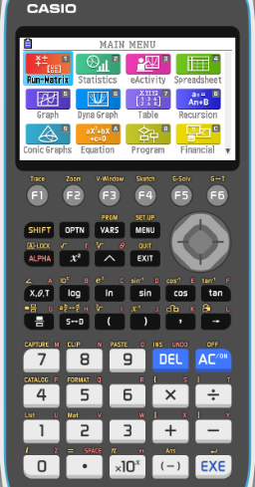
Solving equations using the graphs
Solve the equation tan x = 1 - x, -2π ≤ x ≤ 2π
Give your answers to 3 sf.
We will use the GDC to solve
After turning it on, press 5 for Graph

Slide 6
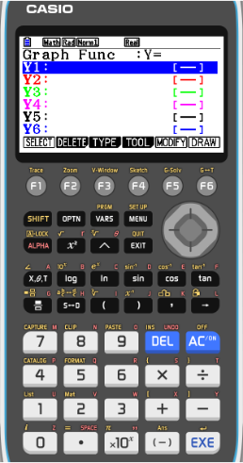
Solving equations using the graphs
Solve the equation tan x = 1 - x, -2π ≤ x ≤ 2π
Give your answers to 3 sf.
We will use the GDC to solve
After turning it on, press 5 for Graph
Now check that the GDC is in radians mode
To do that
SHIFT
MENU

Slide 7
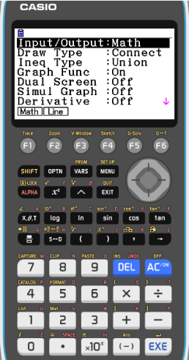
Solving equations using the graphs
Solve the equation tan x = 1 - x, -2π ≤ x ≤ 2π
Give your answers to 3 sf.
We will use the GDC to solve
After turning it on, press 5 for Graph
Now check that the GDC is in degree mode
To do that
SHIFT
MENU
Scroll down to find the option for angle

Slide 8
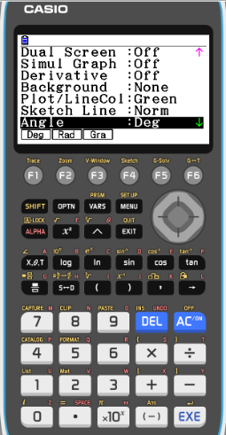
Solving equations using the graphs
Solve the equation tan x = 1 - x, -2π ≤ x ≤ 2π
Give your answers to 3 sf.
We will use the GDC to solve
After turning it on, press 5 for Graph
Now check that the GDC is in degree mode
To do that
SHIFT
MENU
Scroll down to find the option for angle
F2
Rad
EXE

Slide 9
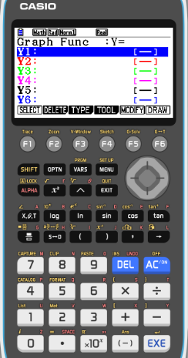
Solving equations using the graphs
Solve the equation tan x = 1 - x, -2π ≤ x ≤ 2π
Give your answers to 3 sf.
We will use the GDC to solve
After turning it on, press 5 for Graph
Enter for Y1
tan x
EXE

Slide 10
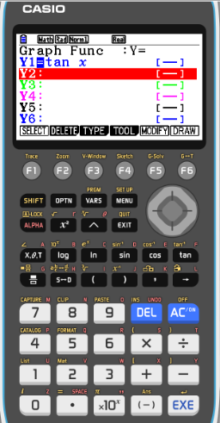
Solving equations using the graphs
Solve the equation tan x = 1 - x, -2π ≤ x ≤ 2π
Give your answers to 3 sf.
We will use the GDC to solve
After turning it on, press 5 for Graph
Enter for Y1
tan x
EXE
Enter for Y2
1 - x
EXE

Slide 11
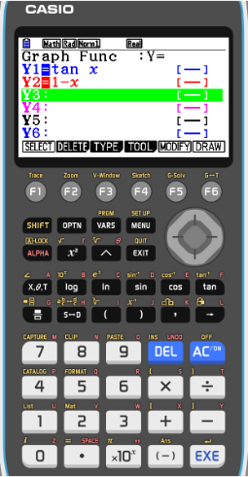
Solving equations using the graphs
Solve the equation tan x = 1 - x, -2π ≤ x ≤ 2π
Give your answers to 3 sf.
We will use the GDC to solve
After turning it on, press 5 for Graph
Enter for Y1
tan x
EXE
Enter for Y2
1 - x
EXE
F6
DRAW

Slide 12
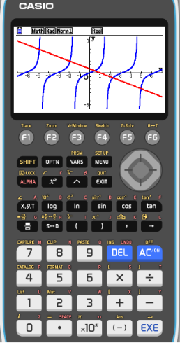
Solving equations using the graphs
Solve the equation tan x = 1 - x, -2π ≤ x ≤ 2π
Give your answers to 3 sf.
We will use the GDC to solve
After turning it on, press 5 for Graph
Enter for Y1
tan x
EXE
Enter for Y2
1 - x
EXE
F6
DRAW
Change the setting of the view window
F3
V-Window

Slide 13
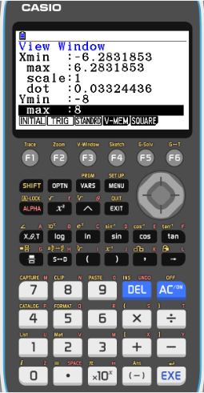
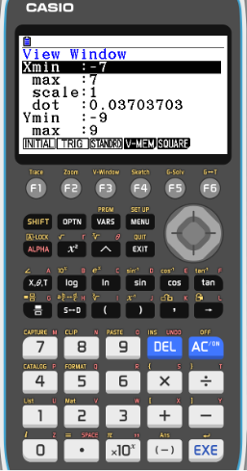
Solving equations using the graphs
Solve the equation tan x = 1 - x, -2π ≤ x ≤ 2π
Give your answers to 3 sf.
We will use the GDC to solve
After turning it on, press 5 for Graph
Enter for Y1
tan x
EXE
Enter for Y2
1 - x
EXE
F6
DRAW
Change the setting of the view window
F3
V-Window
Xmin
- 2π
EXE
max
2π
EXE
EXE
Ymin
-8
max
8
EXE
EXE

Slide 14
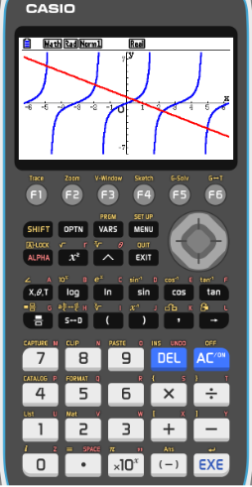
Solving equations using the graphs
Solve the equation tan x = 1 - x, -2π ≤ x ≤ 2π
Give your answers to 3 sf.
We will use the GDC to solve
After turning it on, press 5 for Graph
Enter for Y1
tan x
EXE
Enter for Y2
1 - x
EXE
F6
DRAW

Slide 15
Solving equations using the graphs
Solve the equation tan x = 1 - x, -2π ≤ x ≤ 2π
Give your answers to 3 sf.
We will use the GDC to solve
After turning it on, press 5 for Graph
Enter for Y1
tan x
EXE
Enter for Y2
1 - x
EXE
F6
DRAW
F5
G-solv

Slide 16
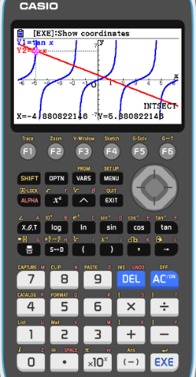
Solving equations using the graphs
Solve the equation tan x = 1 - x, -2π ≤ x ≤ 2π
Give your answers to 3 sf.
We will use the GDC to solve
After turning it on, press 5 for Graph
Enter for Y1
tan x
EXE
Enter for Y2
1 - x
EXE
F6
DRAW
F5
G-solv
F5
INTSECT
x = -4.88

Slide 17
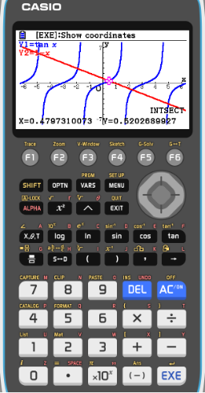
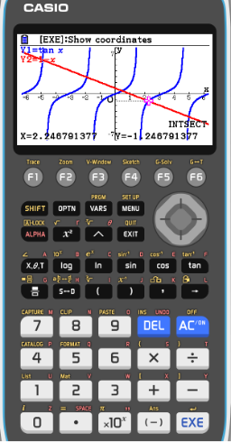
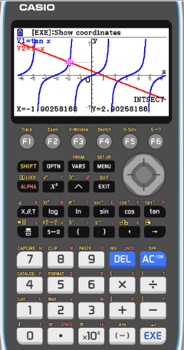
Solving equations using the graphs
Solve the equation tan x = 1 - x, -2π ≤ x ≤ 2π
Give your answers to 3 sf.
We will use the GDC to solve
After turning it on, press 5 for Graph
Enter for Y1
tan x
EXE
Enter for Y2
1 - x
EXE
F6
DRAW
F5
G-solv
F5
INTSECT
x = -4.88
x = -1.90
x = 0.480
x = 2.25
x = 4.96

Slide 18
Thank you for using resources from
For more resources visit our website
https://www.mathssupport.org
If you have a special request, drop us an email
info@mathssupport.org

