Slide 1
Graphing circular functions: Sine and Cosine
LO: To draw the graph of circular functions.
To solve trigonometric equations using graphs.

Slide 2
Graphing sine function
We already know the exact sine values for many angles
Angle measure
0º
30º
45º
60º
90º
120º
135º
150º
180º
$$\frac{1}{2}$$
$$\frac{\sqrt{2}}{2}$$
$$\frac{\sqrt{3}}{2}$$
$$\frac{\sqrt{3}}{2}$$
$$\frac{\sqrt{2}}{2}$$
$$\frac{1}{2}$$
Sine value
0
1
0
Angle measure
210º
225º
240º
270º
300º
315º
330º
360º
390º
$$−\frac{1}{2}$$
$$−\frac{\sqrt{2}}{2}$$
$$−\frac{\sqrt{3}}{2}$$
$$−\frac{\sqrt{3}}{2}$$
$$−\frac{\sqrt{2}}{2}$$
$$−\frac{1}{2}$$
$$\frac{1}{2}$$
Sine value
-1
0
If we let y = sin x we can plot these values on a graph
1
y
What if we continue finding points?
0.5
0
90º
180º
270º
360º
450º
540º
x
-0.5
-1

Slide 3
Graphing sine function
If we measure the angles in radians
Angle measure
0
$$\frac{π}{6}$$
$$\frac{π}{4}$$
$$\frac{π}{3}$$
$$\frac{π}{2}$$
$$\frac{2π}{3}$$
$$\frac{3π}{4}$$
$$\frac{5π}{6}$$
π
$$\frac{1}{2}$$
$$\frac{\sqrt{2}}{2}$$
$$\frac{\sqrt{3}}{2}$$
$$\frac{\sqrt{3}}{2}$$
$$\frac{\sqrt{2}}{2}$$
$$\frac{1}{2}$$
Sine value
0
1
0
Angle measure
$$\frac{7π}{6}$$
$$\frac{5π}{4}$$
$$\frac{4π}{3}$$
$$\frac{3π}{2}$$
$$\frac{5π}{3}$$
$$\frac{7π}{4}$$
$$\frac{11π}{6}$$
2π
$$\frac{13π}{6}$$
$$−\frac{1}{2}$$
$$−\frac{\sqrt{2}}{2}$$
$$−\frac{\sqrt{3}}{2}$$
$$−\frac{\sqrt{3}}{2}$$
$$−\frac{\sqrt{2}}{2}$$
$$−\frac{1}{2}$$
$$\frac{1}{2}$$
Sine value
-1
0
If we let y = sin x we can plot these values on a graph
1
y
The graph has the same shape
0.5
0
$$\frac{π}{2}$$
π
$$\frac{3π}{2}$$
2π
$$\frac{5π}{2}$$
3π
x
-0.5
-1

Slide 4
Graphing cosine function
Similarly, we can do the same with the cosine values
Angle measure
0º
30º
45º
60º
90º
120º
135º
150º
180º
$$\frac{\sqrt{3}}{2}$$
$$\frac{\sqrt{2}}{2}$$
$$\frac{1}{2}$$
$$−\frac{1}{2}$$
$$−\frac{\sqrt{2}}{2}$$
$$−\frac{\sqrt{3}}{2}$$
Cosine value
1
0
-1
Angle measure
210º
225º
240º
270º
300º
315º
330º
360º
390º
$$−\frac{\sqrt{3}}{2}$$
$$−\frac{\sqrt{2}}{2}$$
$$−\frac{1}{2}$$
$$\frac{1}{2}$$
$$\frac{\sqrt{2}}{2}$$
$$\frac{\sqrt{3}}{2}$$
$$\frac{\sqrt{3}}{2}$$
Cosine value
0
1
If we let y = cos x we can plot these values on a graph
1
y
What if we continue finding points?
0.5
0
90º
180º
270º
360º
450º
540º
x
-0.5
-1

Slide 5
Graphing cosine function
If we measure the angles in radians
Angle measure
0
$$\frac{π}{6}$$
$$\frac{π}{4}$$
$$\frac{π}{3}$$
$$\frac{π}{2}$$
$$\frac{2π}{3}$$
$$\frac{3π}{4}$$
$$\frac{5π}{6}$$
π
$$\frac{\sqrt{3}}{2}$$
$$\frac{\sqrt{2}}{2}$$
$$\frac{1}{2}$$
$$−\frac{1}{2}$$
$$−\frac{\sqrt{2}}{2}$$
$$−\frac{\sqrt{3}}{2}$$
Cosine value
1
0
-1
Angle measure
$$\frac{7π}{6}$$
$$\frac{5π}{4}$$
$$\frac{4π}{3}$$
$$\frac{3π}{2}$$
$$\frac{5π}{3}$$
$$\frac{7π}{4}$$
$$\frac{11π}{6}$$
2π
$$\frac{13π}{6}$$
$$−\frac{\sqrt{3}}{2}$$
$$−\frac{\sqrt{2}}{2}$$
$$−\frac{1}{2}$$
$$\frac{1}{2}$$
$$\frac{\sqrt{2}}{2}$$
$$\frac{\sqrt{3}}{2}$$
$$\frac{\sqrt{3}}{2}$$
Cosine value
0
1
If we let y = cos x we can plot these values on a graph
1
y
The graph has the same shape
0.5
0
$$\frac{π}{2}$$
π
$$\frac{3π}{2}$$
2π
$$\frac{5π}{2}$$
3π
x
-0.5
-1

Slide 6
Compare the sine and cosine functions
1
y
y = sin x
The curves are the same size and shape, only their horizontal position on the axes differ.
0.5
The functions are periodic, which means that they repeat the same cycle of values over and over.
x
0
90º
180º
270º
360º
-0.5
The period or length of one cycle is 360º or 2π. This means that if you look at two points whose x-coordinates are 360º or 2π apart, the y-coordinate of those two points would be the same
-1
1
y
y = cos x
0.5
Both functions have a maximum value of 1 and a minimum value of -1. Each of these functions has an amplitude of 1.
x
0
90º
180º
270º
360º
-0.5
The amplitude is one half the vertical distance from a maximum to a minimum
-1

Slide 7
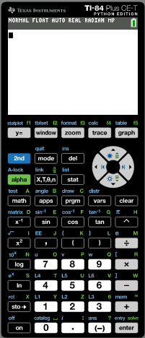
Solving equations using the graphs
Solve the equation cos x = 0.4, -360º ≤ x ≤ 360º
Give your answers to 1 dp.
We will use the GDC to solve
Turn on the GDC
Press mode

Slide 8
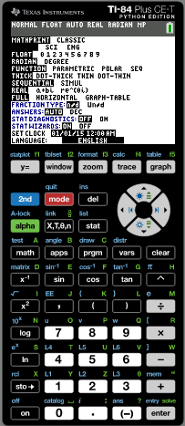
Solving equations using the graphs
Solve the equation cos x = 0.4, -360º ≤ x ≤ 360º
Give your answers to 1 dp.
We will use the GDC to solve
Turn on the GDC
Press mode
Now check that the GDC is in degree mode
If not use the arrows to put the cursor in degrees and press enter

Slide 9
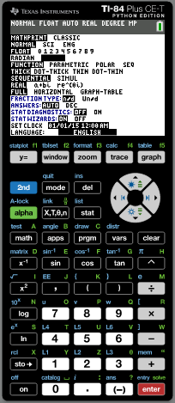
Solving equations using the graphs
Solve the equation cos x = 0.4, -360º ≤ x ≤ 360º
Give your answers to 1 dp.
We will use the GDC to solve
Turn on the GDC
Press mode
Now check that the GDC is in degree mode
If not use the arrows to put the cursor in degrees and press enter
Press y =

Slide 10
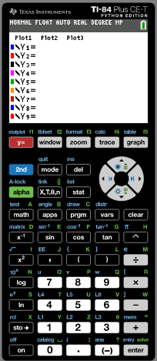
Solving equations using the graphs
Solve the equation cos x = 0.4, -360º ≤ x ≤ 360º
Give your answers to 1 dp.
We will use the GDC to solve
Turn on the GDC
Press mode
Now check that the GDC is in degree mode
If not use the arrows to put the cursor in degrees and press enter
Press y =
In Y1 type
cos (x)
enter

Slide 11
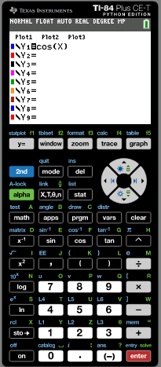
Solving equations using the graphs
Solve the equation cos x = 0.4, -360º ≤ x ≤ 360º
Give your answers to 1 dp.
We will use the GDC to solve
Turn on the GDC
Press mode
Now check that the GDC is in degree mode
If not use the arrows to put the cursor in degrees and press enter
Press y =
In Y1 type
cos (x)
enter
In Y2 type
0.4
enter

Slide 12
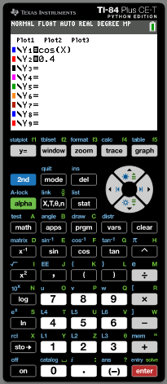
Solving equations using the graphs
Solve the equation cos x = 0.4, -360º ≤ x ≤ 360º
Give your answers to 1 dp.
We will use the GDC to solve
Turn on the GDC
Press mode
Now check that the GDC is in degree mode
If not use the arrows to put the cursor in degrees and press enter
Press y =
In Y1 type
cos (x)
enter
In Y2 type
0.4
enter
Press graph

Slide 13
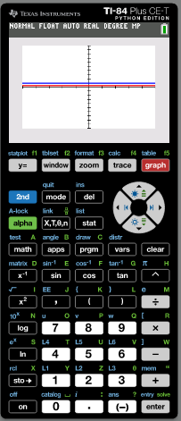
Solving equations using the graphs
Solve the equation cos x = 0.4, -360º ≤ x ≤ 360º
Give your answers to 1 dp.
We will use the GDC to solve
Turn on the GDC
Press mode
Now check that the GDC is in degree mode
If not use the arrows to put the cursor in degrees and press enter
Press y =
In Y1 type
cos (x)
enter
In Y2 type
0.4
enter
Press graph
Press window

Slide 14
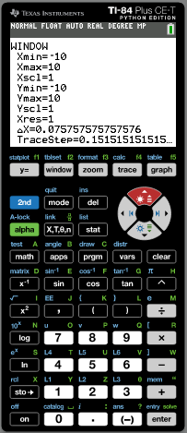
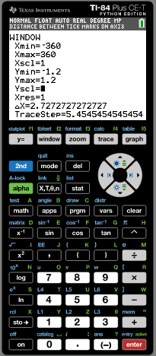
Solving equations using the graphs
Solve the equation cos x = 0.4, -360º ≤ x ≤ 360º
Give your answers to 1 dp.
We will use the GDC to solve
Change the setting of the window
Xmin
-360
EXE
EXE
max
360
EXE
Ymin
-1.2
max
1.2
Press graph
EXE

Slide 15
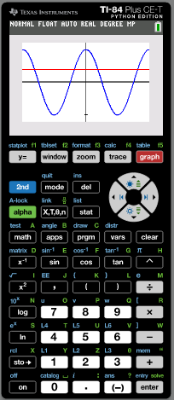
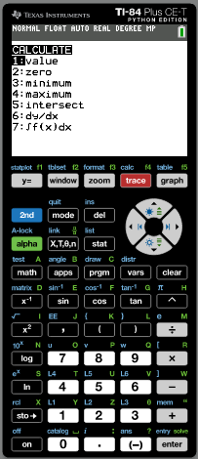
Solving equations using the graphs
Solve the equation cos x = 0.4, -360º ≤ x ≤ 360º
Give your answers to 1 dp.
We will use the GDC to solve
Change the setting of the window
Xmin
-360
EXE
EXE
max
360
EXE
Ymin
-1.2
max
1.2
Press graph
EXE
calc
intersect
Press 2nd
Press 5

Slide 16
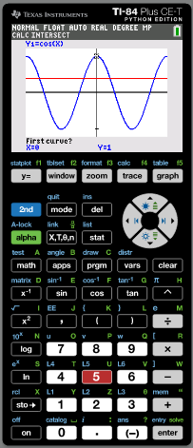
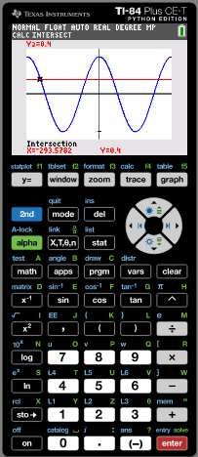
Solving equations using the graphs
Solve the equation cos x = 0.4, -360º ≤ x ≤ 360º
Give your answers to 1 dp.
We will use the GDC to solve
Change the setting of the window
Xmin
-360
EXE
EXE
max
360
EXE
Ymin
-1.2
max
1.2
Press graph
EXE
calc
intersect
Press 2nd
Press 5
Use the arrows to put the cursor on the curve at the left of the first intersection. Enter. Then move the cursor to the line close to the intersecting point. Press enter
enter
x = -293.6º

Slide 17
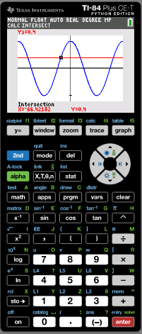
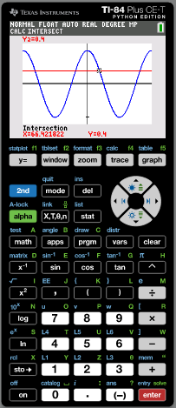
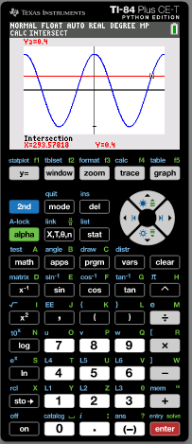
Solving equations using the graphs
Solve the equation cos x = 0.4, -360º ≤ x ≤ 360º
Give your answers to 1 dp.
We will use the GDC to solve
calc
intersect
Press 2nd
Press 5
Use the arrows to put the cursor on the curve at the left of the second intersection. Enter. Then move the cursor to the line close to the intersecting point. Press enter
Repeat the steps for the four points of intersection
x = -293.6º
x = -66.4º
x = 66.4º
x = 293.6º

Slide 18
Thank you for using resources from
For more resources visit our website
https://www.mathssupport.org
If you have a special request, drop us an email
info@mathssupport.org

