Slide 1
Graphing circular functions: Sine and Cosine
LO: To draw the graph of circular functions.
To solve trigonometric equations using graphs.

Slide 2













Graphing sine function
We already know the exact sine values for many angles
Angle measure
0º
30º
45º
60º
90º
120º
135º
150º
180º
$$\frac{1}{2}$$
$$\frac{\sqrt{2}}{2}$$
$$\frac{\sqrt{3}}{2}$$
$$\frac{\sqrt{3}}{2}$$
$$\frac{\sqrt{2}}{2}$$
$$\frac{1}{2}$$
Sine value
0
1
0
Angle measure
210º
225º
240º
270º
300º
315º
330º
360º
390º
$$−\frac{1}{2}$$
$$−\frac{\sqrt{2}}{2}$$
$$−\frac{\sqrt{3}}{2}$$
$$−\frac{\sqrt{3}}{2}$$
$$−\frac{\sqrt{2}}{2}$$
$$−\frac{1}{2}$$
$$\frac{1}{2}$$
Sine value
-1
0
If we let y = sin x we can plot these values on a graph
1
y
What if we continue finding points?
0.5
0
90º
180º
270º
360º
450º
540º
x
-0.5
-1

Slide 3


















Graphing sine function
If we measure the angles in radians
Angle measure
0
$$\frac{π}{6}$$
$$\frac{π}{4}$$
$$\frac{π}{3}$$
$$\frac{π}{2}$$
$$\frac{2π}{3}$$
$$\frac{3π}{4}$$
$$\frac{5π}{6}$$
π
$$\frac{1}{2}$$
$$\frac{\sqrt{2}}{2}$$
$$\frac{\sqrt{3}}{2}$$
$$\frac{\sqrt{3}}{2}$$
$$\frac{\sqrt{2}}{2}$$
$$\frac{1}{2}$$
Sine value
0
1
0
Angle measure
$$\frac{7π}{6}$$
$$\frac{5π}{4}$$
$$\frac{4π}{3}$$
$$\frac{3π}{2}$$
$$\frac{5π}{3}$$
$$\frac{7π}{4}$$
$$\frac{11π}{6}$$
2π
$$\frac{13π}{6}$$
$$−\frac{1}{2}$$
$$−\frac{\sqrt{2}}{2}$$
$$−\frac{\sqrt{3}}{2}$$
$$−\frac{\sqrt{3}}{2}$$
$$−\frac{\sqrt{2}}{2}$$
$$−\frac{1}{2}$$
$$\frac{1}{2}$$
Sine value
-1
0
If we let y = sin x we can plot these values on a graph
1
y
The graph has the same shape
0.5
0
$$\frac{π}{2}$$
π
$$\frac{3π}{2}$$
2π
$$\frac{5π}{2}$$
3π
x
-0.5
-1

Slide 4













Graphing cosine function
Similarly, we can do the same with the cosine values
Angle measure
0º
30º
45º
60º
90º
120º
135º
150º
180º
$$\frac{\sqrt{3}}{2}$$
$$\frac{\sqrt{2}}{2}$$
$$\frac{1}{2}$$
$$−\frac{1}{2}$$
$$−\frac{\sqrt{2}}{2}$$
$$−\frac{\sqrt{3}}{2}$$
Cosine value
1
0
-1
Angle measure
210º
225º
240º
270º
300º
315º
330º
360º
390º
$$−\frac{\sqrt{3}}{2}$$
$$−\frac{\sqrt{2}}{2}$$
$$−\frac{1}{2}$$
$$\frac{1}{2}$$
$$\frac{\sqrt{2}}{2}$$
$$\frac{\sqrt{3}}{2}$$
$$\frac{\sqrt{3}}{2}$$
Cosine value
0
1
If we let y = cos x we can plot these values on a graph
1
y
What if we continue finding points?
0.5
0
90º
180º
270º
360º
450º
540º
x
-0.5
-1

Slide 5



Graphing cosine function
If we measure the angles in radians
Angle measure
0
$$\frac{π}{6}$$
$$\frac{π}{4}$$
$$\frac{π}{3}$$
$$\frac{π}{2}$$
$$\frac{2π}{3}$$
$$\frac{3π}{4}$$
$$\frac{5π}{6}$$
π
$$\frac{\sqrt{3}}{2}$$
$$\frac{\sqrt{2}}{2}$$
$$\frac{1}{2}$$
$$−\frac{1}{2}$$
$$−\frac{\sqrt{2}}{2}$$
$$−\frac{\sqrt{3}}{2}$$
Cosine value
1
0
-1
Angle measure
$$\frac{7π}{6}$$
$$\frac{5π}{4}$$
$$\frac{4π}{3}$$
$$\frac{3π}{2}$$
$$\frac{5π}{3}$$
$$\frac{7π}{4}$$
$$\frac{11π}{6}$$
2π
$$\frac{13π}{6}$$
$$−\frac{\sqrt{3}}{2}$$
$$−\frac{\sqrt{2}}{2}$$
$$−\frac{1}{2}$$
$$\frac{1}{2}$$
$$\frac{\sqrt{2}}{2}$$
$$\frac{\sqrt{3}}{2}$$
$$\frac{\sqrt{3}}{2}$$
Cosine value
0
1
If we let y = cos x we can plot these values on a graph
1
y
The graph has the same shape
0.5
0
$$\frac{π}{2}$$
π
$$\frac{3π}{2}$$
2π
$$\frac{5π}{2}$$
3π
x
-0.5
-1

Slide 6
Compare the sine and cosine functions
1
y
y = sin x
The curves are the same size and shape, only their horizontal position on the axes differ.
0.5
The functions are periodic, which means that they repeat the same cycle of values over and over.
x
0
90º
180º
270º
360º
-0.5
The period or length of one cycle is 360º or 2π. This means that if you look at two points whose x-coordinates are 360º or 2π apart, the y-coordinate of those two points would be the same
-1
1
y
y = cos x
0.5
Both functions have a maximum value of 1 and a minimum value of -1. Each of these functions has an amplitude of 1.
x
0
90º
180º
270º
360º
-0.5
The amplitude is one half the vertical distance from a maximum to a minimum
-1

Slide 7
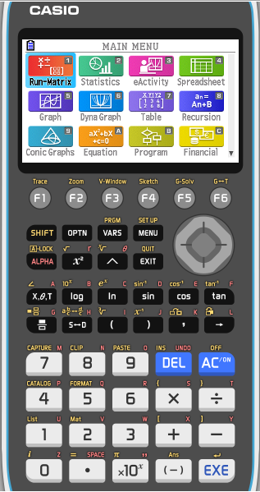
Solving equations using the graphs
Solve the equation cos x = 0.4, -360º ≤ x ≤ 360º
Give your answers to 1 dp.
We will use the GDC to solve
After turning it on, press 5 for Graph

Slide 8
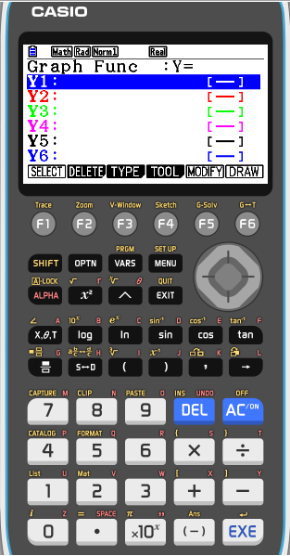
Solving equations using the graphs
Solve the equation cos x = 0.4, -360º ≤ x ≤ 360º
Give your answers to 1 dp.
We will use the GDC to solve
After turning it on, press 5 for Graph
Now check that the GDC is in degree mode
To do that
SHIFT
MENU

Slide 9
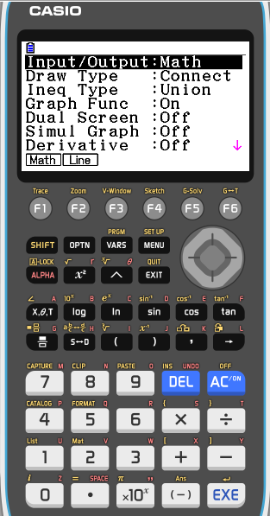
Solving equations using the graphs
Solve the equation cos x = 0.4, -360º ≤ x ≤ 360º
Give your answers to 1 dp.
We will use the GDC to solve
After turning it on, press 5 for Graph
Now check that the GDC is in degree mode
To do that
SHIFT
MENU
Scroll down to find the option for angle

Slide 10
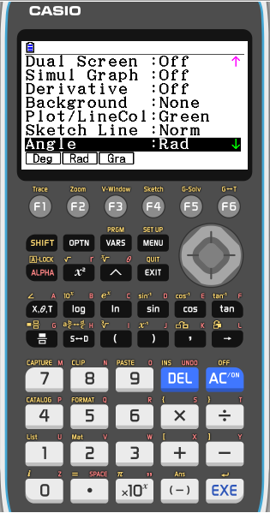
Solving equations using the graphs
Solve the equation cos x = 0.4, -360º ≤ x ≤ 360º
Give your answers to 1 dp.
We will use the GDC to solve
After turning it on, press 5 for Graph
Now check that the GDC is in degree mode
To do that
SHIFT
MENU
Scroll down to find the option for angle
F1
Deg
EXE

Slide 11
Solving equations using the graphs
Solve the equation cos x = 0.4, -360º ≤ x ≤ 360º
Give your answers to 1 dp.
We will use the GDC to solve
After turning it on, press 5 for Graph
Enter for Y1
cos x
EXE

Slide 12
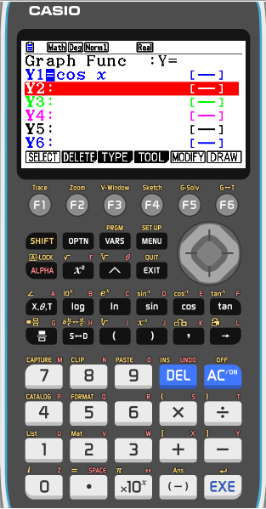
Solving equations using the graphs
Solve the equation cos x = 0.4, -360º ≤ x ≤ 360º
Give your answers to 1 dp.
We will use the GDC to solve
After turning it on, press 5 for Graph
Enter for Y1
cos x
EXE
Enter for Y2
0.4
EXE

Slide 13
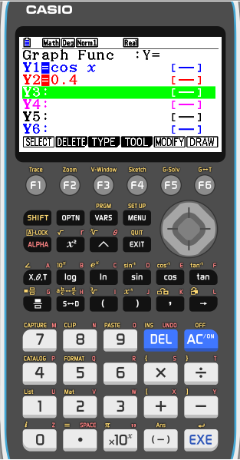
Solving equations using the graphs
Solve the equation cos x = 0.4, -360º ≤ x ≤ 360º
Give your answers to 1 dp.
We will use the GDC to solve
After turning it on, press 5 for Graph
cos x
Enter for Y1
EXE
Enter for Y2
0.4
EXE
F6
DRAW

Slide 14
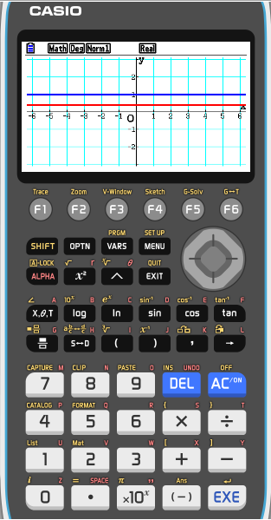
Solving equations using the graphs
Solve the equation cos x = 0.4, -360º ≤ x ≤ 360º
Give your answers to 1 dp.
We will use the GDC to solve
After turning it on, press 5 for Graph
Enter for Y1
cos x
EXE
Enter for Y2
0.4
EXE
F6
DRAW
Change the setting of the view window
F3
V-Window

Slide 15
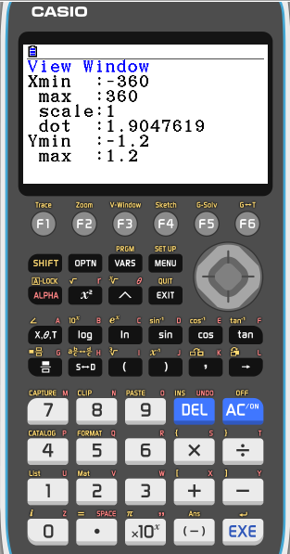
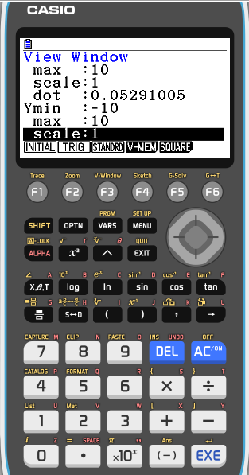
Solving equations using the graphs
Solve the equation cos x = 0.4, -360º ≤ x ≤ 360º
Give your answers to 1 dp.
We will use the GDC to solve
After turning it on, press 5 for Graph
Enter for Y1
cos x
EXE
Enter for Y2
0.4
EXE
F6
DRAW
Change the setting of the view window
F3
V-Window
Xmin
-360
EXE
EXE
max
360
EXE
Ymin
-1.2
max
1.2
EXE
EXE

Slide 16
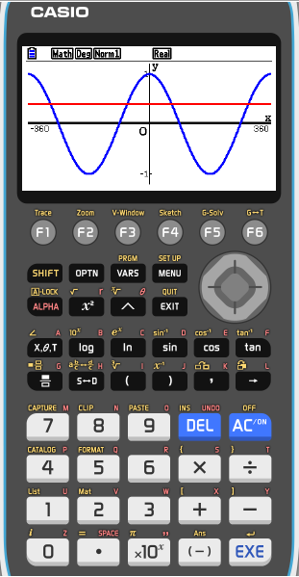
Solving equations using the graphs
Solve the equation cos x = 0.4, -360º ≤ x ≤ 360º
Give your answers to 1 dp.
We will use the GDC to solve
After turning it on, press 5 for Graph
Enter for Y1
cos x
EXE
Enter for Y2
0.4
EXE
F6
DRAW

Slide 17
Solving equations using the graphs
Solve the equation cos x = 0.4, -360º ≤ x ≤ 360º
Give your answers to 1 dp.
We will use the GDC to solve
After turning it on, press 5 for Graph
Enter for Y1
cos x
EXE
Enter for Y2
0.4
EXE
F6
DRAW
F5
G-solv

Slide 18
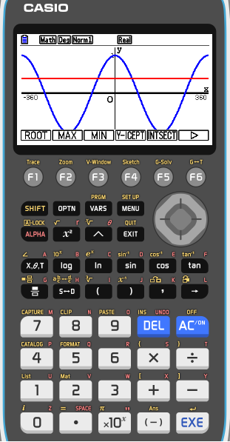
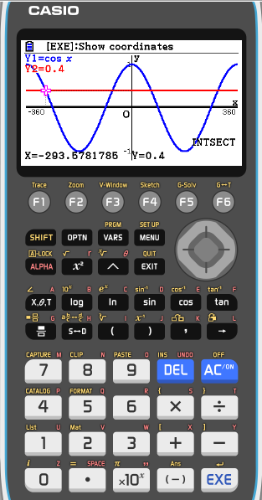
Solving equations using the graphs
Solve the equation cos x = 0.4, -360º ≤ x ≤ 360º
Give your answers to 1 dp.
We will use the GDC to solve
After turning it on, press 5 for Graph
Enter for Y1
cos x
EXE
Enter for Y2
0.4
EXE
F6
DRAW
F5
G-solv
F5
INTSECT
x = -293.6º

Slide 19

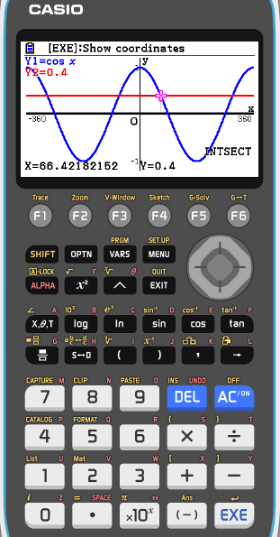
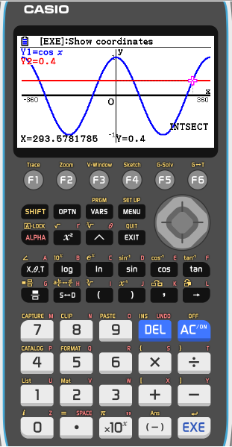
Solving equations using the graphs
Solve the equation cos x = 0.4, -360º ≤ x ≤ 360º
Give your answers to 1 dp.
We will use the GDC to solve
After turning it on, press 5 for Graph
Enter for Y1
cos x
EXE
Enter for Y2
0.4
EXE
F6
DRAW
F5
G-solv
F5
INTSECT
x = -293.6º
x = -66.4º
x = 66.4º
x = 293.6º

Slide 20

Thank you for using resources from
For more resources visit our website
https://www.mathssupport.org
If you have a special request, drop us an email
info@mathssupport.org

