Slide 1
Applications of right-angled triangle trigonometry
LO: To use trigonometric ratios to solve problems involving angles of elevation, angles of depression, bearings

Slide 2
Problem solving using trigonometry
When problems are solved using trigonometry we follow these steps:
Step 1 : Read the question carefully.
Step 2 : Draw a diagram, not necessarily to scale, with the given information clearly marked.
Step 3 : If necessary, label the vertices of triangles in the figure.
Step 4 : State clearly any assumptions you make which enable you to use right angles triangles or properties of other geometric figures .
Step 5 : Choose an appropriate trigonometric ratio and use it to generate an equation connecting the quantities.
Step 6 : Solve the equations(s) to find the unknown.
Step 7 : Answer the question in words.

Slide 3
Problem solving
A 5 m ladder is resting against a wall. It makes an angle of 70° with the ground.
What is the distance between the base of the ladder and the wall?
First draw a sketch
Now label the sides
We are given the hypotenuse and we want to find the length of the side adjacent to the angle, so we use:
5 m
o
h
adjacent
cos θ =
hypotenuse
70°
x
a
x
cos 70° =
5
x = 5 × cos 70°
= 1.71 m (to 2 d.p.)

Slide 4
Problem solving
The angle between a tangent from point P to a circle and the line from P to the centre of the circle is 27º.
Determine the length of the line from P to the centre of the circle if the radius is 3 cm.
First draw a sketch
Now label the sides
We are given the opposite and we want to find the length of the hypotenuse, so we use:
opposite
a
sin θ =
o
27º
hypotenuse
3 cm
C
h
x cm
P
3
sin 27° =
x
3
x =
sin 27°
x =
6.61 m (to 2 d.p.)

Slide 5
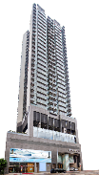
Angles of elevation
In this lesson we will se how to apply the trigonometric ratios to solve problems in real-life situations
Angle of elevation is the angle made between the horizon and the top of an object that you are looking up at
Angle of elevation
Horizon

Slide 6
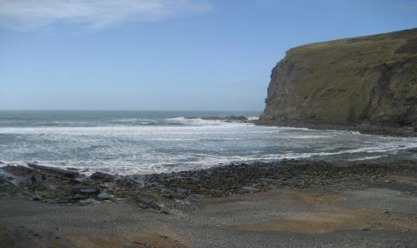
Angles of depression
In this lesson we will se how to apply the trigonometric ratios to solve problems in real-life situations
Angle of depression is the angle made between the horizon and the bottom of an object that you are looking down on
Horizon
Angle of depression

Slide 7
Angles of elevation
Example 1
An observer stands 100 m from the base of a building. The Angle of elevation of the top of the building is 65o. How tall is the building, to the nearest metre?
First draw a sketch
Now label the sides
We are given the adjacent side and we want to find the length of the side opposite to the angle, so we use:
opposite
tan 65º =
o
adjacent
h
x
tan 65º =
$$\frac{x}{100}$$
65º
a
100 m
x = 100(tan 65º )
x = 214.45
To the nearest metre it is 214 m

Slide 8
Angles of depression
From a vertical cliff 80m above sea level, a boat is observed at an angle of depression of 6º. How far out the sea is the boat?
First draw a sketch
Now label the sides
We are given the opposite side and we want to find the length of the side adjacent to the angle, so we use:
a
x
opposite
6º
tan 6º =
80 m
adjacent
o
h
$$\frac{80}{x}$$
tan 6º =
$$\frac{80}{\tan{6°}}$$
x =
x = 761.15
To the nearest metre it is 761 m

Slide 9
True Bearings

Slide 10
Compass points
45° between north and west
N
45° between North and east
NW
NE
W
E
SW
SE
45° between south and west
45° between south and east
S

Slide 11
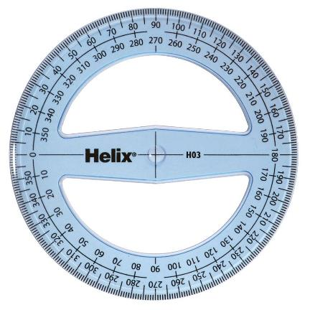
Compass points
When using Compass points for direction, you will see notation such as.
N 35° E
N 35° E
N
Which means 35° east of North
35°
W
E
S

Slide 12
Compass points
When using Compass points for direction, you will see notation such as.
W 25° S
N
Which means 25° south of west
W
E
25°
W 25° S
S

Slide 13
Bearings
Bearings are a measure of direction taken from North.
If you were travelling North you would be travelling on a bearing of 000°.
If you were travelling from the point P in the direction shown by the arrow then you would be travelling on a bearing of 000°.
If you were travelling from the point P in the direction shown by the arrow then you would be travelling on a bearing of 075°.
N
Bearings are always measured clockwise from North and are written as three figures.
75°
P

Slide 14
Bearings
The bearing from point A to point B is 105º.
What is the bearing from point B to point A?
N
The angle from B to A is
105º + 180º =
N
285º
105º
A
This is called a back bearing.
?
105º
B
180°

Slide 15
Bearings
Two ships leave a dock at the same time.
Ship A sails due north for 30 km before dropping anchor.
Ship B sails on a bearing of 050º for 65 km before dropping anchor.
Find the distance between the ships when they are stationary, to the nearest kilometre
Sketch a diagram
C
B
You need to find the length AB, the distance between the ships when they are stationary
A
65
41.781
There are not right angled triangles in the diagram, so draw them in
30
50º
40º
BE
Find BE
sin 40º =
D
E
65
BE =
65
sin 40º
BE =
41.781…

Slide 16
Bearings
Two ships leave a dock at the same time.
Ship A sails due north for 30 km before dropping anchor.
Ship B sails on a bearing of 050º for 65 km before dropping anchor.
Find the distance between the ships when they are stationary, to the nearest kilometre
Sketch a diagram
C
B
You need to find the length AB, the distance between the ships when they are stationary
A
65
41.781
There are not right angled triangles in the diagram, so draw them in
30
50º
40º
DE
Find DE
cos 40º =
D
49.7929
E
65
DE =
65
cos 40º
DE =
49.7929…

Slide 17
Bearings
Two ships leave a dock at the same time.
Ship A sails due north for 30 km before dropping anchor.
Ship B sails on a bearing of 050º for 65 km before dropping anchor.
Find the distance between the ships when they are stationary, to the nearest kilometre
Sketch a diagram
C
49.7929
B
You need to find the length AB, the distance between the ships when they are stationary
11.781
A
65
41.781
There are not right angled triangles in the diagram, so draw them in
30
50º
40º
BC = DE = 49.7929
D
49.7929
E
AC = BE - AD
AC = 41.781 - 30
= 11.781…

Slide 18
Bearings
Two ships leave a dock at the same time.
Ship A sails due north for 30 km before dropping anchor.
Ship B sails on a bearing of 050º for 65 km before dropping anchor.
Find the distance between the ships when they are stationary, to the nearest kilometre
Sketch a diagram
C
49.7929
B
You need to find the length AB, the distance between the ships when they are stationary
11.781
A
65
41.781
There are not right angled triangles in the diagram, so draw them in
30
50º
40º
AB² = (49.7929…)² + (11.7812…)²
D
49.7929
E
AB = 51.1677
The ships are approximately 52 km apart

Slide 19
Thank you for using resources from
For more resources visit our website
https://www.mathssupport.org
If you have a special request, drop us an email
info@mathssupport.org

