Slide 1
Exponential functions
LO: To identify the properties of an exponential function.
To draw the graph of an exponential function.

Slide 2
Exponential functions
In an exponential function, the variable is in the index.
For example:
f(x) = 2^{x}
f(x) = 5^{x}
f(x) = 0.1^{x}
f(x) = 3^{–x}
f(x) = 7^{x+1}
The general form of an exponential function to the base a is:
f(x) = a^{x} where a is a positive real number (a > 0) and a ≠1.
You have probably heard of exponential increase and decrease or exponential growth and decay.
A quantity that changes exponentially either increases or decreases increasingly rapidly as time goes on.
Notes:
Explain that exponential functions frequently occur naturally. For example, when cells multiply by doubling or when radioactive materials decay.
Discuss why negative values of a , a = 0 and a = 1 are not included in the general definition of an exponential function. For example, if we tried to plot y = (–2)^{x} there would be values of x, for example x = ½, for which the function could not be evaluated. Also if a were equal to 1 the function would be a straight line (y = 1).

Slide 3
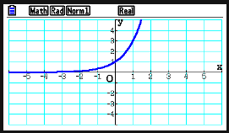
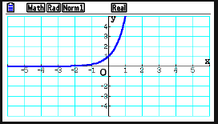
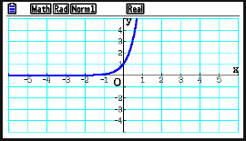
Using a GDC, sketch the graphs of these exponential functions
f(x) = 3^{x}
f(x) = 5^{x}
f(x) = 10^{x}
Look at your graphs. What can you say about the exponential function f(x) = a^{x}, when a > 1?
Think about
The domain
The domain of f(x) = a^{x} is the set of all real numbers.
The range
The range of f(x) = a^{x} is the set of all positive real numbers.
Intercepts on the axes
The y-intercept is 1
The curve does not intercept the x-axis.
Asymptotes
The graph approaches closer and closer to the x-axis as the value of x decreases.
The shape
The graph increases continually.
Behavior
The graph of f passes through the points $\left(−1,\frac{1}{a}\right)$, (0,1), (1,a).

Slide 4
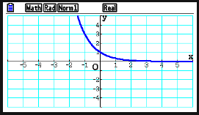
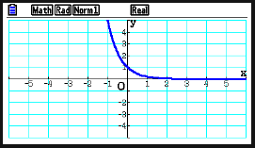
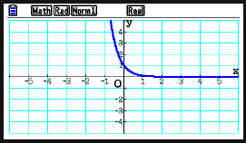



Using a GDC, sketch the graphs of these exponential functions
Now, look at the graphs of exponential functions when the base a is between 0 and 1. f(x) = a ^{x}, when 0 < a < 1?
f(x) = ${\left(\frac{1}{3}\right)}^{x}$
f(x) = ${\left(\frac{1}{5}\right)}^{x}$
f(x) = ${\left(\frac{1}{10}\right)}^{x}$
Compare with the previous graphs:
They are reflections over the y-axis
Think about
The domain
The domain of f(x) = a^{x} is the set of all real numbers.
The range
The range of f(x) = a^{x} is the set of all positive real numbers.
Intercepts on the axes
The y-intercept is 1
The curve does not intercept the x-axis.
Asymptotes
The graph approaches closer and closer to the x-axis as the value of x increases.
The shape
The graph decreases continually.
Behavior
The graph of f passes through the points $\left(−1,\frac{1}{a}\right)$, (0,1), (1,a).
Sketch the following graphs, and compare:
f(x) = 3^{–x}
f(x) = 5^{–x}
f(x) = 10^{–x}

Slide 5



Using a GDC, sketch the graphs of these exponential functions
Now, look at the graphs of exponential functions when the base a is greater than 1 but the index is negative f(x) = a^{–x}, when a > 1
f(x) = 3^{–x}
f(x) = 5^{–x}
f(x) = 10^{–x}
Sketch the following and compare with the previous graphs:
f(x) = ${\left(\frac{1}{3}\right)}^{x}$
f(x) = ${\left(\frac{1}{5}\right)}^{x}$
f(x) = ${\left(\frac{1}{10}\right)}^{x}$

Slide 6

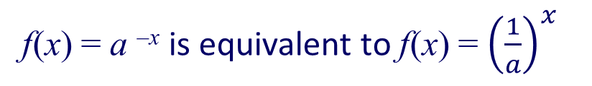

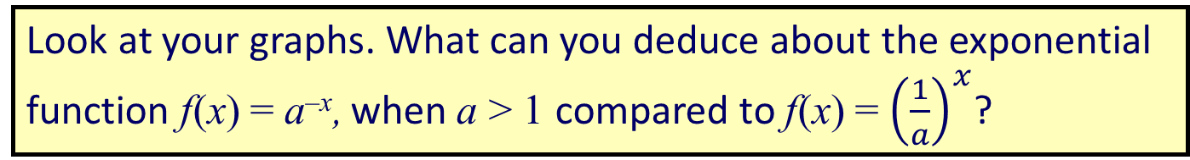

Look at your graphs. What can you deduce about the exponential function f(x) = a^{–x}, when a > 1 compared to f(x) = ${\left(\frac{1}{a}\right)}^{x}$?
f(x) = 3^{-x}
f(x) = 5^{-x}
f(x) = 10^{-x}
f(x) = a ^{–x} is equivalent to f(x) = ${\left(\frac{1}{a}\right)}^{x}$
f(x) = ${\left(\frac{1}{3}\right)}^{x}$
f(x) = ${\left(\frac{1}{5}\right)}^{x}$
f(x) = ${\left(\frac{1}{10}\right)}^{x}$
Whatever positive value a has, the graph of f(x) = a ^{–x} will always have the shape of an exponential decay function

Slide 7
Exponential functions
When a > 1 the graph of f(x) = a^{x} has the following shape:
When 0 < a < 1 the graph of
f(x) = a^{x} has the following shape:
y
y
1
1
(1, a)
(1, a)
x
x
f(x) = a^{x} is an exponential growth function
f(x) = a ^{-x} is an exponential decay function
In both cases the graph passes through (0, 1) and (1, a).
This is because:
a⁰ = 1 and a¹ = a
for all a > 0.
Notes:
Tell students that the graph on the left shows exponential growth while the graph on the right shows exponential decay.

Slide 8

Exponential functions
Draw a graph of the function f(x) = 3^{x} for -2 ≤ x ≤ 2.
Method 1: By hand
10
First make a table of values
8
6
x
–2
–1
0
1
2
1
1
4
f(x) = 3^{x}
9
3
1
3
9
2
Plot the points.
–4
–3
–2
–1
0
1
2
3
4
–2
Then draw the graph connecting all the points with a smooth curve.
–4
–6

Slide 9
Exponential functions
Draw a graph of the function f(x) = 3^{x} for -2 ≤ x ≤ 2.
10
Method 2: Using GDC
(2,9)
8
Sketch the graph
6
y-intercept
(0,1)
4
2
1
(0,1)
1
(-2, )
Two other points
(–2, )
9
9
–4
–3
–2
–1
0
1
2
3
4
–2
(2, 9)
Then draw the graph joining the points with a smooth curve asymptotic to the x-axis.
–4
–6

Slide 10


The exponential graph
The population of a village doubles every five years
Number of years
0
5
10
15
20
25
Population
200
400
$$800$$
1600
3200
6400
Complete the table and draw the graph.
Plot the points and draw the graph.
9000
8000
Estimate the number of years it will take for the population of the village to reach 5000
7000
6000
Population
5000
4000
23 years.
3000
Estimate the population of the village after 17 years.
2000
1000
Population is 2000
23
5
10
15
20
25
30
35
40
45
Number of Years(g)
Notes:
Discuss the behaviour of the function as the value of x approaches 0.
Ask students to imagine drawing this function with a pencil. It cannot be drawn without taking the pencil off the page and is therefore defined as discontinuous.

Slide 11
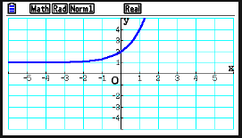
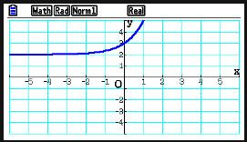
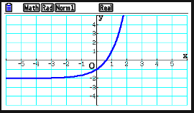
Using a GDC, transformations of the exponential function
We are going to investigate the effect of adding a positive or a negative constant value to y.
f(x) = 3^{x}
f(x) = 3^{x} + 1
f(x) = 3^{x} + 2
f(x) = 3^{x} – 2
Look at your graphs. What can you say about the exponential function after adding a positive or a negative constant value to y?
What is the effect of adding a positive constant to y
Vertical translation upwards
What is the effect of adding a negative constant to y
Vertical translation downwards

Slide 12
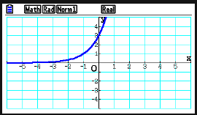
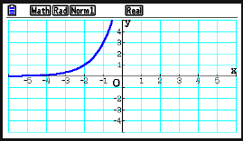
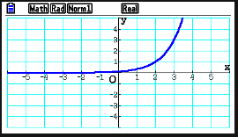
Using a GDC, transformations of the exponential function
We are going to investigate the effect of adding a constant value to x.
f(x) = 3^{x}
f(x) = 3^{x + 1}
f(x) = 3^{x + 2}
f(x) = 3^{x – 2}
Look at your graphs. What can you say about the exponential function after adding to x a positive or a negative constant value?
What is the effect of adding a positive constant to x
Horizontal translation to the left
What is the effect of adding a negative constant to x
Horizontal translation to the right

Slide 13
Exponential functions
For the function
f(x) = 3 – 2^{–x}
f(0)
f(3)
f(–x)
Find:
f(0) = 3 – 2⁰
f(3) = 3 – 2^{–3}
f(3) = 3 – 2^{–(–x)}
f(0) = 3 – 1
f(3) = 3 – $\frac{1}{8}$
f(3) = 3 – 2^{x}
f(0) = 2
f(3) = 2 $\frac{7}{8}$

Slide 14

Thank you for using resources from
For more resources visit our website
https://www.mathssupport.org
If you have a special request, drop us an email
info@mathssupport.org

