Slide 1
The reciprocal function
LO: Sketch the reciprocal function stating the Domain and Range, equations of Horizontal and Vertical asymptotes.

Slide 2
The reciprocal of a number
The reciprocal of a number is 1 divided by that number.
For example
is $\frac{1}{2}$
The reciprocal of 2
1 ÷ 2
The reciprocal of $\frac{1}{4}$
1 ÷ $\frac{1}{4}$
is $\frac{4}{1}$
= 4
The reciprocal of $\frac{3}{4}$
1 ÷ $\frac{3}{4}$
is $\frac{4}{3}$
The reciprocal of $\frac{7}{9}$
1 ÷ $\frac{7}{9}$
is $\frac{9}{7}$
Taking the reciprocal of a fraction turns it upside down

Slide 3
The reciprocal of a number
In general:
The reciprocal of a x is 1 divided by x, which is $\frac{1}{x}$.
A number multiplied by its reciprocal equals 1
x × $\frac{1}{x}$ = 1
Example:
Find the reciprocal of $2\frac{1}{7}$
Write as an improper fraction
$$\frac{15}{7}$$
$$\frac{7}{15}$$
Turn it upside down

Slide 4
The reciprocal function
The reciprocal function is
$$f\left(x\right)=\frac{k}{x}$$
Where k is a constant
Lets draw the graph of the function when k = 1
$$f\left(x\right)=\frac{1}{x}$$
x
- 1
$−\frac{1}{2}$
$−\frac{1}{4}$
$\frac{1}{4}$
$\frac{1}{2}$
1
f(x)
-1
-2
-4
4
2
1
y
Notice that the curve gets closer and closer to the x- and y-axes but never touches them.
4
2
1
-1
-½
-¼
0
¼
½
1
-1
x
The x- and y-axes form asymptotes.
-2
-4
If a curve gets continually closer to a straight line, the straight line is called an asymptote.
You can draw a dashed line to indicate the asymptotes.
This is a reciprocal function
The graph of a reciprocal function is called a hyperbola.

Slide 5
The reciprocal function
Summarising:
The graph of the reciprocal function is called hyperbola
The x-axis is the horizontal asymptote.
The y-axis is the vertical asymptote.
Both the domain and range are all the real numbers except zero.
The y-axis is an asymptote
y
4
2
y = x and y = -x are lines of symmetry for this function
1
-1
-½
-¼
0
¼
½
1
-1
x
-2
-4
The x-axis is an asymptote
The two separate parts of the graph are reflections of each other in y = -x

Slide 6
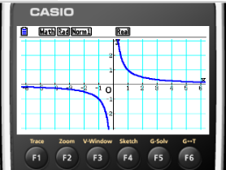
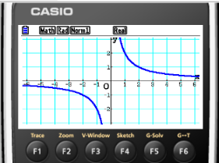
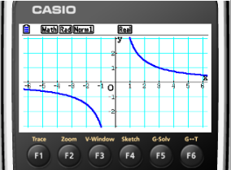
The reciprocal function
We are going to investigate the effect of changing the value of k.
Use your GDC to draw the graph of:
$$f\left(x\right)=\frac{1}{x}$$
$$g\left(x\right)=\frac{2}{x}$$
$$h\left(x\right)=\frac{3}{x}$$
What is the effect of changing the value of k
The graph is vertical stretched
The value of k indicates the scale factor of the vertical stretch

Slide 7
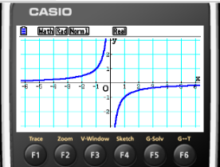
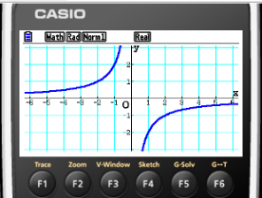
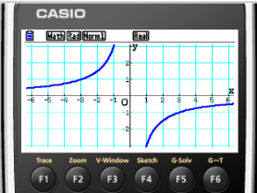
The reciprocal function
We are going to investigate the effect of changing the sign of k.
Use your GDC to draw the graph of:
$$f\left(x\right)=\frac{−1}{x}$$
$$g\left(x\right)=\frac{−2}{x}$$
$$h\left(x\right)=\frac{−3}{x}$$
What is the effect of changing the sign of k
The graph is reflected over the x-axis

Slide 8
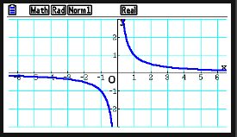
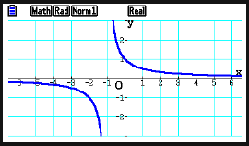
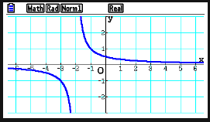
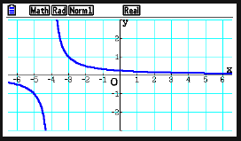
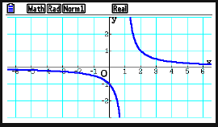
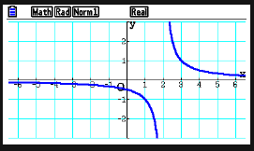
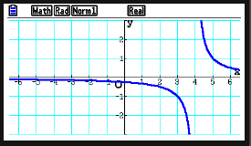
The reciprocal function
We are going to investigate the effect of adding or subtracting a constant from x.
Use your GDC to draw the graph of:
$$f\left(x\right)=\frac{1}{x}$$
$$g\left(x\right)=\frac{1}{x+1}$$
$$h\left(x\right)=\frac{1}{x+2}$$
$$j\left(x\right)=\frac{1}{x+4}$$
$$p\left(x\right)=\frac{1}{x−1}$$
$$q\left(x\right)=\frac{1}{x−2}$$
$$r\left(x\right)=\frac{1}{x−4}$$
What is the effect of adding a positive constant to x
Horizontal translation to the left
What is the effect of adding a negative constant to x
Horizontal translation to the right

Slide 9
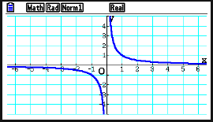
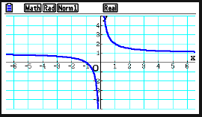
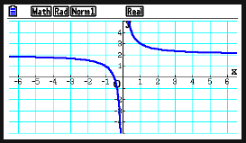
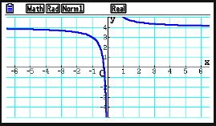
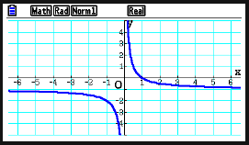
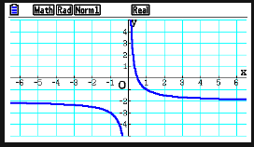
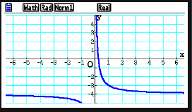
The reciprocal function
We are going to investigate the effect of adding or subtracting a constant from y.
Use your GDC to draw the graph of:
$$f\left(x\right)=\frac{1}{x}$$
$$g\left(x\right)=\frac{1}{x}+1$$
$$h\left(x\right)=\frac{1}{x}+2$$
$$j\left(x\right)=\frac{1}{x}+4$$
$$p\left(x\right)=\frac{1}{x}−1$$
$$q\left(x\right)=\frac{1}{x}−2$$
$$r\left(x\right)=\frac{1}{x}−4$$
What is the effect of adding a positive constant to y
Vertical translation upwards
What is the effect of adding a negative constant to y
Vertical translation downwards

Slide 10
The graph of
$$y=\frac{4}{x}$$
Complete the table for
$$f\left(x\right)=\frac{4}{x}$$
x
0.25
0.4
0.5
1
2
4
8
10
16
16
10
8
4
2
1
0.5
0.4
0.25
What do you notice about the values of x and f(x) in the table?
y
16
14
The top and bottom rows of the table contain the same numbers but in reverse order.
12
10
8
6
If we reflect the graph in the line y = x What do you notice?
4
2
The function reflects onto itself.
0
2
12
14
x
4
6
8
10
16
What does this tell you about the inverse function?
It is a self-inverse function.

Slide 11
The graph of
$$y=\frac{4}{x}$$
What if we take negative values of x?
$$x$$
-16
-10
-8
-4
-2
-1
-0.5
-0.4
-0.25
0
0.25
0.4
0.5
1
2
4
8
10
16
$$y$$
-0.25
-0.4
-0.5
-1
-2
-4
-8
-10
-16
und
16
10
8
4
2
1
0.5
0.4
0.25
16
y
What do you notice?
14
12
The curves get closer and closer to the axes but never actually touch or cross them
10
8
6
4
2
The axes are asymptotes to the graph
-16
-14
-12
-8
-6
-4
0
2
4
6
8
10
12
14
16
-10
-2
x
-2
-4
Domain
x ∈ ℝ ≠ 0
-6
-8
-10
Range
y ∈ ℝ ≠ 0
-12
-14
-16

Slide 12
Thank you for using resources from
For more resources visit our website
https://www.mathssupport.org
If you have a special request, drop us an email
info@mathssupport.org

