Slide 1
Quadratic inequalities
LO: To solve quadratic inequalities by graphing.
Use the GDC to solve quadratic inequalities.

Slide 2
Quadratic inequalities
Quadratic inequalities contain terms in both x² and x. For example:
x² + x – 6 ≥ 0
Factorizing gives
(x + 3)(x – 2) ≥ 0
x² + x – 6 is equal to 0 when:
x + 3 = 0
and
x – 2 = 0
x = –3
x = 2
These values give the end points of the solution set:
–5
–4
–3
–2
–1
0
1
2
3
4
5

Slide 3
Quadratic inequalities
To find the solution set we can substitute a value from each of the following three regions:
region 1
region 2
region 3
region 1
–5
–4
–3
–2
–1
0
1
2
3
4
5
into the original inequality x² + x – 6 ≥ 0.
When x = –4:
–4² + –4 – 6 ≥ 0
16 – 4 – 6 ≥ 0
6 ≥ 0
This is true and so values in region 1 satisfy the inequality.

Slide 4
Quadratic inequalities
When x = 0
0² + 0 – 6 ≥ 0
–6 ≥ 0
This is not true and so values in region 2 do not satisfy the inequality.
region 3
region 2
region 3
region 1
region 2
–5
–4
–3
–2
–1
0
1
2
3
4
5
When x = 3
3² + 3 – 6 ≥ 0
9 + 3 – 6 ≥ 0
6 ≥ 0
This is true and so values in region 3 satisfy the inequality.
Notes:
We choose 0 because it is an easy value to substitute.

Slide 5
Quadratic inequalities
We have shown that values in region 1 and region 3 satisfy the inequality x² + x – 6 ≥ 0.
region 1
region 2
region 3
–5
–4
–3
–2
–1
0
1
2
3
4
5
We can shown the complete solution set as follows:
–5
–4
–3
–2
–1
0
1
2
3
4
5
So the solution to x² + x – 6 ≥ 0 is:
x ≤ –3
or
x ≥ 2

Slide 6
Quadratic inequalities
A method for solving inequalities involves using graphs. For example:
Solve x² – 6x + 8 < 0
The first step is sketch the graph of y = x² – 6x + 8
To do this, we must find where the graph intersects the x-axis by factorizing:
x² – 6x + 8 < 0
y
(x – 2)
(x – 4)
< 0
When (x – 2)(x – 4) = 0, then x = 2 or x = 4
So the graph intersects the x-axis at x = 2 and x = 4
positive
positive
The graph will be ∪-shaped.
0
2
4
x
negative
Above the x-axis the values of y are greater than zero.
Below the x-axis the values of y are smaller than zero
Since we are looking for values where y < 0
The solution is
2 < x < 4

Slide 7
Quadratic inequalities
Solve 2x² – 5 ≥ 4x + 1
The first step is to rearrange the inequality so that all the terms are on one side and 0 is on the other.
2x² – 4x – 6 ≥ 0
Now we factorize to find where the graph intersects the x-axis
(2x + 2)
(x – 3)
≥ 0
y
When (2x + 2)(x – 3) = 0, then x = –1 or x = 3
So the graph intersects the x-axis at
x = –1 and x = 3
positive
positive
-1
0
3
x
The graph will be ∪-shaped.
negative
Above the x-axis the values of y are greater than zero.
Below the x-axis the values of y are smaller than zero
Since we are looking for values where y ≥ 0 we need the values above the x-axis.
The solution is
x ≤ –1
or
x ≥ 3

Slide 8
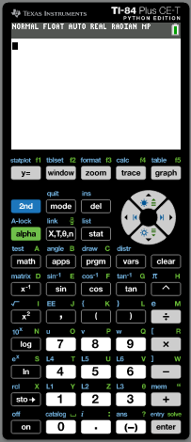
Quadratic inequalities
Use the GDC to solve this inequality.
3x² – 7x < 2x - 2
Give your answers correct to 3 significant figures
Turn on the GDC
Press
Y =
Notes:
We choose 0 because it is an easy value to substitute.

Slide 9
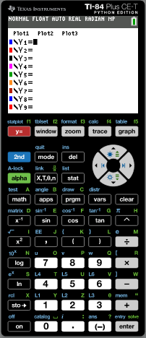
Quadratic inequalities
Use the GDC to solve this inequality.
3x² – 7x < 2x - 2
Give your answers correct to 3 significant figures
Turn on the GDC
Press
Y =
Type Y1:
3x² – 7x
enter
Notes:
We choose 0 because it is an easy value to substitute.

Slide 10
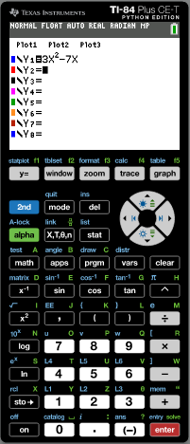
Quadratic inequalities
Use the GDC to solve this inequality.
3x² – 7x < 2x - 2
Give your answers correct to 3 significant figures
Turn on the GDC
Press
Y =
Type Y1:
3x² – 7x
enter
Type Y2:
2x – 2
enter
Notes:
We choose 0 because it is an easy value to substitute.

Slide 11
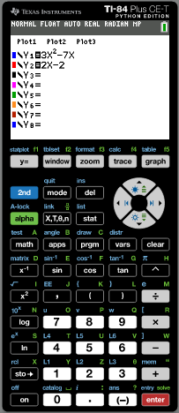
Quadratic inequalities
Use the GDC to solve this inequality.
3x² – 7x < 2x - 2
Give your answers correct to 3 significant figures
Turn on the GDC
Press
Y =
Type Y1:
3x² – 7x
enter
Type Y2:
2x – 2
enter
Press graph
Notes:
We choose 0 because it is an easy value to substitute.

Slide 12
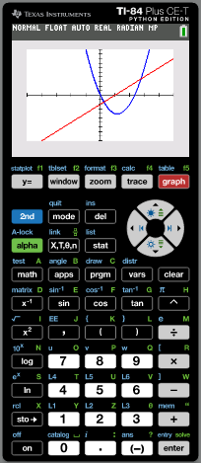
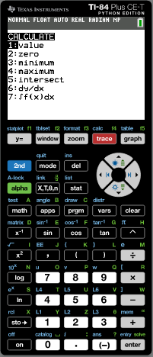
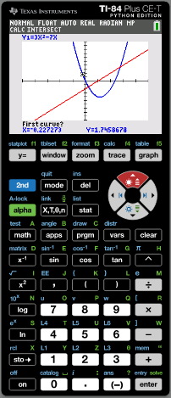
Quadratic inequalities
Use the GDC to solve this inequality.
3x² – 7x < 2x - 2
Give your answers correct to 3 significant figures
Turn on the GDC
Press
Y =
Type Y1:
3x² – 7x
enter
Type Y2:
2x – 2
enter
Press graph
2nd
calc
Press 5
Intersect
Use the arrows to put the cursor on the curve at the left of the 1st intersection.
enter
The cursor will jump to the line close the intersecting point.
enter
enter
Notes:
We choose 0 because it is an easy value to substitute.

Slide 13
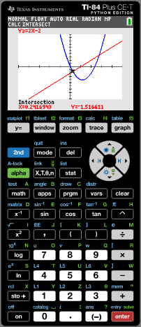
Quadratic inequalities
Use the GDC to solve this inequality.
3x² – 7x < 2x - 2
Give your answers correct to 3 significant figures
x = 0.2416943
Press
2nd
calc
Press 5
Intersect
Use the arrow ► to put the cursor on the curve close to the 2nd intersection.
enter
Use the arrow ▲ to put the cursor on the straight line close to the 2nd intersection.
enter
enter
enter
Notes:
We choose 0 because it is an easy value to substitute.

Slide 14
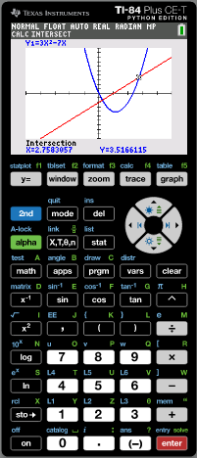
Quadratic inequalities
Use the GDC to solve this inequality.
3x² – 7x < 2x - 2
Give your answers correct to 3 significant figures
x = 0.2416943
Press
Intersect
2nd
calc
Press 5
Use the arrow ► to put the cursor on the curve close to the 2nd intersection.
enter
Use the arrow ▲ to put the cursor on the straight line close to the 2nd intersection.
enter
enter
enter
x = 2.7583057
Notes:
We choose 0 because it is an easy value to substitute.

Slide 15
Quadratic inequalities
Use the GDC to solve this inequality.
3x² – 7x < 2x - 2
Give your answers correct to 3 significant figures
x = 0.2416943
Press
Intersect
2nd
calc
Press 5
Use the arrow ► to put the cursor on the curve close to the 2nd intersection.
enter
Use the arrow ▲ to put the cursor on the straight line close to the 2nd intersection.
enter
enter
enter
x = 2.7583057
The solution consist of the values of x for which the graph of
y = 3x² – 7x lies below (that is less than) the graph of y = 2x – 2
The solution is
0.242 < x < 2.76
Notes:
We choose 0 because it is an easy value to substitute.

Slide 16

Thank you for using resources from
For more resources visit our website
https://www.mathssupport.org
If you have a special request, drop us an email
info@mathssupport.org
Get 20% off in your next purchase from our website, just use this code when checkout: MSUPPORT_20

