Slide 1
Quadratic inequalities
LO: To solve quadratic inequalities by graphing.
Use the GDC to solve quadratic inequalities.

Slide 2
Quadratic inequalities
Quadratic inequalities contain terms in both x² and x. For example:
x² + x – 6 ≥ 0
Factorizing gives
(x + 3)(x – 2) ≥ 0
x² + x – 6 is equal to 0 when:
x + 3 = 0
and
x – 2 = 0
x = –3
x = 2
These values give the end points of the solution set:
–5
–4
–3
–2
–1
0
1
2
3
4
5

Slide 3
Quadratic inequalities
To find the solution set we can substitute a value from each of the following three regions:
region 1
region 2
region 3
region 1
–5
–4
–3
–2
–1
0
1
2
3
4
5
into the original inequality x² + x – 6 ≥ 0.
When x = –4:
–4² + –4 – 6 ≥ 0
16 – 4 – 6 ≥ 0
6 ≥ 0
This is true and so values in region 1 satisfy the inequality.

Slide 4
Quadratic inequalities
When x = 0
0² + 0 – 6 ≥ 0
–6 ≥ 0
This is not true and so values in region 2 do not satisfy the inequality.
region 3
region 2
region 3
region 1
region 2
–5
–4
–3
–2
–1
0
1
2
3
4
5
When x = 3
3² + 3 – 6 ≥ 0
9 + 3 – 6 ≥ 0
6 ≥ 0
This is true and so values in region 3 satisfy the inequality.
Notes:
We choose 0 because it is an easy value to substitute.

Slide 5
Quadratic inequalities
We have shown that values in region 1 and region 3 satisfy the inequality x² + x – 6 ≥ 0.
region 1
region 2
region 3
–5
–4
–3
–2
–1
0
1
2
3
4
5
We can shown the complete solution set as follows:
–5
–4
–3
–2
–1
0
1
2
3
4
5
So the solution to x² + x – 6 ≥ 0 is:
x ≤ –3
or
x ≥ 2

Slide 6
Quadratic inequalities
A method for solving inequalities involves using graphs. For example:
Solve x² – 6x + 8 < 0
The first step is sketch the graph of y = x² – 6x + 8
To do this, we must find where the graph intersects the x-axis by factorizing:
x² – 6x + 8 < 0
y
(x – 2)
(x – 4)
< 0
When (x – 2)(x – 4) = 0, then x = 2 or x = 4
So the graph intersects the x-axis at x = 2 and x = 4
positive
positive
The graph will be ∪-shaped.
0
2
4
x
negative
Above the x-axis the values of y are greater than zero.
Below the x-axis the values of y are smaller than zero
Since we are looking for values where y < 0
The solution is
2 < x < 4

Slide 7
Quadratic inequalities
Solve 2x² – 5 ≥ 4x + 1
The first step is to rearrange the inequality so that all the terms are on one side and 0 is on the other.
2x² – 4x – 6 ≥ 0
Now we factorize to find where the graph intersects the x-axis
(2x + 2)
(x – 3)
≥ 0
y
When (2x + 2)(x – 3) = 0, then x = –1 or x = 3
So the graph intersects the x-axis at
x = –1 and x = 3
positive
positive
-1
0
3
x
The graph will be ∪-shaped.
negative
Above the x-axis the values of y are greater than zero.
Below the x-axis the values of y are smaller than zero
Since we are looking for values where y ≥ 0 we need the values above the x-axis.
The solution is
x ≤ –1
or
x ≥ 3

Slide 8
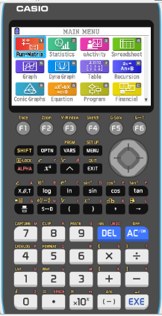
Quadratic inequalities
Use the GDC to solve this inequality.
3x² – 7x < 2x - 2
Give your answers correct to 3 significant figures
Turn on the GDC
5
Graph
Notes:
We choose 0 because it is an easy value to substitute.

Slide 9
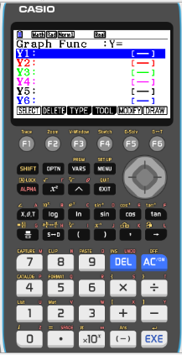
Quadratic inequalities
Use the GDC to solve this inequality.
3x² – 7x < 2x - 2
Give your answers correct to 3 significant figures
Turn on the GDC
5
Graph
Type Y1:
3x² – 7x
EXE
Notes:
We choose 0 because it is an easy value to substitute.

Slide 10
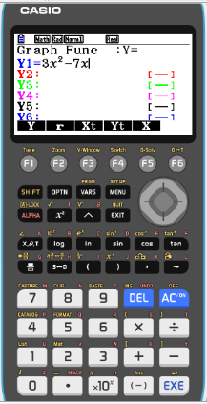
Quadratic inequalities
Use the GDC to solve this inequality.
3x² – 7x < 2x - 2
Give your answers correct to 3 significant figures
Turn on the GDC
5
Graph
Type Y1:
3x² – 7x
EXE
Type Y2:
2x – 2
EXE
Notes:
We choose 0 because it is an easy value to substitute.

Slide 11
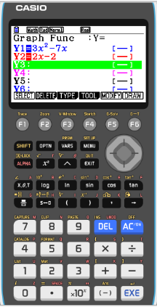
Quadratic inequalities
Use the GDC to solve this inequality.
3x² – 7x < 2x - 2
Give your answers correct to 3 significant figures
Turn on the GDC
5
Graph
Type Y1:
3x² – 7x
EXE
Type Y2:
2x – 2
EXE
F6
DRAW
Notes:
We choose 0 because it is an easy value to substitute.

Slide 12
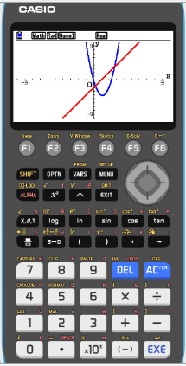
Quadratic inequalities
Use the GDC to solve this inequality.
3x² – 7x < 2x - 2
Give your answers correct to 3 significant figures
Turn on the GDC
5
Graph
Type Y1:
3x² – 7x
EXE
Type Y2:
2x – 2
EXE
F6
DRAW
F5
G-Solv
F5
INTSECT
Notes:
We choose 0 because it is an easy value to substitute.

Slide 13
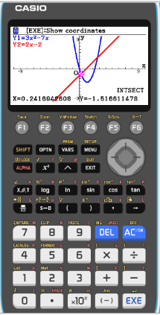
Quadratic inequalities
Use the GDC to solve this inequality.
3x² – 7x < 2x - 2
Give your answers correct to 3 significant figures
Turn on the GDC
5
Graph
Type Y1:
3x² – 7x
EXE
Type Y2:
2x – 2
EXE
F6
DRAW
F5
G-Solv
F5
INTSECT
x = 0.2416942608
►
Notes:
We choose 0 because it is an easy value to substitute.

Slide 14

Quadratic inequalities
Use the GDC to solve this inequality.
3x² – 7x < 2x - 2
Give your answers correct to 3 significant figures
Turn on the GDC
5
Graph
Type Y1:
3x² – 7x
EXE
Type Y2:
2x – 2
EXE
F6
DRAW
F5
G-Solv
F5
INTSECT
x = 0.2416942608
►
x = 2.758305739
The solution consist of the values of x for which the graph of
y = 3x² – 7x lies below (that is less than) the graph of y = 2x – 2
The solution is
0.242 < x < 2.76
Notes:
We choose 0 because it is an easy value to substitute.

Slide 15

Thank you for using resources from
For more resources visit our website
https://www.mathssupport.org
If you have a special request, drop us an email
info@mathssupport.org
Get 20% off in your next purchase from our website, just use this code when checkout: MSUPPORT_20

