Slide 1
Solving quadratic equations (Using GDC)
LO: Use the GDC to solve quadratic equations, either using the solver or graphically

Slide 2
Quadratic equations
The general form of a quadratic equation is
ax² + bx + c = 0
Where a, b and c are constants and a ≠ 0.
The solutions of the equation are the values of x which make the equation true.
We call these the roots of the equation, and they are also the zeros of the quadratic expression ax² + bx + c

Slide 3
Solution of x² = k
Many quadratic equations can be rearranged into the form
x² = k
if k > 0.
$${\left(\sqrt{k}\right)}^{2}=k$$
$$\sqrt{k}$$
exists such that
$${\left(−\sqrt{k}\right)}^{2}=k$$
Thus the solutions are x =
$$±\sqrt{k}$$
if k = 0
x = 0
if k < 0.
There are no real solutions

Slide 4
Example 1:
x² – 81 = 0
x² = 81
x =
x = 9
or
x = -9

Slide 5
Example 2:
3x² – 1 = 8
3x² = 9
x² = 3
x =
$$±\sqrt{3}$$
x = $\sqrt{3}$
or
x = $−\sqrt{3}$

Slide 6
Example 3:
(x – 4)² = 6
$\sqrt{(x – 4)2}$ = $±\sqrt{6 }$
x – 4 = $±\sqrt{6 }$
x =
$$4±\sqrt{6}$$
x = 4+$\sqrt{6}$
or
x = $4−\sqrt{6}$

Slide 7
The Null Factor Law
The Null Factor Law states:
When a product of two (or more) numbers is zero then at least one of them must be zero.
If ab = 0 then a = 0 or b = 0.
Solve for x using the Null Factor Law
3x(x – 5) = 0.
∴ 3x = 0
or x – 5 = 0
∴ x = 0 or x = 5
Solve for x using the Null Factor Law
(x – 4)(3x + 7) = 0.
∴ x – 4 = 0
or 3x + 7 = 0
∴ x = 4 or 3x = – 7
x = - $\frac{7}{3}$

Slide 8
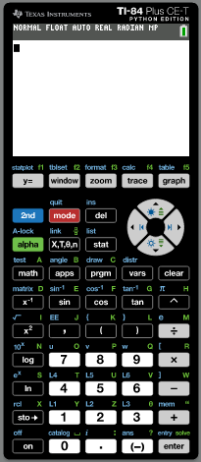
Using the GDC:
Solve the quadratic equation:
3x² + 2x – 11 = 0
Press APPS

Slide 9
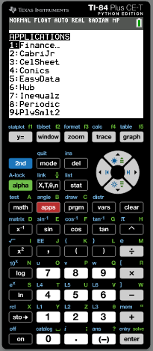
Using the GDC:
Solve the quadratic equation:
3x² + 2x – 11 = 0
Press APPS
Press 9 PolySmlt2

Slide 10
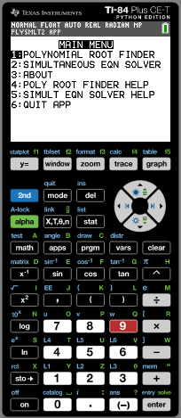
Using the GDC:
Solve the quadratic equation:
3x² + 2x – 11 = 0
Press APPS
Press 9 PolySmlt2
Press 1 Polynomial root finder

Slide 11
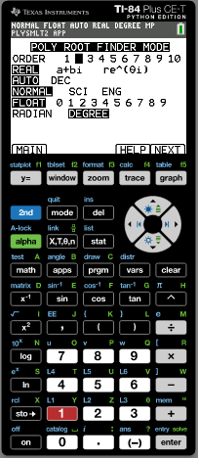
Using the GDC:
Solve the quadratic equation:
3x² + 2x – 11 = 0
Press APPS
Press 9 PolySmlt2
Press 1 Polynomial root finder
ORDER Press 2
Press F5 NEXT

Slide 12
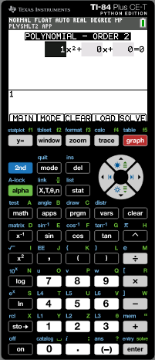
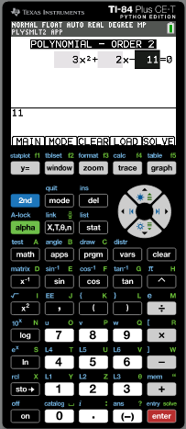
Using the GDC:
Solve the quadratic equation:
3x² + 2x – 11 = 0
Press APPS
Press 9 PolySmlt2
Press 1 Polynomial root finder
ORDER Press 2
Press F5 NEXT
Enter the coefficients
3
Enter
Enter
–
Enter
11
Enter
+
2
Enter
Press F5 SOLVE to solve the equation

Slide 13
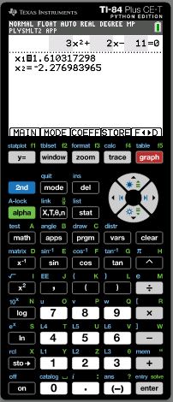
Using the GDC:
Solve the quadratic equation:
3x² + 2x – 11 = 0
Press APPS
Press 9 PolySmlt2
Press 1 Polynomial root finder
ORDER Press 2
Press F5 NEXT
3
Enter
Enter the coefficients
Enter
–
Enter
11
Enter
+
2
Enter
Press F5 SOLVE to solve the equation
You have the two solutions

Slide 14
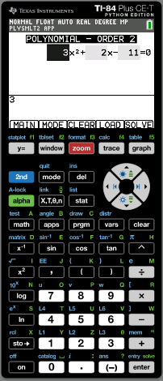
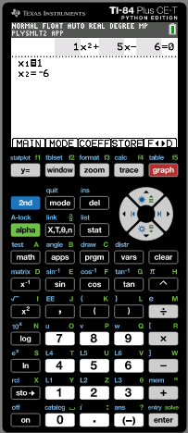
Using the GDC:
Solve the quadratic equation:
3(x – 1) + x(x + 2) = 3
3x – 3 + x² + 2x = 3
Expanding brackets
x² + 5x – 3 = 3
Collecting like terms
x² + 5x – 6 = 0
Making the RHS zero
Press F3 COEFF
Enter the coefficients
1
Enter
Enter
–
Enter
6
Enter
+
5
Enter
Press F5 SOLV to solve the equation
You have the two solutions

Slide 15
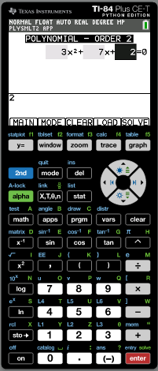
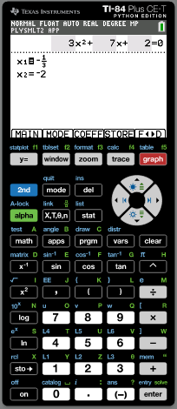
Using the GDC:
Solve the quadratic equation:
$$3x+\frac{2}{x}=−7$$
x$\left(3x+\frac{2}{x}\right)=−7x$
Multiplying both sides by x
3x² + 2 = – 7x
Expanding the brackets
3x² + 7x + 2 = 0
Making the RHS zero
Press F3 COEFF
Enter the coefficients
3
Enter
Enter
+
Enter
2
Enter
+
7
Enter
Press F5 SOLV to solve the equation
You have the two solutions

Slide 16
Using the GDC:
Use a graphical method to solve:
8x² + x – 2 = 9
We graph
Y₁ = 8x² + x – 2
and
Y₂ = 9
On the same set of axes
And find where the graphs intersect

Slide 17
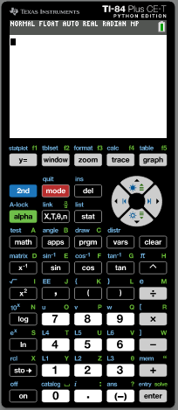
Using the GDC:
Solve the quadratic equation:
8x² + x – 2 = 9
Press 2nd QUIT
Press Y =

Slide 18
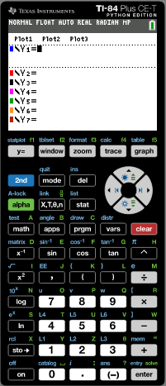
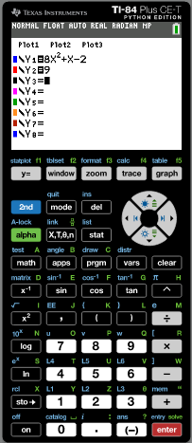
Using the GDC:
Solve the quadratic equation:
8x² + x – 2 = 9
Press 2nd QUIT
Press Y =
Store 8x² + x – 2 into Y1 and
9 into Y2.
Press F5 (GRAPH) to draw a graph of the functions

Slide 19
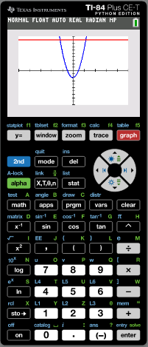
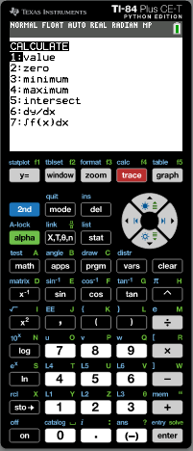
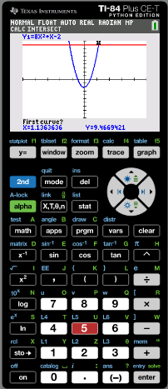
Using the GDC:
Solve the quadratic equation:
8x² + x – 2 = 9
Press 2nd QUIT
Press Y =
Store 8x² + x – 2 into Y1 and
9 into Y2.
Press F5 (GRAPH) to draw a graph of the functions
Press 2nd F4 (Calc)
Press 5 (Intersect)
Use the arrows to put the cursor on the line at the left of the 1st intersection. Enter. Then move the cursor to the parabola close the intersecting point.
enter
enter

Slide 20
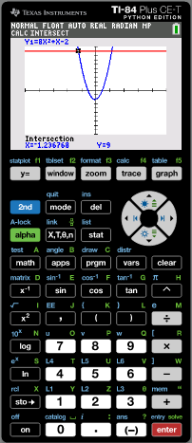
Using the GDC:
Solve the quadratic equation:
8x² + x – 2 = 9
We have found the first point of intersection x = -1.24
enter
Press 2nd F4 (Calc)
Press 5 (Intersect)
Use the arrows to put the cursor on the line at the left of the 2nd intersection. Enter. Then move the cursor to the parabola close the intersecting point.
enter
enter

Slide 21
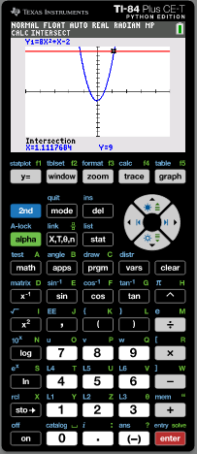
Using the GDC:
Solve the quadratic equation:
8x² + x – 2 = 9
We have found the first point of intersection x = – 1.24
enter
Press 2nd F4 (Calc)
Press 5 (Intersect)
Use the arrows to put the cursor on the line at the left of the 2nd intersection. Enter. Then move the cursor to the parabola close the intersecting point.
enter
enter
We have found the second point of intersection x = 1.11
Solution:
x = – 1.24
or
x = 1.11

Slide 22
Thank you for using resources from
For more resources visit our website
https://www.mathssupport.org
If you have a special request, drop us an email
info@mathssupport.org

