Slide 1
Solving quadratic equations (Using GDC)
LO: Use the GDC to solve quadratic equations, either using the solver or graphically

Slide 2
Quadratic equations
The general form of a quadratic equation is
ax² + bx + c = 0
Where a, b and c are constants and a ≠ 0.
The solutions of the equation are the values of x which make the equation true.
We call these the roots of the equation, and they are also the zeros of the quadratic expression ax² + bx + c

Slide 3
Solution of x² = k
Many quadratic equations can be rearranged into the form
x² = k
if k > 0.
$${\left(\sqrt{k}\right)}^{2}=k$$
$$\sqrt{k}$$
exists such that
$${\left(−\sqrt{k}\right)}^{2}=k$$
Thus the solutions are x =
$$±\sqrt{k}$$
if k = 0
x = 0
if k < 0.
There are no real solutions

Slide 4
Example 1:
x² – 81 = 0
x² = 81
x =
x = 9
or
x = -9

Slide 5
Example 2:
3x² – 1 = 8
3x² = 9
x² = 3
x =
$$±\sqrt{3}$$
x = $\sqrt{3}$
or
x = $−\sqrt{3}$

Slide 6
Example 3:
(x – 4)² = 6
$\sqrt{(x – 4)2}$ = $±\sqrt{6 }$
x – 4 = $±\sqrt{6 }$
x =
$$4±\sqrt{6}$$
x = 4+$\sqrt{6}$
or
x = $4−\sqrt{6}$

Slide 7
The Null Factor Law
The Null Factor Law states:
When a product of two (or more) numbers is zero then at least one of them must be zero.
If ab = 0 then a = 0 or b = 0.
Solve for x using the Null Factor Law
3x(x – 5) = 0.
∴ 3x = 0
or x – 5 = 0
∴ x = 0 or x = 5
Solve for x using the Null Factor Law
(x – 4)(3x + 7) = 0.
∴ x – 4 = 0
or 3x + 7 = 0
∴ x = 4 or 3x = – 7
x = - $\frac{7}{3}$

Slide 8
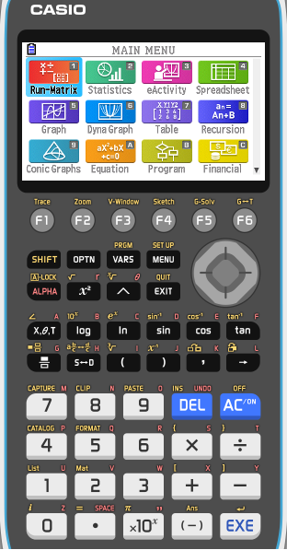
Using the GDC:
Solve the quadratic equation:
3x² + 2x – 11 = 0
Select Equation (A) from the main MENU

Slide 9
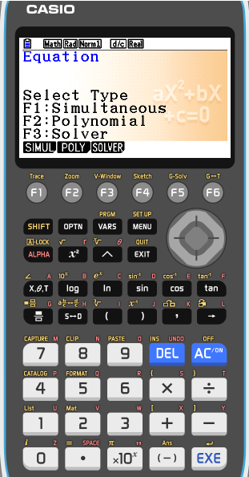
Using the GDC:
Solve the quadratic equation:
3x² + 2x – 11 = 0
Select Equation (A) from the main MENU
Press F2 Polynomial

Slide 10
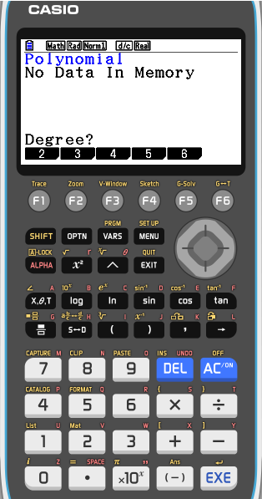
Using the GDC:
Solve the quadratic equation:
3x² + 2x – 11 = 0
Select Equation (A) from the main MENU
Press F2 Polynomial
Press F1 Degree 2

Slide 11
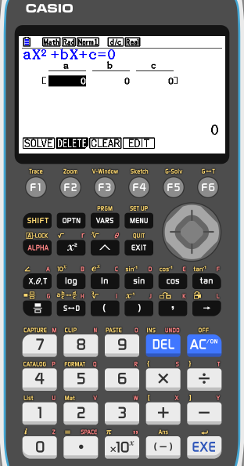
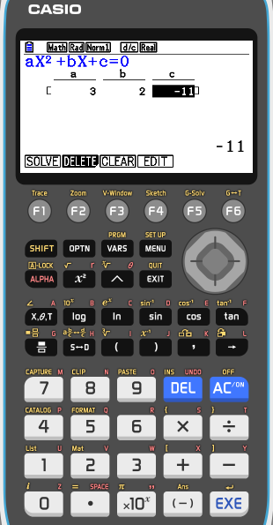
Using the GDC:
Solve the quadratic equation:
3x² + 2x – 11 = 0
Select Equation (A) from the main MENU
Press F2 Polynomial
Press F1 Degree 2
Enter the coefficients 3, 2, and -11
Press F1 SOLV to solve the equation

Slide 12
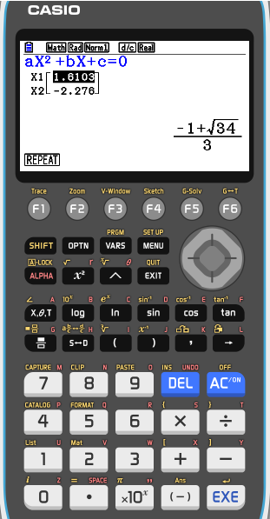
Using the GDC:
Solve the quadratic equation:
3x² + 2x – 11 = 0
Select Equation (A) from the main MENU
Press F2 Polynomial
Press F1 Degree 2
Enter the coefficients 3, 2, and -11
Press F1 SOLV to solve the equation
You have the two solutions

Slide 13
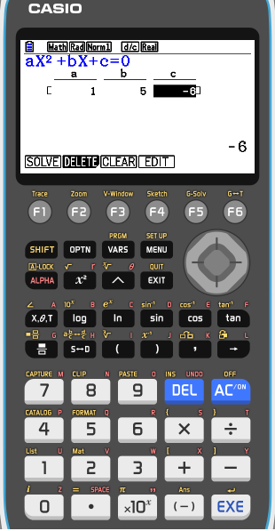
Using the GDC:
Solve the quadratic equation:
3(x – 1) + x(x + 2) = 3
3x – 3 + x² + 2x = 3
Expanding brackets
x² + 5x – 3 = 3
Collecting like terms
x² + 5x – 6 = 0
Making the RHS zero
EXIT
Enter the coefficients 1, 5, and -6
Press F1 SOLV to solve the equation
You have the two solutions

Slide 14
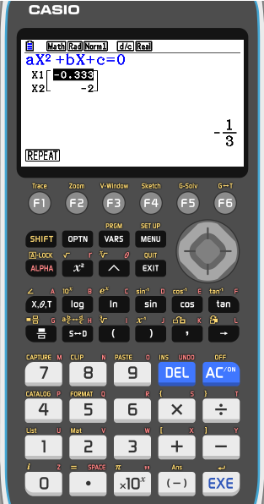
Using the GDC:
Solve the quadratic equation:
$$3x+\frac{2}{x}=−7$$
x$\left(3x+\frac{2}{x}\right)=−7x$
Multiplying both sides by x
3x² + 2 = – 7x
Expanding the brackets
3x² + 7x + 2 = 0
Making the RHS zero
EXIT
Enter the coefficients 3, 7, and 2
Press F1 SOLV to solve the equation
You have the two solutions

Slide 15
Using the GDC:
Use a graphical method to solve:
8x² + x – 2 = 9
We graph
Y₁ = 8x² + x – 2
and
Y₂ = 9
On the same set of axes
And find where the graphs intersect

Slide 16
Using the GDC:
Solve the quadratic equation:
8x² + x – 2 = 9
Select GRAPH from the main MENU

Slide 17
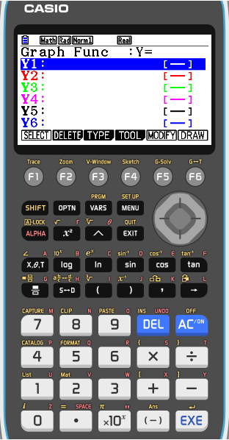
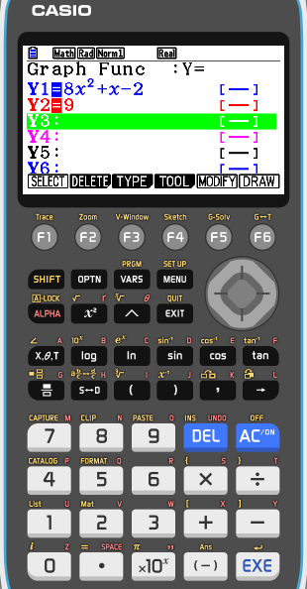
Using the GDC:
Solve the quadratic equation:
8x² + x – 2 = 9
Select GRAPH from the main MENU
Store 8x² + x – 2 into Y1 and
9 into Y2.
Press F6 (DRAW) to draw a graph of the functions

Slide 18
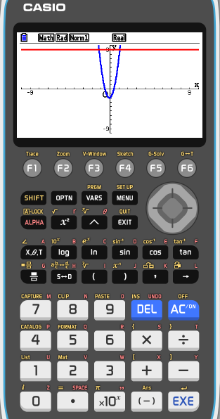
Using the GDC:
Solve the quadratic equation:
8x² + x – 2 = 9
Select GRAPH from the main MENU
Store 8x² + x – 2 into Y1 and
9 into Y2.
Press F6 (DRAW) to draw a graph of the functions
Press F5 (G-Solv) F5 (ISCT) to find one point of intersection x = -1.24

Slide 19
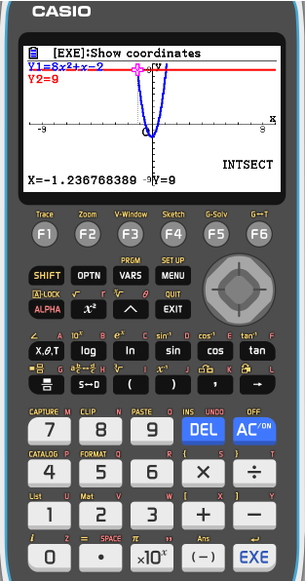
Using the GDC:
Solve the quadratic equation:
8x² + x – 2 = 9
Select GRAPH from the main MENU
Store 8x² + x – 2 into Y1 and
9 into Y2.
Press F6 (DRAW) to draw a graph of the functions
Press F5 (G-Solv) F5 (ISCT) to find one point of intersection x = -1.24
Press ► to find the second point of intersection x = 1.11

Slide 20
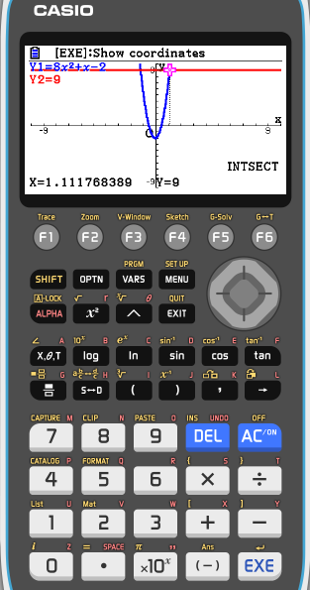
Using the GDC:
Solve the quadratic equation:
8x² + x – 2 = 9
Select GRAPH from the main MENU
Store 8x² + x – 2 into Y1 and
9 into Y2.
Press F6 (DRAW) to draw a graph of the functions
Press F5 (G-Solv) F5 (ISCT) to find one point of intersection x = -1.24
Press ► to find the second point of intersection x = 1.11
Solution:
x = – 1.24
or
x = 1.11

Slide 21
Thank you for using resources from
For more resources visit our website
https://www.mathssupport.org
If you have a special request, drop us an email
info@mathssupport.org

