Slide 1
Transforming functions
LO: To perform the following transformations:
Translations: Horizontal and vertical
Reflections in both axes
Horizontal Stretch and vertical stretch

Slide 2
Transforming functions
Graphs can be transformed by translating, reflecting, stretching or rotating them.
The equation of the transformed graph will be related to the equation of the original graph.
When investigating transformations it is most useful to express functions using function notation.
For example, suppose we wish to investigate transformations of the function f(x) = x³.
The equation of the graph of y = x³, can be written as y = f(x).

Slide 3
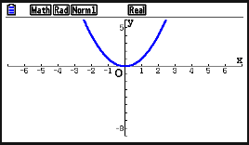
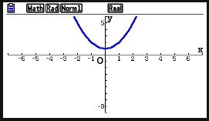
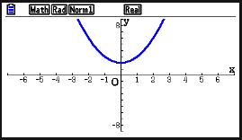
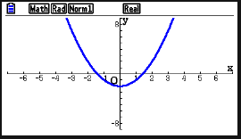
Use your GDC to sketch the following graphs:
y = x²
(
y = x² + 1
= f (x)
If
= f (x)
)
+ 1
f (x) is translated 1 unit upward
(
)
= f (x)
y = x² + 2.
+ 2
(
y = x² – 2.
= f (x)
)
– 2
f (x) is translated 2 units upward
f (x) is translated 2 units downward
Compare your functions
f (x) + k translates f (x) vertically a distance of c units upward
What effect do the constant terms have on the graphs?
f (x) – k translates f (x) vertically a distance of c units downward

Slide 4
Vertical translations
Here is the graph of f (x).
y
This is the graph of f (x) + 1.
4
f (x) + 1
What do you notice?
3
2
The graph of f (x) has been translated 1 units upward.
1
-2
-1
1
2
The graph of f(x) + k is the graph of f(x) translated vertically a distance of k units upwards.
x
-1
f (x)
-2
-3
-4
We can say that has been translated by the vector
0
k

Slide 5
Vertical translations
Here is the graph of f (x).
y
This is the graph of f (x) - 1.
4
What do you notice?
3
f (x)
2
The graph of f (x) has been translated 1 units downward.
1
-2
-1
1
2
The graph of f(x) - k is the graph of f(x) translated vertically a distance of k units downward.
x
-1
-2
f (x) - 1
-3
-4
We can say that has been translated by the vector
0
-k

Slide 6
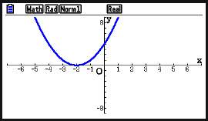
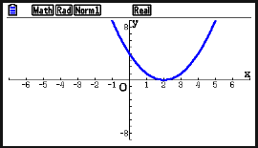
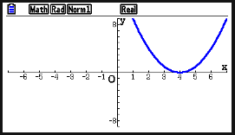
Use your GDC to sketch the following graphs:
y = (x + 2)²
(
)²
= f (x )
If
y = x²
= f (x)
+ 2
f (x) is translated 2 units to the left
(
y = (x – 4)²
)²
)²
(
y = (x – 2)²
= f (x )
= f (x )
– 2
– 4
f (x) is translated 2 units to the right
f (x) is translated 4 units to the right
f (x + k) translates f (x) horizontally k units to the left
Compare your functions
What effect do the constant terms have on the graphs?
f (x – k ) translates f (x) horizontally k units to the right.

Slide 7
Horizontal translations
Here is the graph of f (x).
y
This is the graph of f (x + 2)
4
What do you notice?
3
2
The graph of f (x) has been translated 2 units to the left.
f (x + 2)
1
-2
-1
1
2
The graph of f(x + k) is the graph of f(x) translated horizontally a distance of k units to the left.
x
-1
f (x)
-2
-3
-4
We can say that has been translated by the vector
-k
0

Slide 8
Horizontal translations
Here is the graph of f (x).
y
This is the graph of f (x - 1).
4
What do you notice?
3
f (x)
2
The graph of f (x) has been translated 1 units to the right.
1
-2
-1
1
2
The graph of f(x - k) is the graph of f(x) translated horizontally a distance of k units the right.
x
-1
-2
f (x - 1)
-3
-4
We can say that has been translated by the vector
k
0

Slide 9
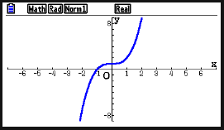
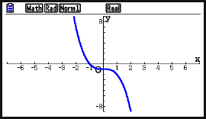
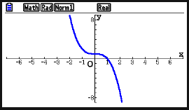
Use your GDC to sketch the following graphs:
(
y = –(x³ + 1)
If
y = x³ + 1
= f (x)
)
= – f (x)
f (x) is reflected in the x-axis
)
y = (–x)³ + 1
(
= f (– x)
f (x) is reflected in the y-axis
Compare your functions
–f (x) reflects f (x) in the x-axis.
What effect do the signs have on the graphs?
f (– x) reflects f (x) in the y-axis

Slide 10
Reflections
Here is the graph of f (x).
y
This is the graph of –f (x)
4
What do you notice?
3
- f (x)
2
The graph of f (x) has been reflected over the x-axis.
1
-2
-1
1
2
x
-1
f (x)
The graph of – f(x) is the reflection of the graph f(x) in the x-axis.
-2
-3
-4

Slide 11
Reflections
Here is the graph of f (x).
y
This is the graph of f (– x).
4
What do you notice?
3
f (– x)
f (x)
2
1
The graph of f (x) has been reflected over the y-axis.
-2
-1
1
2
x
-1
-2
The graph of f(– x) is the reflection of the graph f(x) in the y-axis.
-3
-4

Slide 12
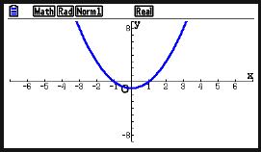
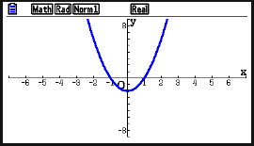
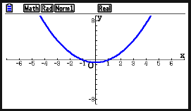
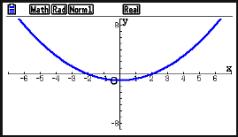
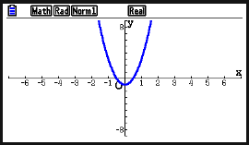

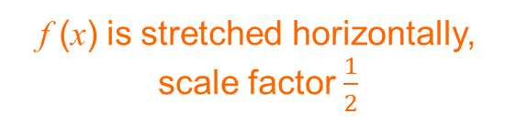

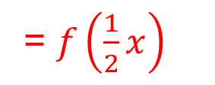
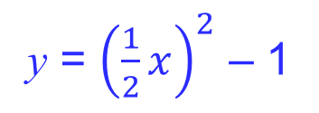
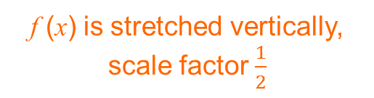
Use your GDC to sketch the following graphs:
y = $\frac{1}{2}$(x² – 1)
= $\frac{1}{2}$(f (x))
y = x² – 1
y = 2(x² – 1)
= 2( f (x))
(
)
If
= f (x)
(
)
f (x) is stretched vertically, scale factor 2
f (x) is stretched vertically, scale factor $\frac{1}{2}$
y = ${\left(\frac{1}{2}x\right)}^{2}$ – 1
= $f\left(\frac{1}{2}x\right)$
(
)
)
y = (2 x)² – 1
(
= f (2x)
f (x) is stretched horizontally, scale factor $\frac{1}{2}$
f (x) is stretched horizontally, scale factor 2
pf (x) stretches f (x) vertically with scale factor p
Compare your functions
What effect do the constant terms have on the graphs?
f (qx) stretches f (x) horizontally with scale factor $\frac{1}{q}$

Slide 13
Stretches
Here is the graph of f (x).
What do you notice?
The graph of f (x) has been stretched or compressed horizontally with scale factor .
This is the graph of f (2x).
1
y
2
4
f (2x)
The graph of f(qx) stretches or compresses f(x) horizontally with scale factor .
3
f (x)
2
1
1
q
-2
-1
1
2
x
The transformation is a horizontal stretch of scale factor .
-1
1
-2
q
When q > 1 the graph is compressed towards the y-axis.
-3
-4
When 0 < q < 1 the graph is stretched away from the y-axis.

Slide 14
Stretches
Here is the graph of f (x).
What do you notice?
The graph of f (x) has been stretched or compressed vertically with scale factor 2.
This is the graph of 2f (x).
y
4
2f (x)
The graph of 2f(x) stretches or compresses f(x) vertically with scale factor 2.
3
2
1
-2
-1
1
2
x
The transformation is a vertical stretch of scale factor p.
-1
-2
f (x)
When p > 1 the graph is stretched away from the x-axis.
-3
-4
When 0 < p < 1 the graph is compressed towards the x-axis.

Slide 15
Transforming functions
Summarising:
Vertical translation
f (x) + k translates f (x) vertically a distance of c units upward
f (x) – k translates f (x) vertically a distance of c units downward
Horizontal translation
f (x + k ) translates f (x) horizontally k units to the left.
f (x – k ) translates f (x) horizontally k units to the right.
Reflection
–f (x) reflects f (x) in the x-axis.
f (– x) reflects f (x) in the y-axis
Stretch
pf (x) stretches f (x) vertically with scale factor p
f (qx) stretches f (x) horizontally with scale factor $\frac{1}{q}$

Slide 16
Example 1.
y
8
Here is the graph of f (x).
7
6
5
4
Sketch the graph of:
3
f (x + 2)
f (x)
2
f (x + 2)
1
–7 –6 –5 –4 –3 –2 –1
1 2 3 4 5 6 7
x
⁻1
⁻2
⁻3
⁻4
⁻5
⁻6

Slide 17
Example 2.
y
8
Here is the graph of f (x).
7
6
5
Sketch the graph of:
4
3
f (x)
f (x) - 3
2
1
x
–7 –6 –5 –4 –3 –2 –1
1 2 3 4 5 6 7
⁻1
f (x ) - 3
⁻2
⁻3
⁻4
⁻5
⁻6

Slide 18
Example 3.
y
8
Here is the graph of f (x).
7
6
5
Sketch the graph of:
4
3
f (x)
f (-x)
f (-x )
2
1
x
–7 –6 –5 –4 –3 –2 –1
1 2 3 4 5 6 7
⁻1
⁻2
⁻3
⁻4
⁻5
⁻6

Slide 19
Example 4.
y
8
Here is the graph of f (x).
7
6
5
Sketch the graph of:
4
3
f (x)
2
-f (x)
1
–7 –6 –5 –4 –3 –2 –1
1 2 3 4 5 6 7
x
⁻1
⁻2
-f (x )
⁻3
⁻4
⁻5
⁻6

Slide 20
Example 5.
y
8
Here is the graph of f (x).
7
2f (x )
6
Sketch the graph of:
5
4
3
2f (x)
f (x)
2
1
–7 –6 –5 –4 –3 –2 –1
1 2 3 4 5 6 7
x
⁻1
⁻2
⁻3
⁻4
⁻5
⁻6
Notes:
.

Slide 21
Example 6.
y
Here is the graph of f (x).
8
7
6
f (2x )
Sketch the graph of:
5
4
f (2x)
3
f (x)
2
1
x
–7 –6 –5 –4 –3 –2 –1
1 2 3 4 5 6 7
⁻1
⁻2
⁻3
⁻4
⁻5
⁻6

Slide 22

Thank you for using resources from
For more resources visit our website
https://www.mathssupport.org
If you have a special request, drop us an email
info@mathssupport.org

