Slide 1
Different forms of the equation of straight lines
LO: To understand and use different forms of the equation of a straight line.

Slide 2
The equation of a straight line
The coordinates x and y of any point on a line are linked by an equation, called the equation of the line
This means that:
If a point Q lies on a line L then the coordinates of Q satisfy the equation of L
If the coordinates of any point Q satisfy the equation of a line L, then the point Q lies on L

Slide 3
The equation of a straight line
The equation of a line can be written in different forms:
Gradient-intercept form
General form
Point-gradient form
A straight line can be defined by:
the y-intercept and the gradient of the line
one point on the line and the gradient of the line
two points on the line

Slide 4
The gradient-intercept form of the equation of a straight line
The equation of a straight line can be written in the form y = mx + c, where
m is the gradient
c is the y-intercept
y = mx + c, is the gradient-intercept form of the straight line equation
To write the equation in this form we just need to know:
m
the gradient
c
the y-intercept

Slide 5
The gradient-intercept form of the equation of a straight line
y
10
run = 1
9
rise = 2
Write the equation of this straight line in the form
y = mx + c
8
7
6
5
4
3
y intercept = 3
(0, 3)
The gradient is defined as the rise/run
2
1
x
-10
-9
-8
-7
-6
-5
-4
-3
-2
-1
0
1
2
3
4
5
6
7
8
9
10
-1
-2
m
= 2
-3
-4
c
= 3
-5
-6
The equation
-7
-8
y = 2x + 3
-9
-10
m gives the gradient of the line and c gives the y intercept.

Slide 6
The gradient-intercept form of the equation of a straight line
For example:
A line passes through the point (0, –4) and has a gradient of . What is the equation of the line?
Using y = mx + c
We can write the equation of the line as
c = –4

Slide 7
The Point-gradient form of the equation of a straight line
Finding the equation of a line given a point on the line and the gradient
If the point we are given is not the y-intercept and we are also given the gradient of the line, we can write the equation of that line in the Point-gradient form.
The equation of the straight line in the point gradient form is:
y – y₁ = m(x – x₁)

Slide 8
The Point-gradient form of the equation of a straight line
Example
A line passes through the point (2, 5) and has a gradient of 2. What is the equation of the line?
We are going to write the equation in the point gradient form .
y
P(x, y)
m = 2
y – y₁ = m(x – x₁)
A(2, 5)
y – 5
x₁
y₁
(2, 5)
y – 5 = 2(x – 2 )
x – 2
This is the equation in the point-gradient form.
0
x
Expanding brackets
y – 5 = 2x – 4
Rearranging for y
y = 2x + 1
This is the equation in the gradient-intercept form.

Slide 9
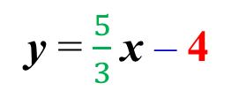
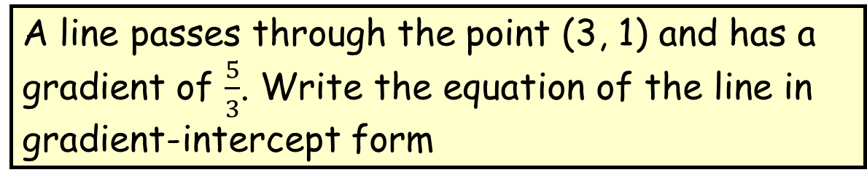
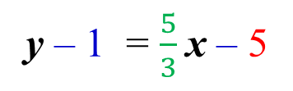
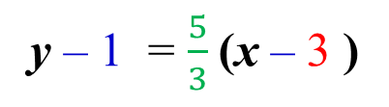
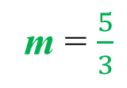
The Point-gradient form of the equation of a straight line
Example 2
A line passes through the point (3, 1) and has a gradient of $\frac{5}{3}$. Write the equation of the line in gradient-intercept form
We write the equation in point gradient form .
y – y₁ = m(x – x₁)
m = $\frac{5}{3}$
y – 1 = $\frac{5}{3}$(x – 3 )
x₁
y₁
This is the equation in the point-gradient form.
(3, 1)
y – 1 = $\frac{5}{3}$x – 5
Expanding brackets
Rearranging for y
y = $\frac{5}{3}$x – 4
This is the equation in the gradient-intercept form.

Slide 10
The equation of a straight line
Finding the equation of a line given two points on the line.
If we are given the coordinates of two distinct points on the line but we are not given the gradient of the line.
Find the equation of the line passing through the points
P₁=
(
x₁
,
y₁
)
P₂=
(
x₂
,
y₂
)
We can use the point-gradient form
y – y₁ = m(x – x₁)
The gradient of the line is
m =
$$\frac{y_{2}−y_{1}}{x_{2}−x_{1}}$$
y – y₁ = $\frac{y_{2}−y_{1}}{x_{2}−x_{1}}$ (x – x₁)
This is the equation of the line given two points

Slide 11
The equation of a straight line
Example
x₁
y₁
x₂
y₂
A line passes through the points A(1, 2) and B(–1, 6). What is the equation of the line?
Using the equation of the line given two points
y – y₁ = $\frac{y_{2}−y_{1}}{x_{2}−x_{1}}$ (x – x₁)
6 – 2
Substituting values
y – 2 =
(x – 1)
–1 – 1
4
Simplifying
y – 2 =
(x – 1)
–2
Equation in the point-gradient form.
y – 2 =
–
2
(x – 1)
–2x + 2
Expanding brackets
y – 2 =
Rearranging for y
y =
–
2
x + 4

Slide 12
The equation of a straight line
General form
The equation of a straight line can be written in the form
ax + by + c = 0.
where a, b and c ∈
If we have the gradient-intercept form y = mx + c, we can rearrange to get the general form.
We can rearrange any equation to change the form.

Slide 13
The equation of a straight line
General form
ax + by + c = 0.
Example 1:
A line L passes through the point (1, 2) and has a gradient of . What is the equation of the line in general form?
3
4
Starting with the equation in the point-gradient form .
3
y – y₁ = m(x – x₁)
m =
4
3
x₁
y₁
y – 2 = (x – 1)
Substituting values
4
(1, 2)
=
(x – 1)
(y – 2)
3
Eliminating the denominator
4
=
3x – 3
Expanding brackets
4y – 8
0
=
3x – 4y + 8 – 3
Rearranging for 0
The general form of the equation is 3x – 4y + 5 = 0.

Slide 14



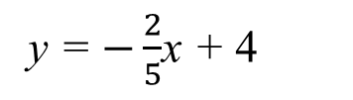
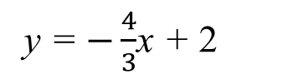
Equation of a line, general form
Example 2.
Write the equation y = $−\frac{2}{5}$x + 4 in general form
y = $−\frac{2}{5}$x + 4
( )5
Multiplying both sides by 5
5y = $−2$x + 20
+2x
+2x
Adding 2x to both sides
$2$x$+$ 5y = 20
Example 3.
Write the equation 4x + 3y = 6 in gradient-intercept form
4x + 3y = 6
–4x
–4x
Subtracting 4x from both sides
3y = $−4$x + 6
3
3
Dividing both sides by 3
y = $−\frac{4}{3}$x + 2

Slide 15

Thank you for using resources from
For more resources visit our website
https://www.mathssupport.org
If you have a special request, drop us an email
info@mathssupport.org

