Slide 1
Change of base
LO: Change log expressions of any base into logs base 10 or ln.

Slide 2
Changing the base of a logarithm
Suppose we wish to calculate the value of log₅ 8.
We can’t calculate this directly using a calculator because it only find logs to the base 10 or the base e.
We can change the base of the logarithm as follows:
Let x = log₅ 8
So:
5^{x} = 8
Taking the log to the base 10 of both sides:
log 5^{x} = log 8
x log 5 = log 8
But x = log₅ 8
So:
1.29 (to 3 sig. figs.)

Slide 3
Changing the base of a logarithm
Suppose we wish to calculate the value of log₅ 8.
If we had used natural logarithm instead:
Let x = log₅ 8
So:
5^{x} = 8
Taking the ln of both sides:
ln 5^{x} = ln 8
x ln 5 = ln 8
$$x= \frac{\ln{8}}{\ln{5}}$$
But x = log₅ 8
So:
1.29 (to 3 sig. figs.)

Slide 4
Changing the base of a logarithm
In general, to find log_{a} b:
Let x = log_{a} b, so we can write
a^{x} = b
Taking the log to the base c of both sides gives:
log_{c} a^{x} = log_{c} b
xlog_{c} a = log_{c} b
So:

Slide 5
Changing the base of a logarithm
Example 1:
Use the change of base formula to evaluate log₄ 9
We can change the base of the logarithm to base 10 using the formula
So:
a = 4
b = 9
c = new base (10)
$$\text{log}\text{4}\text{ 9}= \frac{\log{9}}{\log{4}}$$
$$\text{log}\text{4}\text{ 9}= \frac{\log{9}}{\log{4}}$$
So:
= 1.58 (to 3 sig. figs.)

Slide 6
Changing the base of a logarithm
Example 2:
Given that a = log_{x} 3 and b = log_{x} 6
Find log₃ 6 in terms of a and b
$$\text{log}\text{3} \text{6}= \frac{\log_{x}{6}}{\log_{x}{3}}$$
Use the change of base formula
$$\text{log}\text{3} \text{6}= \frac{b}{a}$$
$$\text{log}\text{3} \text{6}= \frac{b}{a}$$
So:

Slide 7
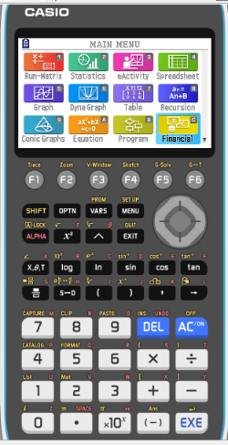
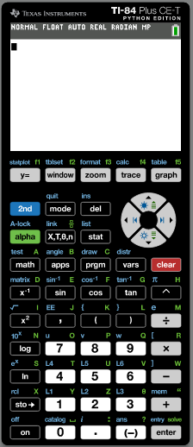
Changing the base of a logarithm
Example 3:
y = log₄ x
Use your GDC to sketch the graph of
We are going to use Graphing display calculator to sketch the graph. Select the Calculator you are using.
CASIO
Texas Instruments

Slide 8
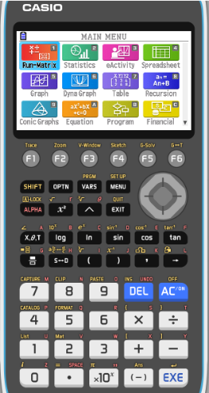
Changing the base of a logarithm
Example 3:
y = log₄ x
Use your GDC to sketch the graph of
We have to change the log₄ into log or ln
Change to an expression using logarithms base 10
$$\text{log}\text{4} \text{x}= \frac{\log{x}}{\log{4}}$$
Go to MENU in the GDC

Slide 9
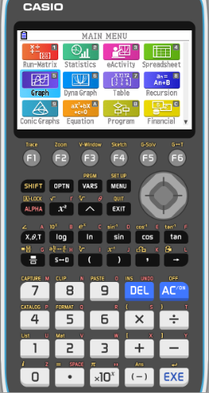
Changing the base of a logarithm
Example 3:
y = log₄ x
Use your GDC to sketch the graph of
We have to change the log₄ into log or ln
Change to an expression using logarithms base 10
$$\text{log}\text{4} \text{x}= \frac{\log{x}}{\log{4}}$$
Go to MENU in the GDC

GRAPH
EXE

Slide 10
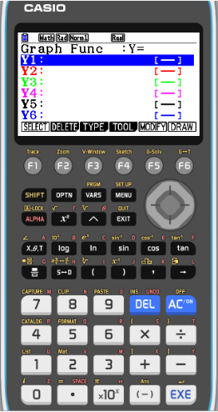
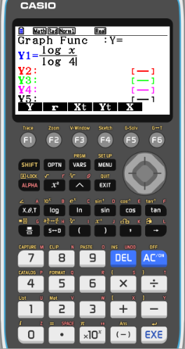
Changing the base of a logarithm
Example 3:
y = log₄ x
Use your GDC to sketch the graph of
We have to change the log₄ into log or ln
Change to an expression using logarithms base 10
$$\text{log}\text{4} \text{x}= \frac{\log{x}}{\log{4}}$$
Go to MENU in the GDC

GRAPH
EXE
$$Type \frac{\log{x}}{\log{4}}$$
EXE

Slide 11
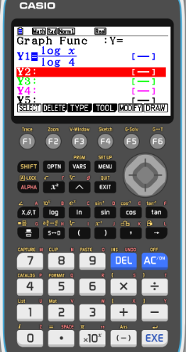
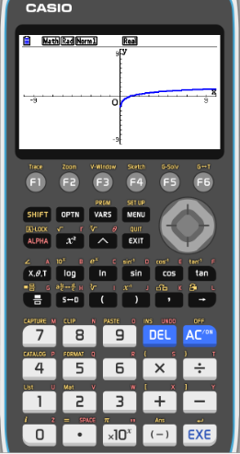
Changing the base of a logarithm
Example 3:
y = log₄ x
Use your GDC to sketch the graph of
We have to change the log₄ into log or ln
Change to an expression using logarithms base 10
$$\text{log}\text{4} \text{x}= \frac{\log{x}}{\log{4}}$$
Go to MENU in the GDC

GRAPH
$$Type \frac{\log{x}}{\log{4}}$$
EXE
F6
DRAW

Slide 12
Thank you for using resources from
For more resources visit our website
https://www.mathssupport.org
If you have a special request, drop us an email
info@mathssupport.org

Slide 13
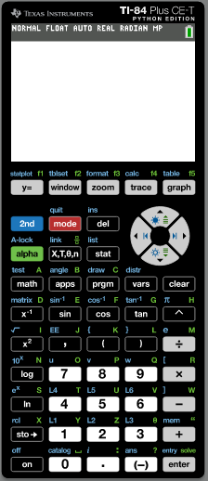
Changing the base of a logarithm
Example 3:
y = log₄ x
Use your GDC to sketch the graph of
We have to change the log₄ into log or ln
Change to an expression using logarithms base 10
$$\text{log}\text{4} \text{x}= \frac{\log{x}}{\log{4}}$$
Turn on the GDC
Click on Y =

Slide 14
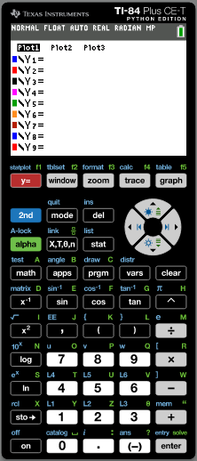
Changing the base of a logarithm
Example 3:
y = log₄ x
Use your GDC to sketch the graph of
We have to change the log₄ into log or ln
Change to an expression using logarithms base 10
$$\text{log}\text{4} \text{x}= \frac{\log{x}}{\log{4}}$$
Turn on the GDC
Click on Y =
$$Type$$
(
log(
x
)
)
÷
(
ENTER
log(
4
)
)

Slide 15
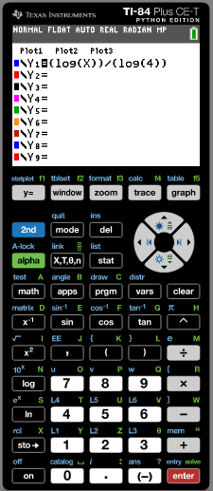
Changing the base of a logarithm
Example 3:
y = log₄ x
Use your GDC to sketch the graph of
We have to change the log₄ into log or ln
Change to an expression using logarithms base 10
$$\text{log}\text{4} \text{x}= \frac{\log{x}}{\log{4}}$$
Turn on the GDC
Click on Y =
$Type$ (log(x)) ÷ (log(4))
ENTER
GRAPH

Slide 16
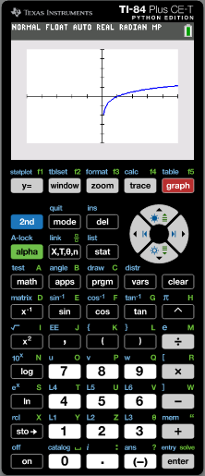
Changing the base of a logarithm
Example 3:
y = log₄ x
Use your GDC to sketch the graph of
We have to change the log₄ into log or ln
Change to an expression using logarithms base 10
$$\text{log}\text{4} \text{x}= \frac{\log{x}}{\log{4}}$$
Turn on the GDC
Click on Y =
$Type$ (log(x)) ÷ (log(4))
ENTER
GRAPH

Slide 17
Thank you for using resources from
For more resources visit our website
https://www.mathssupport.org
If you have a special request, drop us an email
info@mathssupport.org

