Slide 1
Expansion and factorisation
LO: To use the Laws of indices for rational exponents when expanding and factorising.

Slide 2
Expanding brackets and factorising
We are going to use the standard rules of algebra, together with the laws of exponents, to simplify expressions containing rational or variable exponents.
=
ab + ac
a(b + c)
=
ac + ad + bc + bd
(a + b)(c + d)
=
a² – b²
(a + b)(a – b)
=
a² + 2ab + b²
(a + b)²
=
a² – 2ab + b²
(a – b)²

Slide 3









Expanding brackets
x (x + 2x – 3x )
Expand and simplify:
$$−\frac{1}{2}$$
$$\frac{3}{2}$$
$$\frac{1}{2}$$
$$−\frac{1}{2}$$
x (x + 2x – 3x )
x
$$−\frac{1}{2}$$
$$\frac{1}{2}$$
$$− \frac{1}{2}$$
$$\frac{3}{2}$$
$$−\frac{1}{2}$$
Multiply each term by
=
(x )
(x )
+
(x )
(2x )
–
(x )
(3x )
$$−\frac{1}{2}$$
$$\frac{3}{2}$$
$$−\frac{1}{2}$$
$$\frac{1}{2}$$
$$−\frac{1}{2}$$
$$−\frac{1}{2}$$
Adding indices
(x )
+
(2x )
–
(3x )
=
$$−\frac{1}{2}+\frac{3}{2}$$
$$−\frac{1}{2}+\frac{1}{2}$$
$$−\frac{1}{2}−\frac{1}{2}$$
Simplifying
(x )
+
(2x )
–
(3x )
=
1
$$0$$
$$−1$$
$$\frac{3}{x}$$
=
x
+
2
–
Notes:
Stress that the indices can only be added when the base is the same.

Slide 4
Expanding brackets
Expand and simplify:
(2^{x} + 3)(2^{x} + 1)
(2^{x} + 3)(2^{x} + 1)
Expanding the brackets
(2^{x})
(2^{x})
(1)
(3)
(1)
(2^{x})
+
(3)
(2^{x})
=
+
+
=
2^{x + x}
4
(2^{x})
+
3
+
(2^{x})
+
=
2^{2x}
2²
3
+
=
2^{2x}
+
2^{2 + x}
+
3
Notes:
Stress that the indices can only be added when the base is the same.

Slide 5

Expanding brackets
Expand and simplify:
(7^{x} + 7^{–x})²
(7^{x} + 7^{–x})²
Expanding the brackets
=
(7^{x})²
+
2
(7^{x})
(7^{–x})
+
(7^{–x})²
=
7^{2x}
+
2
(7⁰)
+
7^{–2x}
=
7^{2x}
+
2
+
7^{–2x}
$$\frac{1}{7^{2x}}$$
=
7^{2x}
+
2
+
Notes:
Stress that the indices can only be added when the base is the same.

Slide 6
Factorise
Example.
Factorise:
2^{x + 3} + 2^{x}
2^{x + 3} + 2^{x}
Rewriting using the Laws of indices
=
(2^{x})
(2)³
+
(2^{x})
Removing the common factor
2^{x}
+
1)
=
(2³
=
2^{x}
(8 + 1)
=
9(2^{x})
Notes:
Stress that the indices can only be added when the base is the same.

Slide 7
Factorise
Example.
Factorise:
3^{x + 3} + 27
3^{x + 3} + 27
Rewriting using the Laws of indices
=
(3^{x})
(3)³
+
27
=
(27)
(3^{x} )
+
27
Removing the common factor
=
27
(3^{x} + 1)
Notes:
Stress that the indices can only be added when the base is the same.

Slide 8
Factorise
Example.
Factorise:
5^{3x} + 5^{2x}
5^{3x} + 5^{2x}
Rewriting using the Laws of indices
(5^{2x})
+
=
(5^{x})
5^{2x}
Removing the common factor
+
1)
=
(5^{2x})
(5^{x}
Notes:
Stress that the indices can only be added when the base is the same.

Slide 9
Factorise
Factorise:
4^{x} – 9
4^{x} – 9
Rewriting using the Laws of indices
=
(2^{x})²
–
(3)²
Using difference of square
=
(2^{x}
+ 3)
(2^{x}
– 3)
Factorise:
9^{x} + 4(3^{x}) + 4
9^{x} + 4(3^{x}) + 4
Rewriting using the Laws of indices
+
4
=
(3^{x})²
+
4(3^{x})
Using perfect square factorisation
=
(3^{x}
+ 2)
²

Slide 10
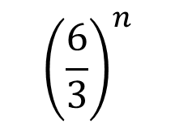

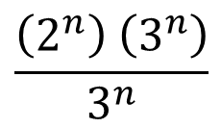
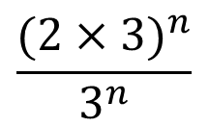
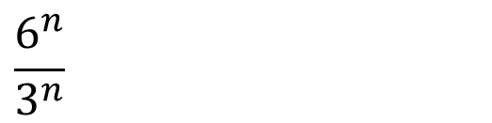
Simplifying expressions
Simplify:
$$\frac{6^{n}}{3^{n}}$$
$$\frac{6^{n}}{3^{n}}$$
Rewriting using the Laws of indices
or
$$\frac{({2×3)}^{n}}{3^{n}}$$
$${\left(\frac{6}{3}\right)}^{n}$$
=
=
=
$$\frac{\left(2^{n}\right) \left(3^{n}\right)}{3^{n}}$$
Simplifying
=
2^{n}
=
2^{n}

Slide 11

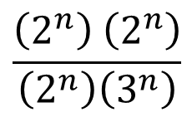
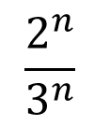
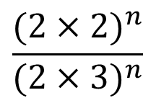
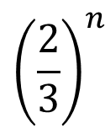
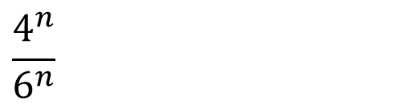
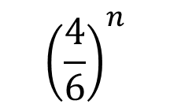
Simplifying expressions
Simplify:
$$\frac{4^{n}}{6^{n}}$$
$$\frac{4^{n}}{6^{n}}$$
Rewriting using the Laws of indices
or
$$\frac{({2×2)}^{n}}{{(2×3)}^{n}}$$
$${\left(\frac{4}{6}\right)}^{n}$$
=
=
=
$$\frac{\left(2^{n}\right) \left(2^{n}\right)}{\left(2^{n}\right)\left(3^{n}\right)}$$
$${\left(\frac{2}{3}\right)}^{n}$$
Simplifying
=
$$\frac{2^{n}}{3^{n}}$$
=

Slide 12
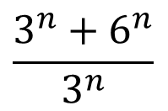
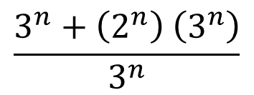
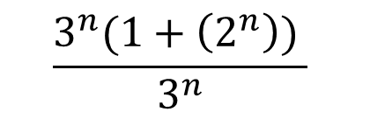
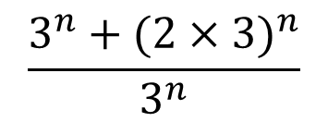
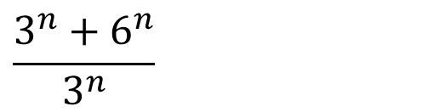
Fractional exponents
Example.
Simplify:
$$\frac{3^{n}+6^{n}}{3^{n}}$$
$$\frac{3^{n}+6^{n}}{3^{n}}$$
Rewriting using the Laws of indices
$$\frac{3^{n}+({2×3)}^{n}}{3^{n}}$$
=
$$\frac{3^{n}+\left(2^{n}\right) \left(3^{n}\right)}{3^{n}}$$
Factorising
=
$$\frac{3^{n}(1+\left(2^{n}\right)) }{3^{n}}$$
=
Simplifying
=
1 + 2^{n}
Notes:
Stress that the indices can only be added when the base is the same.

Slide 13
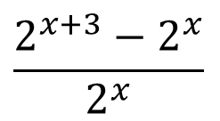
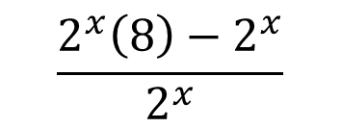
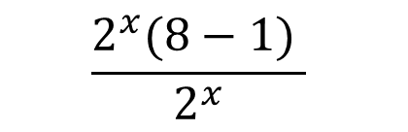
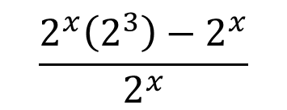
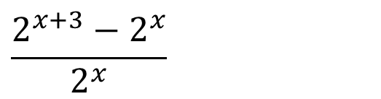
Fractional exponents
Example.
Simplify:
$$\frac{2^{x+3}−2^{x}}{2^{x}}$$
$$\frac{2^{x+3}−2^{x}}{2^{x}}$$
Rewriting using the Laws of indices
$$\frac{2^{x}\left(2^{3}\right)−2^{x}}{2^{x}}$$
=
$$\frac{2^{x}\left(8\right)−2^{x}}{2^{x}}$$
Factorising
=
$$\frac{2^{x}(8−1) }{2^{x}}$$
Simplifying
=
=
7
Notes:
Stress that the indices can only be added when the base is the same.

Slide 14
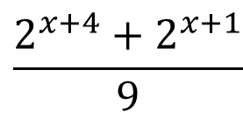
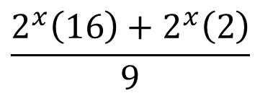
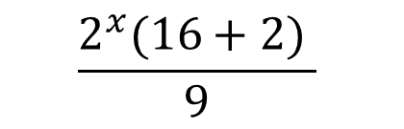
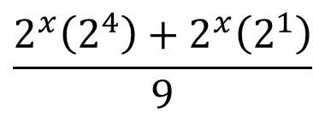

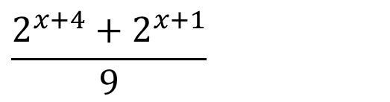

Fractional exponents
Example.
Simplify:
$$\frac{2^{x+4}+2^{x+1}}{9}$$
$$\frac{2^{x+4}+2^{x+1}}{9}$$
Rewriting using the Laws of indices
$$\frac{2^{x}\left(2^{4}\right)+2^{x}\left(2^{1}\right)}{9}$$
=
$$\frac{2^{x}\left(16\right)+2^{x}\left(2\right)}{9}$$
Factorising
=
$$\frac{2^{x}(16+2) }{9}$$
=
Simplifying
2
$$\frac{2^{x}(18) }{9}$$
$$2^{x}(2)$$
=
=
1
=
2^{x+1}
Notes:
Stress that the indices can only be added when the base is the same.

Slide 15

Thank you for using resources from
For more resources visit our website
https://www.mathssupport.org
If you have a special request, drop us an email
info@mathssupport.org

