Slide 1
Properties of logarithms
LO: Know and use properties of logarithms to change between exponential and logarithmic forms.

Slide 2
Some important results
We are familiar with the exponential notation
Index, exponent or logarithm
2³
=
8
For example:
Base
Power
We read: “the third power of two is”
It means that we take two as a factor three times
2 × 2 × 2 =
8
and the power is
We can write the same using a different notation
log₂ 8 = 3
logarithm
Base
Power or Argument
This is called logarithmic notation
We read: “the logarithm of 8, to base 2 is 3”

Slide 3
Some important results
a^{x} = b
If
This can be written in logarithmic form as:
log_{a} b = x
x is the logarithm of b, to base a.:
Being able to change between these two forms allows you to simplify log statements
Examples:
Write the equivalent logarithmic statement for 3⁴ = 81
log₃ 81 = 4
Write the equivalent exponential statement for log₂ 128 = 7
2⁷ = 128

Slide 4
Some important results
Some properties of logarithms that is important to remember when manipulating logarithms.
Write the equivalent logarithmic statement for 3¹
= 3
log₃ 3 = 1
Write the equivalent logarithmic statement for 8¹
= 8
log₈ 8 = 1
In general
a¹ = a
This can be written in logarithmic form as:
log_{a} a = 1

Slide 5
Some important results
Some properties of logarithms that is important to remember when manipulating logarithms.
Write the equivalent logarithmic statement for 3⁰
= 1
log₃ 1 = 0
Write the equivalent logarithmic statement for 8⁰
= 1
log₈ 1 = 0
In general
a⁰ = 1
This can be written in logarithmic form as:
log_{a} 1 = 0

Slide 6
Some important results
Some properties of logarithms that is important to remember when manipulating logarithms.
Write the equivalent exponential statement for log₃ (-27)
= x
3^{x} = -27
Can you find an exponent that satisfies this equation?
This equation has no solution
log_{a} b is undefined for any base a if b is negative

Slide 7
Some important results
Some properties of logarithms that is important to remember when manipulating logarithms.
Write the equivalent exponential statement for log₃ 0
= x
3^{x} = 0
Can you find an exponent that satisfies this equation?
This equation has no solution
log_{a} 0 is undefined

Slide 8
Some important results
Some properties of logarithms that is important to remember when manipulating logarithms.
= x
Write the equivalent exponential statement for log₃ 3⁵
3^{x} = 3⁵
We have an exponential equation with the same base
The exponents must be equal
log_{a} (a^{n}) = n

Slide 9
Logarithms in base 10 and Natural logarithm

Slide 10
Logarithms in base 10
10 ^{x} = a
If
This can be written in logarithmic form as:
log₁₀ a = x
For logarithms base 10 is not necessary to write the base
This expression can be written simply as
log a = x
Examples:
log₁₀ 100 = 2
Can be written as
log 100 = 2

Slide 11
Logarithms in base 10
Our decimal number system is based on powers of ten.
We can write powers of ten using logarithmic notation.
10⁵ =
100 000
log 100 000 = 5
10⁴ =
10 000
log 10 000 = 4
10³ =
1 000
log 1000 = 3
10² =
100
log 100 = 2
10¹=
10
log 10 = 1
10⁰ =
1
log 1 = 0
10⁻¹ =
0.1
log 0.1 = -1
10⁻² =
0.01
log 0.01 = -2
10⁻³ =
0.001
log 0.001 = -3
What about other numbers? For example, what is log 125.
We know is a number between log 100 and log 1000.

Slide 12
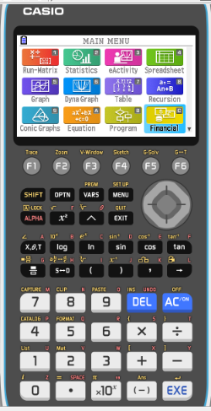
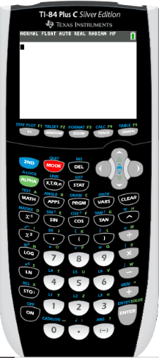
Using a GDC for Logarithms in base 10
We are going to use Graphing display calculator to find the natural logarithm
Click on the calculator you are using
CASIO
Texas Instruments

Slide 13
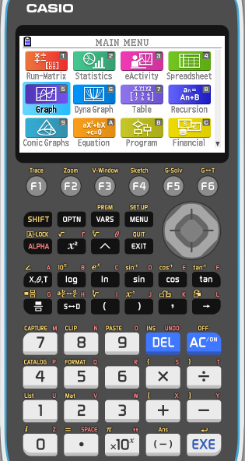
Logarithms in base 10
We use a calculator to find log 125.
Turn on
MENU
1

Slide 14
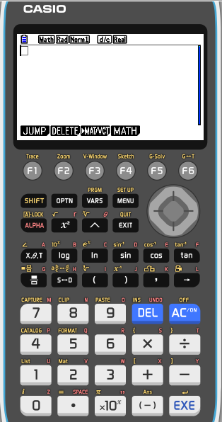
Logarithms in base 10
We use a calculator to find log 125.
Turn on
MENU
1
Type
Log
125
EXE

Slide 15
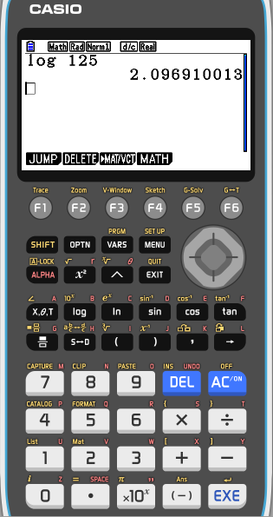
Logarithms in base 10
We use a calculator to find log 125.
Turn on
MENU
1
Type
Log
125
EXE

Slide 16
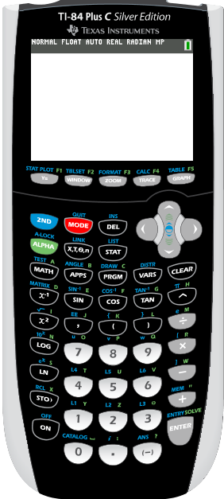
Logarithms in base 10
We use a calculator to find ln 125.
Turn on
Type
LOG
125
)
ENTER

Slide 17
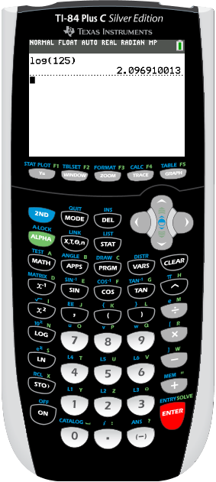
Logarithms in base 10
We use a calculator to find ln 125.
Turn on
Type
LN
125
)
ENTER

Slide 18
Natural logarithm

Slide 19
Natural Logarithms
The natural logarithm of a number is its logarithm to the base of the mathematical constant e
e is an irrational and transcendental number approximately equal to 2.718281828459.
The natural logarithm of x is generally written as ln x, log_{e} x
We use ln x to represent log_{e} x, and call ln x the natural logarithm of x
ln x = y
e^{y} = x
Notice that:
ln 1 =
ln e⁰ =
0
ln e =
ln e¹ =
1
ln e² =
2

Slide 20
Using a GDC for Natural logarithms
We are going to use Graphing display calculator to find the natural logarithm
Click on the calculator you are using
CASIO
Texas Instruments

Slide 21
Natural Logarithms
We use a calculator to find ln 125.
Turn on
MENU
1

Slide 22
Natural Logarithms
We use a calculator to find ln 125.
Turn on
MENU
1
Type
ln
125
EXE

Slide 23
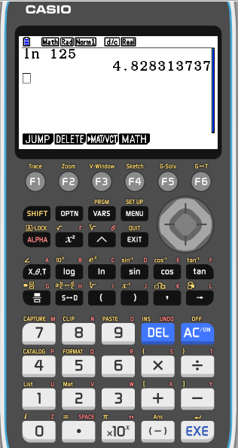
Natural Logarithms
We use a calculator to find ln 125.
Turn on
MENU
1
Type
ln
125
EXE

Slide 24
Natural Logarithms
We use a calculator to find ln 125.
Turn on
Type
LN
125
)
ENTER

Slide 25
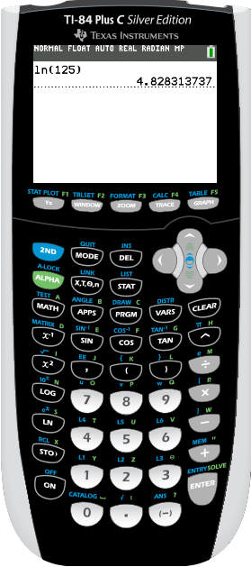
Natural Logarithms
We use a calculator to find ln 125.
Turn on
Type
LN
125
)
ENTER

Slide 26
Thank you for using resources from
For more resources visit our website
https://www.mathssupport.org
If you have a special request, drop us an email
info@mathssupport.org

