Slide 1
Exponents
LO: Know and use the Laws of exponents.

Slide 2
Exponents
We use exponents as a shorthand way of representing the repeated multiplication of a number by itself.
For example,
we can use index notation to write 2 × 2 × 2 × 2 × 2 as
Exponent, index or power
2⁵
base
This number is read as ‘two to the power of five’.
2⁵ =
2 × 2 × 2 × 2 × 2 =
32
Notes:
Talk about the use of index notation as a mathematical shorthand.

Slide 3
Index notation
Evaluate the following:
When we raise a negative number to an odd power the answer is negative.
6² =
6 × 6 =
36
3⁴ =
3 × 3 × 3 × 3 =
81
(–5)³ =
–5 × –5 × –5 =
–125
2⁷ =
2 × 2 × 2 × 2 × 2 × 2 × 2 =
128
When we raise a negative number to an even power the answer is positive.
(–1)⁵ =
–1 × –1 × –1 × –1 × –1 =
–1
(–4)⁴ =
–4 × –4 × –4 × –4 =
64
Notes:
Talk through each example.
Recall that two negative numbers multiply together to give a positive number. So if we calculate –1 × –1 × –1 × –1 × –1, for example, there are five negatives multiplied together. That makes two positive numbers with one negative number left over. The answer is therefore negative.
Remind pupils that 6² can be said as ‘six squared’ or ‘six to the power of two’ and that (–5)³ can be said as ‘negative five cubed’ or ‘negative five to the power of three’.

Slide 4
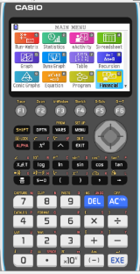
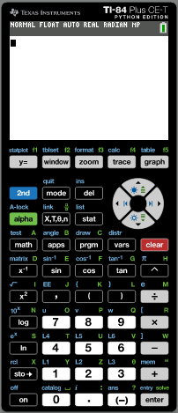
Calculating powers
We can use the GDC to find powers.
We are going to use a Graphing display calculator to calculate the value of 7⁴
Click on the calculator you are using
CASIO
Texas Instruments
Notes:
Reveal the steps on the board. Ensure that pupils are able to locate the power key, x^{y}, on their calculators.
We could also key in 7 × 7 × 7 × 7, but using the x^{y} key is more efficient and we are less likely to make a mistake.
State that 2401 must be a square number and ask pupils how we can show that this is true.

Slide 5
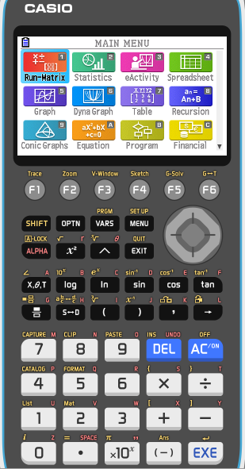

Calculating powers
We can use the GDC to find powers.
For example,
to calculate the value of 7⁴ we key in:
Notes:
Reveal the steps on the board. Ensure that pupils are able to locate the power key, x^{y}, on their calculators.
We could also key in 7 × 7 × 7 × 7, but using the x^{y} key is more efficient and we are less likely to make a mistake.
State that 2401 must be a square number and ask pupils how we can show that this is true.

Slide 6
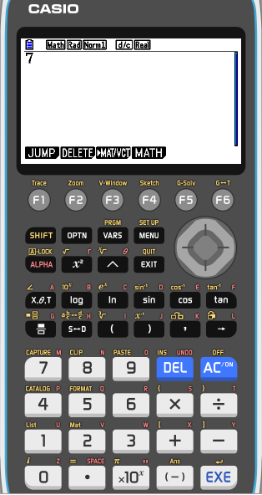
Calculating powers
We can use the GDC to find powers.
For example,
to calculate the value of 7⁴ we key in:
Notes:
Reveal the steps on the board. Ensure that pupils are able to locate the power key, x^{y}, on their calculators.
We could also key in 7 × 7 × 7 × 7, but using the x^{y} key is more efficient and we are less likely to make a mistake.
State that 2401 must be a square number and ask pupils how we can show that this is true.

Slide 7


Calculating powers
We can use the GDC to find powers.
For example,
to calculate the value of 7⁴ we key in:
Notes:
Reveal the steps on the board. Ensure that pupils are able to locate the power key, x^{y}, on their calculators.
We could also key in 7 × 7 × 7 × 7, but using the x^{y} key is more efficient and we are less likely to make a mistake.
State that 2401 must be a square number and ask pupils how we can show that this is true.

Slide 8


Calculating powers
We can use the GDC to find powers.
For example,
to calculate the value of 7⁴ we key in:
Notes:
Reveal the steps on the board. Ensure that pupils are able to locate the power key, x^{y}, on their calculators.
We could also key in 7 × 7 × 7 × 7, but using the x^{y} key is more efficient and we are less likely to make a mistake.
State that 2401 must be a square number and ask pupils how we can show that this is true.

Slide 9

Calculating powers
We can use the GDC to find powers.
For example,
to calculate the value of 7⁴ we key in:
The calculator shows this as 2401.
7⁴ = 7 × 7 × 7 × 7 = 2401
Click here for the Next
Notes:
Reveal the steps on the board. Ensure that pupils are able to locate the power key, x^{y}, on their calculators.
We could also key in 7 × 7 × 7 × 7, but using the x^{y} key is more efficient and we are less likely to make a mistake.
State that 2401 must be a square number and ask pupils how we can show that this is true.

Slide 10
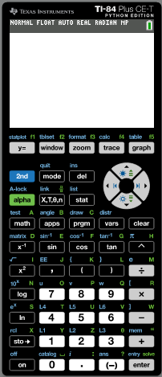
Calculating powers
We can use the GDC to find powers.
For example,
to calculate the value of 7⁴ we key in:
Notes:
Reveal the steps on the board. Ensure that pupils are able to locate the power key, x^{y}, on their calculators.
We could also key in 7 × 7 × 7 × 7, but using the x^{y} key is more efficient and we are less likely to make a mistake.
State that 2401 must be a square number and ask pupils how we can show that this is true.

Slide 11
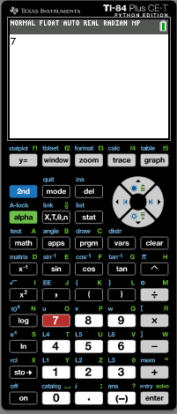
Calculating powers
We can use the GDC to find powers.
For example,
to calculate the value of 7⁴ we key in:
Notes:
Reveal the steps on the board. Ensure that pupils are able to locate the power key, x^{y}, on their calculators.
We could also key in 7 × 7 × 7 × 7, but using the x^{y} key is more efficient and we are less likely to make a mistake.
State that 2401 must be a square number and ask pupils how we can show that this is true.

Slide 12
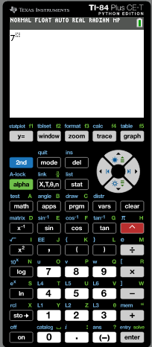
Calculating powers
We can use the GDC to find powers.
For example,
to calculate the value of 7⁴ we key in:
Notes:
Reveal the steps on the board. Ensure that pupils are able to locate the power key, x^{y}, on their calculators.
We could also key in 7 × 7 × 7 × 7, but using the x^{y} key is more efficient and we are less likely to make a mistake.
State that 2401 must be a square number and ask pupils how we can show that this is true.

Slide 13
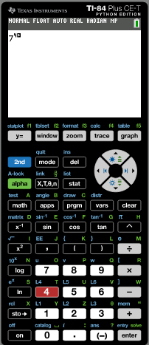
Calculating powers
We can use the GDC to find powers.
For example,
to calculate the value of 7⁴ we key in:
Notes:
Reveal the steps on the board. Ensure that pupils are able to locate the power key, x^{y}, on their calculators.
We could also key in 7 × 7 × 7 × 7, but using the x^{y} key is more efficient and we are less likely to make a mistake.
State that 2401 must be a square number and ask pupils how we can show that this is true.

Slide 14
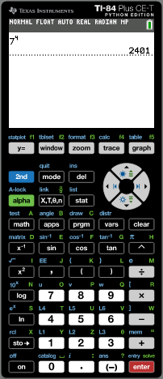
Calculating powers
We can use the GDC to find powers.
For example,
to calculate the value of 7⁴ we key in:
The calculator shows this as 2401.
7⁴ = 7 × 7 × 7 × 7 = 2401
Click here for the Next
Notes:
Reveal the steps on the board. Ensure that pupils are able to locate the power key, x^{y}, on their calculators.
We could also key in 7 × 7 × 7 × 7, but using the x^{y} key is more efficient and we are less likely to make a mistake.
State that 2401 must be a square number and ask pupils how we can show that this is true.

Slide 15
Laws of exponents -
multiplication
When we multiply two numbers written in index form and with the same base we can see an interesting result.
For example,
3⁴ × 3² =
(3 × 3 × 3 × 3) × (3 × 3)
= 3 × 3 × 3 × 3 × 3 × 3
= 3⁶
= 3⁽⁴ ⁺ ²⁾
a³ × a⁵ =
(a × a × a) × (a × a × a × a × a)
= a × a × a × a × a × a × a × a
= a⁸
= a⁽³ ⁺ ⁵⁾
What do you notice?
When we multiply two numbers with the same base the indices are added.
a^{m} × a^{n} =
a^{(m + n)}
Notes:
Stress that the indices can only be added when the base is the same.

Slide 16
Laws of exponents -
multiplication
When we multiply two powers with different bases but the same exponent we can see an interesting result.
For example,
a⁴ × b⁴ =
(a × a × a × a) × (b × b × b × b)
= ab × ab × ab × ab
= (ab)⁴
What do you notice?
When we multiply two powers with different bases but the indices are the same is equal to the product of the bases with the same exponent
a^{n} × b^{n} =
(ab) ^{n}
Notes:
Stress that the indices can only be added when the base is the same.

Slide 17
division
Laws of exponents -
When we divide two numbers written in index form and with the same base we can see another interesting result.
For example,
4⁵ ÷ 4² =
4 × 4 × 4 × 4 × 4
4 × 4 × 4 =
4³
= 4^{(5 – 2)}
=
4 × 4
a⁶ ÷ a⁴ =
a × a × a × a × a × a
a × a =
a²
= a^{(6 – 4)}
=
a × a × a × a
What do you notice?
When we divide two numbers with the same base the indices are subtracted.
a^{m} ÷a^{n} =
a^{(m - n)}
Notes:
Stress that the indices can only be subtracted when the base is the same.

Slide 18
division
Laws of exponents -
When we divide two powers with different bases but the same exponent, we can see another interesting result.
For example,
a⁵ ÷ b⁵ =
a × a × a × a × a
b × b × b × b × b
a
a
a
a
a
a
a
( )
⁵
=
×
×
×
×
=
⁵
b
b
b
b
b
b
b
⁵
What do you notice?
When we divide two powers with different bases but the indices are the same, is equal to the quotient of the bases with the same exponent.
a
a
^{n}
( )
=
^{n}
b
b
^{n}
Notes:
Stress that the indices can only be subtracted when the base is the same.

Slide 19
Laws of exponents -
Raising to a power
When we raise a power to another power we can see another interesting result.
For example,
(3⁴)² =
(3 × 3 × 3 × 3)
× (3 × 3 × 3 × 3)
= 3 × 3 × 3 × 3 × 3 × 3 × 3 × 3
= 3⁸
= 3^{(4 ˟ 2)}
(a²)⁵ =
(a × a)
× (a × a)
× (a × a)
× (a × a)
× (a × a)
= a × a × a × a × a × a × a × a × a × a
= a¹⁰
= a^{(2 ˟ 5)}
What do you notice?
When we raise a power to another power the indices are multiplied.
(a^{m})^{n} =
a^{m n}
Notes:
Stress that the indices can only be added when the base is the same.

Slide 20
The power zero
Look at the following division:
6⁴ ÷ 6⁴ =
1
Using the second index law,
6⁴ ÷ 6⁴ = 6^{(4 – 4)} =
6⁰
That means that,
6⁰ = 1
Any number raised to the power of zero is equal to one.
For example,
10⁰ = 1
3.452⁰ = 1
723 538 592⁰ = 1
a⁰ = 1
a⁰ =
1

Slide 21
Negative exponents
Look at the following division:
3⁴ ÷ 3⁶
Using the second index law,
3⁴ ÷ 3⁶ = 3^{(4 – 6)} =
3⁻²
Solving the division,
3 × 3 × 3 × 3
1
=
1
3⁴ ÷ 3⁶ =
=
= 3^{–2}
3 × 3 × 3 × 3 × 3 × 3
3 × 3
3²
a × a
1
1
a² ÷ a⁵ =
=
=
= a^{–3}
a × a × a × a × a
a × a × a
a³
What do you notice?
When we raise a number to a negative power, is the same as one over the number with positive power.
1
a^{-n} =
a^{n}
Notes:
Stress that the indices can only be subtracted when the base is the same.

Slide 22

Thank you for using resources from
For more resources visit our website
https://www.mathssupport.org
If you have a special request, drop us an email
info@mathssupport.org

