Slide 1
Vectors in geometry
LO: To use vectors in geometry.

Slide 2
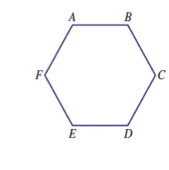
Vectors in geometry
ABCDEF is a regular hexagon
$\vec{AB}$ = n
Explain why $\vec{ED}$ = n
n
Since ABCDEF is a regular hexagon
$$\overline{AB}=\overline{ED}$$
$$\overline{AB} || \overline{ED}$$
m
$\vec{AB}$ =
$\vec{ED}$
= n
$\vec{BC}$ = m
$\vec{CD}$ = p
Find $\vec{AC}$
$$\vec{AB}+\vec{BC}$$
= n + m
p
n
Find $\vec{AD}$
$\vec{AB}+\vec{BC}$ $+ \vec{CD}$
= n + m + p
What is $\vec{FD} ?$
$$\vec{FE}+\vec{ED}$$
= m + n

Slide 3
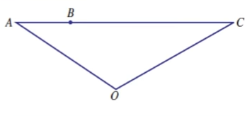
Vectors in geometry
ABC is a straight line where BC = 3AB
$\vec{OA}$ = a
$\vec{AB}$ = b
Express $\vec{OC}$ in terms of a and b
$$\vec{OC}=$$
$$\vec{OA}+\vec{AC}$$
= a + 4b
$\vec{OA}$ = a
b
$\vec{AC}$ =
$$\vec{AB}+\vec{BC}$$
= 4b
$\vec{AB}$ = b
a
$$\vec{OC}=$$
a + 4b
$\vec{BC}$ = 3 $\vec{AB}$
= 3b

Slide 4
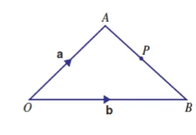
Vectors in geometry
In triangle OAB, $\vec{OA}$ = a and $\vec{OB}$ = b
Find in terms of a and b, the vector $\vec{AB}$
$$\vec{AB}=$$
$$\vec{AO}+\vec{OB}$$
$\vec{AB}$=
˗ a
+
b
= b ˗ a
P is the midpoint of AB
Find in terms of a and b, the vector $\vec{AP}$
$$\vec{AP}=$$
$$\frac{1}{2}\vec{AB}$$
= $\frac{1}{2}$ (b ˗ a)
Find in terms of a and b, the vector $\vec{OP}$
$$\vec{OP}=$$
$$\vec{OA}+\vec{AP}$$
$\vec{OP}$=
a
$\frac{1}{2}$ (b ˗ a)
$=\frac{1}{2}$ (a + b)
+

Slide 5
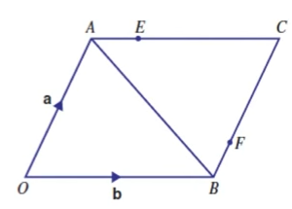
Vectors in geometry
OACB is a parallelogram with $\vec{OA}$ = a and $\vec{OB}$ = b
E is the point on AC such that AE = $\frac{1}{4}$ AC
F is the point on BC such that BF = $\frac{1}{4}$ BC
Find in terms of a and b
a$) \vec{AB}$
$$=\vec{AO}+\vec{OB}$$
=
˗ a
+
b
= b ˗ a
b$) \vec{AE}$
= $\frac{1}{4}$ AC
Since $\vec{AC}=\vec{OB}$
= b
∴ $\vec{AE}$= $\frac{1}{4}$b
c$) \vec{OE}$
$$=\vec{OA}+\vec{AE}$$
=
a
+ $\frac{1}{4}$b
d$) \vec{OF}$
$$=\vec{OB}+\vec{BF}$$
=
b
+ $\frac{1}{4}$a
e$) \vec{EF}$
$$=\vec{EC}+\vec{CF}$$
=
$\frac{3}{4}$b
˗ $\frac{3}{4}$ a

Slide 6
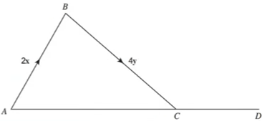
Vectors in geometry
AB = 2x
BC = 4y
ACD is a straight line
Write down the vector $\vec{AC}$ in terms of x and y.
$$\vec{AC}=$$
$$\vec{AB}+\vec{BC}$$
=
2x
+
4y
= 2(x + 2y)
AC : CD = 2 : 1
Work out the vector $\vec{AD}$ in terms of x and y.
Give your answer as simply as possible.
$$\vec{AC}=$$
$\frac{2}{3}$ $\vec{AD}$
$$\vec{AD}=$$
$\frac{3}{2}$ $\vec{AC}$
$$\vec{AD}=$$
$\frac{3}{2}$(2(x + 2y))
$$\vec{AD}=$$
3(x + 2y)

Slide 7
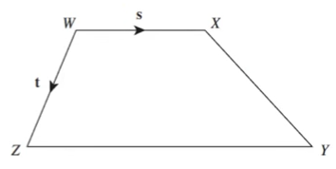
Vectors in geometry
WXYZ is a trapezium
$\vec{WX}$ = s
$\vec{WZ}$ = t
ZY : WX = 3 : 2
Write vector $\vec{ZY}$ in terms of s
$$\vec{ZY}=$$
$\frac{3}{2}$ $\vec{WX}$
= $\frac{3}{2}$ s
Work out the vector $\vec{XY}$ in terms of s and t.
Give your answer in its simplest form.
$$\vec{XY}=$$
$$\vec{XW}$$
$$+ \vec{WZ}$$
$$+ \vec{ZY}$$
$$\vec{XY}=$$
˗ s
+ t
+ $\frac{3}{2}$ s
$$\vec{XY}=$$
$\frac{1}{2}$ s
+ t

Slide 8
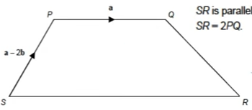
Vectors in geometry
PQRS is a trapezium as shown
SR is parallel to PQ
SR = 2PQ
Write down in terms of a and b vector $\vec{SR}$.
$\vec{SR}$ = 2 $\vec{PQ}$
= 2a
Work out in terms of a and b vector $\vec{QR}$.
Give your answer as simply as possible.
$$+ \vec{PS}$$
$$\vec{QR}=$$
$$\vec{QP}$$
$$+ \vec{SR}$$
$$\vec{QR}=$$
˗ a
˗ (a ˗ 2b)
+ 2a
$$\vec{QR}=$$
˗ a
˗ a + 2b
+ 2a
$$\vec{QR}=$$
2b

Slide 9
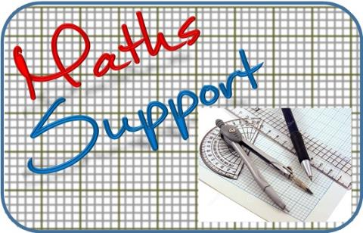
Thank you for using resources from
For more resources visit our website
https://www.mathssupport.org
If you have a special request, drop us an email
info@mathssupport.org
Get 20% off in your next purchase from our website, just use this code when checkout: MSUPPORT_20

