Slide 1
Surds
LO: To understand what surds are.
To simplify expressions using surds

Slide 2
Types of numbers
The counting numbers
ℕ
Natural Numbers
1, 2, 3, 4, 5, . . .
Include all the whole numbes and zero
ℤ
Integers
. . . -3, -2, -1, 0, 1, 2, 3, . . .
Numbers that can be written as a fraction Include all the integers plus fractions
ℚ
Rational Numbers
Include all the Rational Numbers plus numbers that cannot be written as fractions
ℝ
Real Numbers

Slide 3
Real numbers
REAL NUMBERS
Rational Numbers
Irrational Numbers
These include all the whole numbers and numbers which can be written as a fraction.
These are all the numbers which can NOT be written as a fraction.
ALL decimals which recur or terminate can be written as fractions.

Slide 4
Surds
The square roots of many numbers cannot be found exactly.
For example, the value of $\sqrt{3}$ cannot be written exactly as a fraction or a decimal.
The value of $\sqrt{3}$ is an irrational number.
For this reason it is often better to leave the square root sign in and write the number as $\sqrt{3}$.
$\sqrt{3}$ is an example of a surd.
Which one of the following is not a surd?
$\sqrt{2}$, $\sqrt{6}$, $\sqrt{9}$ or $\sqrt{14}$
$\sqrt{9}$ is not a surd because it can be written exactly.

Slide 5
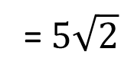
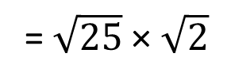
Simplifying surds
We are often required to simplify surds by writing them in the form $a\sqrt{b}$. For example,
Simplify $\sqrt{50}$ by writing it in the form $a\sqrt{b}$.
Start by finding the largest square number that divides into 50.
This is 25. We can use this to write:
$\sqrt{50}$= $\sqrt{(25×2)}$
= $\sqrt{25}$ × $\sqrt{2}$
$$\sqrt{50}$$
= $5\sqrt{2}$
When a surd is written in its simplest form, the number under the square root sign must not contain any factors that are square numbers

Slide 6
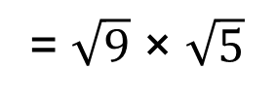
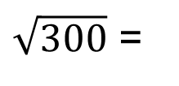
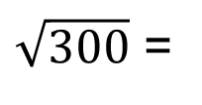
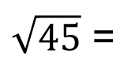
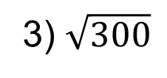
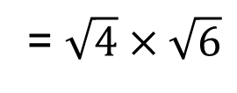
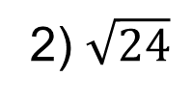
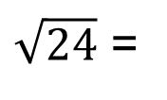
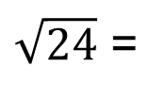
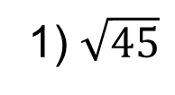
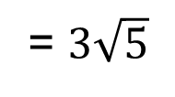
Simplifying surds
Simplify the following surds by writing them in the form $a\sqrt{b}$.
1) $\sqrt{45}$
2) $\sqrt{24}$
3) $\sqrt{300}$
$\sqrt{45}$ =
$\sqrt{9×5}$
$\sqrt{24}$ =
$\sqrt{4×6}$
$\sqrt{300}$ =
$$\sqrt{100×3}$$
= $\sqrt{9}$ × $\sqrt{5}$
= $\sqrt{4}×\sqrt{6}$
= $\sqrt{100}×\sqrt{3}$
$\sqrt{45}$
= $3\sqrt{5}$
$\sqrt{24}$ =
$2\sqrt{6}$
$\sqrt{300}$ =
$10\sqrt{3}$

Slide 7
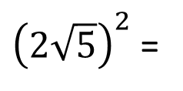
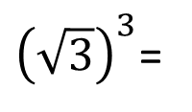
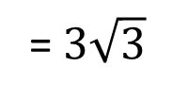
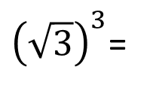
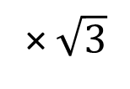
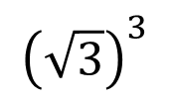
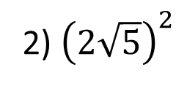
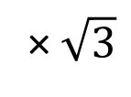
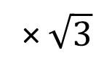
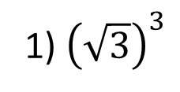
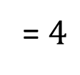
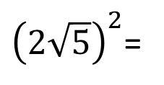
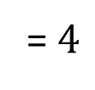
Simplifying surds
Simplify the following surds by writing them in the form $a\sqrt{b}$.
1) ${\left(\sqrt{3}\right)}^{3}$
2) ${\left(2\sqrt{5}\right)}^{2}$
${\left(2\sqrt{5}\right)}^{2}$=
$$2\sqrt{5}$$
$$×2\sqrt{5}$$
${\left(\sqrt{3}\right)}^{3}$=
$\sqrt{3}$
× $\sqrt{3}$
× $\sqrt{3}$
${\left(\sqrt{3}\right)}^{3}$=
$$\sqrt{9}$$
× $\sqrt{3}$
= $4$
$×$ $\sqrt{25}$
= $4$
$×$ $5$
$${\left(\sqrt{3}\right)}^{3}$$
= $3\sqrt{3}$
${\left(2\sqrt{5}\right)}^{2}$=
$20$

Slide 8
Thank you for using resources from
For more resources visit our website
https://www.mathssupport.org
If you have a special request, drop us an email
info@mathssupport.org

