Slide 1
Volume of solids of revolution: Method of cylinders (shells)
LO: Use integrals to calculate the volume of a solid

Slide 2
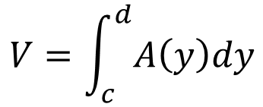
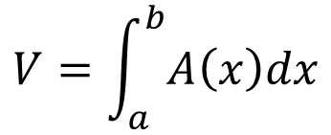
Volume of solids of Revolution
In the previous section we started looking at finding volumes of solids of revolution.
In that section we took cross sections that were rings or disks, found the cross-sectional area and then used the following formulas to find the volume of the solid.
$$V=\int_{a}^{b}{A\left(x\right)dx}$$
$$V=\int_{c}^{d}{A\left(y\right)dy}$$
We only used cross sections that were in the shape of a disk or a ring.
This however does not always need to be the case.
We can use any shape for the cross sections as long as it can be expanded or contracted to completely cover the solid we’re looking at.
This is a good thing because as our first example will show us we can’t always use rings/disks.

Slide 3
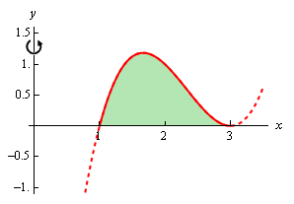
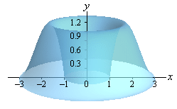
Volume of solids of Revolution
Example 1
Determine the volume of the solid obtained by rotating the region bounded by y = (x − 1)(x − 3)² and the x-axis about the y-axis, from x = 1 to x = 3.
As we did in the previous section, let’s first graph the bounded region
and the solid as we rotate it about the y-axis.
Note that the bounded region here is the shaded portion shown.

Slide 4
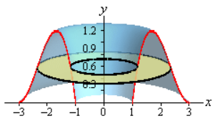
Volume of solids of Revolution
Example 1
Determine the volume of the solid obtained by rotating the region bounded by y = (x − 1)(x − 3)² and the x-axis about the y-axis, from x = 1 to x = 3.
As we did in the previous section, let’s first graph the bounded region
and the solid as we rotate it about the y-axis.
If we were to use rings on this solid here is what a typical ring would look like.

Slide 5
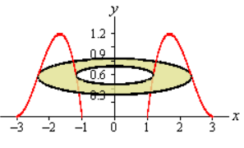
Volume of solids of Revolution
Example 1
Determine the volume of the solid obtained by rotating the region bounded by y = (x − 1)(x − 3)² and the x-axis about the y-axis, from x = 1 to x = 3.
This leads to several problems.
First, both the inner and outer radius are defined by the same function.
The second problem we got here is that in order to use rings we would need to put this function into the form x = f(y).
That is NOT easy in general for a cubic polynomial and in other cases may not even be possible to do.
Even when it is possible to do this the resulting equation is often significantly messier than the original which can also cause problems.

Slide 6
Volume of solids of Revolution
Example 1
Determine the volume of the solid obtained by rotating the region bounded by y = (x − 1)(x − 3)² and the x-axis about the y-axis, from x = 1 to x = 3.
This leads to several problems.
So, we’ve seen three problems with rings in this case that will either increase our workload or outright prevent us from using rings.
What we need to do is to find a different way to cut the solid that will give us a cross-sectional area that we can work with.
One way to do this is to think of our solid as a lump of cookie dough and instead of cutting it perpendicular to the axis of rotation we could instead center a cylindrical cookie cutter on the axis of rotation and push this down into the solid.

Slide 7
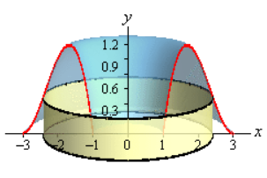
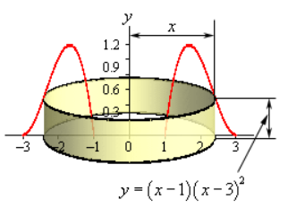
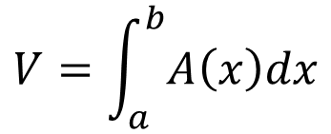
Volume of solids of Revolution
Example 1
Determine the volume of the solid obtained by rotating the region bounded by y = (x − 1)(x − 3)² and the x-axis about the y-axis, from x = 1 to x = 3.
Doing this would give the following picture
This gives us a cylinder or shell in the object, and we can easily find its surface area.
r
The surface area of this hollow cylinder is:
h
A(x) = 2π(radius)(height)
A(x) = 2π
(x)
((x − 1)(x − 3)²)
A(x) = 2π(x⁴ − 7x³ + 15x² − 9x)
Notice as well that as we increase the radius of the cylinder we will completely cover the solid and so we can use this in our formula to find the volume of this solid.
$$V=\int_{a}^{b}{A\left(x\right)dx}$$
The volume of this solid is then,

Slide 8
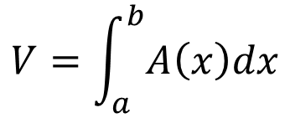
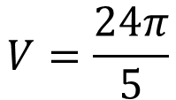
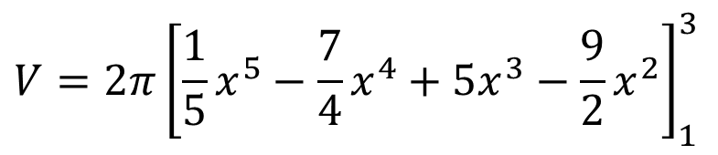
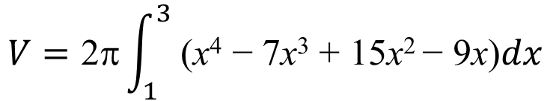
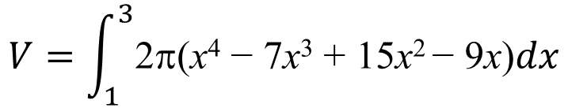
Volume of solids of Revolution
Example 1
Determine the volume of the solid obtained by rotating the region bounded by y = (x − 1)(x − 3)² and the x-axis about the y-axis, from x = 1 to x = 3.
Doing this would give the following picture
$$V=\int_{a}^{b}{A\left(x\right)dx}$$
$$V=\int_{1}^{3}{\text{2}\text{p}\text{(}\text{x}\text{4}\text{ − 7}\text{x}\text{3}\text{ + 15}\text{x}\text{2 }\text{− 9}\text{x}\text{)}dx}$$
$$V=\text{2}\text{p}\int_{1}^{3}{ \text{(}\text{x}\text{4}\text{ − 7}\text{x}\text{3}\text{ + 15}\text{x}\text{2 }\text{− 9}\text{x}\text{)}dx}$$
The method used in this example is called the method of cylinders or method of shells.
$$V=2π{\left[\frac{1}{5}x^{5}−\frac{7}{4}x^{4}+5x^{3}−\frac{9}{2}x^{2}\right]}_{1}^{3}$$
The formula for the area in all cases will be,
A = 2π(radius)(height)
$$V=\frac{24π}{5}$$

Slide 9
Volume of solids of Revolution
There are a couple of important differences between this method and the method of rings/disks that we should note before moving on.
First, rotation about a vertical axis will give an area that is a function of x and rotation about a horizontal axis will give an area that is a function of y.
This is exactly opposite of the method of rings/disks.
Second, we don’t take the complete range of x or y for the limits of integration as we did in the previous section.
Instead, we take a range of x or y that will cover one side of the solid.
Let’s take a look at another example.

Slide 10
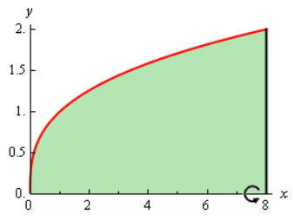
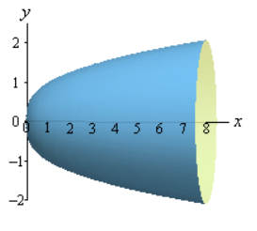
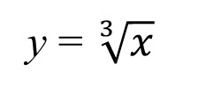
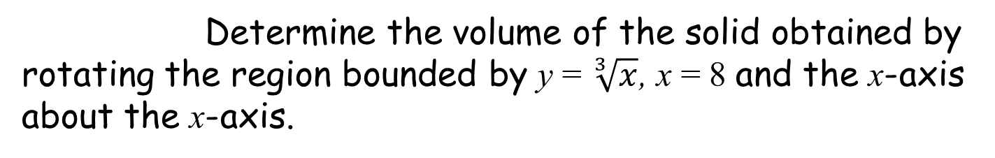
Volume of solids of Revolution
Example 2
Determine the volume of the solid obtained by rotating the region bounded by y = $\sqrt[3]{x}$, x = 8 and the x-axis about the x-axis.
and the solid as we rotate it about the x-axis.
First let’s get a graph of the bounded region
We are rotating about a horizontal axis.
This means that the area will be a function of y and so our equation will also need to be written in x = f(y) form.
y = $\sqrt[3]{x}$
⇒
x = y³

Slide 11
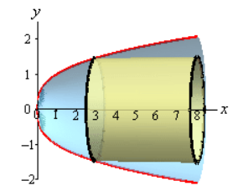
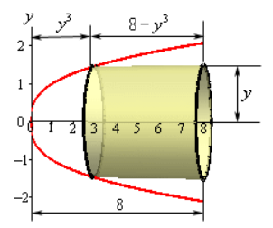
Volume of solids of Revolution
Example 2
Determine the volume of the solid obtained by rotating the region bounded by y = $\sqrt[3]{x}$, x = 8 and the x-axis about the x-axis.
To calculate the surface area of this hollow cylinder we need
Let’s take a couple of looks at a typical cylinder.
length
radius
The surface area of this hollow cylinder is:
A(x) = 2π(radius)(lenght)
A(x) = 2π
(y)
(8 − y³)
A(x) = 2π(8y − y⁴)

Slide 12
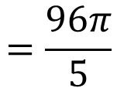
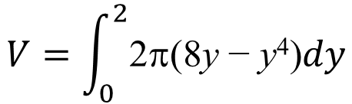

Volume of solids of Revolution
Example 2
Determine the volume of the solid obtained by rotating the region bounded by y = $\sqrt[3]{x}$, x = 8 and the x-axis about the x-axis.
The first cylinder occurs at y = 0
We need to determine the limits of integration.
, The last cylinder occurs at y = 2
length
radius
$$V=\int_{a}^{b}{A\left(x\right)dx}$$
The volume of this solid is:
$$V=\int_{0}^{2}{\text{2}\text{p}\text{(8}\text{y} \text{− }\text{y}\text{4}\text{)}dy}$$
$$=\frac{96π}{5}$$

Slide 13
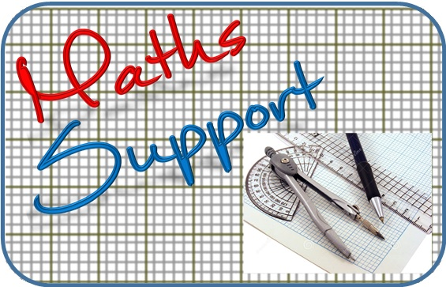
Thank you for using resources from
For more resources visit our website
https://www.mathssupport.org
If you have a special request, drop us an email
info@mathssupport.org

