Slide 1
Reversing the process of differentiation
LO: To find the function knowing the derivative of the function.

Slide 2
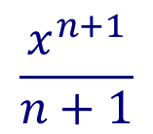
Reversing the process of differentiation
When differentiating powers of x, y = x^{n}, we multiply by the original exponent and then drop the exponent by one.
We can write this process as follows:
nx^{n}
x^{n}
multiply by the the original exponent
reduce the exponent by 1
nx^{n-1}
Reversing the process of differentiation given above would give
nx^{n}
divide by the exponent
increase the exponent by 1
nx^{n-1}
x^{n}
Suppose we are given the derivative = x^{n} and asked to find y in terms of x.
x^{n+1}
$$\frac{x^{n+1}}{n+1}$$
x^{n}
increase the exponent by 1
divide by the exponent

Slide 3
Reversing the process of differentiation
The process of finding a function f(x) whose derivative is f ’(x) is called anti-differentiation, which relates to integration.
For example,
What is the derivative of x² with respect to x?
2x
If you anti-differentiate 2x with respect to x
x²
What is the derivative of x² + 3 with respect to x?
2x
What is the derivative of x² – 5 with respect to x?
2x
You can easily see that 2x is the derivative for any function of the form x² + c, where c is any real number
The antiderivative of all of them is the same
This set, or family, of all anti-derivatives of a function is called the indefinite integral
We therefore have to write y = x² + c.

Slide 4
Reversing the process of differentiation
General form of an Antiderivative
Let F be an antiderivative of f over an interval I, then
i. For each constant C, the function F(x) + C is also an antiderivative of f over I;
ii. If G is an antiderivative of f over I, there is a constant C to which G(x) = F(x) + C over I.
In other words, the most general form of the antiderivative of f over I is F(x) + C

Slide 5
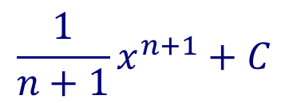
Reversing the process of differentiation
For example:
Adding 1 to the power and dividing by the new power gives:
= 2x³
This is not the complete solution, however, because if we differentiated y = 2x³ + 1,
or y = 2x³ – 3,
or y = 2x³ + any constant
we would also get
We therefore have to write y = 2x³ + c.
In general:
The antiderivative of x^{n} are given by
$$\frac{1}{n+1}x^{n+1}+C$$

Slide 6
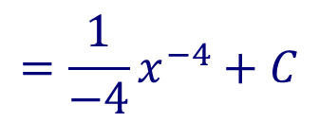
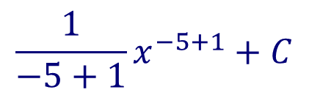
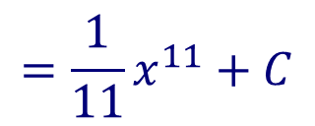
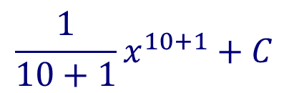
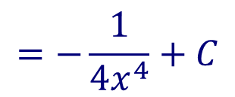
Reversing the process of differentiation
Find the antiderivative of the function x¹⁰:
Adding 1 to the power and dividing by the new power gives:
$$\frac{1}{10+1}x^{10+1}+C$$
$$=\frac{1}{11}x^{11}+C$$
Find the antiderivative of the function $\frac{1}{x^{5}}$
= x⁻⁵
Adding 1 to the power and dividing by the new power gives:
$$\frac{1}{−5+1}x^{−5+1}+C$$
$$=\frac{1}{−4}x^{−4}+C$$
$$=−\frac{1}{4x^{4}}+C$$

Slide 7
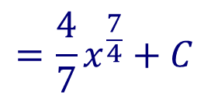
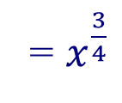
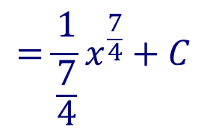
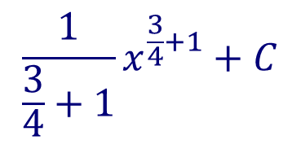
Reversing the process of differentiation
Find the antiderivative of the function $\sqrt[4]{x^{3}}$
Rewriting using rational exponents
= $x^{\frac{3}{4}}$
Adding 1 to the power and dividing by the new power gives:
$$\frac{1}{\frac{3}{4}+1}x^{\frac{3}{4}+1}+C$$
$$=\frac{1}{\frac{7}{4}}x^{\frac{7}{4}}+C$$
$$=\frac{4}{7}x^{\frac{7}{4}}+C$$

Slide 8
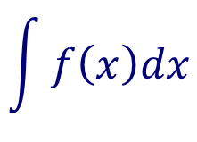
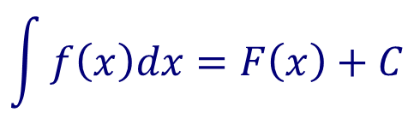

Reversing the process of differentiation
Antidifferentiation is also known as indefinite integration
$$\int{dx}$$
And is denoted with an integral symbol,
$$\int{f\left(x\right)dx=F\left(x\right)+C}$$
If F’(x) = f(x), we write
integrand
Constant of integration
$$\int{f\left(x\right)dx}$$
Variable of integration
Is read as:
“The antiderivative of f with respect to x”
“The integral of f with respect to x”

Slide 9
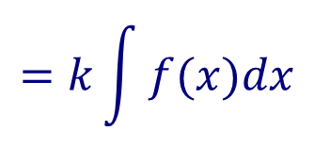
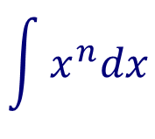
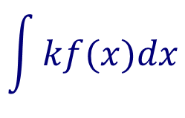

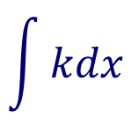
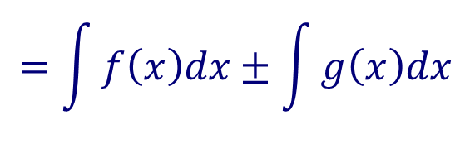
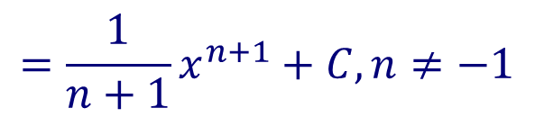
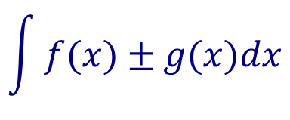
Rules to find the indefinite integrals
Power rule
$$\int{x^{n}dx}$$
$$=\frac{1}{n+1}x^{n+1}+C, n≠−1$$
Constant rule
$$\int{kdx}$$
$$=kx+C,$$
Constant multiple rule
$$\int{kf(x)dx}$$
$$=k\int{f(x)dx}$$
Sum or difference rule
$$\int{f(x)±g(x)dx}$$
$$=\int{f\left(x\right)dx±\int{g\left(x\right)dx}}$$

Slide 10
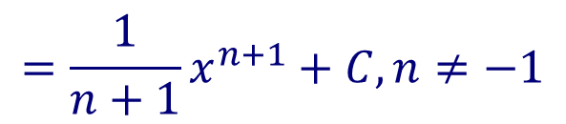




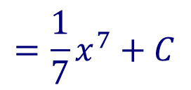

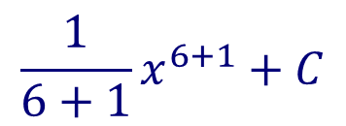

Indefinite integrals
$$\int{x^{6}dx}$$
Find the indefinite integral
$$\int{x^{n}dx}$$
$$=\frac{1}{n+1}x^{n+1}+C, n≠−1$$
Applying the power rule
$$\frac{1}{6+1}x^{6+1}+C$$
$$=\frac{1}{7}x^{7}+C$$
$$\int{4dt}$$
Find the indefinite integral
$$\int{kdx}$$
Applying the constant rule
$$=kx+C,$$
The dt tells you that the variable of integration is t
$$=4t+C,$$

Slide 11



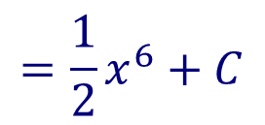
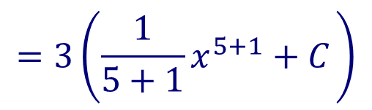
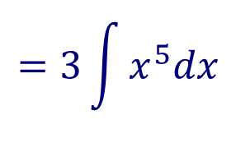
Indefinite integrals
$$\int{{3x}^{5}dx}$$
Find the indefinite integral
$$\int{kf(x)dx}$$
$$=k\int{f(x)dx}$$
Applying the constant multiple rule
$$=3\int{x^{5}dx}$$
$$=3\left(\frac{1}{5+1}x^{5+1}+C \right)$$
$$=\frac{1}{2}x^{6}+C$$

Slide 12
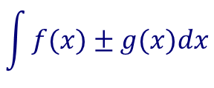
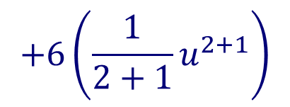
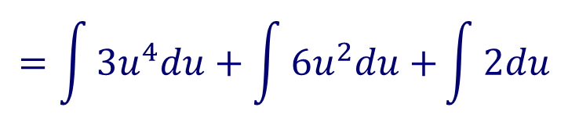



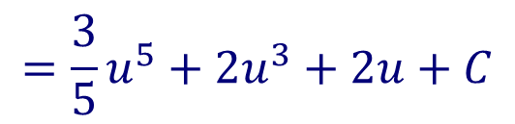

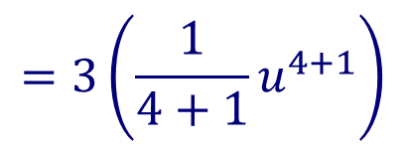
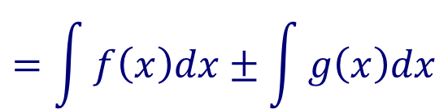

Indefinite integrals
$$\int{{(3u}^{4}+{6u}^{2}+2)du}$$
Find the indefinite integral
Applying the sum or difference rule
$$\int{f(x)±g(x)dx}$$
$$=\int{f\left(x\right)dx±\int{g\left(x\right)dx}}$$
$$=\int{{3u}^{4}du+\int{{6u}^{2}du+}\int{2du}}$$
$$=3\int{u^{4}du}$$
$$+6\int{u^{2}du}$$
$$+\int{2du}$$
Applying the constant multiple rule
$$=3\left(\frac{1}{4+1}u^{4+1}\right)$$
$$+6\left(\frac{1}{2+1}u^{2+1}\right)$$
Applying the power rule and constant rule
$$+2u+C$$
$$=\frac{3}{5}u^{5}+2u^{3}+2u+C$$

Slide 13

Thank you for using resources from
For more resources visit our website
https://www.mathssupport.org
If you have a special request, drop us an email
info@mathssupport.org

