Slide 1
Linear Approximations
LO: To describe the linear approximation to a function at a point.

Slide 2
Linear Approximation of a Function at a Point
We are going to take a look at an application not of derivatives but of the tangent line to a function.
Of course, to get the tangent line we do need to take derivatives, so in some way this is an application of derivatives as well.
Given a function, f(x), we can find its tangent at x = a
The equation of the tangent line, which we’ll call L(x) for this discussion, is,
L(x) =
f (a)
+
f ′(a)
(x – a)

Slide 3
Linear Approximation of a Function at a Point
For example:
Consider the function f (x) = $\frac{1}{x}$ at a = 2
Since f (x) is differentiable at x = 2 and f ′(x) = $−\frac{1}{x^{2}}$ we see that f ′(2) = $−\frac{1}{4}$ . Therefore, the tangent line to the graph of f (x) at a = 2 is given by the equation
$$\frac{1}{2}$$
$$−\frac{1}{4}$$
L(x) =
(x – 2)
This is the graph of f(x), along with the tangent line at x = 2
Note that for x near 2, the graph of the tangent line is close to the graph of f(x).
As a result, we can use the equation of the tangent line to approximate f(x) for x near 2.

Slide 4
Linear Approximation of a Function at a Point
For example, if x = 2.1, the y-value of the corresponding point on the tangent line is
$$\frac{1}{2}$$
$$−\frac{1}{4}$$
L(2.1) =
(2.1 – 2)
= 0.475
The actual value of f (2.1) is given by
f (2.1) = $\frac{1}{2.1}$
= 0.47619
Therefore, the tangent line gives us a fairly good approximation of f(2.1)
Note that for values of x far from 2, the equation of the tangent line does not give us a good approximation.

Slide 5
Linear Approximation of a Function at a Point
In general, for a differentiable function f, the equation of the tangent line to f at x = a can be used to approximate f(x) for x near a.
Therefore, we can write
+
f(x) ≈
f (a)
f ′(a)
(x – a)
for x near a.
We call the linear function
L(x) =
+
f ′(a)
(x – a)
f (a)
The linear approximation, or tangent line approximation, of f at x = a.
This function L is also known as the linearization of f at x = a.

Slide 6
Linear Approximation of a Function at a Point
Example 1
To show how useful the linear approximation can be, we look at how to find the linear approximation for $f\left(x\right)=\sqrt{x}$ at x = 9. Use the linear approximation to approximate the value of $\sqrt{9.1}$
Solution:
Since we are looking for the linear approximation at x = 9
+
(x – a)
Using:
L(x) =
f (a)
f ′(a)
+
(x – 9)
the linear approximation is given by
L(x) =
f (9)
f ′(9)
We need to find f (9) and f ′(9)
f (x)
$=\sqrt{x}$
⇒
f (9)
$=\sqrt{9}$
= 3
$$=\frac{1}{2\sqrt{x}}$$
$$=\frac{1}{2\sqrt{9}}$$
f ′(x)
⇒
f ′(9)
= $\frac{1}{6}$
Therefore, the linear approximation is given by
$$\frac{1}{6}$$
L(x) =
3
+
(x – 9)
Using the linear approximation, we can estimate $\sqrt{9.1}$
$$\frac{1}{6}$$
≈ 3.0167
= 3
+
(9.1 – 9)
$\sqrt{9.1}$ =
f (9.1)
≈ L(9.1)

Slide 7
Linear Approximation of a Function at a Point
Example 2
Determine the linear approximation for $f\left(x\right)=\sqrt[3]{x}$ at x = 8. Use the linear approximation to approximate the value of$\sqrt[3]{8.05}$
Solution:
Since we are looking for the linear approximation at x = 8
+
(x – a)
Using:
L(x) =
f (a)
f ′(a)
+
(x – 8)
the linear approximation is given by
L(x) =
f (8)
f ′(8)
We need to find f (8) and f ′(8)
f (x)
$$=\sqrt[3]{x}$$
⇒
f (8)
$$=\sqrt[3]{8}$$
= 2
$$=\frac{1}{3\sqrt[3]{x^{2}}}$$
$$=\frac{1}{3\sqrt[3]{64}}$$
f ′(x)
⇒
f ′(8)
= $\frac{1}{12}$
Therefore, the linear approximation is given by
$$\frac{1}{12}$$
L(x) =
2
+
(x – 8)
Using the linear approximation, we can estimate$\sqrt[3]{8.05}$
$$\frac{1}{12}$$
≈ 2.004167
= 2
+
(8.05 – 8)
$\sqrt[3]{8.05}$=
f (8.05)
≈ L(8.05)

Slide 8
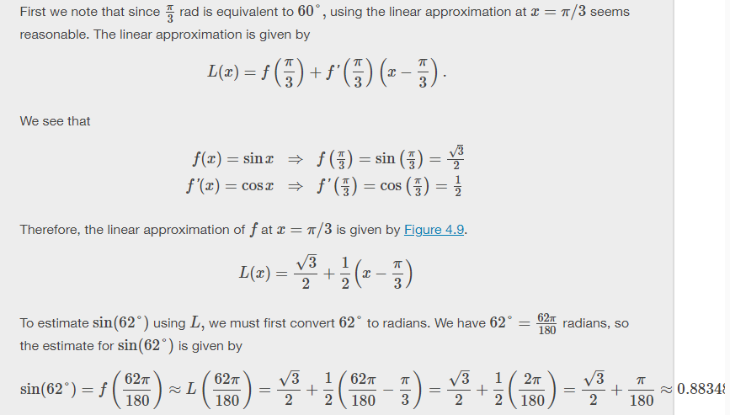
Find the linear approximation of f(x)=sinxf(x)=sinx at x=π3x=π3 and use it to approximate sin(62°).
Linear Approximation of a Function at a Point
Example 3
Determine the linear approximation for $f(x)=\sin{x}$ at x = $\frac{π}{3}$. Use the linear approximation to approximate the value of sin 62°
Solution:
Since $\frac{π}{3}$rad is equivalent to 60° using the linear approximation at x = $\frac{π}{3}$ seems reasonable
+
(x – a)
Using:
L(x) =
f (a)
f ′(a)
+
$$\left(x−\frac{π}{3}\right)$$
the linear approximation is given by
L(x) =
f $\left(\frac{π}{3}\right)$
f ′$\left(\frac{π}{3}\right)$
We need to find f (9) and f ′(9)
f (x)
$$=\sin{x}$$
⇒
f $\left(\frac{π}{3}\right)$
$$=sin\left(\frac{π}{3}\right)$$
= $\frac{\sqrt{3}}{2}$
f ′(x)
⇒
$$=cos\left(\frac{π}{3}\right)$$
$$=\cos{x}$$
f ′$\left(\frac{π}{3}\right)$
= $\frac{1}{2}$
Therefore, the linear approximation at x = $\frac{π}{3}$ is given by
$$\frac{\sqrt{3}}{2}$$
$$\frac{1}{2}$$
L(x) =
+
(x – $\frac{π}{3}$)
Using the linear approximation, we can estimate $\sqrt{9.1}$
$$\frac{1}{6}$$
≈ 3.0167
= 3
+
(9.1 – 9)
$\sqrt{9.1}$ =
f (9.1)
≈ L(9.1)

Slide 9
Thank you for using resources from
For more resources visit our website
https://www.mathssupport.org
If you have a special request, drop us an email
info@mathssupport.org

