Slide 1
Limits at Infinity - transcendental functions
LO: To understand the concept of limits at infinity and Horizontal asymptotes.

Slide 2
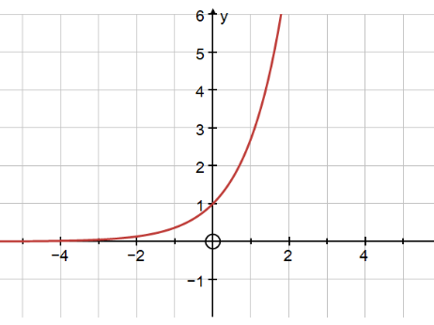
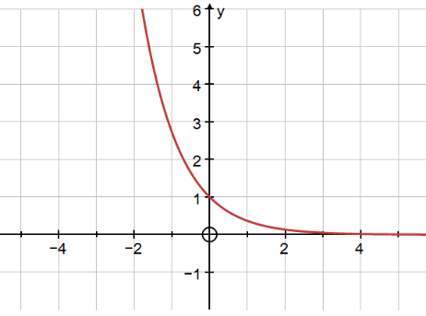
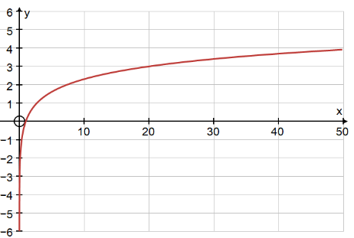
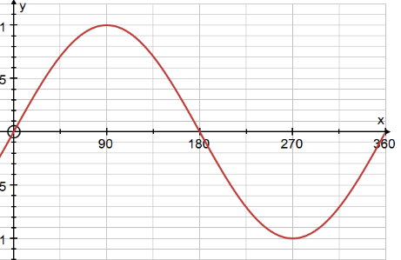
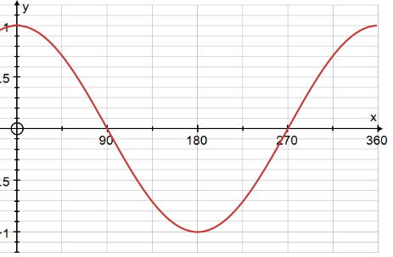
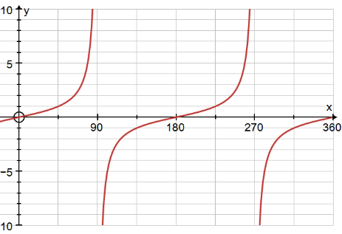
Limits at infinity
In the previous sections we looked at limits at infinity of polynomials, rational expression involving polynomials (algebraic functions).
In this section we want to take a look at some other types of functions (transcendental functions).
The functions we’ll be looking at here are the most common transcendental functions:
and
trigonometric functions.
exponential,
logarithmic,
$$f\left(x\right)=\ln{x}$$
$$f\left(x\right)=e^{−x}$$
$$f\left(x\right)=e^{x}$$
$$f\left(x\right)=\tan{x}$$
$$f\left(x\right)=\sin{x}$$
$$f\left(x\right)=\cos{x}$$

Slide 3
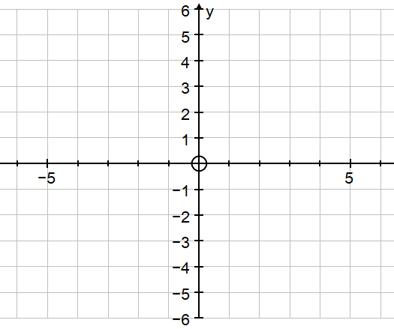
Logarithmic function
In this lesson we will see the limits of logarithmic functions
A logarithmic function is a function in the form,
$$f\left(x\right)=\ln{x}$$
Sketching the graph of the exponential function $f\left(x\right)=e^{x}$
Reflect $f\left(x\right)=e^{x} \text{over} \text{the} \text{line} \text{y}\text{ = }\text{x}$
Draw the line y = x
$$\text{This} \text{is} \text{the} \text{function} f\left(x\right)=\ln{x}$$
Evaluate each of the following limits.
$$f\left(x\right)=\ln{x}$$
$\lim_{x→0^{+}}$ $\text{ln} \text{x}$
$$f\left(x\right)=e^{x}$$
= –∞
Note that we had to do a right-handed limit, since we can not evaluate for –∞ because we cannot plug negative x’s into a logarithm
$$\lim_{x→∞}\text{ln} \text{x}$$
= ∞

Slide 4
Limits at infinity
$$\lim_{x→∞}{\text{ln}\text{ (7}x^{3}−x^{2}+1)}$$
Evaluate the following limit
In this part we need to see what the argument of the log is doing.
$$\lim_{x→∞}{(\text{7}x^{3}−x^{2}+1})$$
$$\lim_{x→∞}{x^{3}\left(\frac{7x^{3}}{x^{3}}−\frac{x^{2}}{x^{3}}+\frac{1}{x^{3}}\right)}$$
Factoring out the largest power of x..
Apply the limit property 2: the limit of a product is the product of the limits.
$$\left[\lim_{x→∞}\left(x^{3}\right)\right]\left[\lim_{x→∞}\left(7−\frac{x}{x^{2}}+\frac{1}{x^{3}}\right)\right]$$
(∞)
–
+
( )
7
0
0
(∞)
(7)
= ∞
The argument goes to infinity in the limit and so the log must also be going to infinity in the limit.
So, the limit is
$$\lim_{x→∞}{\text{ln}\text{ (7}x^{3}−x^{2}+1)}$$
= ∞

Slide 5
Limits at infinity
$$\lim_{x→−∞}{\ln\left(\frac{1}{x^{2}−5x}\right)}$$
Evaluate the following limit
In this part we need to see what the argument of the log is doing.
We factor out x² from both the numerator and denominator.
$$\lim_{x→−∞}{\frac{\frac{1}{x^{2}}}{1+\frac{5}{x}}}$$
x²
$$\left(\frac{1}{x^{2}}\right)$$
$$\lim_{x→−∞}$$
=
We can cancel the x² from both
$$\left(\frac{x^{2}}{x^{2}}\right.$$
$$\left.− \frac{{5x}^{}}{x^{2}}\right)$$
And simplify
x²
Apply the limit property 3: the limit of a quotient is the quotient of the limits.
$$=\frac{\lim_{x→−∞}\frac{1}{x^{2}}}{\lim_{x→−∞}1+\frac{5}{x}}$$
0
=
= 0
+
0
1
let’s note that for negative numbers (which we can assume we’ve got since we’re going to minus infinity in the limit) the denominator will always be positive and so the quotient will also always be positive. Therefore, not only does the argument go to zero, it goes to zero from the right. This is exactly what we need to do this limit.
$$\lim_{x→−∞}{\ln\left(\frac{1}{x^{2}−5x}\right)}$$
So, the limit is
= –∞

Slide 6
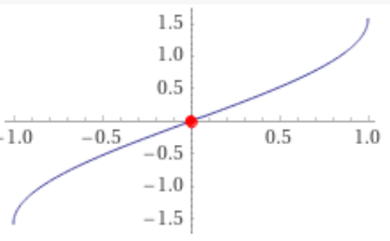
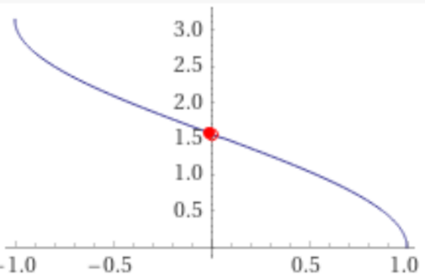
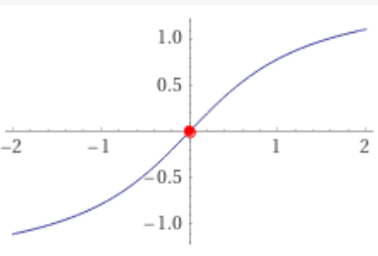
Trigonometric function
Due to the characteristics of the trigonometric functions these are some of the limits defined in these functions:
$$f\left(θ\right)=\sin{θ}$$
$$f\left(θ\right)=\cos{θ}$$
$$f\left(θ\right)=\tan{θ}$$
$\lim_{θ→0}$ $\sin{θ}$
$\lim_{θ→0}$ $\cos{θ}$
$$\lim_{θ→0}\tan{θ}$$
= 0
= 1
= 0
$$f\left(θ\right)=\sin^{−1}{θ}$$
$$f\left(θ\right)=\cos^{−1}{θ}$$
$$f\left(θ\right)=\tan^{−1}{θ}$$
$\lim_{θ→0}$ $\sin^{−1}{θ}$
$$\lim_{θ→0}\cos^{−1}θ$$
$$\lim_{θ→0}\tan^{−1}θ$$
= $0$
= 0
= $\frac{π}{2}$
$$\lim_{θ→−∞}\tan^{−1}θ$$
So, we are going to work the limit at infinity for functions of the form $f\left(θ\right)=\tan^{−1}{θ}$
= $−\frac{π}{2}$
$$\lim_{θ→∞}\tan^{−1}θ$$
= $\frac{π}{2}$

Slide 7
Limits at infinity
Evaluate the following limit
$$\lim_{x→∞}{\tan^{−1}\text{(}x^{2}−5x+6)}$$
In this part we need to see what is the limit of the argument of the inverse tangent function (the stuff inside the parenthesis) because it determines the behaviour of the function,
$$\lim_{x→∞}{(x^{2}−5x+6})$$
$$\lim_{x→∞}{x^{2}\left(\frac{x^{2}}{x^{2}}−\frac{5x}{x^{2}}+\frac{6}{x^{2}}\right)}$$
Factoring out the largest power of x..
Apply the limit property 2: the limit of a product is the product of the limits.
$$\left[\lim_{x→∞}\left(x^{2}\right)\right]\left[\lim_{x→∞}\left(1−\frac{5}{x}+\frac{6}{x^{2}}\right)\right]$$
(∞)
–
+
( )
1
0
0
(∞)
(1)
= ∞
The argument goes to positive infinity in the limit and so the inverse tangent function must also be going to this limit.
So, the limit is
$$\lim_{x→∞}{\tan^{−1}\text{(}x^{2}−5x+6)}$$
= $\frac{π}{2}$

Slide 8
Limits at infinity
$$\lim_{x→0^{−}}{\tan^{−1}\left(\frac{1}{x}\right)}$$
Evaluate the following limit
Even though this limit is not a limit at infinity we’re still looking at the same basic idea here.
We know from the Infinite Limits section that we have the following limit for the argument of this inverse tangent,
$$\lim_{x→0^{−}}\frac{1}{x}$$
= –∞
So, since the argument goes to minus infinity in the limit, we know that this limit must be,
$$\lim_{x→0^{−}}{\tan^{−1}\left(\frac{1}{x}\right)}$$
= $−\frac{π}{2}$

Slide 9
Thank you for using resources from
For more resources visit our website
https://www.mathssupport.org
If you have a special request, drop us an email
info@mathssupport.org

