Slide 1
Introduction to Limits
LO: To understand the concept of limit.

Slide 2
Limits of functions
You can think of a limit as a way of describing the output of a function as the input gets closer to a certain value
$$\lim_{x→c}{f(x)=L}$$
Means that as the value of x becomes closer to c (from either side), the function, f(x), becomes close to a fixed value L
If f(x) does not become close to a fixed value L we say that the limit does not exist
You can use a GDC to help find the limit of a function.
Graphically: You can graph the function and examine the values of f(x) when x is near c.
Numerically: You can make a table of values and examine the values of f(x) when x is near c.

Slide 3
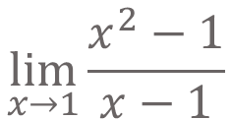
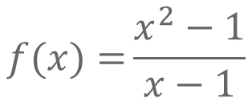
Limits of functions
A limit allows us to examine the tendency of a function around a given point even when the function is not defined at the point. Let us look at the function below.
$$f(x)={\frac{x^{2}−1}{x−1}}$$
Since its denominator is zero when x = 1, f(1) is undefined; however, its limit at x = 1 exists
$$\lim_{x→1}{\frac{x^{2}−1}{x−1}}$$
We read: The limit as x is approaching to 1 of the function

Slide 4
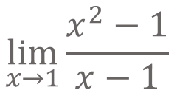
Limits of functions, Numerically
Find
$$\lim_{x→1}{\frac{x^{2}−1}{x−1}}$$
Now, using your calculator, complete the table of values for the function:
$$f(x)=\frac{x^{2}−1}{x−1}$$
x
0.8
0.9
0.99
0.999
1
1.001
1.01
1.1
1.2
$$y=\frac{x^{2}−1}{x−1}$$
We want to see the value of the function as x approaches 1

Slide 5
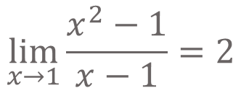
Limits of functions, Numerically
Find
$$\lim_{x→1}{\frac{x^{2}−1}{x−1}}$$
Now, using your calculator, complete the table of values for the function:
$$f(x)=\frac{x^{2}−1}{x−1}$$
approaching x = 1 from the left
approaching x = 1 from the right
x
0.8
0.9
0.99
0.999
1
1.001
1.01
1.1
1.2
$$y=\frac{x^{2}−1}{x−1}$$
1.8
1.9
1.99
1.999
undef.
2.001
2.01
2.1
2.2
We want to see the value of the function as x approaches 1
There is discontinuity at x = 1
You have seen that the value of the function as x approaches 1 is approaching to 2 from both sides.
You can write this result using this notation:
$$\lim_{x→1}{\frac{x^{2}−1}{x−1}}=2$$

Slide 6
Limits of functions, Analytically
Case 1
Point: When approaching a point defined or not (Closed or Open) the limit is the y coordinate of the point you are approaching.
Case 2
Vertical Asymptote: When approaching a vertical asymptote, the limit is infinity if you are heading up and negative infinity if you are heading downwards.

Slide 7
Limits of functions, Analytically
To find the limit of a function we follow these steps:
STEPS
Step 1:
Plug in the value of x.
If undefined go to step 2
Step 2:
Factor, rationalize or rewrite the function then simplify if possible and plug in the given value of x
If undefined go to step 3
Step 3:
Use another method to confirm non-existence of the limit if possible and plug in the given value of x

Slide 8
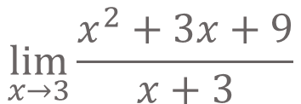
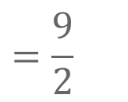
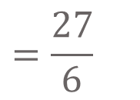
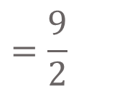
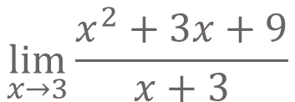
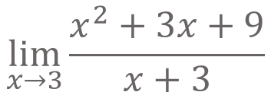
Limits of functions, Analytically
Example 1:
$$\lim_{x→3}{\frac{x^{2}+3x+9}{x+3}}$$
Find
Step 1:
Plug in the value of x.
$$\lim_{x→3}{\frac{x^{2}+3x+9}{x+3}}$$
$$=\frac{3^{2}+3(3)+9}{3+3}$$
$$=\frac{27}{6}$$
$$=\frac{9}{2}$$
$$\lim_{x→3}{\frac{x^{2}+3x+9}{x+3}}$$
$$=\frac{9}{2}$$

Slide 9
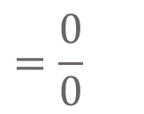
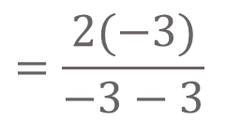
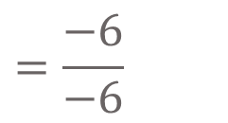
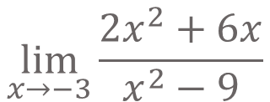
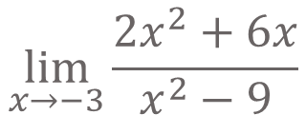
Limits of functions, Analytically
Example 2:
$$\lim_{x→−3}{\frac{{2x}^{2}+6x}{x^{2}−9}}$$
Find
Step 1:
Plug in the value of x.
If undefined go to step 2
$$\lim_{x→−3}{\frac{{2x}^{2}+6x}{x^{2}−9}}$$
$$=\frac{{2\left(−3\right)}^{2}+6(−3)}{{\left(−3\right)}^{2}−9}$$
$$=\frac{0}{0}$$
It is undefined
Step 2:
Factor, rationalize or rewrite the function then simplify if possible and plug in the given value of x
Factorising the numerator
2x
(x + 3)
=
Factorising the denominator
(x – 3)
(x + 3)
$$=\frac{2x}{x−3}$$
Simplifying
$$=\frac{2(−3)}{−3−3}$$
$$=\frac{−6}{−6}$$
$$\lim_{x→−3}{\frac{{2x}^{2}+6x}{x^{2}−9}=1}$$
Substituting x
= 1
∴

Slide 10

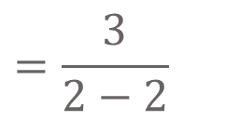
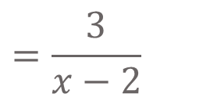

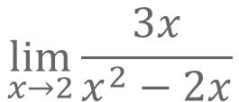
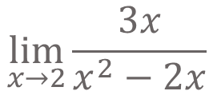
Limits of functions, Analytically
Example 3:
$$\lim_{x→2}{\frac{3x}{x^{2}−2x}}$$
Find
Step 1:
Plug in the value of x.
If undefined go to step 2
$$=\frac{3(2)}{{\left(2\right)}^{2}−2(2)}$$
$$\lim_{x→2}{\frac{3x}{x^{2}−2x}}$$
$$=\frac{6}{0}$$
It is undefined
Step 2:
Factor, rationalize or rewrite the function then simplify if possible and plug in the given value of x
Factorising the denominator
3x
$$=\frac{3}{x−2}$$
=
Simplifying
x
(x – 2)
$$=\frac{3}{2−2}$$
$$=\frac{3}{0}$$
It is undefined
Substituting x
If undefined go to step 3
Step 3:
Use another method to confirm non-existence of the limit if possible and plug in the given value of x

Slide 11

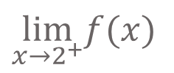
Limits of functions, Analytically
Example 3:
Step 3:
Use another method to confirm non-existence of the limit if possible and plug in the given value of x
$$f\left(x\right)={\frac{3x}{x^{2}−2x}}$$
If we sketch the graph of.
What do you notice?
As x is approaching 2 from the left
y is going to -∞
$$\lim_{x→2^{−}}f(x)$$
= -∞
2
As x is approaching 2 from the right
y is going to +∞
$$\lim_{x→2^{+}}f(x)$$
= ∞
≠
$$\lim_{x→2^{−}}f(x)$$
$$\lim_{x→2^{+}}f(x)$$
the limit does not exist
DNE

Slide 12
Thank you for using resources from
For more resources visit our website
https://www.mathssupport.org
If you have a special request, drop us an email
info@mathssupport.org

