Slide 1
Evaluating definite integrals using GDC
LO: Using the GDC to evaluate a definite integral.

Slide 2
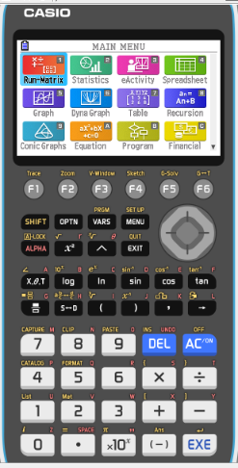
Evaluating definite integrals using GDC
$$\int_{1}^{4}{\left(\frac{1−\sqrt{x}}{\sqrt{x}}\right)dx}$$
Use a GDC to evaluate the definite integral
Turn on the GDC
1
Run-Matrix

Slide 3
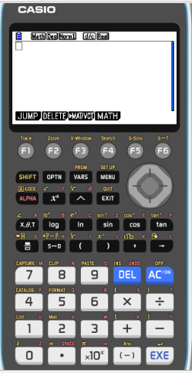
Evaluating definite integrals using GDC
$$\int_{1}^{4}{\left(\frac{1−\sqrt{x}}{\sqrt{x}}\right)dx}$$
Use a GDC to evaluate the definite integral
Turn on the GDC
1
Run-Matrix
OPTN

Slide 4
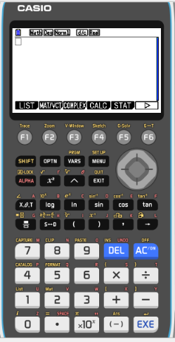
Evaluating definite integrals using GDC
$$\int_{1}^{4}{\left(\frac{1−\sqrt{x}}{\sqrt{x}}\right)dx}$$
Use a GDC to evaluate the definite integral
Turn on the GDC
1
Run-Matrix
OPTN
F4
CALC

Slide 5
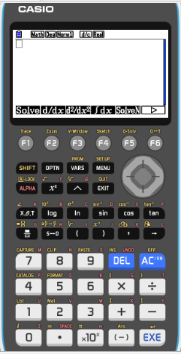
Evaluating definite integrals using GDC
$$\int_{1}^{4}{\left(\frac{1−\sqrt{x}}{\sqrt{x}}\right)dx}$$
Use a GDC to evaluate the definite integral
Turn on the GDC
1
Run-Matrix
OPTN
F4
CALC
F4
∫dx

Slide 6
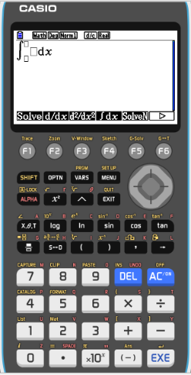
Evaluating definite integrals using GDC
$$\int_{1}^{4}{\left(\frac{1−\sqrt{x}}{\sqrt{x}}\right)dx}$$
Use a GDC to evaluate the definite integral
Turn on the GDC
1
Run-Matrix
OPTN
F4
CALC
F4
∫dx
Type
1- $\sqrt{x}$

$$\sqrt{x}$$


Slide 7
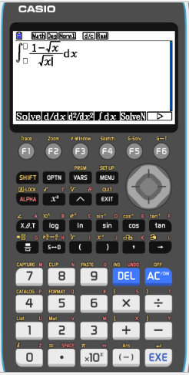
Evaluating definite integrals using GDC
$$\int_{1}^{4}{\left(\frac{1−\sqrt{x}}{\sqrt{x}}\right)dx}$$
Use a GDC to evaluate the definite integral
Turn on the GDC
1
Run-Matrix
OPTN
F4
CALC
F4
∫dx

Type
1- $\sqrt{x}$

$$\sqrt{x}$$



1

4

Slide 8
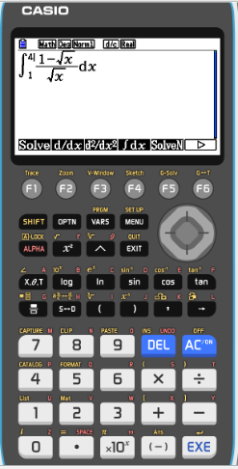
Evaluating definite integrals using GDC
$$\int_{1}^{4}{\left(\frac{1−\sqrt{x}}{\sqrt{x}}\right)dx}$$
Use a GDC to evaluate the definite integral
Turn on the GDC
1
Run-Matrix
OPTN
F4
CALC
F4
∫dx
Type
1- $\sqrt{x}$

$$\sqrt{x}$$



1

4
EXE

Slide 9
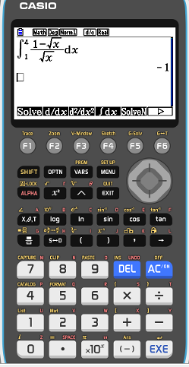
Evaluating definite integrals using GDC
$$\int_{1}^{4}{\left(\frac{1−\sqrt{x}}{\sqrt{x}}\right)dx}$$
Use a GDC to evaluate the definite integral
1
Run-Matrix
OPTN
F4
CALC
F4
∫dx
Type
1- $\sqrt{x}$

$$\sqrt{x}$$



1

4
EXE
$$\int_{1}^{4}{\left(\frac{1−\sqrt{x}}{\sqrt{x}}\right)dx}$$
= –1

Slide 10
Thank you for using resources from
For more resources visit our website
https://www.mathssupport.org
If you have a special request, drop us an email
info@mathssupport.org

