Slide 1
Integral of, sine x, cosine $\text{x} \text{and}\frac{1}{\cos^{2}{x}}$
LO: To find the indefinite integral of sine x, cosine x and $\frac{1}{\cos^{2}x}$

Slide 2
The derivative of trigonometric functions
Derivatives of sine, cosine and tangent functions
Sine function
If f(x) = sin(x), then f ’(x) = cos(x)
Cosine function
If f(x) = cos(x), then f ’(x) = - sin(x)
Tangent function
If f(x) = tan(x), then f ’(x) = $\frac{1}{{\text{cos}}^{2}(x)}$ where cos(x) ≠ 0
Notes:
This result tells us that the gradient of any point on the curve y = x² is 2 times the x-coordinate.

Slide 3
Integrals of sine cosine and $\frac{1}{\cos^{2}x}$
These integrals result directly from the derivatives of sine cosine and tangent
$$\int{\sin{x}dx}$$
$$=−cos x$$
$$+ C$$
$$\int{\cos{x}dx}$$
$$=sin x$$
$$+ C$$
$$\int{\frac{1}{{\text{cos}}^{2}(x)}dx}$$
$$=tan x$$
$$+ C$$

Slide 4
Indefinite integrals
$$\int{3\sin{x}dx}$$
Find the integral
$$=3\int{\sin{x}dx}$$
$$=3 (−\cos{x)}+C$$
$$=−3 \cos{x}+C$$

Slide 5
Indefinite integrals
$$\int{\cos^{3}x sin xdx}$$
Find the indefinite integral
$$\int{{\left(\cos{x}\right)}^{3}\sin{x}dx}$$
Let
$$u=\cos{x}$$
Rewrite using rational exponents
$$\frac{du}{dx}=−sin{x}$$
$$=\int{u^{3}\left(−\frac{du}{dx}\right)dx}$$
Substitute
$$−\frac{du}{dx}=\sin{x}$$
$$=−\int{u^{3}du}$$
Simplify
$$=−\frac{u^{4}}{4}+C$$
$$=−\frac{1}{4}\cos^{4}x+C$$

Slide 6
$$\int{\frac{1}{{\text{cos}}^{2}(x)}dx}$$
Indefinite integrals
$$=tan x$$
$$+ C$$
$$\int{\frac{1}{{\text{cos}}^{2}(2x)}dx}$$
Find the indefinite integral
$$\int{\frac{1}{{\text{cos}}^{2}(2x)}dx}$$
Let
$$u=2{x}$$
Rewrite
$$\frac{du}{dx}=2$$
$$=\int{\frac{1}{{\text{cos}}^{2}(u)}\left(\frac{du}{2}\right)}$$
Substitute
$$\frac{du}{2}=dx$$
$$=\frac{1}{2}\int{\frac{1}{{\text{cos}}^{2}(u)}du}$$
Moving out the constant
$$=\frac{1}{2}tan u+C$$
Integrating
$$=\frac{1}{2}tan 2x+C$$
Replacing u

Slide 7
Definite integrals

Slide 8
Definite integrals
$$\int_{0}^{\frac{π}{6}}{\sin^{2}x cos xdx}$$
Evaluate the definite integral
$$\int_{0}^{\frac{π}{6}}{{\left(\sin{x}\right)}^{2}\cos{x}dx}$$
Let
$$u=\sin{x}$$
Rewrite the expression
$$\frac{du}{dx}=\cos{x}$$
$$=\int_{0}^{\frac{π}{6}}{u^{2}}$$
$$\left(\frac{du}{dx}\right)dx$$
Substitute
When x = $\frac{π}{6}$
$$=\int_{0}^{\frac{π}{6}}{u^{2}du}$$
$$u=\sin{\frac{π}{6}}$$
= $\frac{1}{2}$
Simplify
$$={\left[\frac{1}{3}u^{3}\right]}_{0}^{\frac{π}{6}}$$
$$={\left[\frac{1}{3}\sin^{3}x\right]}_{0}^{\frac{π}{6}}$$
When x = $0$
$$u=\sin{0}$$
= $0$
$$=\left(\frac{1}{3}\right)$$
$${\left(\frac{1}{2}\right)}^{3}$$
$$−\left(\frac{1}{3}\right)$$
$$=\frac{1}{24}$$
$${\left(0\right)}^{3}$$

Slide 9
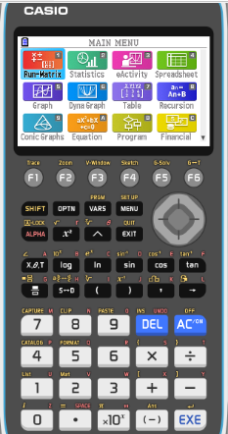
Definite integrals using GDC
$$\int_{0}^{\frac{π}{6}}{\sin^{2}x cos xdx}$$
Evaluate the definite integral
Turn on the GDC
1
Run-Matrix

Slide 10
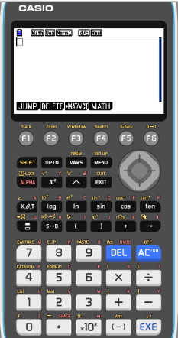
Definite integrals using GDC
$$\int_{0}^{\frac{π}{6}}{\sin^{2}x cos xdx}$$
Evaluate the definite integral
Turn on the GDC
1
Run-Matrix
F4
MATH

Slide 11
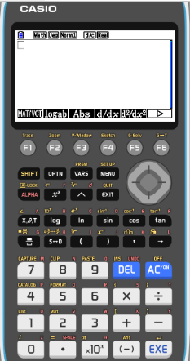
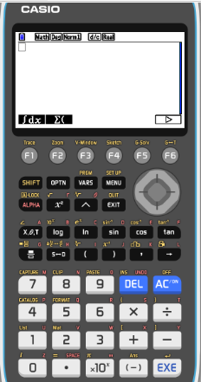
Definite integrals using GDC
$$\int_{0}^{\frac{π}{6}}{\sin^{2}x cos xdx}$$
Evaluate the definite integral
Turn on the GDC
1
Run-Matrix
F4
MATH
F6

F1
∫dx

Slide 12
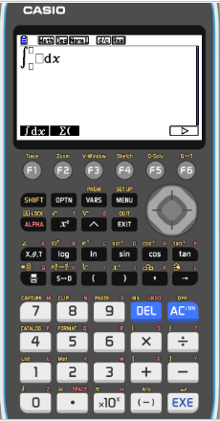
Definite integrals using GDC
$$\int_{0}^{\frac{π}{6}}{\sin^{2}x cos xdx}$$
Evaluate the definite integral
Turn on the GDC
1
Run-Matrix
F4
MATH
F6

F1
∫dx
Type in
(
sin
x
)
²

Slide 13
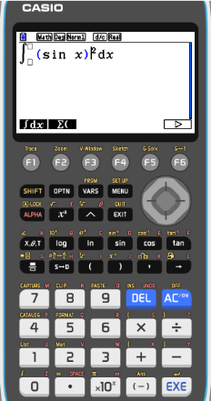
Definite integrals using GDC
$$\int_{0}^{\frac{π}{6}}{\sin^{2}x cos xdx}$$
Evaluate the definite integral
Turn on the GDC
1
Run-Matrix
F4
MATH
F6

F1
∫dx
Type in
(
sin
x
²
)
cos
x

Slide 14
Definite integrals using GDC
$$\int_{0}^{\frac{π}{6}}{\sin^{2}x cos xdx}$$
Evaluate the definite integral
Turn on the GDC
1
Run-Matrix
F4
MATH
F6



F1
∫dx
Type in
(
sin
x
cos
x
)
²

π

6
EXE
0

SHIFT

Slide 15
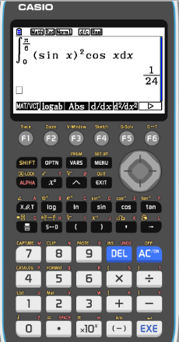
Definite integrals using GDC
$$\int_{0}^{\frac{π}{6}}{\sin^{2}x cos xdx}$$
Evaluate the definite integral
Turn on the GDC
1
Run-Matrix
F4
MATH
F6

F1
∫dx
Type in
(
sin
²
x
)
cos
x

π

6
EXE
0

SHIFT
$$\int_{0}^{\frac{π}{6}}{{\left(\sin{x}\right)}^{2}\cos{x}dx}$$
$$=\frac{1}{24}$$
Make sure your GDC setting is in RAD for angles

Slide 16
Definite integrals
$$\int_{0}^{\frac{π}{8}}{tan 2xdx}$$
Evaluate the definite integral
Let
$$u=\cos{(2x)}$$
$$\int_{0}^{\frac{π}{8}}{\frac{sin⁡(2x)}{\cos{(2x})}dx}$$
$$=\int_{0}^{\frac{π}{8}}{\frac{1}{\cos{(2x})}sin⁡(2x)dx}$$
$$\frac{du}{dx}=−2sin{(2x)}$$
Rewrite the expression
$$−\frac{1}{2}\frac{du}{dx}=\sin{(2x)}$$
$$=\int_{0}^{\frac{π}{8}}{\frac{1}{u}}$$
$$\left(−\frac{1}{2}\frac{du}{dx}\right)dx$$
Substitute
When x = $\frac{π}{8}$
$$=−\frac{1}{2}\int_{0}^{\frac{π}{8}}{\frac{1}{u}du}$$
$$u=cos(2){\frac{π}{8}}$$
$$=\cos{\frac{π}{4}}$$
= $\frac{\sqrt{2}}{2}$
Simplify
When x = $0$
$$={−\frac{1}{2}\left[\ln{u}\right]}_{0}^{\frac{π}{8}}$$
$$=−\frac{1}{2}$$
$$\ln{\frac{\sqrt{2}}{2}}$$
$$+\frac{1}{2}\ln{1}$$
$$u=\cos{0}$$
= 1
$$=−\frac{1}{2}\left[\ln{\frac{\sqrt{2}}{2}−\ln{1}}\right]$$
$$=−\frac{1}{2}\left[\ln{2^{−\frac{1}{2}}−0}\right]$$
$$=−\frac{1}{2}\left[−\frac{1}{2}ln{2}\right]$$
$$=\frac{1}{4}\ln{2}$$
Use your GDC to check your answer

Slide 17
Thank you for using resources from
For more resources visit our website
https://www.mathssupport.org
If you have a special request, drop us an email
info@mathssupport.org

