Slide 1
Indefinite and definite integration of x^{n} and e^{x}
LO: To find the indefinite integral of x^{n} where n ∈ ℚ, including n = -1 and e^{x}.
Use the GDC to find the definite integral.

Slide 2
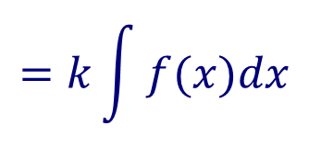
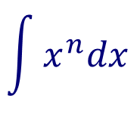
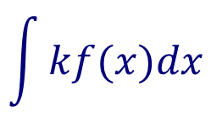
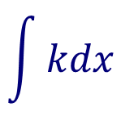
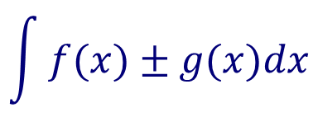
Rules to find the indefinite integrals
Power rule
$$\int{x^{n}dx}$$
$$=\frac{1}{n+1}x^{n+1}+C, n≠−1$$
Constant rule
$$\int{kdx}$$
$$=kx+C,$$
Constant multiple rule
$$\int{kf(x)dx}$$
$$=k\int{f(x)dx}$$
Sum or difference rule
$$\int{f(x)±g(x)dx}$$
$$=\int{f\left(x\right)dx±\int{g\left(x\right)dx}}$$

Slide 3


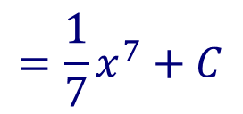

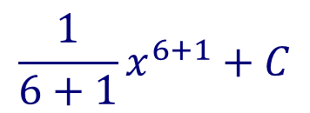

Indefinite integrals
$$\int{x^{6}dx}$$
Find the indefinite integral
$$\int{x^{n}dx}$$
$$=\frac{1}{n+1}x^{n+1}+C, n≠−1$$
Applying the power rule
$$\frac{1}{6+1}x^{6+1}+C$$
$$=\frac{1}{7}x^{7}+C$$
$$\int{4dt}$$
Find the indefinite integral
$$\int{kdx}$$
Applying the constant rule
$$=kx+C,$$
The dt tells you that the variable of integration is t
$$=4t+C,$$

Slide 4

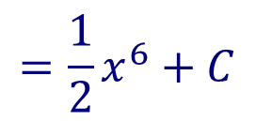
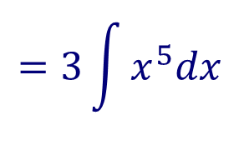
Indefinite integrals
$$\int{{3x}^{5}dx}$$
Find the indefinite integral
$$\int{kf(x)dx}$$
$$=k\int{f(x)dx}$$
Applying the constant multiple rule
$$=3\int{x^{5}dx}$$
$$=3\left(\frac{1}{5+1}x^{5+1}+C \right)$$
$$=\frac{1}{2}x^{6}+C$$

Slide 5
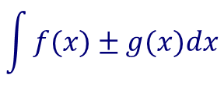
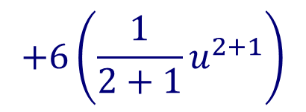




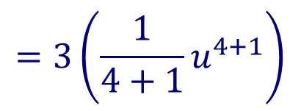
Indefinite integrals
$$\int{{(3u}^{4}+{6u}^{2}+2)du}$$
Find the indefinite integral
Applying the sum or difference rule
$$\int{f(x)±g(x)dx}$$
$$=\int{f\left(x\right)dx±\int{g\left(x\right)dx}}$$
$$=\int{{3u}^{4}du+\int{{6u}^{2}du+}\int{2du}}$$
$$=3\int{u^{4}du}$$
$$+6\int{u^{2}du}$$
$$+\int{2du}$$
Applying the constant multiple rule
$$=3\left(\frac{1}{4+1}u^{4+1}\right)$$
$$+6\left(\frac{1}{2+1}u^{2+1}\right)$$
Applying the power rule and constant rule
$$+2u+C$$
$$=\frac{3}{5}u^{5}+2u^{3}+2u+C$$

Slide 6





More on indefinite integrals
$$\int{x^{−1}dx}$$
Find the indefinite integral
If we try to apply the power rule
$$\int{x^{n}dx}$$
$$=\frac{1}{n+1}x^{n+1}+C, n≠−1$$
We can see that the rule does not work when n = -1 because it would result in dividing by 0
$$\int{x^{−1}dx}$$
So what is ?
We have seen that $\frac{d}{dx}(\ln{x)= \frac{1}{x}= x^{−1}}$ for x > 0, so
$$\int{\frac{1}{x}dx}$$
$$=\ln{x}+C$$
, x > 0
We also have seen that $\frac{d}{dx}\left(e^{x}\right)= e^{x}$, so
$$\int{e^{x}dx}$$
$$=e^{x}+C$$

Slide 7


More on indefinite integrals
Integral of $\frac{1}{x}$
$$\int{\frac{1}{x}dx}$$
$$=\ln{x}+C$$
, x > 0
Integral of$e^{x}$
$$\int{e^{x}dx}$$
$$=e^{x}+C$$

Slide 8
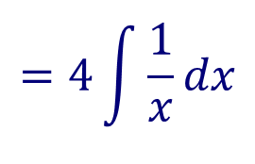
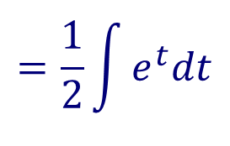
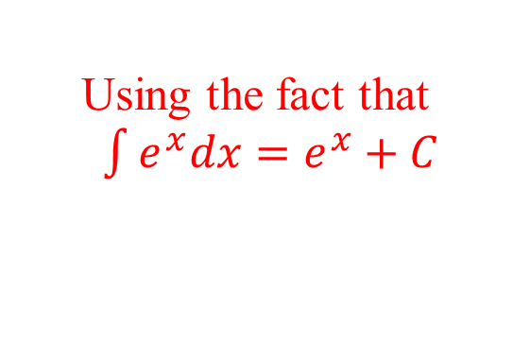



Indefinite integrals
$$\int{\frac{4}{x}dx}$$
Find the indefinite integral
$$\int{kf(x)dx}$$
$$=k\int{f(x)dx}$$
Applying the constant multiple rule
$$=4\int{\frac{1}{x}dx}$$
Using the fact that $\int{\frac{1}{x}dx=\ln{x}+C,\text{x}\text{ > 0 }}$
$$=4\ln{x+C, x>0}$$
$$\int{\frac{e^{t}}{2}dt}$$
Find the indefinite integral
$$\int{kf(x)dx}$$
$$=k\int{f(x)dx}$$
Applying the constant multiple rule
$$=\frac{1}{2}\int{e^{t}dt}$$
Using the fact that $\int{e^{x}dx=e^{x}+C }$
$$=\frac{1}{2}e^{t}+C$$

Slide 9
Definite integrals

Slide 10
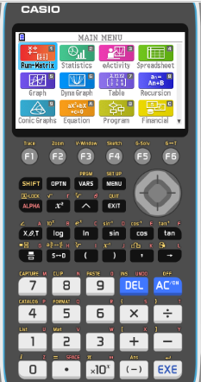

Definite integrals using GDC
$$\int_{1}^{5}{\frac{1}{4x}dx}$$
Evaluate the definite integral
Turn on the GDC
1
Run-Matrix

Slide 11
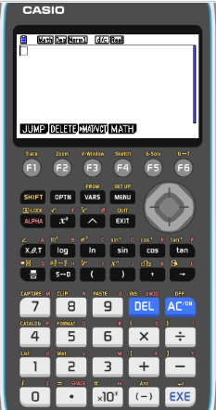
Definite integrals using GDC
$$\int_{1}^{5}{\frac{1}{4x}dx}$$
Evaluate the definite integral
Turn on the GDC
1
Run-Matrix
F4
MATH

Slide 12
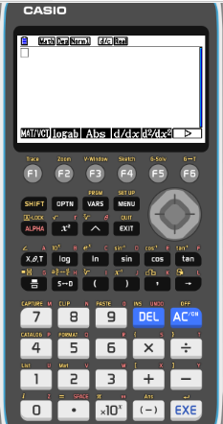
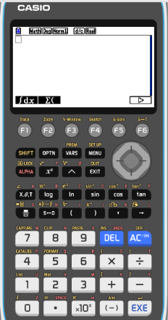
Definite integrals using GDC
$$\int_{1}^{5}{\frac{1}{4x}dx}$$
Evaluate the definite integral
Turn on the GDC
1
Run-Matrix
F4
MATH
F6

F1
∫dx

Slide 13
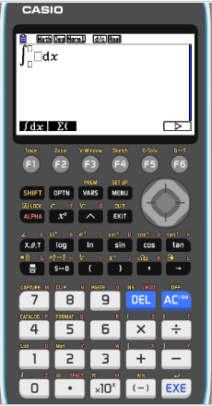
Definite integrals using GDC
$$\int_{1}^{5}{\frac{1}{4x}dx}$$
Evaluate the definite integral
Turn on the GDC
1
Run-Matrix
F4
MATH
F6


F1
∫dx
Type in
1

4
x

Slide 14
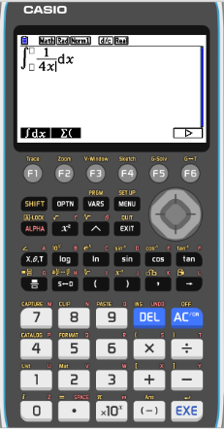
Definite integrals using GDC
$$\int_{1}^{5}{\frac{1}{4x}dx}$$
Evaluate the definite integral
Turn on the GDC
1
Run-Matrix
F4
MATH
F6


F1
∫dx
Type in
1

4
x


1

5

Slide 15
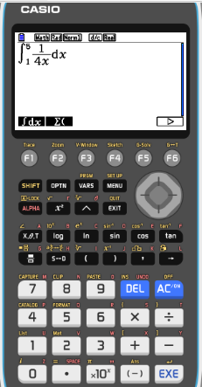
Definite integrals using GDC
$$\int_{1}^{5}{\frac{1}{4x}dx}$$
Evaluate the definite integral
Turn on the GDC
1
Run-Matrix
F4
MATH
F6

F1
∫dx
Type in
1

4
x


1

5
EXE

Slide 16
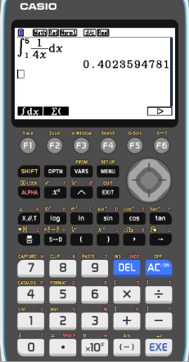
Definite integrals using GDC
$$\int_{1}^{5}{\frac{1}{4x}dx}$$
Evaluate the definite integral
Turn on the GDC
1
Run-Matrix
F4
MATH
F6

F1
∫dx
Type in
1

4
x


1

5
EXE
$$\int_{1}^{5}{\frac{1}{4x}dx}$$
$$=0.402$$
3sf

Slide 17
Thank you for using resources from
For more resources visit our website
https://www.mathssupport.org
If you have a special request, drop us an email
info@mathssupport.org

