Slide 1
Differentiation: The product rule
LO: Find the derivative of the product of functions.

Slide 2
The product rule
To find the derivative of a product of functions you use the product rule.
The derivative of a product of functions is not equal the product of the derivatives of the functions.
For example:
f(x) = x²
g(x) = x
h(x) = x
f(x) = g(x) h(x)
f ’(x) = 2x
g’(x) = 1
h’(x) = 1
f ’(x) ≠ g’(x) h’(x)
2x ≠ (1) (1)

Slide 3
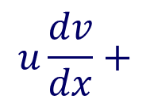
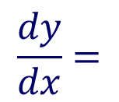
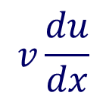
The product rule
If
f(x) = u(x) v(x)
Where
u(x)
Are differentiable functions
and
v(x)
u’(x)
f '(x) =
+
v(x)
u(x)
Then:
v’(x)
Another way of writing this is:
If
y = u v
u
v
Where
and
are functions of x and differentiable
Then:
$$\frac{dy}{dx}=$$
$$u\frac{dv}{dx}+$$
$$v\frac{du}{dx}$$

Slide 4
The product rule
Example 1:
Find f '(x) if f (x) = (2x + 3)(4 – 3x)
Let u(x) = 2x + 3
and
v(x) =
$$(4 −3x)$$
Define u and v
So
u’(x) = 2
v’(x) = -3
Find u’(x) and v’(x)
v(x)
f '(x) =
+
u’(x)
u(x)
v’(x)
Use the product rule
f '(x) =
-3
(2x + 3)
+
2
$$(4 −3x)$$
Expand brackets
f '(x) =
–6x – 9 + 8 – 6x
Simplify
f '(x) =
– 1 – 12x

Slide 5
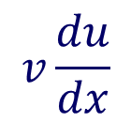
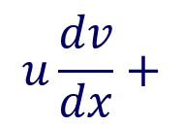
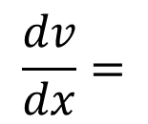

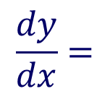
The product rule
Example 2:
Find $\frac{dy}{dx}$ given that f(x) = $e^{x}(4x^{2}−2x)$
Let u = e^{x}
and
v =
$$4x^{2}−2x$$
Define u and v
$$\frac{du}{dx}=e^{x}$$
$$\frac{dv}{dx}=$$
So
$$8x−2$$
Find $\frac{du}{dx}$ and $\frac{dv}{dx}$
$$\frac{dy}{dx}=$$
$$u\frac{dv}{dx}+$$
$$v\frac{du}{dx}$$
Use the product rule
$$\frac{dy}{dx}=$$
e^{x}
(8𝑥−2)
+
e^{x}
$$\left(4x^{2}−2x\right)$$
Removing the common factor
$$\frac{dy}{dx}=$$
(4x² – 2x)
e^{x}
(8𝑥−2)
+
Simplify
$$\frac{dy}{dx}=$$
e^{x}
(4x² + 6𝑥−2)

Slide 6


Summary
The product rule
If
f(x) = u(x) v(x)
If
y = u v
$$\frac{dy}{dx}=$$
$$u\frac{dv}{dx}+$$
$$v\frac{du}{dx}$$
f '(x) =
u(x)
v(x)
v'(x)
+

Slide 7
Thank you for using resources from
For more resources visit our website
https://www.mathssupport.org
If you have a special request, drop us an email
info@mathssupport.org

