Slide 1
The derivative of e^{x} and the derivative of ln x
LO: Find the derivative of e^{x} and ln x functions.

Slide 2
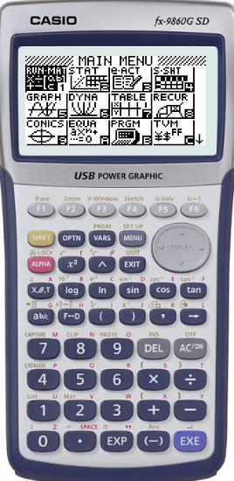
The derivative of e^{x}
We are going to sketch the graph f(x) = e^{x}
Turn on your calculator
Click on MENU
1
EXE

Slide 3
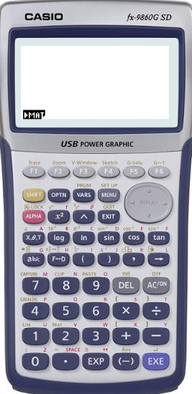
The derivative of e^{x}
We are going to sketch the graph f(x) = e^{x}
Turn on your calculator
Click on MENU
1
EXE
SHIFT + MENU
(SET UP)

Slide 4
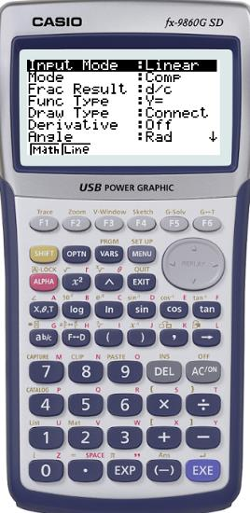
The derivative of e^{x}
We are going to sketch the graph f(x) = e^{x}
Turn on your calculator
Click on MENU
1
EXE
SHIFT + MENU
(SET UP)
Scroll down to Derivative

Slide 5
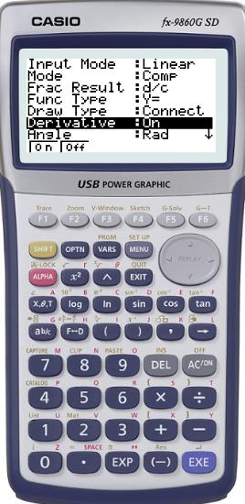
The derivative of e^{x}
We are going to sketch the graph f(x) = e^{x}
Turn on your calculator
Click on MENU
1
EXE
SHIFT + MENU
(SET UP)
Scroll down to Derivative
F1 to turn it On

Slide 6
The derivative of e^{x}
We are going to sketch the graph f(x) = e^{x}
Turn on your calculator
Click on MENU
1
EXE
SHIFT + MENU
(SET UP)
Scroll down to Derivative
F1 to turn it On
EXE
+ MENU
+ 5
GRAPH

Slide 7
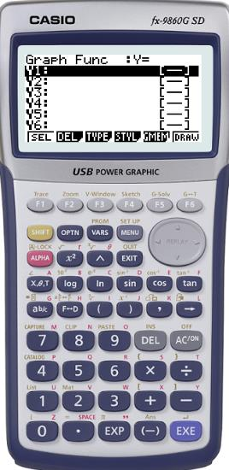
The derivative of e^{x}
We are going to sketch the graph f(x) = e^{x}
Turn on your calculator
Click on MENU
1
EXE
SHIFT + MENU
(SET UP)
Scroll down to Derivative
F1 to turn it On
EXE
+ MENU
+ 5
GRAPH
In Y1 type e^{x}
EXE
F6
DRAW

Slide 8
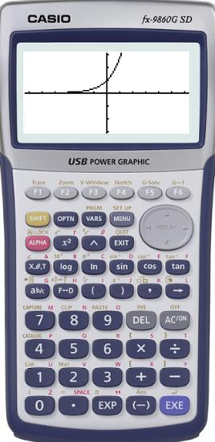
The derivative of e^{x}
We are going to sketch the graph f(x) = e^{x}
Turn on your calculator
Click on MENU
1
EXE
SHIFT + MENU
(SET UP)
Scroll down to Derivative
F1 to turn it On
EXE
+ MENU
+ 5
GRAPH
In Y1 type e^{x}
EXE
F6
DRAW
MENU
+ 7
F1 (SEL)
F6 (TABL)
TABLE

Slide 9
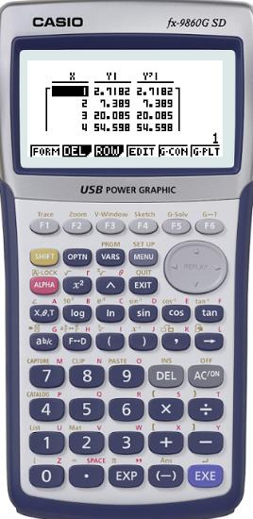
The derivative of e^{x}
We are going to sketch the graph f(x) = e^{x}
Turn on your calculator
Click on MENU
1
EXE
SHIFT + MENU
(SET UP)
Scroll down to Derivative
F1 to turn it On
EXE
+ MENU
+ 5
GRAPH
In Y1 type e^{x}
EXE
F6
DRAW
MENU
+ 7
F1 (SEL)
F6 (TABL)
TABLE
Compare the values for the function and the derivative of the function
Make a conjecture about the derivative of f(x) = e^{x}

Slide 10
The derivative of e^{x}
From the table you can easily see that derivative of the function e^{x} is e^{x}
If f (x) = e^{x}, then f ’(x) = e^{x}
or
From this, it follows that
If f (x) = ke^{x}, then f ’(x) = ke^{x}
or
where k is a constant.

Slide 11
The derivative of e^{x}
Now we are going to sketch the graph f(x) = ln x and the derivative of f(x) = ln x
Turn on your calculator
Click on MENU
5 (Graph)
Make sure that Derivative is on
in the settings

Slide 12
The derivative of e^{x}
Now we are going to sketch the graph f(x) = ln x and the derivative of f(x) = ln x
Turn on your calculator
Click on MENU
5 (Graph)
Make sure that Derivative is on
in the settings
In Y1 type ln x
EXE
F6
DRAW

Slide 13
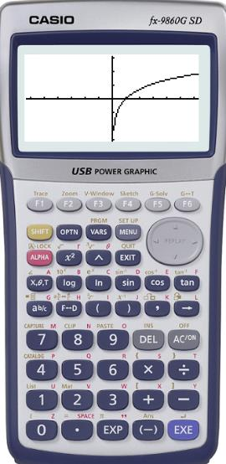
The derivative of e^{x}
Now we are going to sketch the graph f(x) = ln x and the derivative of f(x) = ln x
Turn on your calculator
Click on MENU
5 (Graph)
Make sure that Derivative is on
in the settings
In Y1 type ln x
EXE
F6
DRAW
Now we want to sketch the derivative
EXIT
Scroll down to Y2
OPTN
F2 (Calc)
F1 (d/dx)

Slide 14
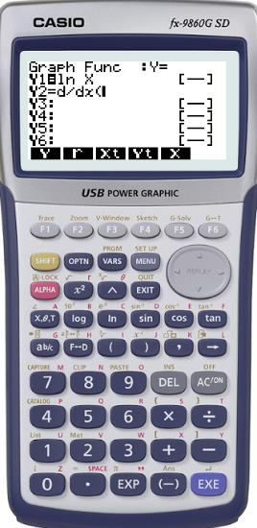
The derivative of e^{x}
Now we are going to sketch the graph f(x) = ln x and the derivative of f(x) = ln x
Turn on your calculator
Click on MENU
5 (Graph)
Make sure that Derivative is on
in the settings
In Y1 type ln x
EXE
F6
DRAW
Now we want to sketch the derivative
EXIT
Scroll down to Y2
OPTN
F2 (Calc)
F1 (d/dx)
F1 (Y)
1
EXE
F4 (Styl)
F2 ( )
EXE

Slide 15
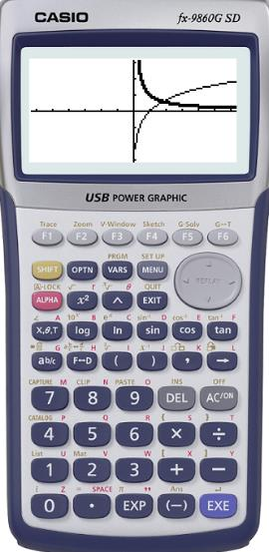
The derivative of e^{x}
Now we are going to sketch the graph f(x) = ln x and the derivative of f(x) = ln x
Turn on your calculator
Click on MENU
5 (Graph)
Make sure that Derivative is on
in the settings
In Y1 type ln x
EXE
F6
DRAW
Now we want to sketch the derivative
EXIT
Scroll down to Y2
OPTN
F2 (Calc)
F1 (d/dx)
F1 (Y)
1
EXE
F4 (Styl)
F2 ( )
EXE
You can identify the function and the derivative. Now lets make the table of values
MENU
7
Select both
F6 (tabl)

Slide 16
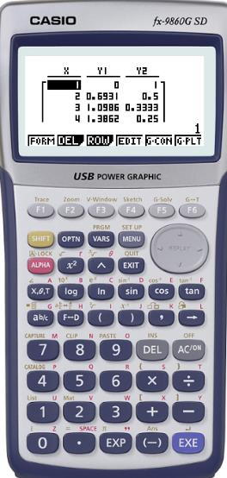
The derivative of e^{x}
Now we are going to sketch the graph f(x) = ln x and the derivative of f(x) = ln x
Turn on your calculator
Click on MENU
5 (Graph)
Make sure that Derivative is on in the settings
In Y1 type ln x
EXE
F6
DRAW
Now we want to sketch the derivative
EXIT
Scroll down to Y2
OPTN
F2 (Calc)
F1 (d/dx)
1
EXE
EXE
F1 (Y)
F4 (Styl)
F2 ( )
You can identify the function and the derivative. Now lets make the table of values
MENU
7
Select both
F6 (tabl)
Make a conjecture about the derivative of f(x) = ln x

Slide 17
The derivative of e^{x}
From the graph and the table you can easily see that derivative of the function ln x is $\frac{1}{x}$
If f (x) = ln x, then f ’(x) = $\frac{1}{x}$
or
If y = ln x, then y ’ = $\frac{1}{x}$

Slide 18
The derivative of ln x
Remember, ln x is the inverse of e^{x}.
So, if y = ln x
means
log_{e} x = y
then x = e^{y}
Differentiating with respect to y gives:
However, for y = ln x we want $\frac{dy}{dx}$not $\frac{dx}{dy}$.
$\frac{dy}{dx}$behaves like a fraction, so,
But e^{y} = x so,

Slide 19
Functions of the form e^{x}
Suppose we are asked to differentiate a function of the form ke^{x}, where k is a constant. For example,
Differentiate f (x) = 5e^{x} with respect to x.
Using the Constant multiple rule
If f(x) = kf(x), where k is any real number, then f ’(x) = kf ’(x)
Using the derivative of e^{x}
If f (x) = e^{x}, then f ’(x) = e^{x}
f ’(x) = 5e^{x}

Slide 20
Functions of the form e^{x}
Differentiate f (x) = x² + ln x with respect to x.
f (x) = x² + ln x
Find the derivative of each term
f ’(x) = 2x + $\frac{1}{x}$
$\frac{2x^{2}+ 1}{x}$
or

Slide 21
Functions of the form e^{x}
Differentiate f (x) = ln e^{3x} with respect to x.
f (x) = ln e^{3x}
Use the fact that the functions are inverses to simplify first
f (x) = 3x
Find the derivative
f ’(x) = 3

Slide 22
Thank you for using resources from
For more resources visit our website
https://www.mathssupport.org
If you have a special request, drop us an email
info@mathssupport.org

