Slide 1
Poisson distribution, mean and variance
LO: To understand and use the Poisson distribution

Slide 2
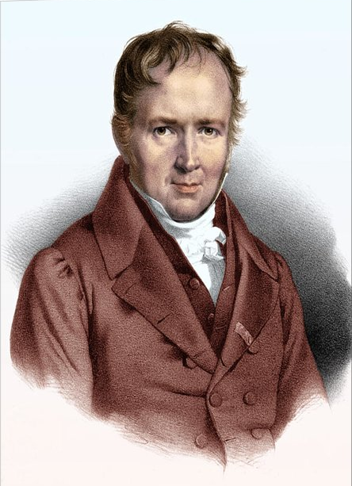
Poisson distribution.
The Poisson distribution is named after Simeon-Denis Poisson (1781 – 1840) who first discovered this model as an approximation to the binomial distribution when the number of trial n gets larger and larger while the probability of success p gets smaller and smaller
Poisson was an extremely hard-working mathematician. His major work on probability was a book with over 400 pages where just one was dedicated to the derivation of the Poisson distribution.

Slide 3
Poisson distribution.
A discrete random variable X follows a Poisson distribution when it models situations that satisfy these conditions.
The occurrence of an event at a particular point in space is independent of what happens elsewhere.
The probability of an event occurring within a small fixed interval (or in a small region or space) is constant.
There is not chance that two events will occur at precisely the same moment or at the same place.

Slide 4
Poisson distribution.
Examples of typical real-life situations that can be modeled by a Poisson distribution
The number of phone calls received during a given period of time.
The number of car accidents at a certain location during a given period of time.
The number of particles emitted by a radioactive source in a given time.
The number of typing errors on a randomly chosen page of a book.
The number of flowers in a randomly chosen area of a field.

Slide 5
Poisson distribution.
In theory, the Poisson distribution has no upper value, and in this way it differs from the binomial distribution.
If an event is randomly scattered in time or space, the discrete random variable X that models the number of its occurrences in a given interval follows a Poisson distribution with parameter m, X ~ Po(m).
The probability distribution function (PDF) of X is
f(x) = P(X = x) = $\frac{e^{−m}m^{x}}{x!}$ where x = 0, 1, 2, …
The Poisson cumulative distribution function (CDF) is
$$\text{F}\text{(}\text{x}\text{) = }\text{P}\text{(}\text{X}\text{ ≤ }\text{x}\text{) =} \sum_{t=0}^{x}{\frac{e^{−m}m^{t}}{t!}}$$

Slide 6
Poisson distribution.
EXAMPLE 1:
The random variable X follows a Poisson distribution such that X ~ Po(2).
Calculate P(X = x) for x = 0, 1, 2, 3, 4, 5 and draw a bar graph to illustrate the distribution.
P(X=x) = $\frac{e^{−2}2^{x}}{x!}$
X~Po(2).
X
P(X = x)
P(X=0) = $\frac{e^{−2}2^{0}}{0!}$
0
0.1353
If x = 0
P(X=0) = $0.1353$

Slide 7
Poisson distribution.
EXAMPLE 1:
The random variable X follows a Poisson distribution such that X ~ Po(2).
Calculate P(X = x) for x = 0, 1, 2, 3, 4, 5 and draw a bar graph to illustrate the distribution.
P(X=x) = $\frac{e^{−2}2^{x}}{x!}$
X~Po(2).
X
P(X = x)
P(X=1) = $\frac{e^{−2}2^{1}}{1!}$
0
0.1353
If x = 1
1
0.2707
P(X=1) = $0.2707$

Slide 8
Poisson distribution.
EXAMPLE 1:
The random variable X follows a Poisson distribution such that X ~ Po(2).
Calculate P(X = x) for x = 0, 1, 2, 3, 4, 5 and draw a bar graph to illustrate the distribution.
P(X=x) = $\frac{e^{−2}2^{x}}{x!}$
X~Po(2).
X
P(X = x)
P(X=2) = $\frac{e^{−2}2^{2}}{2!}$
0
0.1353
If x = 2
1
0.2707
P(X=2) = $0.2707$
2
0.2707

Slide 9
Poisson distribution.
EXAMPLE 1:
The random variable X follows a Poisson distribution such that X ~ Po(2).
Calculate P(X = x) for x = 0, 1, 2, 3, 4, 5 and draw a bar graph to illustrate the distribution.
P(X=x) = $\frac{e^{−2}2^{x}}{x!}$
X~Po(2).
X
P(X = x)
P(X=3) = $\frac{e^{−2}2^{3}}{3!}$
0
0.1353
If x = 3
1
0.2707
P(X=3) = $0.1804$
2
0.2707
3
0.1804

Slide 10
Poisson distribution.
EXAMPLE 1:
The random variable X follows a Poisson distribution such that X ~ Po(2).
Calculate P(X = x) for x = 0, 1, 2, 3, 4, 5 and draw a bar graph to illustrate the distribution.
P(X=x) = $\frac{e^{−2}2^{x}}{x!}$
X~Po(2).
X
P(X = x)
P(X=4) = $\frac{e^{−2}2^{4}}{4!}$
0
0.1353
If x = 4
1
0.2707
P(X=4) = $0.09022$
2
0.2707
3
0.1804
4
0.09022

Slide 11
Poisson distribution.
EXAMPLE 1:
The random variable X follows a Poisson distribution such that X ~ Po(2).
Calculate P(X = x) for x = 0, 1, 2, 3, 4, 5 and draw a bar graph to illustrate the distribution.
P(X=x) = $\frac{e^{−2}2^{x}}{x!}$
X~Po(2).
X
P(X = x)
P(X=5) = $\frac{e^{−2}2^{5}}{5!}$
0
0.1353
If x = 5
1
0.2707
P(X=5) = $0.03609$
2
0.2707
3
0.1804
4
0.09022
0.3
5
0.03609
0.2
0.1
0
1
2
3
4
5

Slide 12
Poisson distribution.
EXAMPLE 2:
The number of accidents in a randomly chosen day at a road crossing can be modeled by a Poisson distribution with a parameter 0.5.
Find the probability that, on a randomly chosen day, there are.
(a) Exactly two accidents
(b) At least two accidents
X~Po(0.5).
P(X=2) = $\frac{e^{−0.5}{0.5}^{2}}{2!}$
(a)
P(X=x) = $\frac{e^{−0.5}{0.5}^{x}}{x!}$
P(X=2) = $0.0758$
(b)
P(X ≥ 2) = $1 −P(X≤1$)
P(X ≥ 2) = $0.0902$

Slide 13
Parameters of the Poisson distribution.
The variable X in a Poisson distribution is a discrete variable, therefore we can use the formulae
$$\sum{xP}(X=x)$$
Mean
$$E\left(X\right)=$$
$$=m$$
$$σ2=Var\left(X\right)=E\left(X^{2}\right)−{\left(E\left(X\right)\right)}^{2}$$
Variance
The variable X can take an infinite number of values: 0, 1, 2, 3, 4, … so, instead of a finite sum for E(X) and Var(X) you get infinite series.
The study of infinite series is beyond the scope of this course, you cannot directly deduce formulae for these parameters.

Slide 14
Parameters of the Poisson distribution.
One important characteristic of the Poisson distribution is:
If X ~ Po(m) then E(X) = Var (X) = m.
Another important property of the Poisson distribution is the relationship between the mean and the length of the associated interval
If X ~ Po(m) and X is the number of successes in an interval of length l, the number of in an interval of length kl (k > 0) is modeled by another Poisson variable with parameter (or mean) km.

Slide 15
Parameters of the Poisson distribution.
EXAMPLE 3:
In a book of 520 pages there are 135 misprints.
What is the mean number of misprints per page?
(b) Find the probability that pages 444 and 445 do not contain any misprint.
Solving
(a)
X ~ Po(m).
m =
$$\frac{135}{520}$$
$$=\frac{27}{104}$$
= 0.2596
(b)
Let X be the number of misprints found in 2 pages
X ~ Po(2m).
P(X = 0) = $\frac{e^{−2m}{(2m)}^{0}}{02!}$
P(X = 0) = $0.595$
= $\frac{e^{−0.5192}{(0.5192)}^{0}}{0!}$
P(X = 0) = $0.595$

Slide 16
Thank you for using resources from
For more resources visit our website
https://www.mathssupport.org
If you have a special request, drop us an email
info@mathssupport.org

