Slide 1
Identity and zero matrices, determinants and inverse matrix
LO: To be able to find the inverse matrix of a matrix

Slide 2
The identity matrix
A matrix in which the entries of the leading diagonal are all 1 is known as the IDENTITY MATRIX
The following matrix is known as the IDENTITY MATRIX of order 2 × 2
(
)
1
0
I =
The IDENTITY MATRIX is always represented by I
0
1
(
)
The following matrix is the IDENTITY MATRIX of order 3 × 3
1
0
0
I =
0
1
0
For 3 × 3 matrices
0
0
1

Slide 3
The zero matrix
A matrix in which all the elements are zero is called a ZERO MATRIX.
(
)
0
0
0
0
Multiplying a matrix by a zero matrix gives a zero matrix

Slide 4
The determinant of a 2 × 2 matrix
The determinant of a matrix A is represented by |A|
(
)
a
b
Let
A =
c
d
The determinant |A| of the matrix A is:
The product of the elements in the leading diagonal
ad
minus
The product of the elements in the secondary diagonal
bc
|A|
= ad
−
bc

Slide 5
The determinant of a 2 × 2 matrix
(
)
Example 1
3
5
Let
B =
2
4
Find the determinant |B| of the matrix B
The product of the elements in the leading diagonal
3 × 4
= 12
minus
The product of the elements in the secondary diagonal
2 × 5
= 10
|B|
= 12
- 10
= 2

Slide 6
The determinant of a 2 × 2 matrix
(
)
Example 2
3
-4
Let
S =
2
1
Find the determinant |S| of the matrix S
The product of the elements in the leading diagonal
3 × 1
= 3
minus
The product of the elements in the secondary diagonal
2 × -4
= -8
|S|
= 3
- (-8)
= 11

Slide 7
The determinant of a 3 × 3 matrix
(
)
a
b
c
Let
A =
d
e
f
g
h
i
To calculate the determinant |A| of the matrix A we are going to use the Laplace formula
a
b
c
d
e
f
e
f
=
a
g
h
i
h
i

Slide 8
The determinant of a 3 × 3 matrix
(
)
a
b
c
Let
A =
d
e
f
g
h
i
To calculate the determinant |A| of the matrix A we are going to use the Laplace formula
a
b
c
d
e
f
e
f
d
f
−
=
a
b
g
h
i
h
i
g
i

Slide 9
The determinant of a 3 × 3 matrix
(
)
a
b
c
Let
A =
d
e
f
g
h
i
To calculate the determinant |A| of the matrix A we are going to use the Laplace formula
This is the Laplace formula for the determinant of a 3 × 3 matrix:
a
b
c
d
e
f
e
f
d
f
d
e
−
c
=
a
b
+
g
h
i
h
i
g
i
g
h
this can be expanded out to give
=
a
(ei
−
fh)
−
b
(di
−
fg)
+
c
(dh
−
eg)
Rearranging positives and negatives
=
aei
+
bfg
+
cdh
−
afh
−
bdi
−
ceg
This is the Leibniz formula for the determinant of a
3 × 3 matrix.

Slide 10
The determinant of a 3 × 3 matrix
(
)
6
1
3
Example 3
A =
Let
4
-2
5
2
8
7
To calculate the determinant |A| of the matrix A we are going to use the Laplace formula
6
1
3
4
-2
5
-2
5
=
6
2
8
7
8
7

Slide 11
The determinant of a 3 × 3 matrix
(
)
6
1
3
Let
A =
4
-2
5
2
8
7
To calculate the determinant |A| of the matrix A we are going to use the Laplace formula
6
1
3
4
-2
5
-2
5
4
5
−
=
6
1
2
8
7
8
7
2
7

Slide 12
The determinant of a 3 × 3 matrix
(
)
6
1
3
Let
A =
4
-2
5
2
8
7
To calculate the determinant |A| of the matrix A we are going to use the Laplace formula
6
1
3
4
-2
5
-2
5
4
5
4
-2
−
=
6
1
+
3
2
8
7
8
7
2
7
2
8
=
3
(−14
(28
(32
−
this can be expanded out to give
6
−
40)
−
1
−
10)
+
(−4))
6(−54)
1(18)
Simplifying
=
−
+
3(36)
|A|
−234
=

Slide 13
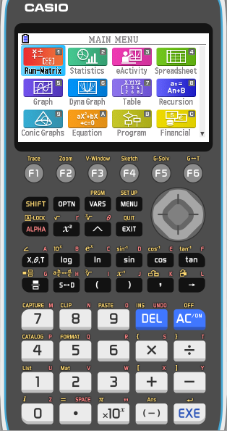
The determinant of a 3 × 3 matrix
(
)
6
1
3
Example 4
Let
A =
4
-2
5
2
8
7
Using the GDC to calculate the determinant |A| of the matrix A
From the MAIN menu enter 1
RUN-MAT mode

Slide 14
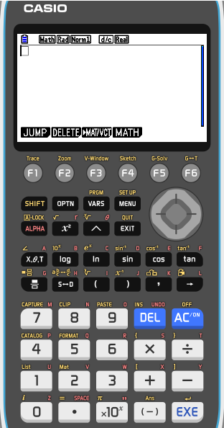
The determinant of a 3 × 3 matrix
(
)
6
1
3
Let
A =
4
-2
5
2
8
7
Using the GDC to calculate the determinant |A| of the matrix A
From the MAIN menu enter 1
RUN-MAT mode
F3
MAT/VCT

Slide 15
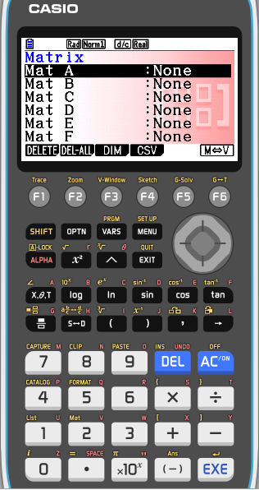
The determinant of a 3 × 3 matrix
(
)
6
1
3
Let
A =
4
-2
5
2
8
7
Using the GDC to calculate the determinant |A| of the matrix A
From the MAIN menu enter 1
RUN-MAT mode
F3
MAT/VCT
MAT A
EXE
Enter the dimensions
m: 3
EXE
n: 3
EXE
EXE

Slide 16
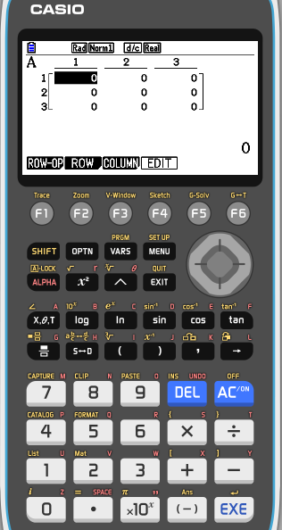
The determinant of a 3 × 3 matrix
(
)
6
1
3
Let
A =
4
-2
5
2
8
7
Using the GDC to calculate the determinant |A| of the matrix A
From the MAIN menu enter 1
RUN-MAT mode
F3
MAT/VCT
MAT A
EXE
Enter the dimensions
m: 3
EXE
n: 3
EXE
EXE
Type in the entries, by row

Slide 17
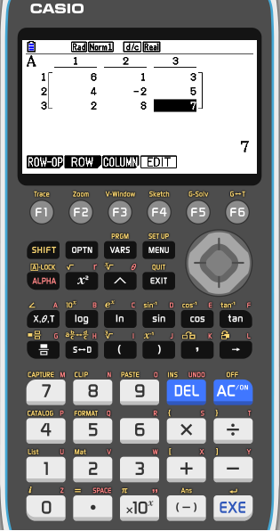
The determinant of a 3 × 3 matrix
(
)
6
1
3
Let
A =
4
-2
5
2
8
7
Using the GDC to calculate the determinant |A| of the matrix A
From the MAIN menu enter 1
RUN-MAT mode
F3
MAT/VCT
MAT A
EXE
Enter the dimensions
m: 3
EXE
n: 3
EXE
EXE
Type in the entries, by row
EXIT
EXIT

Slide 18
The determinant of a 3 × 3 matrix
(
)
6
1
3
Let
A =
4
-2
5
2
8
7
Using the GDC to calculate the determinant |A| of the matrix A
OPTN
F2
MAT/VCT
F3
DET
F1
MAT
ALPHA
X, θ, T
A
EXE

Slide 19
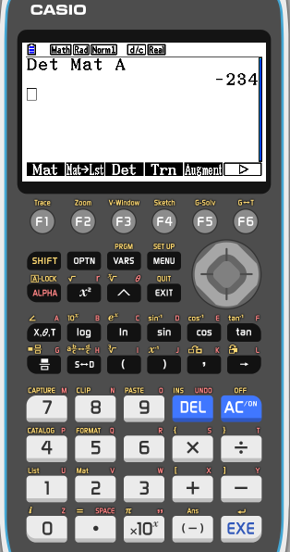
The determinant of a 3 × 3 matrix
(
)
6
1
3
Let
A =
4
-2
5
2
8
7
Using the GDC to calculate the determinant |A| of the matrix A
OPTN
F2
MAT
F3
DET
F1
MAT
ALPHA
X, θ, T
A
EXE
|A|
−234
=

Slide 20
The inverse of a matrix
Only square matrices have inverse.
For a square matrix A, the inverse is written A⁻¹
When A is multiplied by A-1 the result is the identity matrix I.
AA⁻¹ = A⁻¹A = I
Not all square matrices have inverses.
A square matrix which has an inverse is called invertible or non-singular
A square matrix without an inverse is called noninvertible or singular.

Slide 21
The inverse of a matrix
For a square matrix A, of order 2 × 2, the inverse is calculated as follow
(
)
a
b
Let
A =
c
d
(
)
Switch the entries of the leading diagonal
d
-b
A⁻¹ =
$$\frac{1}{\text{det}{\text{A}}}$$
-c
a
Change the sign of the secondary diagonal
(
)
d
-b
A⁻¹ =
$$\frac{1}{ad−bc}$$
-c
a

Slide 22
The inverse of a matrix
(
)
Example 5
3
4
Let
A =
Find A⁻¹
1
2
(
)
Switch the entries of the leading diagonal
2
-4
A⁻¹ =
$$\frac{1}{3×2−1×4}$$
-1
3
Change the sign of the secondary diagonal
(
)
2
-4
$$\frac{1}{2}$$
A⁻¹ =
-1
3
(
)
1
-2
A⁻¹ =
$$−\frac{1}{2}$$
$$\frac{3}{2}$$

Slide 23
The inverse of a matrix
(
)
(
)
3
4
1
-2
Example 6
Let
A =
A⁻¹ =
1
2
$$−\frac{1}{2}$$
$$\frac{3}{2}$$
Show that AA⁻¹ = I
(
)
(
)
3
4
1
−2
AA⁻¹ =
×
$$−\frac{1}{2}$$
$$\frac{3}{2}$$
1
2
(
)
3(1)
3(-2)
+ 4($\frac{3}{2}$)
+ 4(−$\frac{1}{2}$)
AA⁻¹ =
1(1)
+ 2(−$\frac{1}{2}$)
1(-2)
+ 2($\frac{3}{2}$)
(
)
1
0
I =
0
1

Slide 24
The inverse of a matrix
For higher order derivatives we will be using the GDC to calculate the inverse of the square matrix A
(
)
6
1
3
Let
A =
4
-2
5
2
8
7
From the MAIN menu enter 1
RUN-MAT mode

Slide 25
The inverse of a matrix
For higher order derivatives we will be using the GDC to calculate the inverse of the square matrix A
(
)
6
1
3
Let
A =
4
-2
5
2
8
7
From the MAIN menu enter 1
RUN-MAT mode
F3
MAT/VCT

Slide 26
The inverse of a matrix
For higher order derivatives we will be using the GDC to calculate the inverse of the square matrix A
(
)
6
1
3
Let
A =
4
-2
5
2
8
7
From the MAIN menu enter 1
RUN-MAT mode
F3
MAT/VCT
MAT A
EXE
Enter the dimensions
m: 3
EXE
n: 3
EXE
EXE

Slide 27
The inverse of a matrix
For higher order derivatives we will be using the GDC to calculate the inverse of the square matrix A
(
)
6
1
3
Let
A =
4
-2
5
2
8
7
From the MAIN menu enter 1
RUN-MAT mode
F3
MAT/VCT
MAT A
EXE
Enter the dimensions
m: 3
EXE
n: 3
EXE
EXE
Type in the entries, by row

Slide 28
The inverse of a matrix
For higher order derivatives we will be using the GDC to calculate the inverse of the square matrix A
(
)
6
1
3
Let
A =
4
-2
5
2
8
7
From the MAIN menu enter 1
RUN-MAT mode
F3
MAT/VCT
MAT A
EXE
Enter the dimensions
m: 3
EXE
n: 3
EXE
EXE
Type in the entries, by row
EXIT
EXIT

Slide 29
The inverse of a matrix
For higher order derivatives we will be using the GDC to calculate the inverse of the square matrix A
(
)
6
1
3
Let
A =
4
-2
5
2
8
7
Using the GDC to calculate the inverse
OPTN
F2
MAT/VCT
F1
MAT
ALPHA
X, θ, T
A
SHIFT
)
x⁻¹
EXE

Slide 30
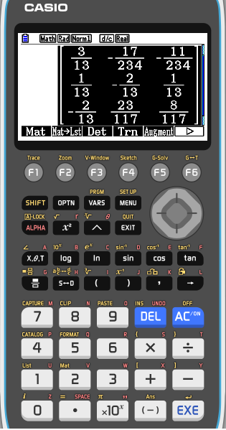
The inverse of a matrix
For higher order derivatives we will be using the GDC to calculate the inverse of the square matrix A
(
)
6
1
3
Let
A =
4
-2
5
2
8
7
$$\frac{3}{13}$$
$$−\frac{17}{234}$$
$$−\frac{11}{234}$$
$$\frac{1}{13}$$
$$−\frac{2}{13}$$
$$\frac{1}{13}$$
A^{–1} =
$$−\frac{2}{13}$$
$$\frac{23}{117}$$
$$\frac{8}{117}$$

Slide 31
Thank you for using resources from
For more resources visit our website
https://www.mathssupport.org
If you have a special request, drop us an email
info@mathssupport.org

