Slide 1
Complex numbers
LO: To understand what complex numbers are and what are the conjugate and modulus of complex numbers.

Slide 2
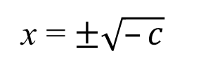
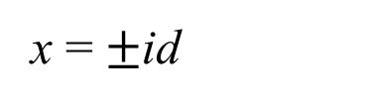

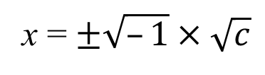
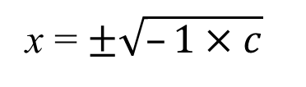
Complex numbers
If we have to solve the equation
x² = c
c ∈ ℝ–
x² = –c
x = $±\sqrt{–c}$
–c = –1 × c
x = $±\sqrt{–1×c}$
x = $±\sqrt{–1}×\sqrt{c}$
$$\sqrt{–1}=i$$
Called the imaginary unit
x = $±$id
Numbers like this are purely imaginary numbers

Slide 3
Complex numbers
Complex numbers have the form
z = a + ib
a, b ∈ ℝ
a is called the real part, Re(z) = a
b is called the imaginary part, Im(z) = b
of the complex number z
When b = 0
z = a + i(0)
z = a
Since the complex number does not have a part containing i, it reduces to a real number.
When a = 0
z = 0 + ib
z = ib
Since the complex number has only a part containing the imaginary unit i, it is called a purely imaginary number.

Slide 4
Geometrical approach of a complex number
The complex plane is a two-dimensional coordinate plane where the usual coordinate axes x and y are called the real and the imaginary axes respectively
The geometrical visualization of complex numbers in a plane is known as and Argand diagram or Gaussian plane
iy
Each complex number numbers z = x + iy is represented by a point P(x, y) in the plane where the coordinates are the real and imaginary parts of the complex number itself.
8
7
6
5i
x
5
4
3
4 + 2i
2
x
1
6
4
5
x
x
–3
–2
7
–1
3
–6
–4
0
1
2
6
8
–8
–7
–5
–1
x
–2
3 – i
–3
EXAMPLE.
x
–4
–4 – 4i
–5
Plot the complex numbers
–6
–7
4 + 2i,
3 – i,
–4 –4i,
–8
6,
5i,

Slide 5
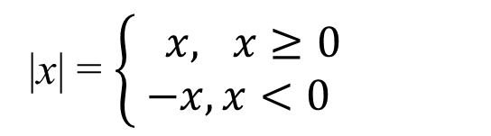

Modulus of a complex number
The modulus or absolute value of a real number is algebraically defined as:
|x| = $\left\{\begin{matrix} x, x≥0 \\ −x, x<0\end{matrix}\right.$
Geometrically it represents the distance from the number x on the number line to the origin 0
iy
|x|
|x|
z
–x
0
x
●
= x + iy
Extending this idea to complex numbers
0
x
The modulus of a complex number |z|
Is the distance from the point P (which represents the complex number z = x + iy) to the origin (0, 0) in the complex plane.
To find the distance between two points use Pythagoras’ theorem
|z| =
|x + iy|
$$=\sqrt{x^{2}+y^{2}}$$

Slide 6
Conjugate complex numbers
Two complex numbers are said to be a conjugate pair if they have equal real parts and opposite sign imaginary parts
If z = a + ib then its conjugate is z* = a – ib
Example
Given the complex number z = a + ib find:
z + z*
z – z*
z · z*
=
+
(a – ib)
=
(a + ib)
(a – ib)
(a + ib)
=
–
(a – ib)
(a + ib)
(a)²
(ib)²
=
a + ib
–a + ib
=
–
=
2a
=
a²
i ² b²
=
2ib
–
=
a²
b²
+

Slide 7
Conjugate complex numbers
Conjugate complex numbers have these properties
(z*)* = z
(z₁ + z₂)*
=
z₁* + z₂*
(z₁ · z₂ )*
=
z₁* · z₂ *
z · z*
=
|z|²
(z^{n})*
=
(z*) ^{n}
, n ∈ ℤ.

Slide 8

Thank you for using resources from
For more resources visit our website
https://www.mathssupport.org
If you have a special request, drop us an email
info@mathssupport.org

