Slide 1
Position vectors
LO: Identify position vectors.

Slide 2
Position vectors
Position vectors are vectors giving the position of a point, relative to a fixed origin, O.
Example:
The point P
with coordinates (7, 4)
has position
vector:
5
(7, 4)
P
(x, y)
4
7
3
OP
=
=7i + 4j
4
2
1
0
1
2
3
4
5
6
7
8
O
The point P with coordinates (x, y) has position vector
x
OP
=
=xi + yj
y

Slide 3
Displacement vectors
Consider the points A(4, 5) and B(8, 4)
From this diagram we can see that
6
A
5
B
4
4
AB
=
3
–1
We can describe this movement as going directly from A to B
2
1
0
1
2
3
4
5
6
7
8
9
10
O
Or we describe this movement using the position vectors
OA
and
OB
Thus we could write
AB
=
AO
+
OB
AB
The vector is called the resultant of the vectors
– OA
AB
=
OB
–
OA
and
OB
Recall that
OA
AO =

Slide 4
Example 1
Points A and B have coordinates (-4, 3, 0) and (-3, 6, 4) respectively.
Find the vector
AB
First we write the position vector
OA
and
OB
-4
-3
OA =
3
OB =
6
0
4
-3
-4
1
AB =
OB -
OA
=
6
–
3
=
3
4
0
4

Slide 5
Resultant vectors
PR
Similarly if we know a vector and a vector then each of the points Q and R are given relative to point P.
PQ
P
R
Q
We can write:
QR
=
QP
+
PR
=
PR
–
PQ

Slide 6
Example 2
Given that
2
0
XY =
1
XZ =
-8
-3
-2
Find the vector
YZ
0
2
-2
YZ =
XZ -
XY
=
-8
–
1
=
-9
-2
-3
1

Slide 7
Example 3
Show that the points A, B and C with position vectors
i – 2j + 3k, – 2i + 3j – k and 4i – 7j + 7k respectively are collinear
1
-2
4
OA =
-2
OB =
3
OC =
-7
3
-1
7
Find the vector
AB
-2
1
-3
AB =
OB-
OA
=
3
–
-2
=
5
-1
3
-4
Find the vector
AC
AB =
– AC
4
1
3
AC =
OC-
OA
=
-7
–
-2
=
-5
7
3
4

Slide 8
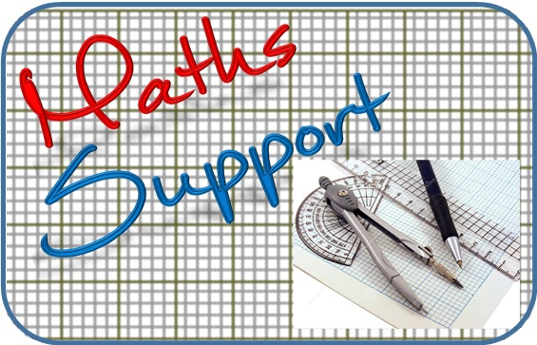
Thank you for using resources from
For more resources visit our website
https://www.mathssupport.org
If you have a special request, drop us an email
info@mathssupport.org

